Slide 1
South Dublin Sports Pitch Strategy
Strategic Policy Committee
May 2021

Slide 2
SPORTS PITCH STRATEGY: 5 ACTIONS TO OPTIMISE CAPACITY
No.: | Action: | Location: | Priority
1 | Increase maintenance of pitches to improve match play equivalents | Targeted: Areas of high use, high demand, growing population | Ongoing Lifetime of strategy
2 | Develop revised allocation policy; including pitch sharing and multipurpose use of facilities | County wide | On-going
3 | Reserve ability to change configuration of pitches. | Targeted as tastes, demographics and / or local needs change | On-going
4 | Provide new pitches to meet capacity issues | New development areas, areas of growing population | On-going
5 | Provide AGPs to augment long term capacity and meet training need | 3-5 across county | On-going

Slide 3
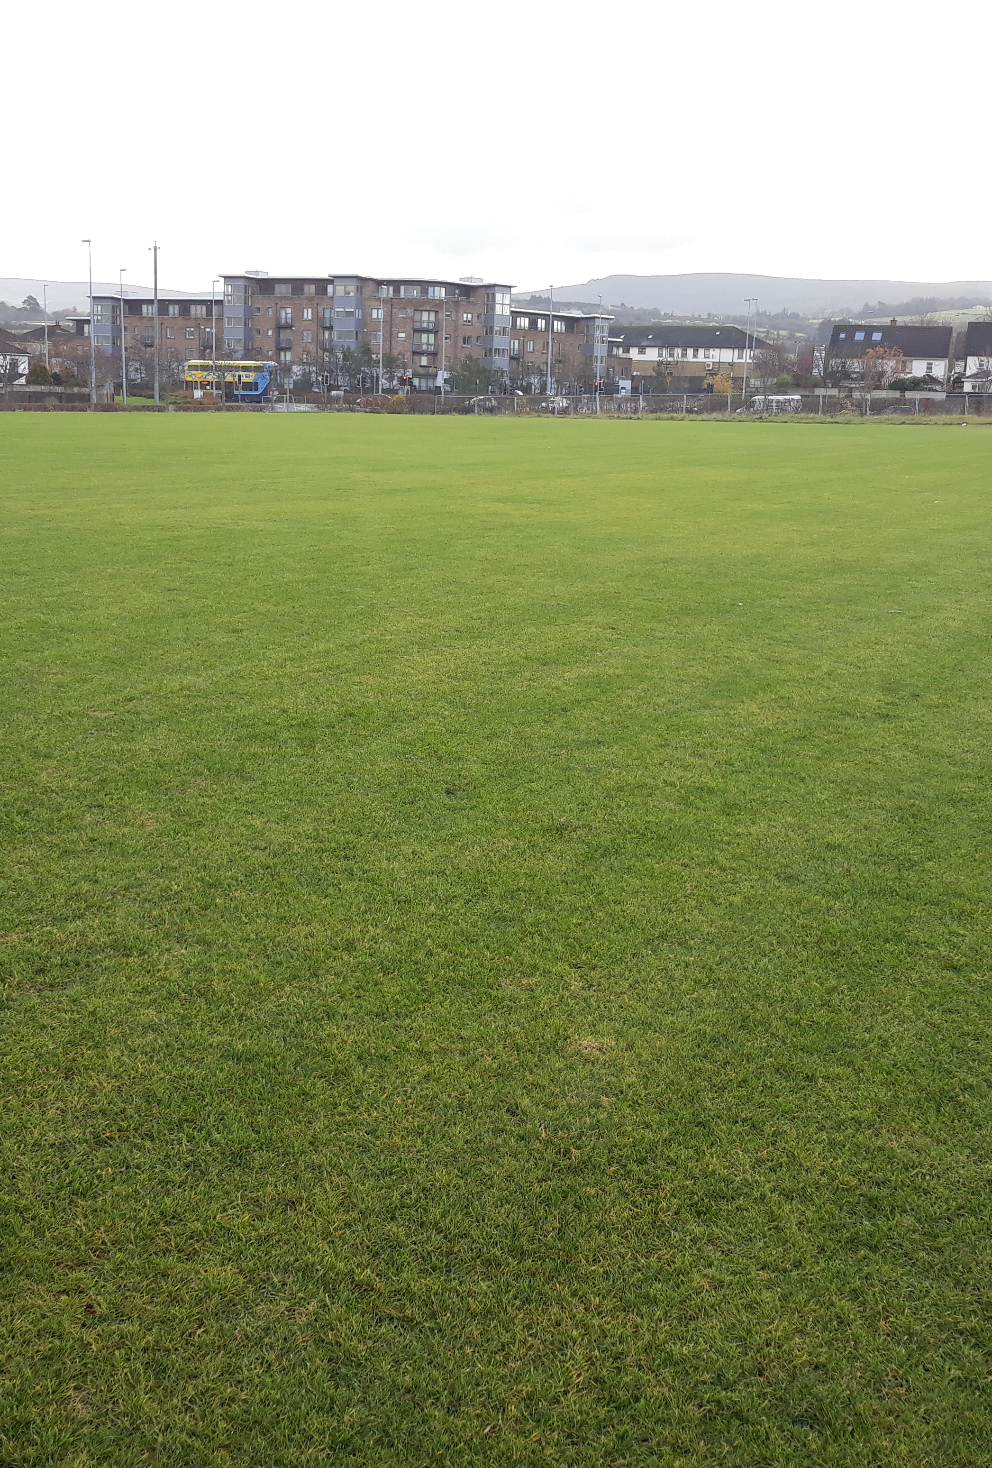
Maintenance of existing pitches:
Annual maintenance regimes: provide intensive maintenance to existing pitches
Maintain capital investment to facilitate increased match play on existing pitches:
Firhouse pitches (3 pitches completed)
Tymon pitches (2 completed and 1 underway)
Jobstown Park and Butler McGee Park (2 pitches completed)
Dodder Valley Old Bawn (existing pitch enhancements in tandem with pavillion provision)
Capital investment in pitches to be continued (SCGs)
Continue high level of communication between the council and clubs
Targeting higher use sites, shared sites and sites with high amount of community use
Continue on a rolling basis.
Allocation via Revenue budget for aeration, top dressing, goal mouth and damaged area repairs, provision / replacement of goal posts etc.)
Athletics Track, Lucan (phase 2 underway)
Covid has led to under –use of pitches

Slide 4
Develop a revised allocation model in association with on-line booking system:
Review of current allocation model to increase pitch use efficiencies; consider:
Targeting shared usage of under-used or over subscribed locations
Reviewing match fixtures to examine match pitch allocations.
Developing a revised allocation policy; including pitch sharing and multipurpose use of facilities
Maintain flexibility in pitch designation and configuration to match changing demographics or local need.
Revise current charging / fee structure versus economic cost
Considerations to be included: capacity in the area, club buy-in, over usage of pitches and management of same.
Improve on-line communication. Automate pitch allocation, pitch booking and pavilion booking systems
Book-a-pitch system
Obligation to report usage.
Use of pitches and quality of pitches to be reviewed on on-going basis.
Booking systems will generate usage reports and allow pitch provision to be planned to meet demand.

Slide 5
Meet the need for new pitch provision in areas of population growth
New pitches planned and underway:
Dodder Valley Mt Carmel: (1 athletics track, 1 soccer pitch)
Adamstown SDZ parks (1 multi sport sized AGP, 1 GAA pitch, 1 cricket pitch)
Clonburris SDZ parks (1 multi sport sized AGP, 1 soccer sized AGP, 5 soccer pitches)
Kiltipper Park Phase 2 (1 GAA sized pitch, 2 soccer pitches)
Fortunestown LAP area (1-2 pitches)
Firhouse/ Ballycullen LAP area (1 GAA sized pitch)
Newcastle LAP area (1 small sized pitch)
Rathcoole area in conjunction with GAA

Slide 6
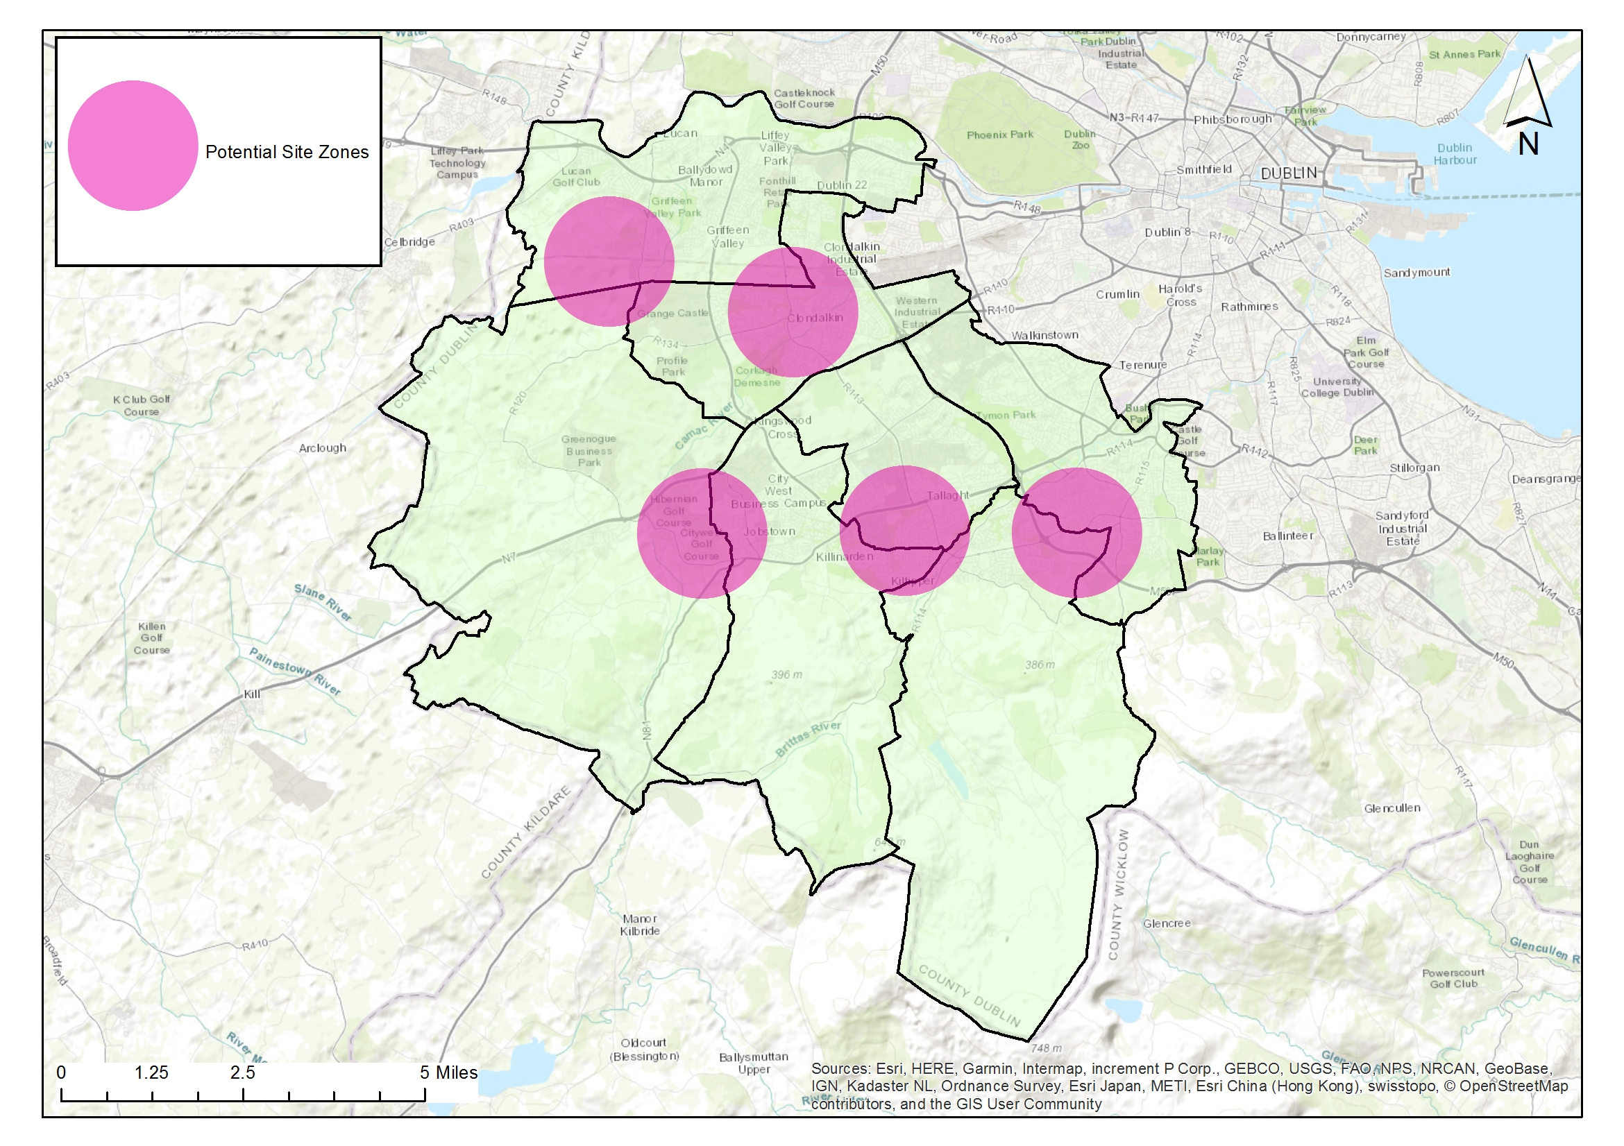
Provide 3-5 Artificial Grass Pitches (AGPs) to increase provision, usage and provide for training need.
The multi-use nature of AGP pitches should lead to sports hubs and efficiencies in use (GAA, Soccer and Rugby Union)
High capital outlay required; high use and meeting community demand shall be built into management structures
Provision to be made for replacement / repair over lifetime of the facility
AGP’s provide pitch capacity to meet increased population growth in higher density/ urban locations
AGP’s meet demand for increased match play
AGP’s remove training pressure from grass pitches with resultant higher standard of grass pitches.
Strategic locations, new development and high population areas; facilitates high use, late evening and flood lighting.
AGP’s provide all weather, year-round facilites. Provide ancillary facilites as required to maximise use.
AGP’s meet demand for training provision which is not currently being met.
AGPs:
Adamstown SDZ
Clonburris SDZ
Fortunestown LAP area / Rathcoole/ Newcastle area
Tallaght LAP
Ballycullen / Firhouse LAP
€3million provided within capital budget for Astros

Slide 7
Ancillary facilities
Storage Areas:
In larger parks with new pavilions:
Some storage to be provided in new changing rooms or will be provided in a railed off area adjacent to a pavilion
In open spaces without pavilions / changing rooms:
Railed off areas for storage of heavy-duty pitch infrastructure e.g. goalposts etc. will be considered.
These areas should ideally be in well overlooked areas with plenty of passive surveillance.
Hierarchy of provision: High usage areas with several clubs and pitches.
Funding:
Subject to funding:
May be sourced by sports capital grants, large scale infrastructure grants
Sports Governing body or club contributions could be facilitated
Security of Provision:
All ancillary facilites provided within public lands are linked to sports pitch use to allow for future proofing of provision and ownership of facilites is not limited to a club or sport. Facility shall remain available to SDCC.
Current pavilion programme (subject to funding):
Dodder Valley Old Bawn (complete)
Griffeen Valley Park (North) (at construction stage)
Corkagh Park (West) (Part 8 completed)
Tymon Park (West of M50)
Dodder Valley Mt Carmel (Part 8 completed)
Griffeen Valley Park (Arthur Griffith Park)
Collinstown Park

Slide 8
Recent Sports Capital Grant application 2021
SCP20 Lucan Athletics Track infield works Phase 3
SCP20 Ball Courts Dodder Valley
SCP20 Ball Courts Beechfield Park
SCP20 Ball Stop Net Kilnamanagh
SCP20 Storage Facilities Griffeen Park
SCP20 Storage Facilities Greentrees Park 1
SCP20 Storage Facilities Ballymount
SCP20 Pavillion programme Dodder Valley Mt Carmel
SCP20 Pavillion Programme Collinstown Pavillion Phase2
SCP20 Water Sports Facility Lucan Demesne Phase 1
SCP20 Bowling Green SWP
SCP20 Dodder Valley Mt Carmel BMX
SCP20 Kiltipper GAA Pitch 01
SCP20 Kiltipper Soccer Pitch 01
SCP20 Kiltipper Soccer Pitch 02
SCP20 Killinarden GAA Pitch 82
SCP20 Killinarden Soccer Pitch 83
SCP 20 Ballymount GAA Pitch 94
SCP20 Clondalkin Park GAA Pitch 50
SCP20 Glenaulin GAA Pitch 24
SCP20 Weston Hockey Pitch Re-surfacing

Slide 9
South Dublin Sports Pitch Strategy
Strategic Policy Committee
Thank you

