Slide 1
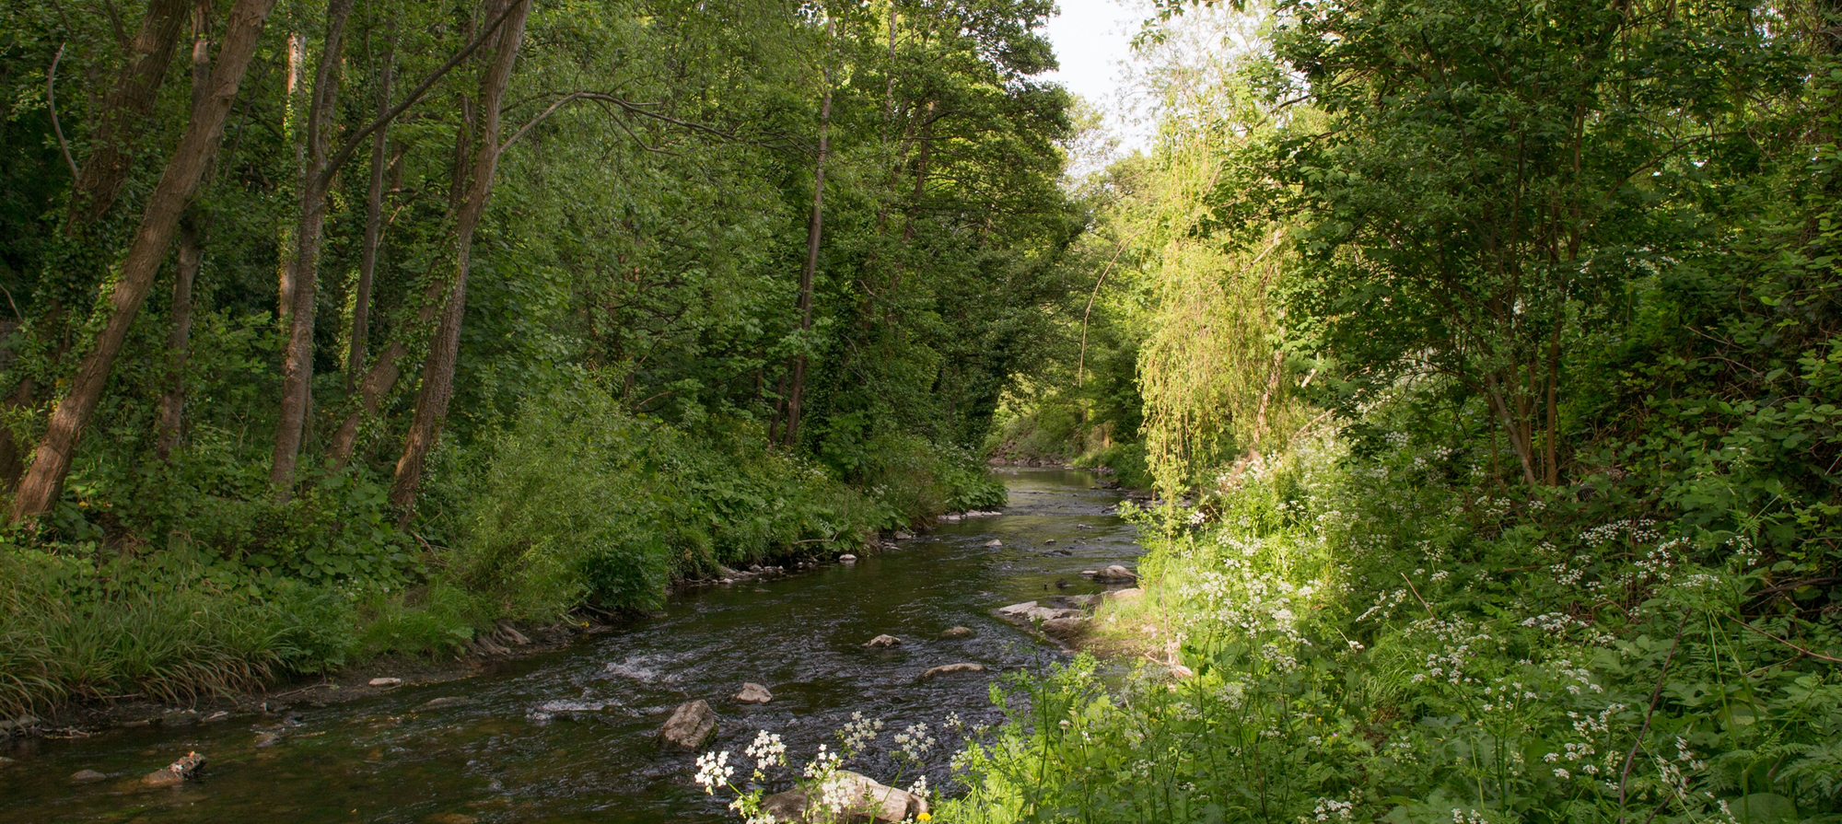
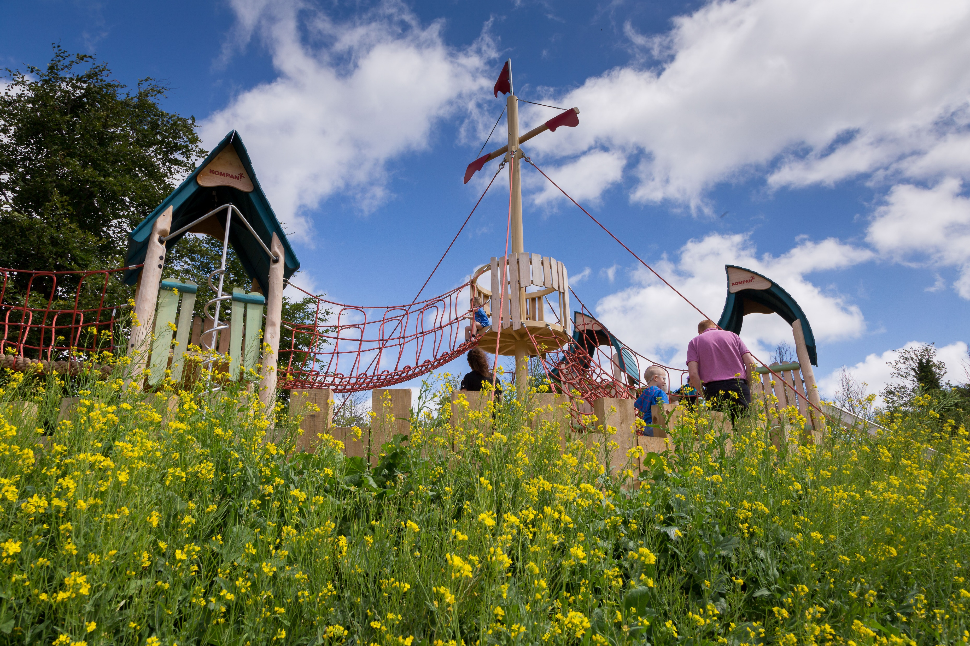
Parks and Open Space (POS) Strategy Update
Green Infrastructure (GI) Strategy Update
Update to EWCC SPC
04 05 2021

Slide 2
GREEN INFRASTRUCTURE ……“a strategically planned network of natural and semi-natural areas with other environmental features designed and managed to deliver a wide range of ecosystem services such as water purification, air quality, space for recreation and climate mitigation and adaptation.”……. A GI STRATEGY WILL: “form the basis for the identification, protection, enhancement and management of the Green Infrastructure network within the County.”
CONTEXT FOR ACTION
Climate Action & Biodiversity loss
Policy Context:
National Planning Framework
Regional Spatial & Economic Strategy

Slide 3
GI Strategy Development
These 5 Key Themes, relevant to GI, frame the policies and objectives within the County Development Plan and allow us to identify opportunities to improve the GI network:
Biodiversity
Sustainable Water Management
Climate Resilience
Recreation and Amenity (Human health and wellbeing)
Landscape (Natural and Cultural Heritage)
Case Studies are underway to inform policy development. 5 areas representing different Green Infrastructure Network Characteristics will assist in generating relevant policies for similar areas.

Slide 4
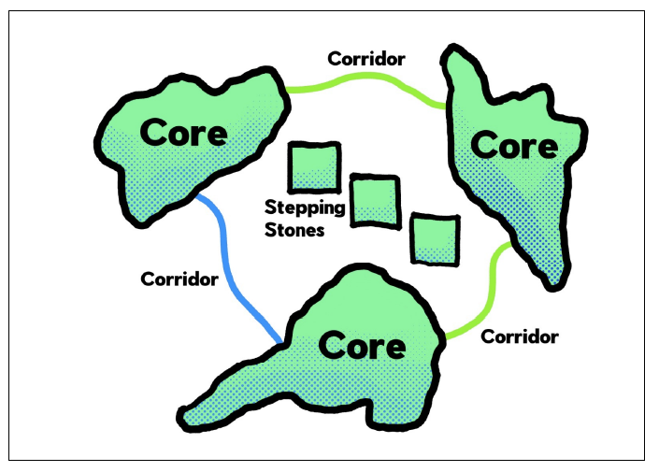
GI Strategy Development
Components of GI:
GI Cores serve as anchors within the network.
They are ecological resources of regional / national importance, and / or high levels of outstanding amenity and act as points of origin / destination for wildlife at which essential ecological processes occur.
e.g. Dublin Mountains, Liffey Valley, Grand Canal, Regional Parks.
GI Corridors are physical links that tie the network together.
They provide for movement of flora and fauna between GI Cores. Primary GI Corridors operate at the regional level; linking GI Cores within and beyond our own county. Local GI Corridors link Cores or Corridors within our county at a more local level.
e.g. Primary GI Corridors: Camac Valley, Dodder Valley, Rural Fringe
Local GI Corridors: Griffeen River Valley, tributaries of the Dodder River.
GI Stepping Stones are smaller areas of green space; important at the local level.
They are discrete pieces of GI Infrastructure that are not linked to a wider network as yet but can act as alternative ecological routes, as refuges for ecology or small zones of biodiversity and amenity within an urban or hard landscape area or an area of monoculture. GI stepping stones can be improved on or linked-up over time to become local or even primary GI Corridors.
e.g. Small open space areas proximal to GI Cores and Corridors, private gardens, hedge and ditch combinations.
Spatial Framework

Slide 5
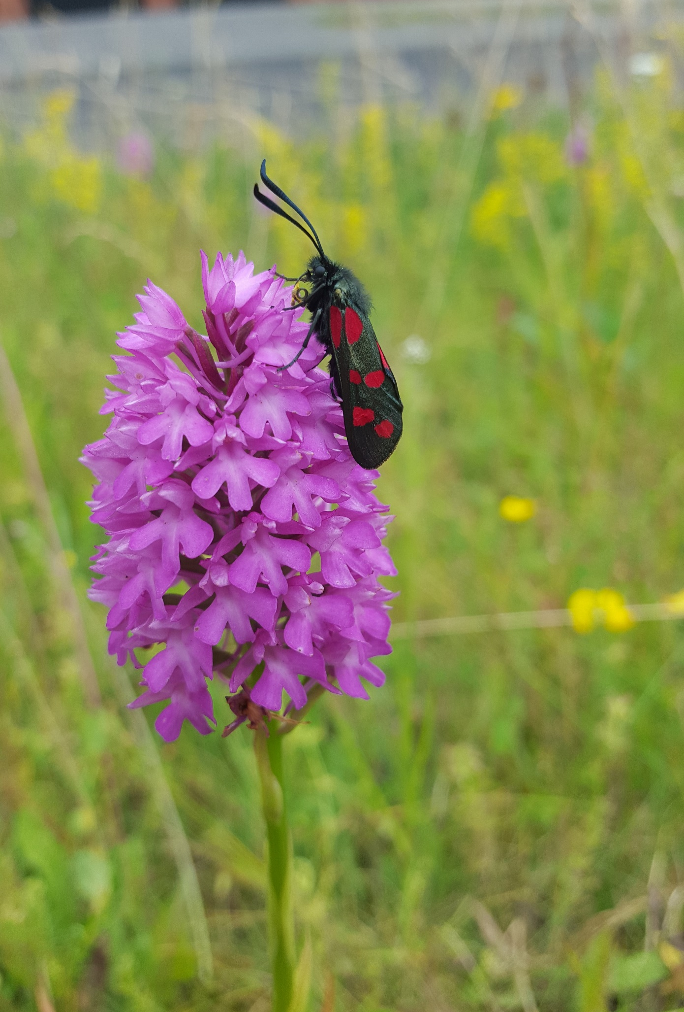
GI Strategy Implementation
Implementation:
Policies and Objectives in the Development Plan tailored to the GI network that protect, restore or enhance the GI assets and support sustainable development:
Derived from:
5 themes
Cores, corridors and stepping-stone locations
Case Studies

Slide 6
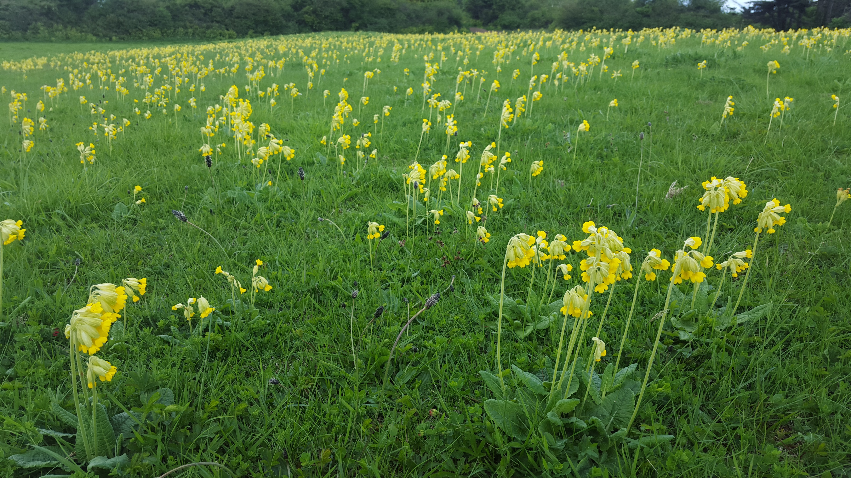
GI Strategy Implementation
Implementation:
All relevant development shall be accompanied by a GI Infrastructure Plan as follows:
Site location plan showing site in context of wider GI in the county
Site Survey and analysis; identifying existing GI Infrastructure within the site
GI protection, enhancement and restoration proposals as part of the landscape plan for the site; including proposed linkages to wider GI network.
.

Slide 7
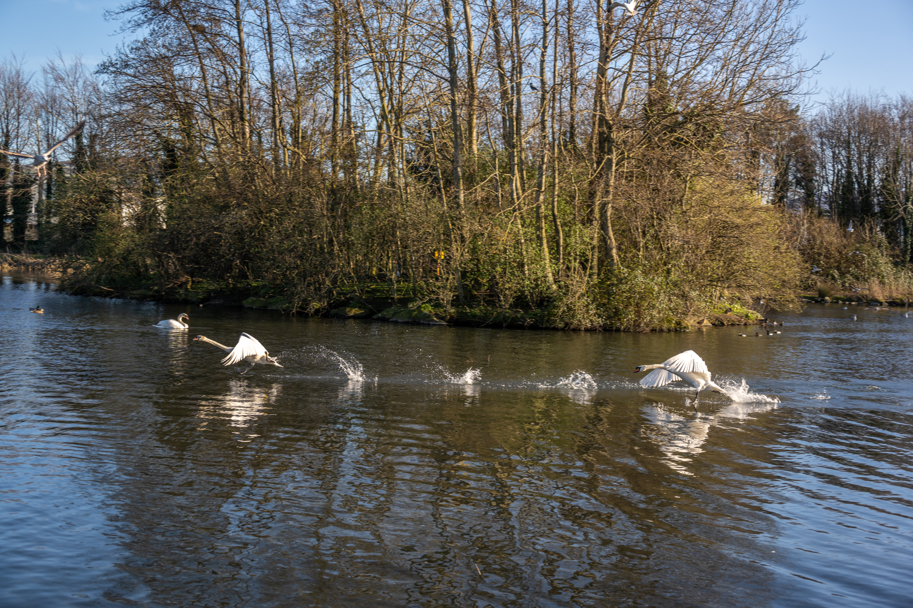
GI Chapter Implementation
Implementation:
GI Proposals will be assessed against the policies and objectives contained within the County Development Plan for GI and the Greening Factor outlined below.
Greening Factor:
“An urban greening factor is a ratio between the amount of built areas and non-built areas within an urban area. The urban greening factor tool is used to assess and quantify the amount and quality of urban greening that a scheme provides”.
An urban greening factor will be applied to submitted GI Infrastructure Plans.
The appropriate scoring mechanism for greening urban areas based on best international practice and its application to local circumstances in South Dublin County will be developed and applied during the lifetime of the plan.

Slide 8
GI Strategy Implementation
Monitoring:
Implementation and monitoring the GI Strategy through the further development of a GI scoring approach which will support ongoing identification, protection, enhancement and management of GI in the County and which will enable the assessment and monitoring of GI interventions.
GI Scoring:
A methodology for GI scoring is being developed based on:
Level 3 detailed habitat mapping of the county which broadly assesses the ability of different types of land cover to deliver different ecosystem services.
Ecosystem services are the direct and indirect contributions of ecosystems to human wellbeing. There are four main types; provisioning, regulating, supporting and cultural services.
Each habitat type will be assigned a score based on its capacity to provide ecosystem services.
Scoring enables comprehensive analysis and calculation of GI value across the county as well as allowing for repeat monitoring over time.

Slide 9
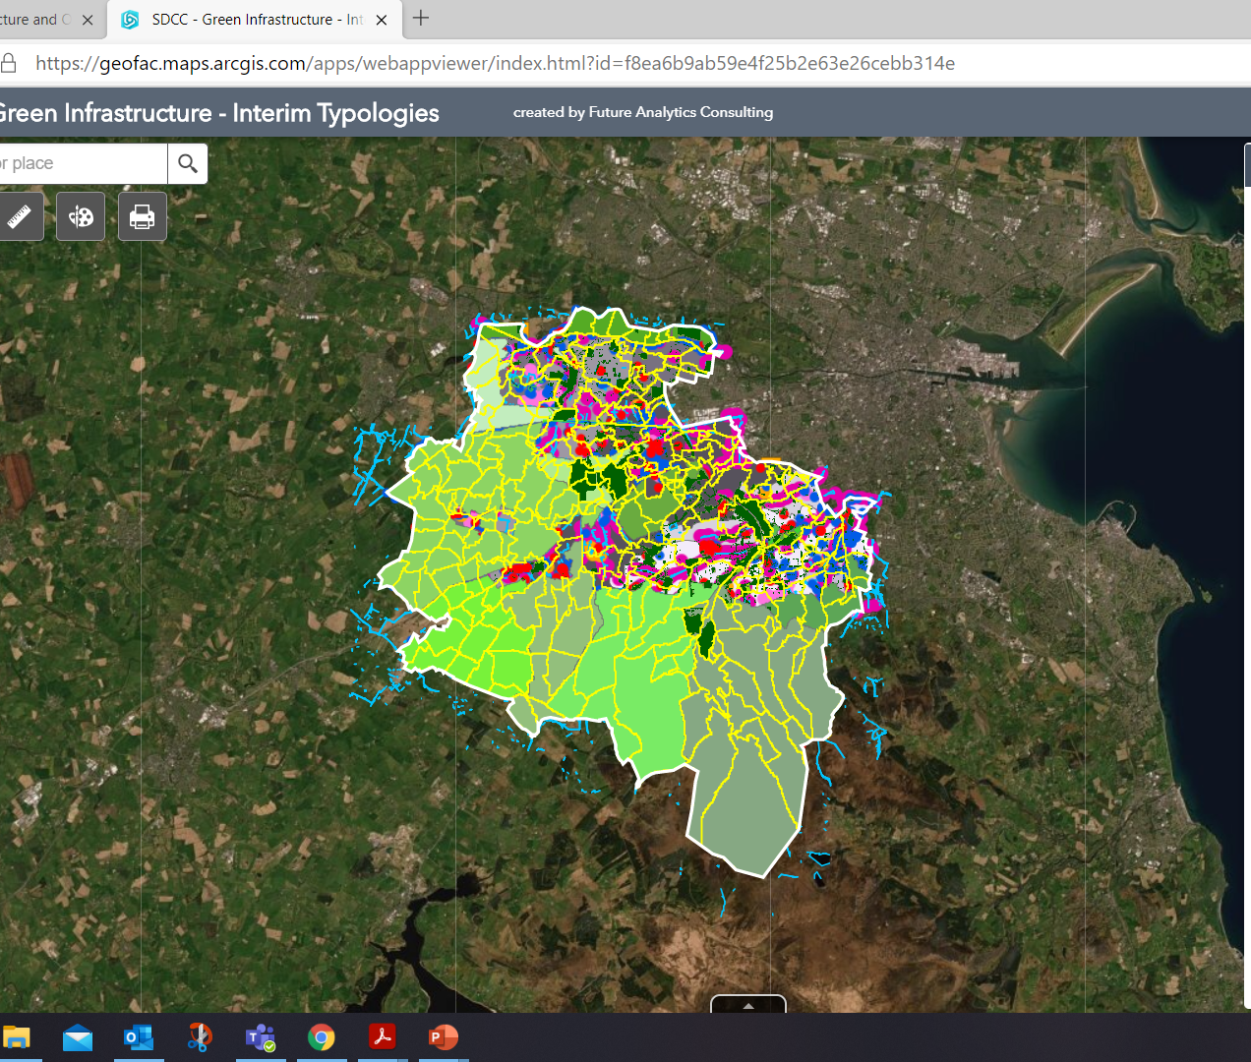
Mapping Framework
The GI Strategy will have accompanying mapping:
Maps adopted with the County Development Plan showing layers of Green Infrastructure and how they relate to the Plan.
This will be represented in the CDP document diagrammatically.
It will also be supported by the background GIS mapping that SDCC can keep updated to monitor changes and improvements to GI networks over time.

Slide 10
Parks and Open Space (POS) Strategy Update

Slide 11
PARKS AND OPEN SPACES: Are fundamental in contributing to a high quality of life for those living, working and visiting the County. They provide habitats for ecological processes, a focal point for active and passive recreation, promote community interaction and help mitigate the impacts of climate change.
Define Open Space standards
Quantity
Access
Quality
Benchmarking of Standards
Application of Standards to South Dublin neighbourhoods (as per county development plan)
Draft Development Plan Policies and Objectives being finalised prior to publication for public consultation in May.

Slide 12
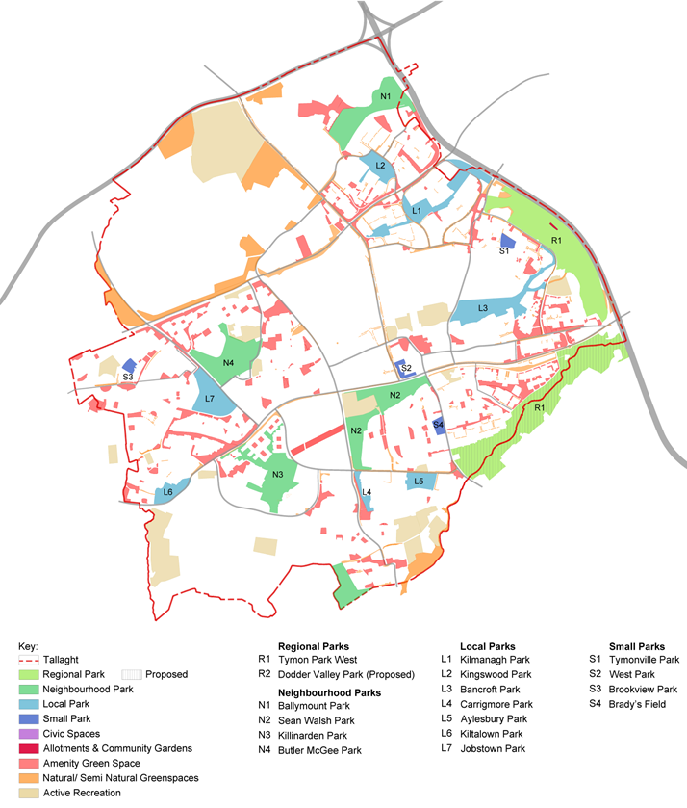
Parks and Open Spaces Strategy
Type | Park | Area (ha)
Regional Parks | Tymon Park West | 128.83
 | Dodder Valley (Proposed) | 118.31
 | Totals | 247.14
Neighbourhood Parks | Ballymount Park | 21.15
 | Sean Walsh Park | 21.86
 | Killinarden Park | 20.81
 | Butler McGee Park | 20.67
 | Totals | 84.49
Local Parks | Kilnamanagh Park | 15.52
 | Kingswood Park | 6.71
 | Bancroft Park | 18.00
 | Carrigmore Park | 2.38
 | Aylesbury Park | 5.15
 | Kiltalown Park | 5.49
 | Jobstown Park | 13.34
 | Totals | 66.59
Small Parks | Tymonville Park | 1.73
 | West Park | 1.42
 | Brookview Park | 1.40
 | Brady’s Field | 1.91
 | Totals | 6.46
Amenity Green Space | Various | 118.72
Natural/semi-natural | Various | 92.90
Applying the Standards: Tallaght
Quantity

Slide 13
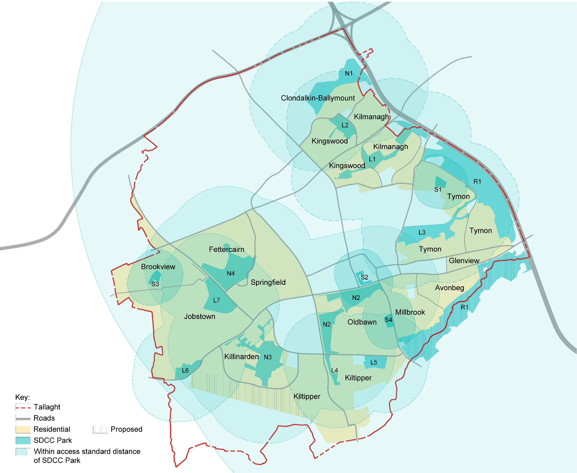
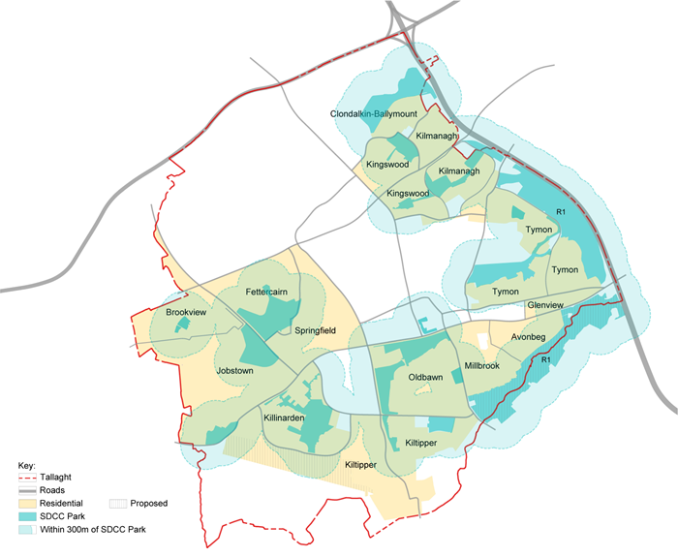
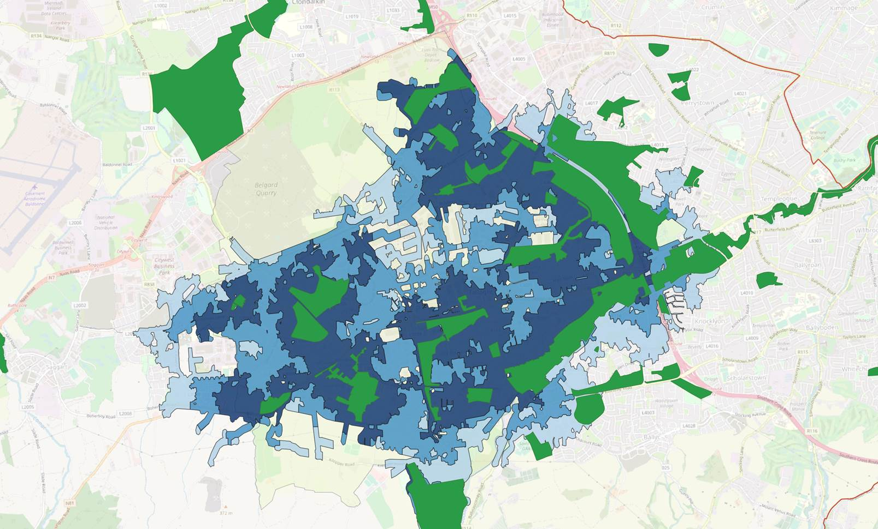
Parks and Open Spaces Strategy
Applying the Standards: Tallaght
Accessibility
Within prescribed walking thresholds of all SDCC Parks
Within 300m band of all SDCC Parks
Information is being refined
Applying the Access Standards: Public Parks
Within the Tallaght neighbourhood there is an existing well-distributed network of public parks.
There are no residential areas in the neighbourhood that do not have access to a park within the prescribed walking thresholds.
Note:
Initial access thresholds and assessments are being up-dated in line with walkability bands created by SDCC using 'Open Street Maps' to give truer walking routes and catchments.
Adding a 300m band (to existing public parks only)

Slide 14
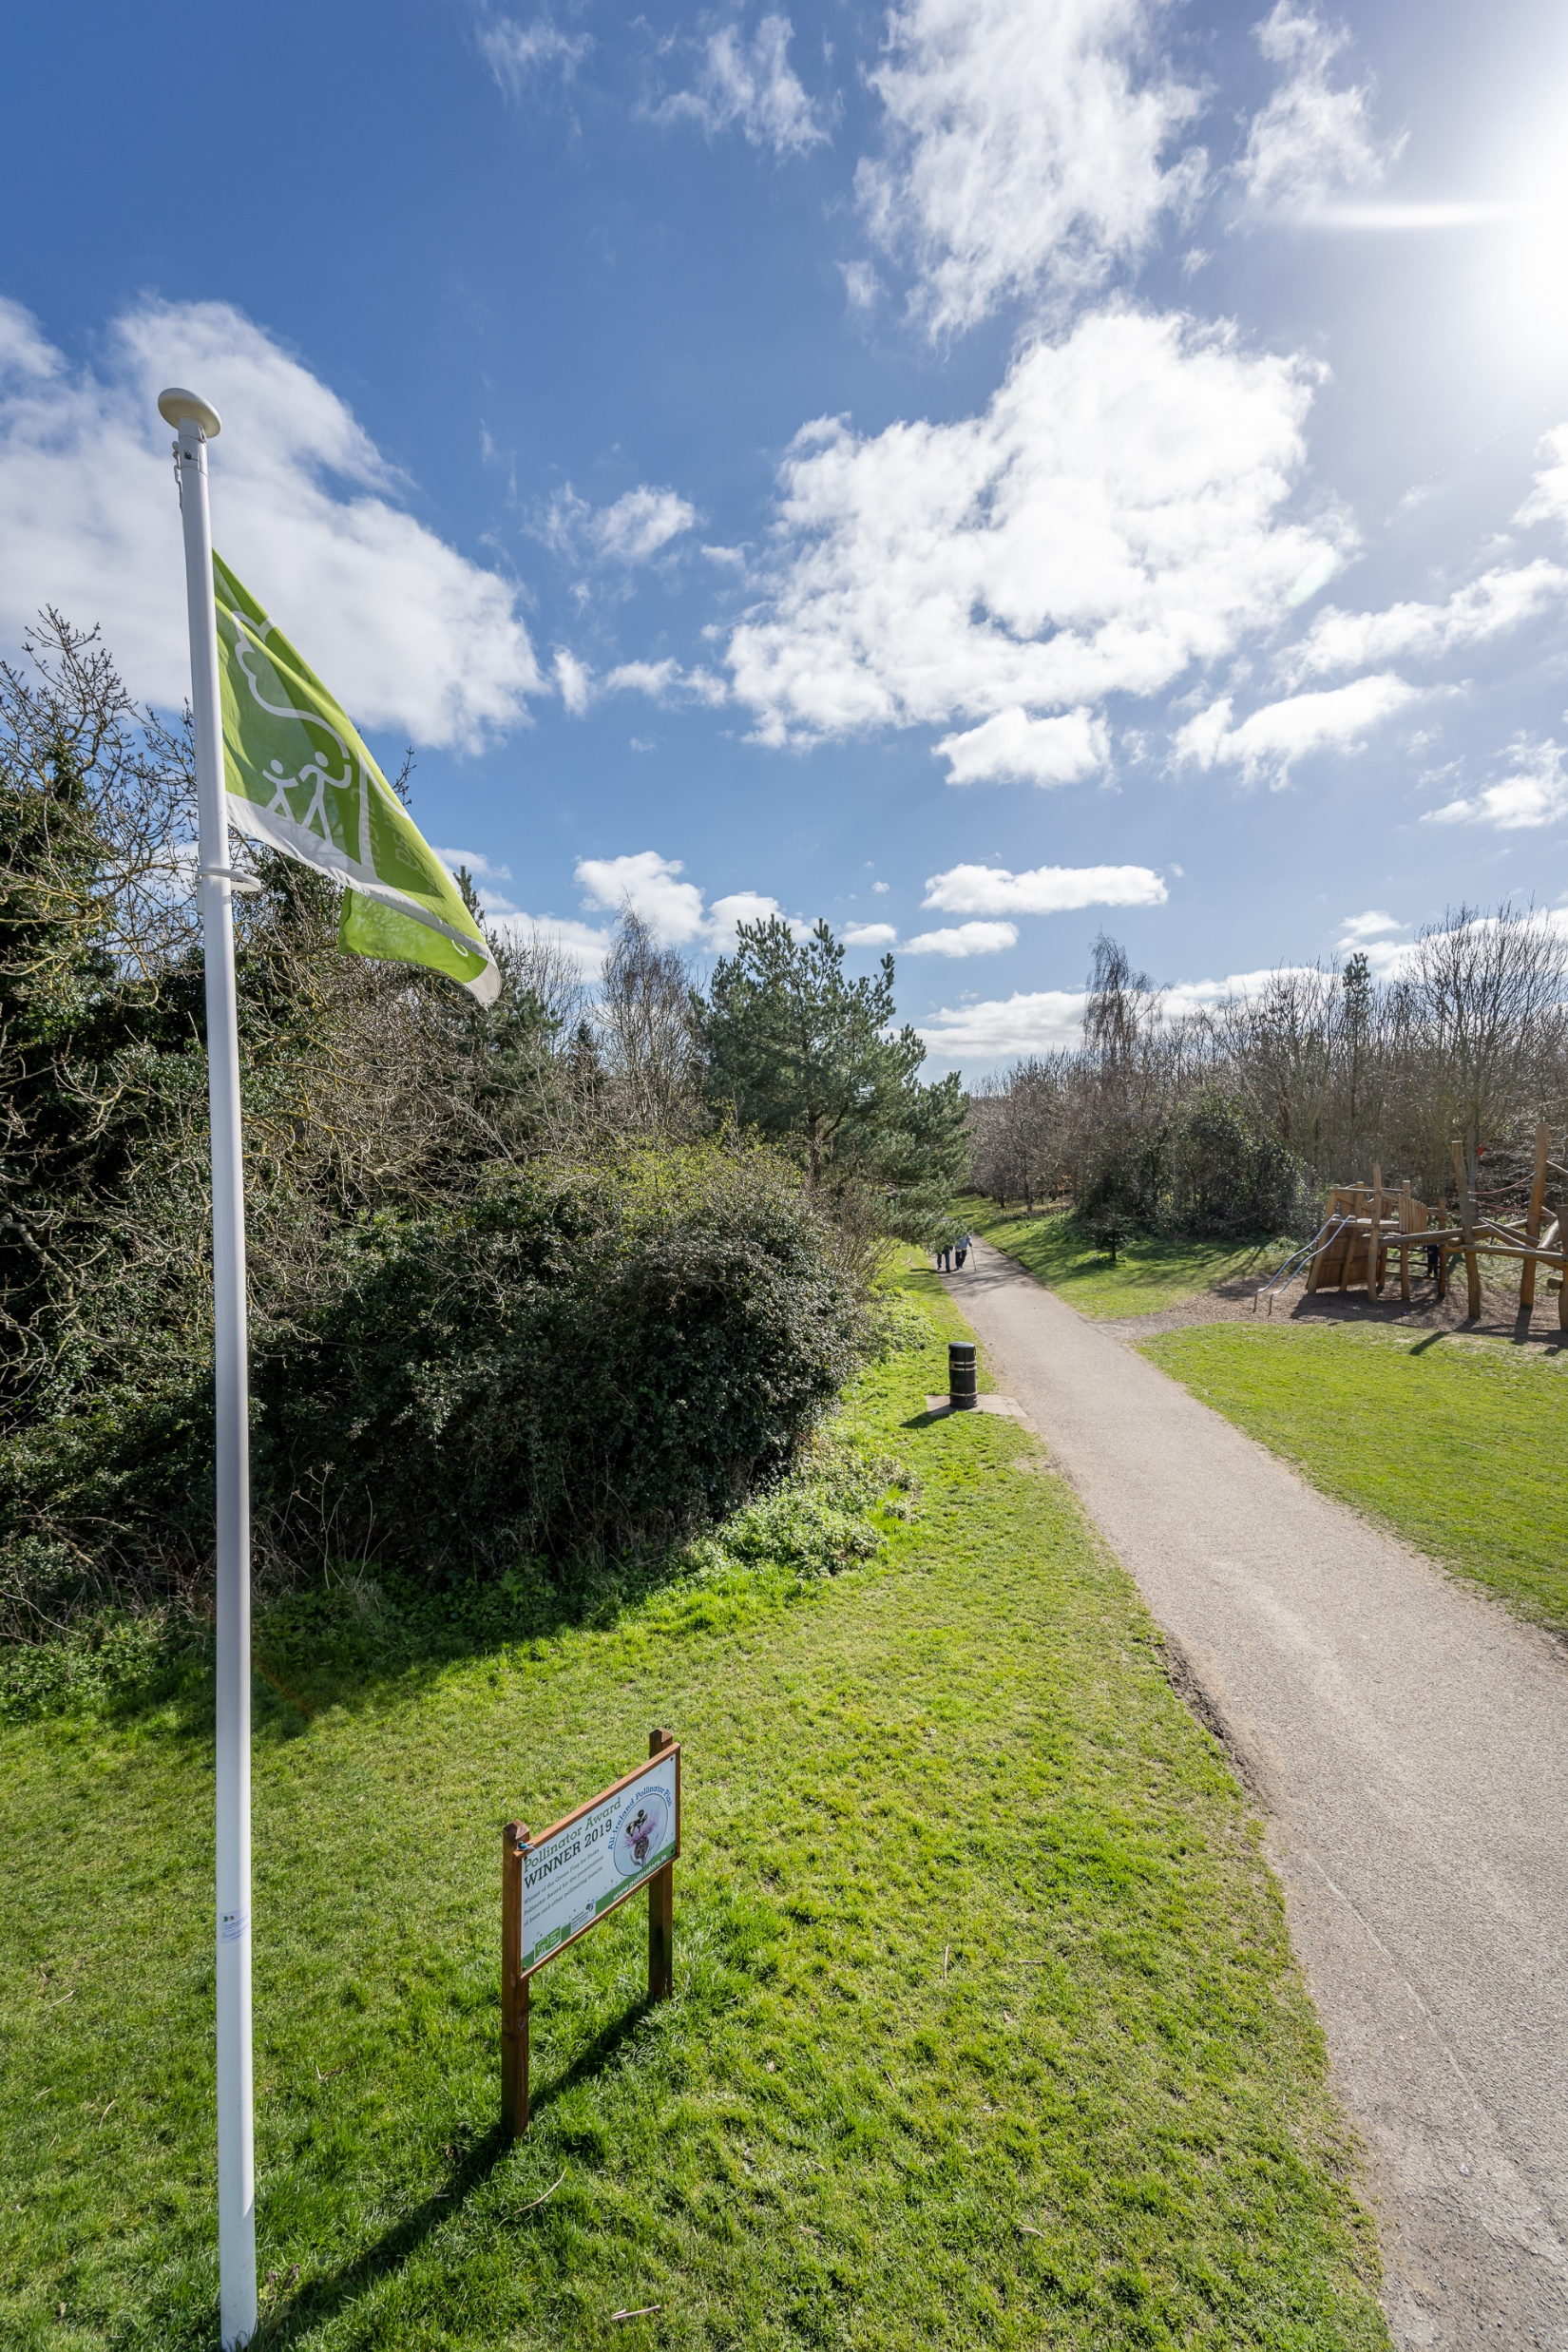
Parks and Open Spaces Strategy
Quality Standards – Green flag standard with developed biodiversity section.
A locally set quality assessment is being undertaken for each area of open space. Scores are given against a basic expected level of quality/maintenance, potential for biodiversity and community value, as shown.
A Welcoming Place
1. Welcoming entrances
2. Good and safe access
3. Signage
4. Equal access for all
Healthy, Safe and Secure
5. Safe and accessible equipment and facilities
6. Personal security
7. Appropriate provision of facilities
8. Quality of places
Management
9. Clean and well-maintained
10. Litter and waste management
11. Grounds maintenance and horticulture
12. Building and infrastructure maintenance
Potential for Biodiversity
13. Linkages to GI network
14. Native tree and shrub planting
15. Hedgerows
16. SuDS features (incl. integrated wetlands)
17. Natural water features (including stream re-profiling)

Slide 15
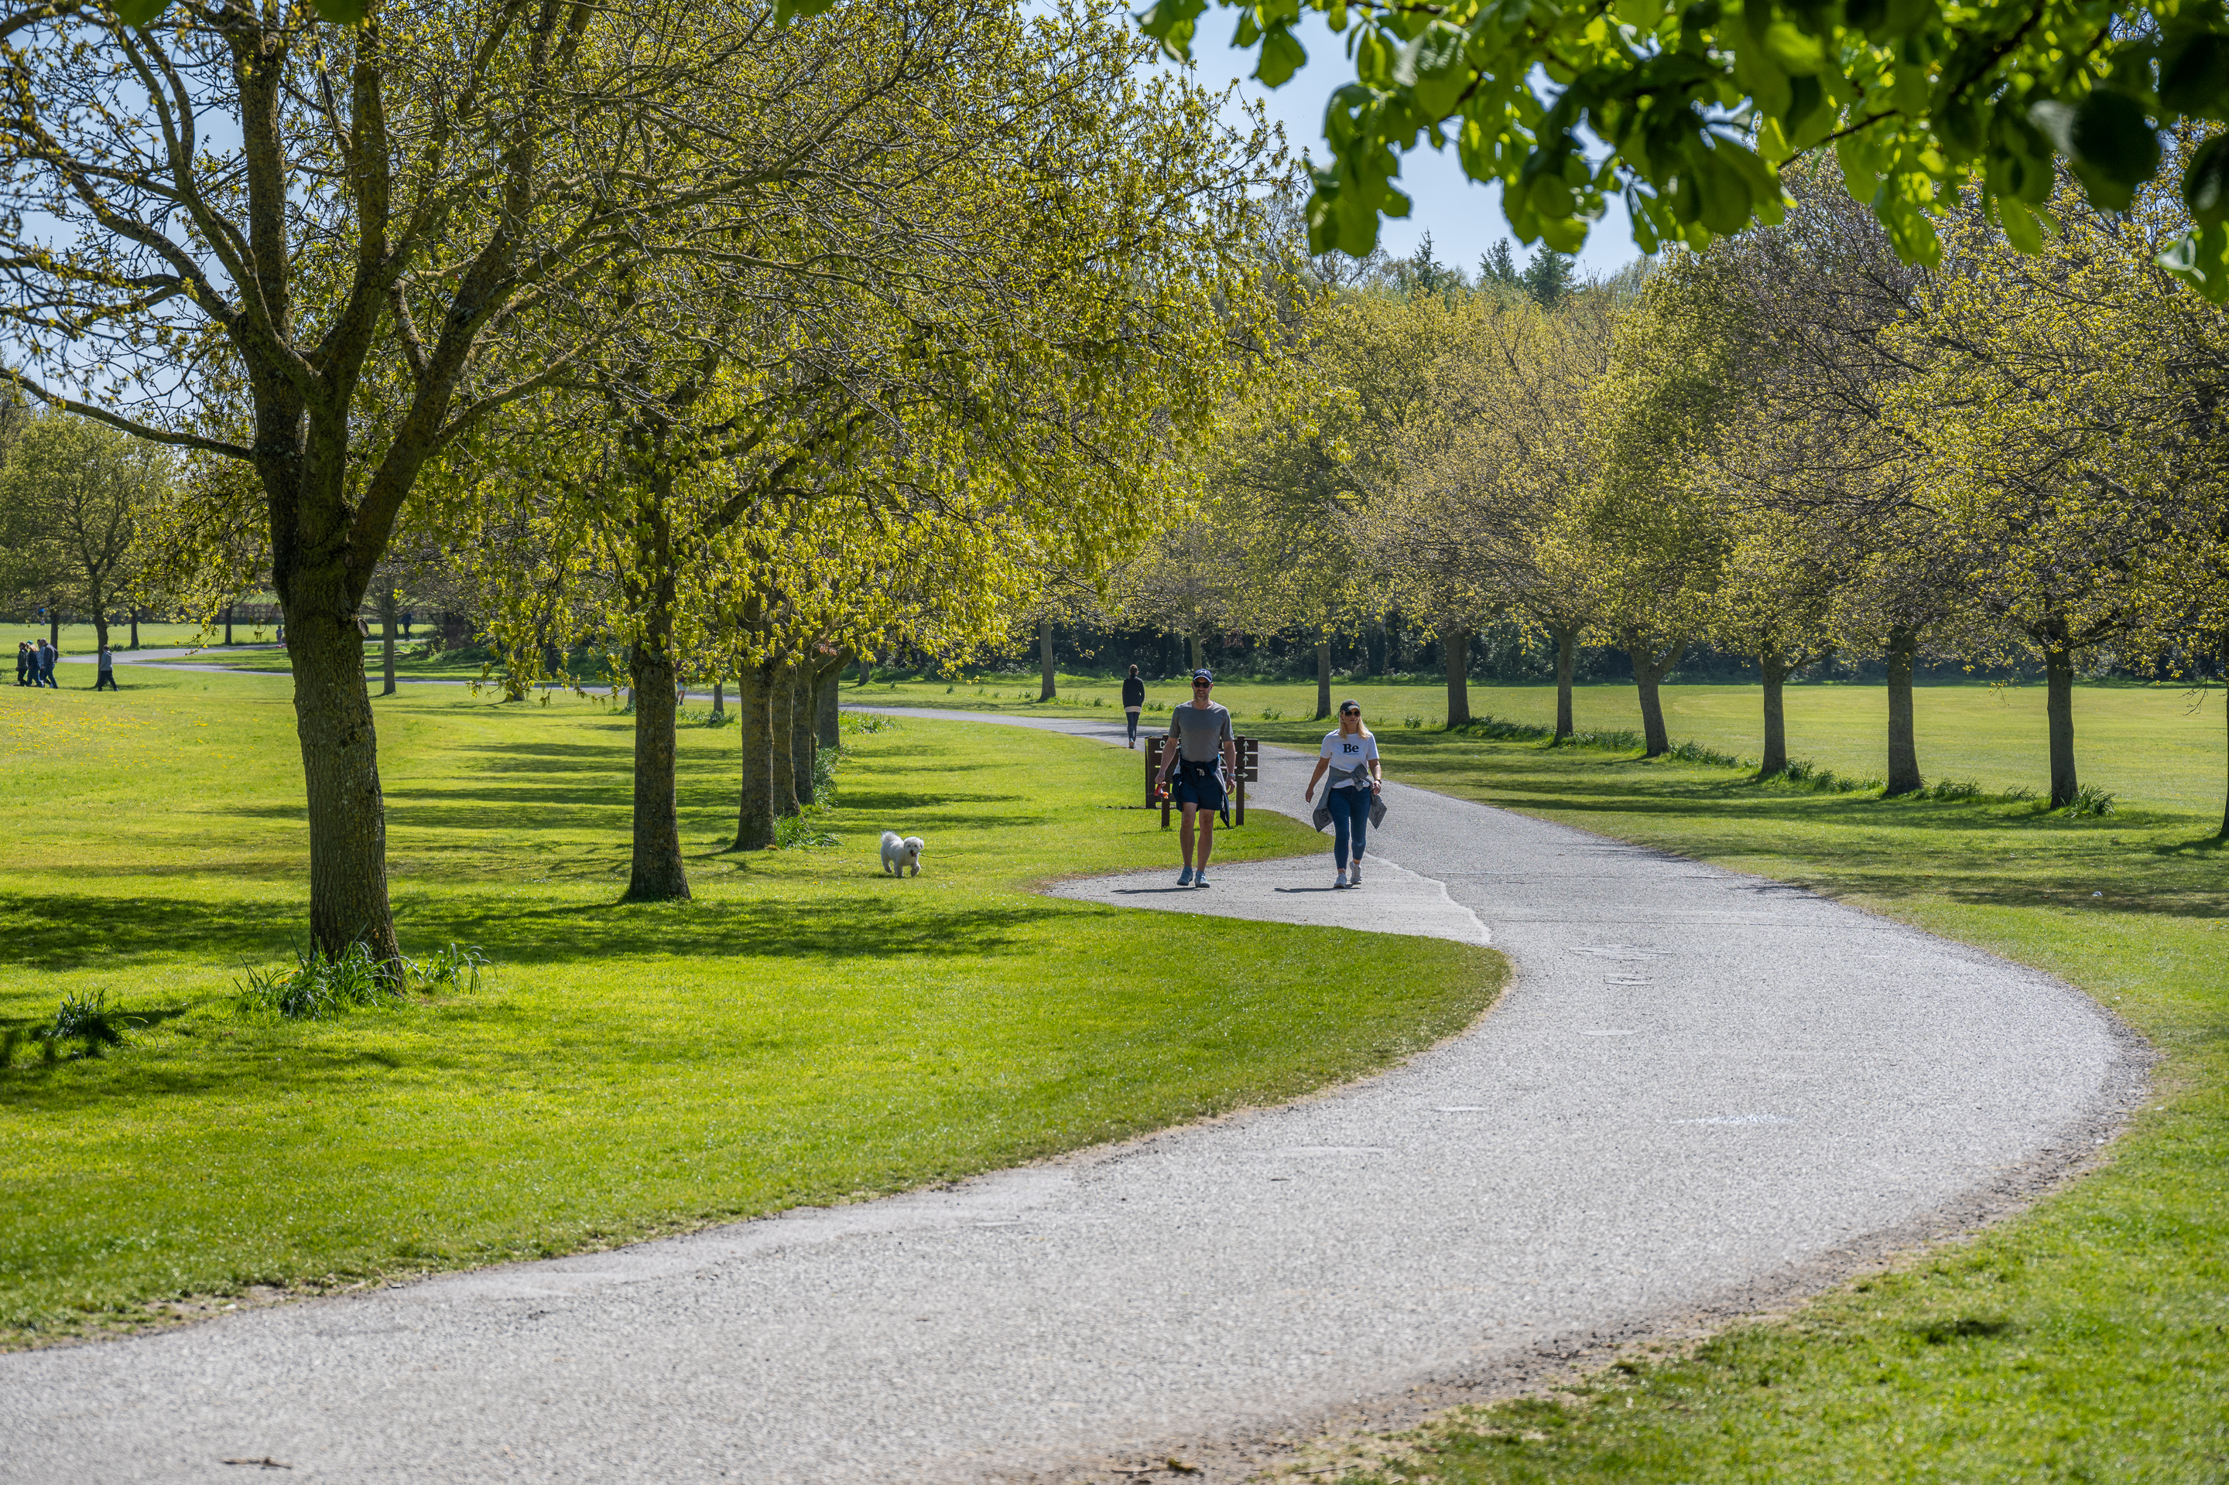
Parks and Open Spaces Strategy
Parks and Open Space Survey
To help guide the development of the Parks and Open Space Strategy, we are seeking public views on the quality and quantity of South Dublin’s parks and any ideas people have for improving them.
This will be live in May 2021 and available at:
https://consult.sdublincoco.ie/
A video promoting SDCC parks and requesting feedback accompanies the survey.

Slide 16
Methodology and programme: GI Strategy and POS Strategy being delivered in tandem GI Strategy will be a chapter within the Draft CDP. Relevant POS policies and actions will be incorporated into the CDP. 2 separate but complementary documents POS has a separate consultation process.
STAGE 1
Scoping of Project and Summary Report
August 2020
STAGE 2
Desktop Investigation, Surveys and Mapping
August-October 2020
STAGE 3
Interim Report(s), Analysis, Mapping
Sept 2020-May 2021 with submission of policy and mapping information in line with requirements of CDP key dates.
STAGE 4
Final Report – Draft reports, Consultation, Finalised Mapping, Findings, Recommendations & Action Plans. Greening Factor and GI Scoring system being developed.
Feb 2021-March 2022

Slide 17
Parks and Open Space (POS) Strategy Update
Thank you
Green Infrastructure (GI) Strategy Update

