Slide 1
SHD Application Ref: SHD3ABP-309731-21
Applicant: Joseph Costello, Absolute Limousines Ltd and Boherkill Property Development Ltd.
Location: lands west of Old Belgard Rd and north, south & west of Old Belgard Rd and north, south & west of Cookstown Rd, Cookstown Industrial Estate, Tallaght.
Presentation to: Tallaght ACM 26th April 2021
Jim Johnston
Senior Executive Planner

Slide 2
Timelines
SHD Lodged with ABP on 19-Mar-2021.
5 Week Obs by 5.30pm on 22-Apr-2021.
8 Wks SDCC report due to ABP 13-May-2021.
16 Week Decision due from ABP 08-July-2021.
Consultations
S.247 pre-planning meetings with SDCC as follows:
SHD1SPP012/19 on 09-May- 2019.
SHD1SPP012/19-1 on 11-July-2019.
SHD1SPP023/19 on 02-Oct-2019.
Tripartite meeting ref SHD2ABP-306402-20 held on 20-Feb-2020 with An Bord Pleanála, the applicant and SDCC.

Slide 3
Proposed Development
Demolition of the existing industrial and commercial buildings (15,989sq.m);
construction of a mixed-use development featuring:
(a) 1104 no. ‘build-to-rent’ apartments (132 no. studio apartments, 475 no. 1-bed apartments, 208 no. 2-bed apartments, 244 no. 2-bed duplex units and 45 no. 3-bed apartments) in 4 no. blocks varying in height from four to eleven storeys. Each apartment has associated private open space in the form of a ground floor terrace or a balcony and has access to internal communal amenity spaces (totalling 2741sqm) and 5,107sqm of external communal amenity space at ground, first floor and roof levels; and
(b) Four commercial units at ground floor level of Blocks B and D (comprising of 2 no. in Block B accommodating a cafe/restaurant/bar; 1 no. in Block D accommodating Class 1, 2 and 8 uses as per the Planning and Development Regulations, 2001-2019, as amended; and 1 no. in Block D to serve the Circle K Belgard petrol station which is to be retained), 1,500sqm of office space across first to sixth floor levels of Block D and a crèche with external play area at ground floor level of Block C.
The development is served by a total of 351 no. parking spaces (including 17 no. limited mobility parking spaces and 16 no. car share spaces) and 1860 no. bicycle spaces (1464 no. resident spaces and 396 no. visitor spaces);

Slide 4
road, junction and streetscape upgrade works along First Avenue, Cookstown Road and Old Belgard Road, including the installation a signalised junction at the intersection of First Avenue and Cookstown Road and Old Belgard Road and Cookstown Road;
construction of 3 no. new roads and 1 no. pedestrian/cycle link to the Belgard Luas Stop;
construction of a 1,688sqm landscaped public plaza with an outdoor flexible events space in the south-western corner of the site; and
associated site and infrastructural works are also proposed which include: foul and surface water drainage; attenuation tanks; lighting; landscaping; boundary fences; plant areas; ESB substations; internal hard landscaping, including footpaths and street furniture; and all associated site development works.

Slide 5
ABP comments – the Bord requested that the following issues be addressed
Further consideration of the documentation as it relates to:
the integration of the proposed development with the regeneration of adjoining sites and the rest of the industrial estate. Demonstrate whether and how the proposed development could form part of a coherent and sustainable regeneration of the area with regard to the layout, design and height of the proposed buildings; the number, size and type of the proposed residential units; open space; and the mix of uses including the provision of supporting social and commercial services including childcare. Address the Development Plan including its core strategy, and the LAP.
2. access to the proposed development and to the streets in and around the site. Demonstrate whether the street network would provide adequate access for pedestrians and other road uses from the proposed development to public transport facilities, places of employment and commercial and social services, having regard to the principles and detailed requirements for urban streets set out in DMURS. Clarify any new pedestrian access to the Luas stop at Belgard and how the existing roads in the industrial estate would be altered to make them suitable to serve urban residential development. Cycle facilities should comply with the National Cycle Manual and provide proper priority for cyclists over vehicles exiting from minor roads at junctions. Rationale for the proposed provision of parking for cars and bicycles.
drainage and water supply having regard to the issues raised in the submissions from the county council and Irish Water.

Slide 6
the Bord requested that the following specific information should be submitted:
A housing quality assessment which provides the specific information regarding the proposed apartments required by the 2018 Guidelines on Design Standards for New Apartments. The assessment should also demonstrate how the proposed apartments comply with the various requirements of those guidelines. Clarify which apartments are proposed to be built-to-rent and the information required under SPPR 7 of the guidelines should be submitted in respect of them. A building lifecycle report for the proposed apartments in accordance with section 6.13 of the 2018 guidelines should also be submitted.
2. A report demonstrating compliance with the Guidelines for Planning Authorities on Urban Development and Building Heights
3. A report addressing the potential for the proposed development to affect the use of Baldonnel Aerodrome and the helipad at Tallaght Hospital.
4. An analysis of the daylight and sunlight
5. A phasing scheme
6. A landscaping and open space strategy
7. Proposals in respect of the 110kV line at the north of the site.
8. A draft construction management plan.
9. A draft waste management plan.

Slide 7
Statistics for Proposed Development
Proposal - 1104 ‘build-to-rent’ apartments comprising:
132 studio apartments (12%)
475 1-bed apartments (43%)
452 2-bed apartments (41%)
45 3-bed apartments (4%)
Site area – 5 ha
Density – 221 units per ha
Plot ratio – 2.4
Public Open Space – 6,680sq.m. (18%)
Height – 4 blocks varying in height from four to eleven storeys.
Dual Aspect apartments – 50%
Public and communal open space – 6,680 sq.m of public open space, inclusive of a 1,688sqm public plaza located in the south-western corner of the site
Car parking – 351 Cycle parking - 1860
Gross Internal Area – 91,281sq.m. Commercial space – 762sqm Offices (1,500sq.m),

Slide 8
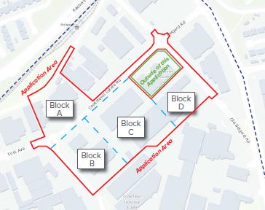

Slide 9
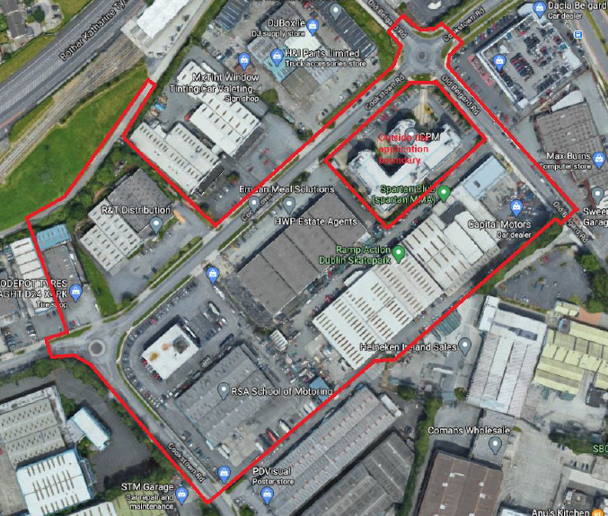

Slide 10
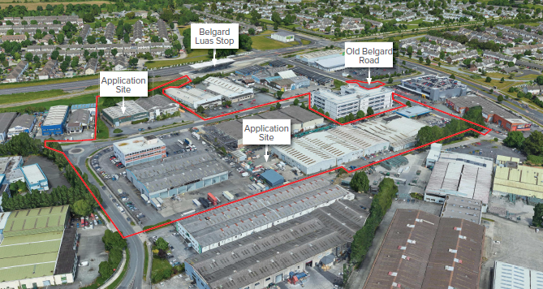

Slide 11
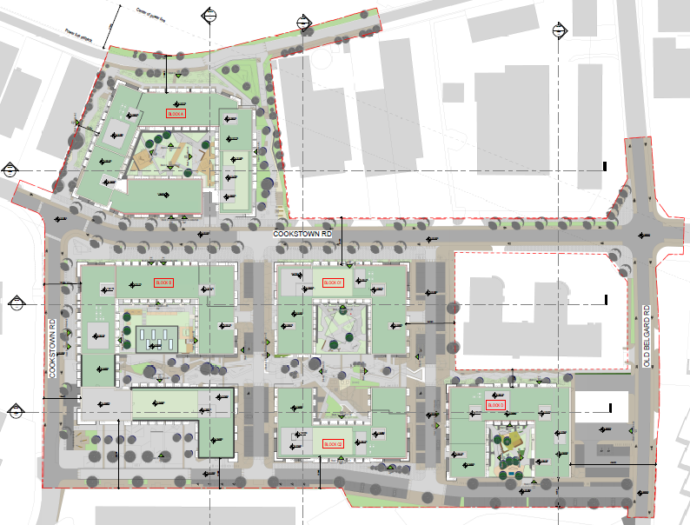

Slide 12
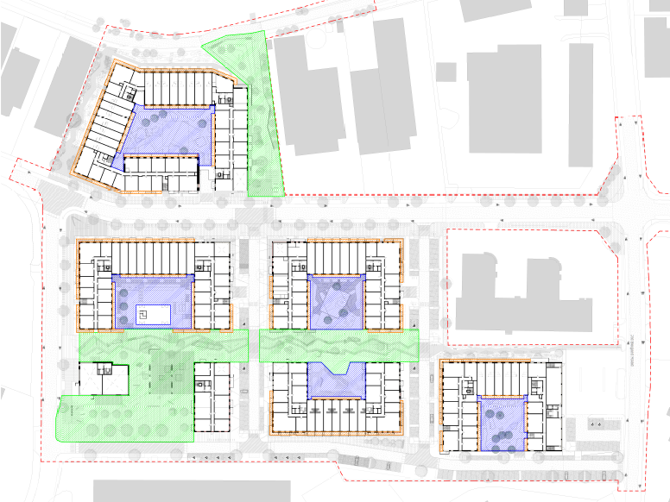

Slide 13
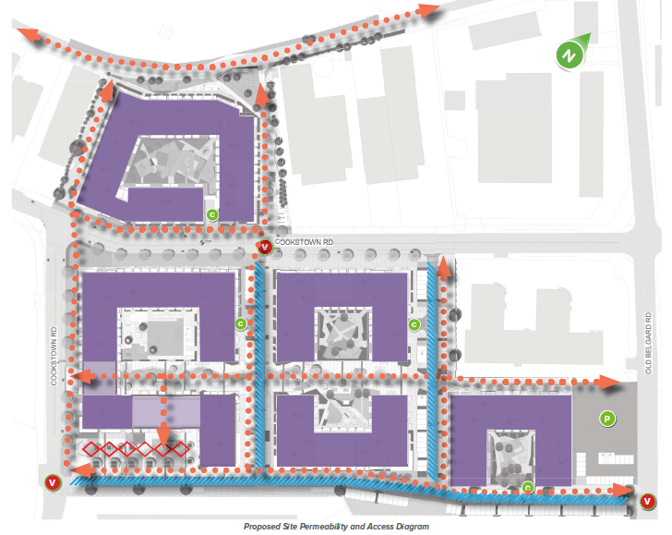

Slide 14
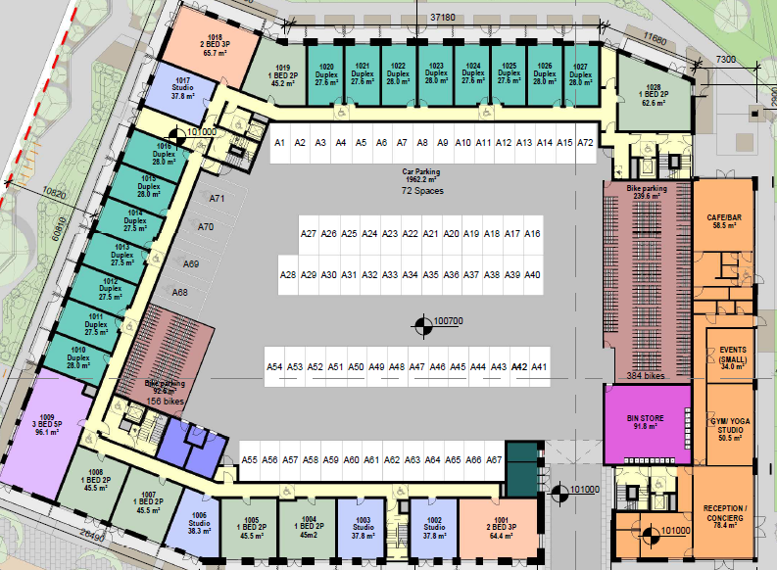
Block A

Slide 15
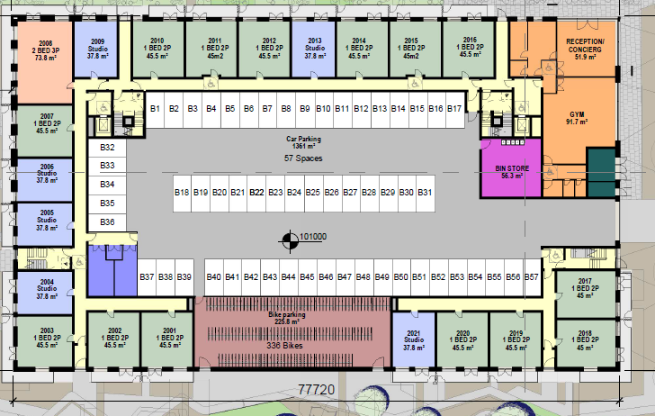
Block B (north)

Slide 16
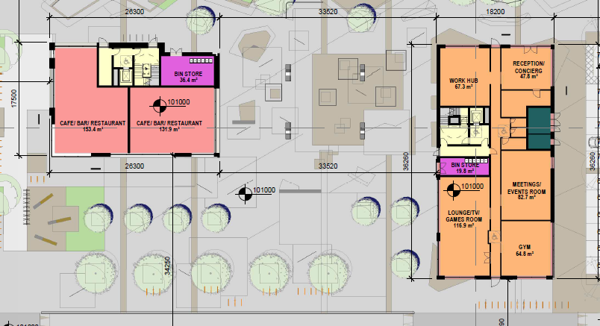
Block B (south)

Slide 17
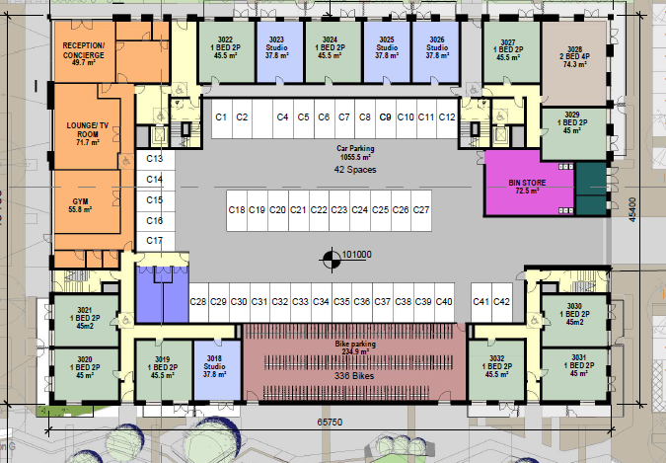
Block C (north)

Slide 18
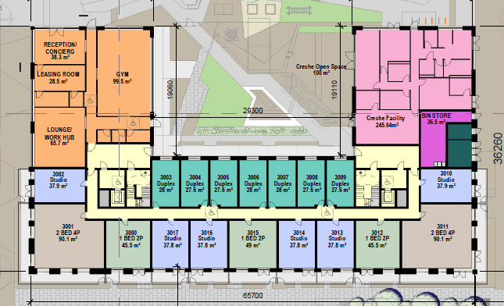
Block C (south)

Slide 19
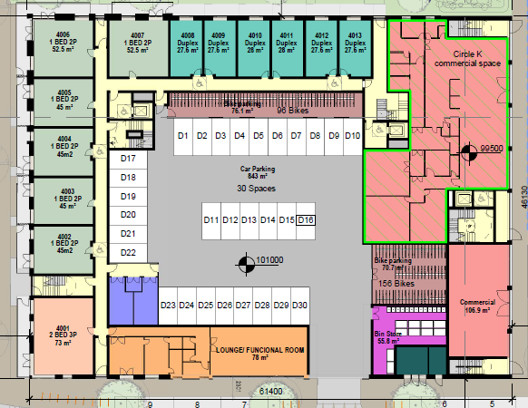
Block D

Slide 20
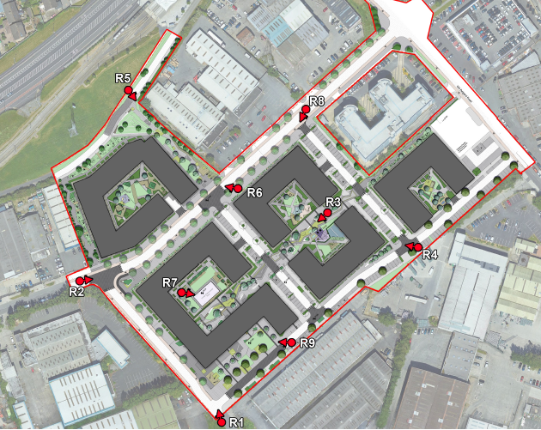

Slide 21
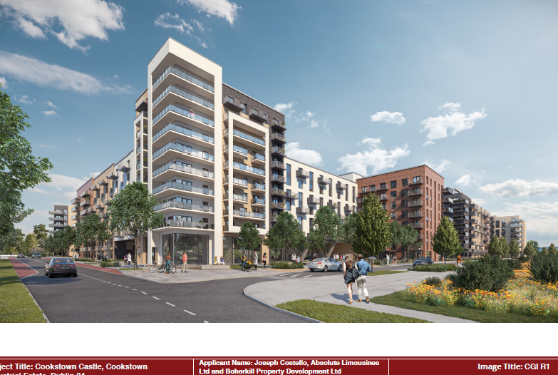

Slide 22
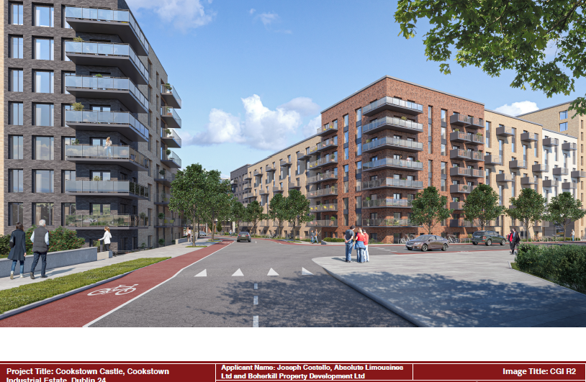

Slide 23
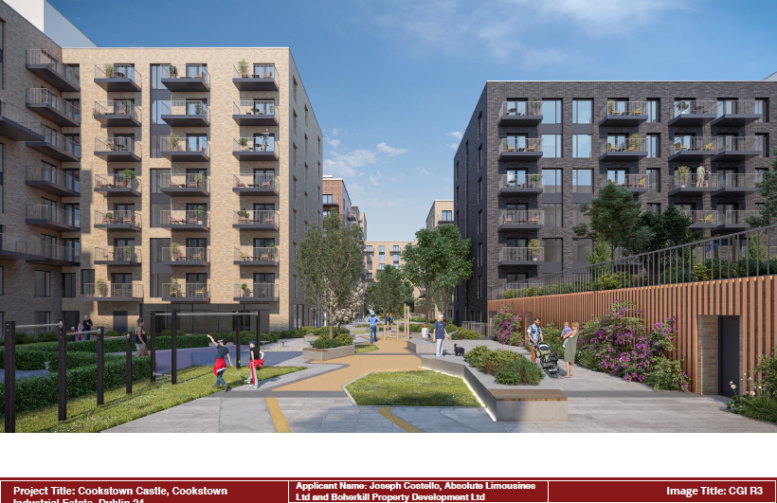

Slide 24
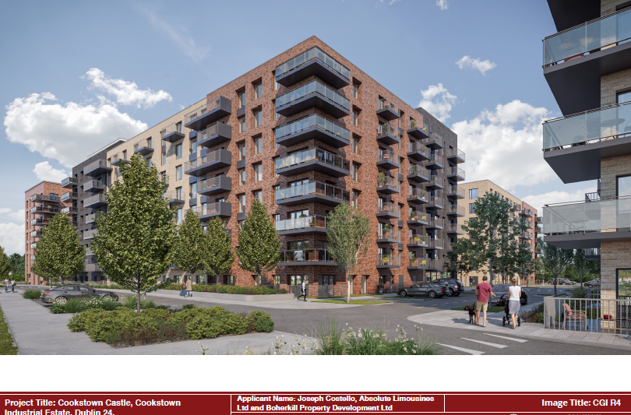

Slide 25
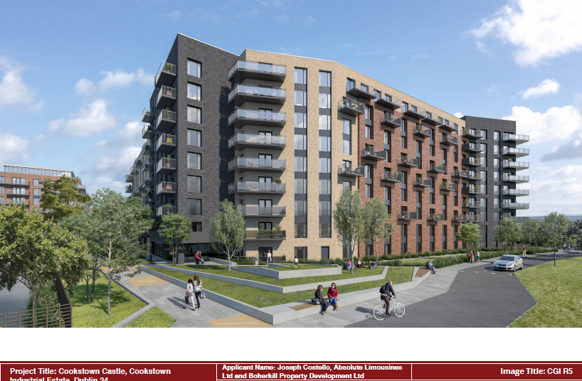

Slide 26
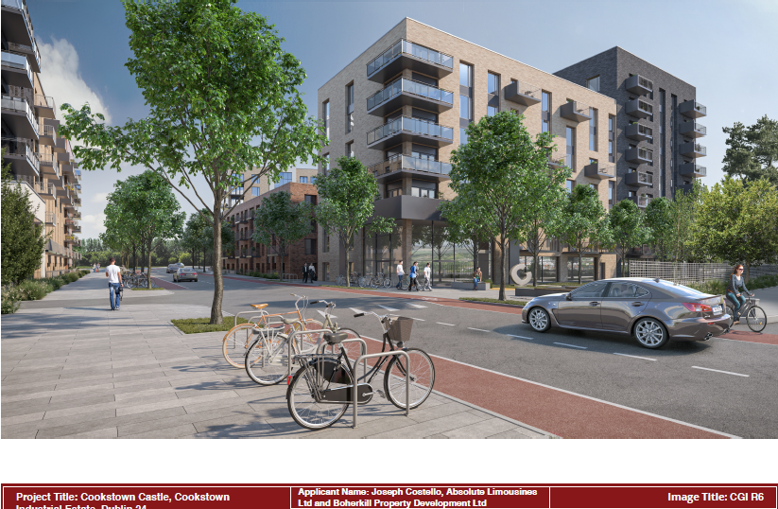

Slide 27
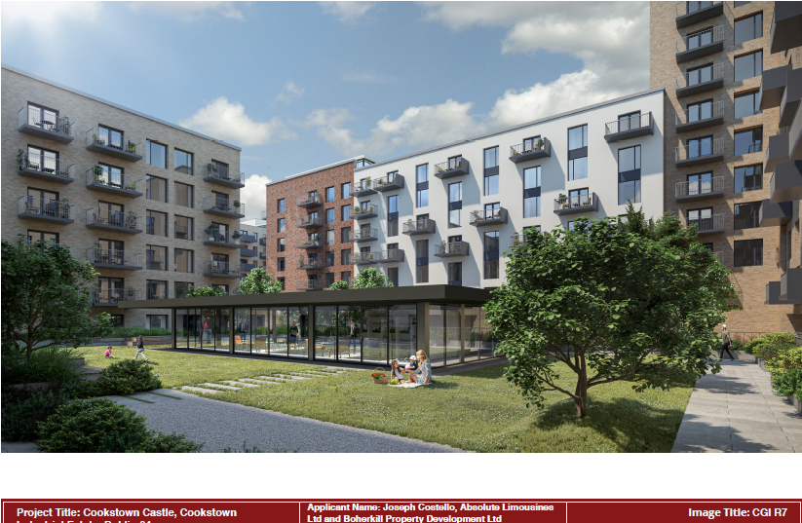

Slide 28
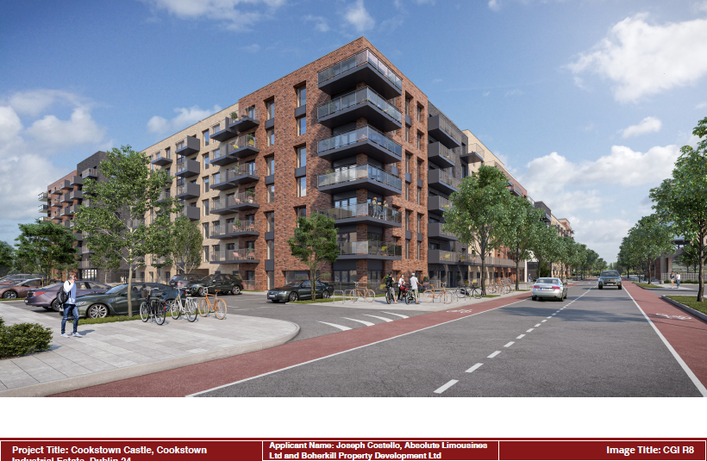

Slide 29
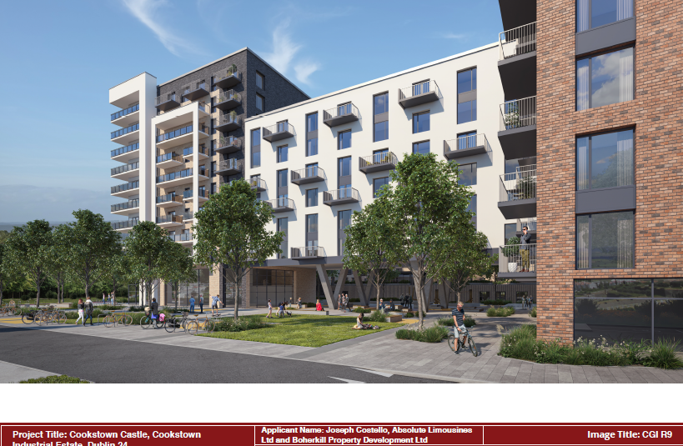

Slide 30
Thank You
Questions

