Slide 2
S.C.E.NE.
Objective:
Signpost Artists/Members to appropriate Agency
Facilitate the Creation of an Active Programme of Events, Seminars and Workshops
Advise of Financial and other Supports available through LEO/SDCC
Network of Creative and Design Artists and Promoters in South Dublin
Steering Group Build a working collaboration with SDCC / LEO / Support Agencies for benefit of our Design & Creative Artists

Slide 3
LEO Supports
Dedicated Networks
Set up Network for industries / sectors
Working collaboratively with stakeholders to deliver a program of events to support network members and share best practice
Establish / Facilitate Network member led events, sharing experiences and tips.
Provide Financial Support
Trading online Voucher Scheme (TOVS)
Technical Assistance for Micro Exporters (TAME)
Other Financial supports where applicable
Additional supports under Business Support Fund
Connect with wider SDCC Arts Officer / CPU Countywide Council Events
Example potential to collaborate on Food / Craft Design and Creative Arts Event
Redirect to DDCI / AVI for Training & Mentoring as appropriate

Slide 4
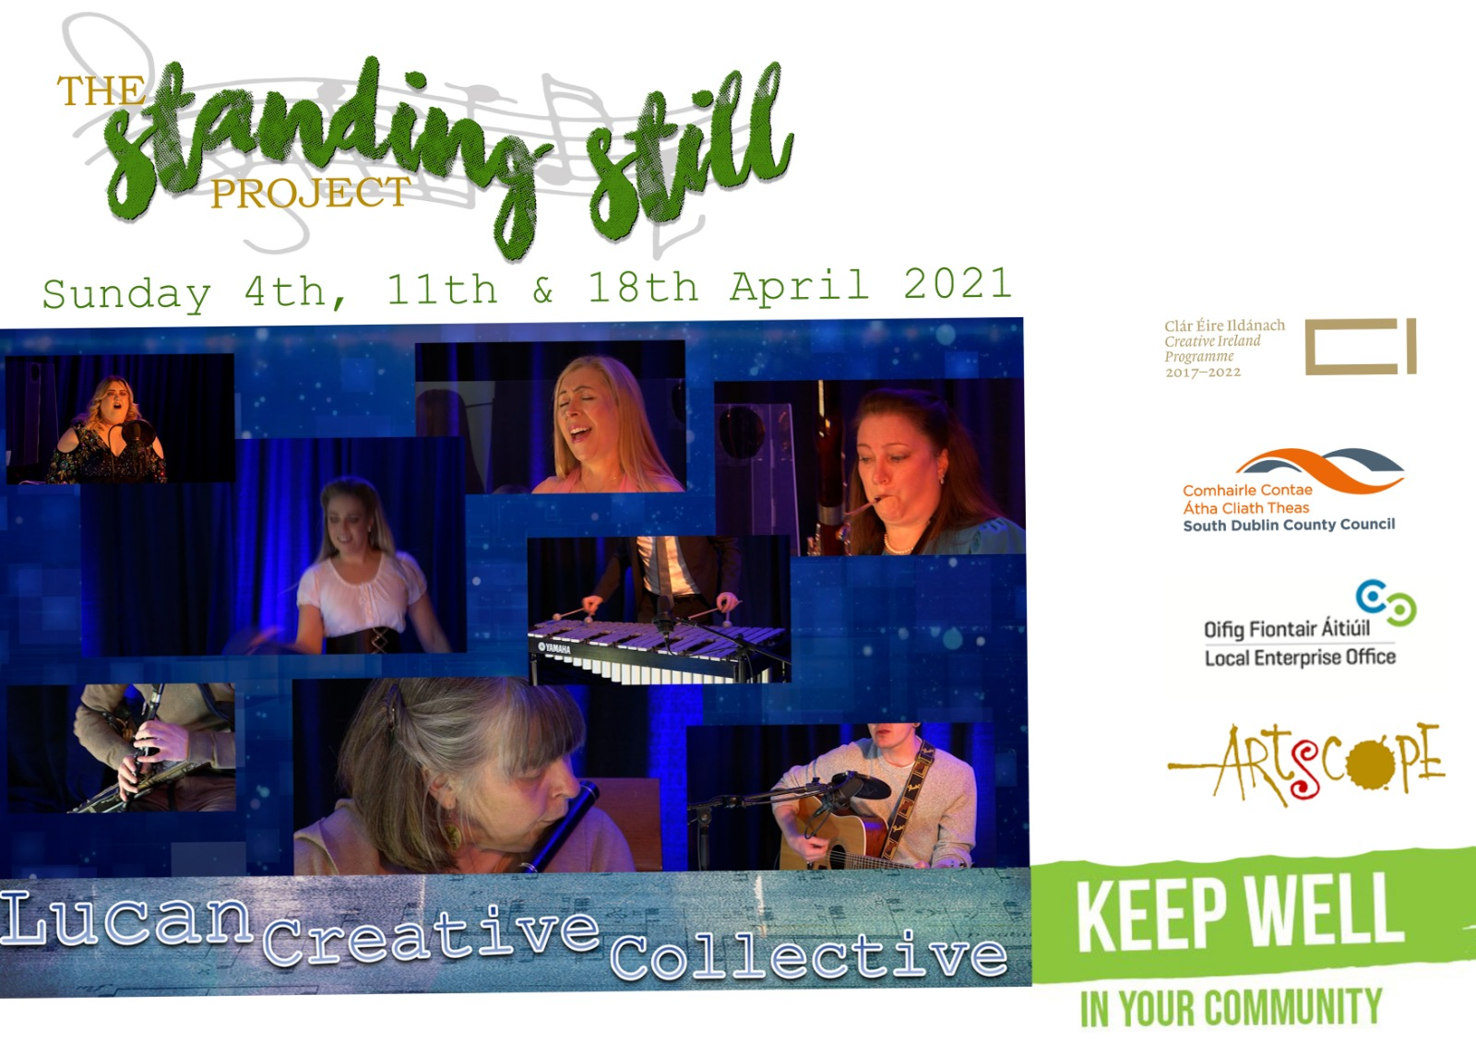
Secured BCV & TOV from LEO
&
Bursaries from Arts Officer to improve / expand Digialisation capability
Launched a Virtual programme of Artists performances Events during COVID called The Standing Still Project
Now calls itself an Arts Enterprise!

