Slide 1
Welcome
River Camac Flood Alleviation Scheme

Slide 2
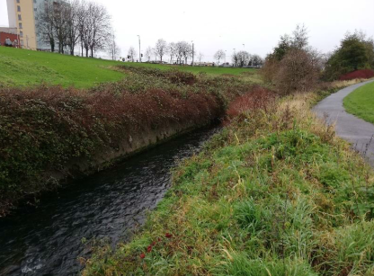
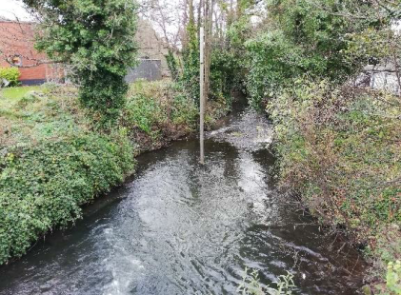
Camac Flood Alleviation Scheme

Slide 3
The Camac Project – What we want to do
Overview
Dublin City Council and South Dublin County Council in partnership with The Office of Public Works (OPW), have commissioned the River Camac Flood Alleviation Scheme to address flooding within the catchment of the Camac River.
Objectives and Project Need
The Overriding Purpose of the project is to enhance the flood defences of the River Camac to the standards of the EU Directive on the Assessment and Management of Flood Risk (Floods Directive 2007/60/EC) transposed into Irish Law as SI 122 of 2010.
The implications of climate change will be considered as part of the proposed flood defences and will take account of Environmental, Social and Health & Safety concerns.

Slide 4
The AECOM Project Team
AECOM – Karol McCusker – Lead Designer & Project Manager
AECOM – Paul Lynas – Ecology & Environment
The Client Project Team
Dublin City Council – Mary-Liz Walshe / Gerry O’Connell
South Dublin County Council – David Grant
Office of Public Works – Funding and Technical Advisors

Slide 5
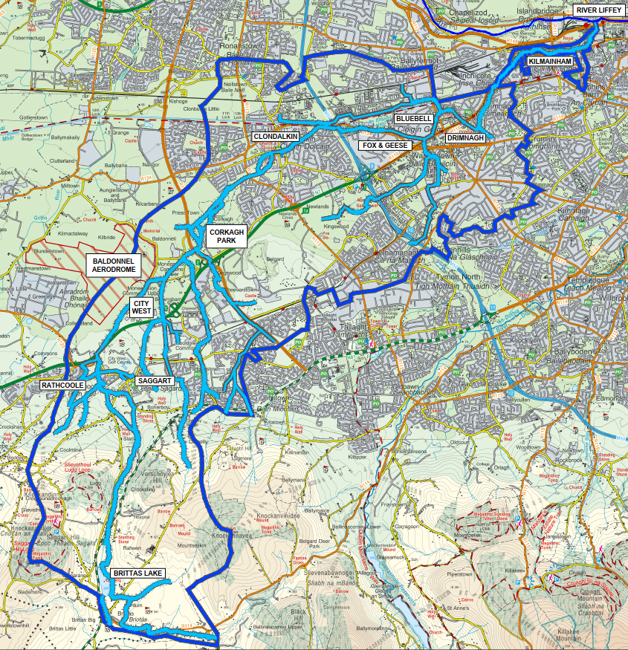
The Camac Project –
The Camac River
Catchment
Two Council Areas
Area = 58.8km²
Transition from Rural to Urban
55km of River (approx.)
28km of culverts (approx.)

Slide 6
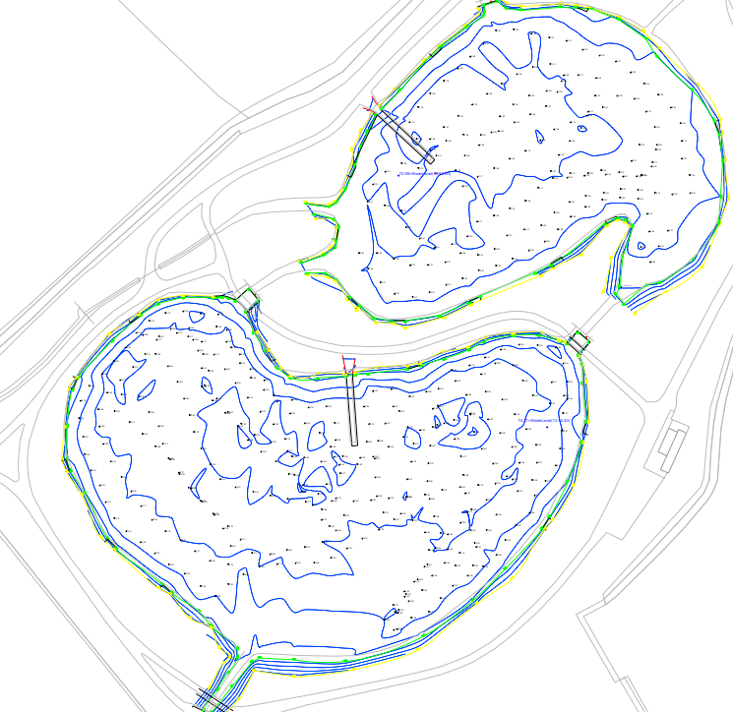
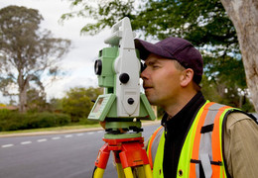
The Camac Project – What have we done
Topographical and Bathymetric Surveys
These surveys included taking measurements and levels of the rivers, lakes, manholes and bridges within the catchment.

Slide 7
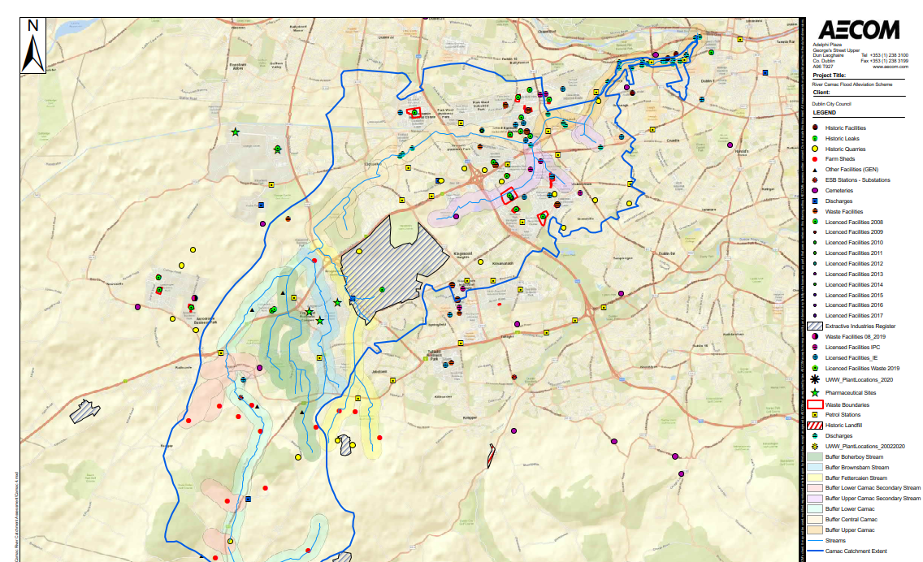
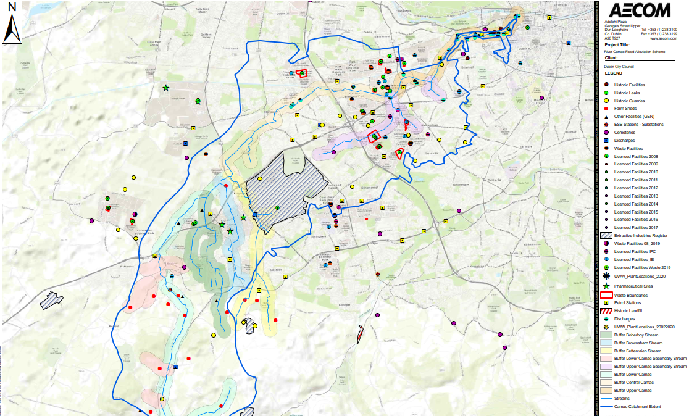
The Camac Project – What have we done
Contaminated Land
A desktop review of publicly available information was conducted to identify potential contaminated sites within the catchment.

Slide 8
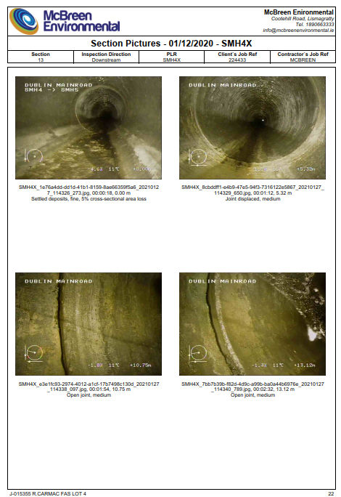
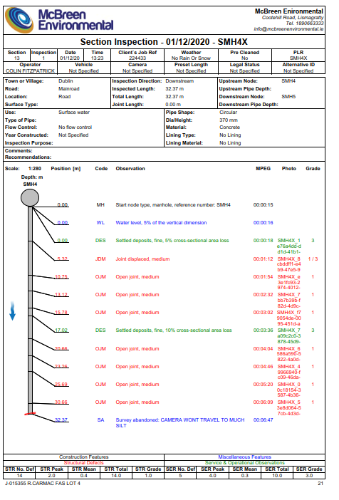
The Camac Project – What have we done
CCTV and Culvert Surveys
CCTV survey of the storm drainage network in a number of locations is continuing. This is currently ongoing throughout the catchment.

Slide 9
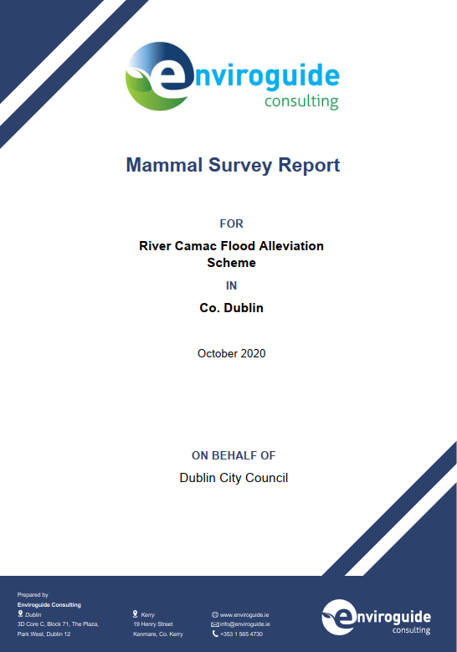
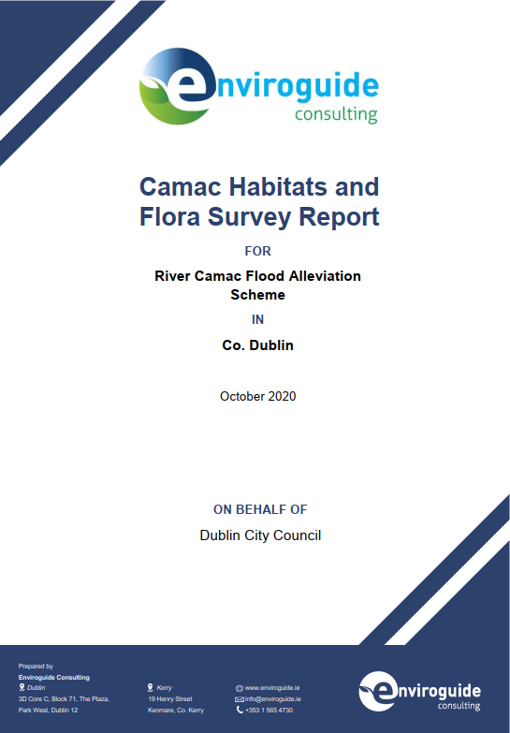
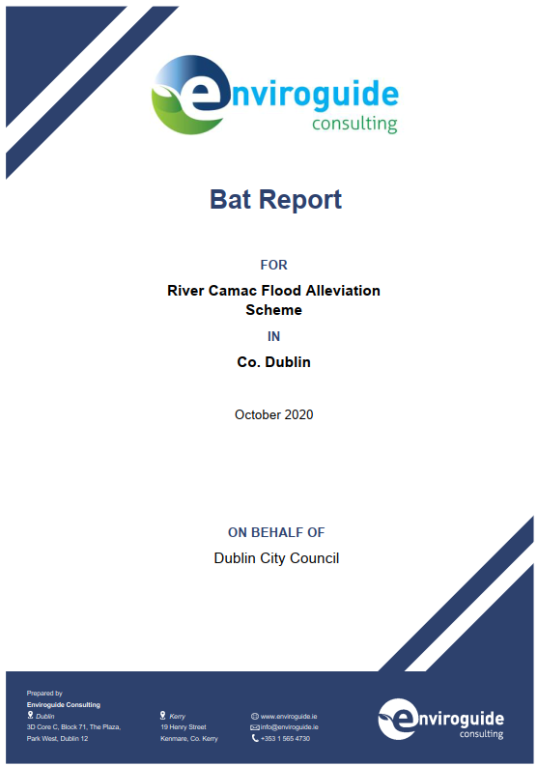
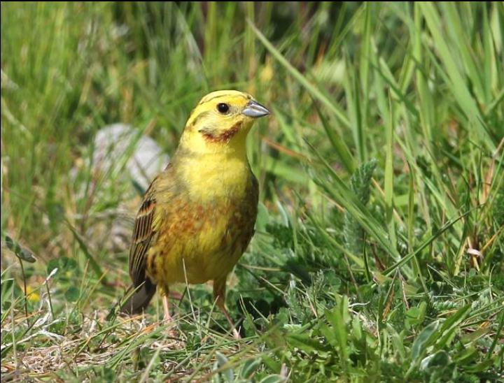
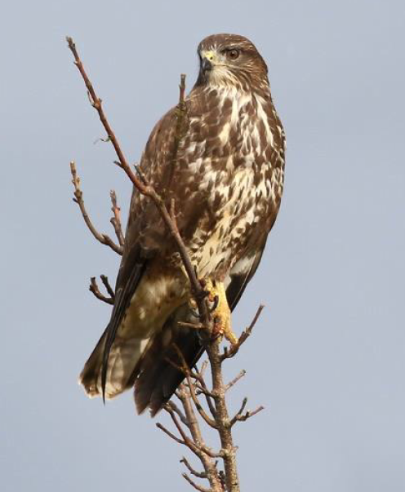
The Camac Project – What have we done
Environmental Surveys
The site surveys for the following have now been completed and reports finalised:
Bats
Birds
Mammals
Habitat and Invasive Species
Wintering Birds

Slide 10
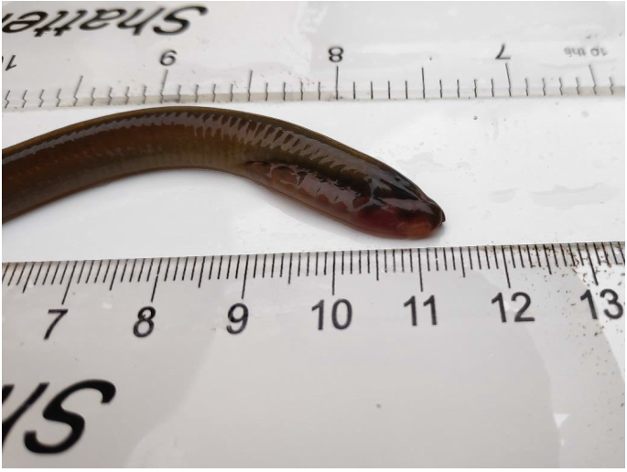
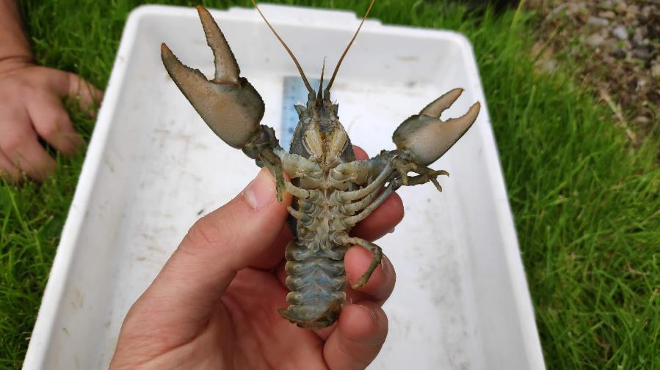
The Camac Project – What have we done
Aquatic Surveys
Aquatic Surveys across the River Camac catchment.
These surveys included;
White-clawed Crayfish
Fisheries Assessment
Macro-Invertebrates

Slide 11
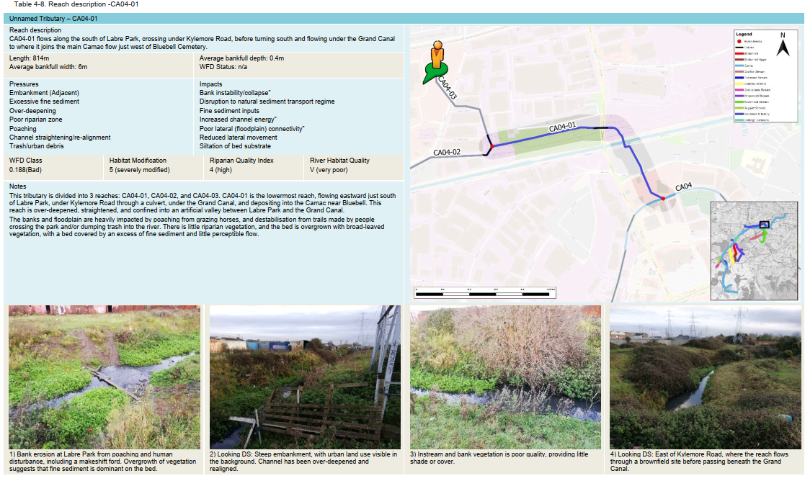
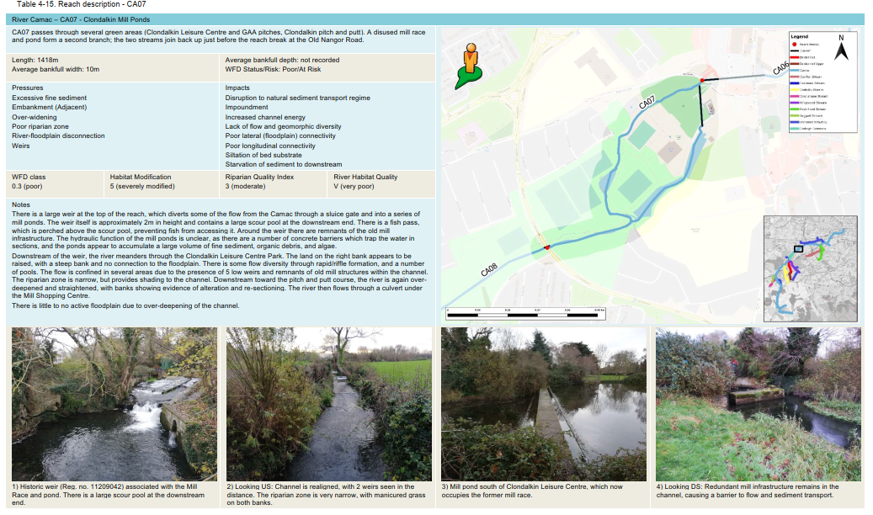
The Camac Project – What have we done
Hydromorphology Assessment
This assessment will aid in determining the baseline physical character and water content of catchment. This assessment will link with the Water Framework Directive and assist in the assessment of the future flood alleviation measures.

Slide 12
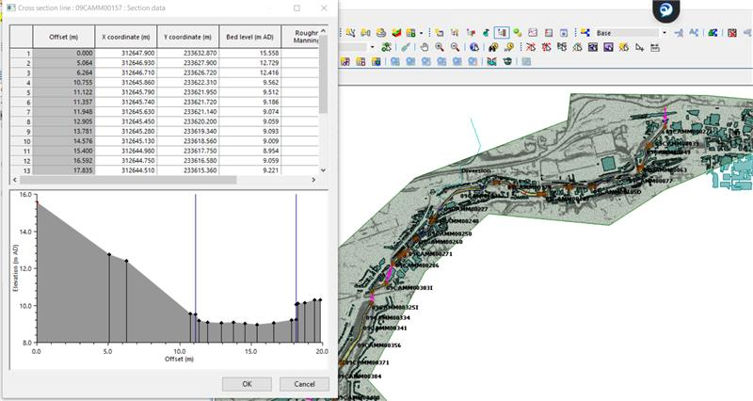
The Camac Project – What Next……
Hydraulic Model
Continuation of CCTV & Culvert Surveys to help confirm and build a hydraulic model of the Catchment.
We use this model to help us predict flooding and understand how areas flood.
This allows up to identify flooded homes & business, but most importantly how we may be able to project them.

Slide 13
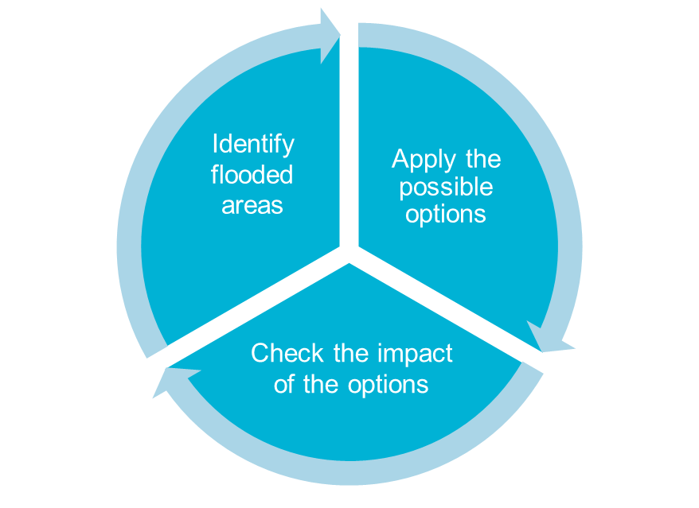
The Camac Project – What Next……
Typical Options to be considered for flood projection
Natural based solutions where possible including:
Reconnect existing flood plains/creation of new floodplain areas
Flood storage/retention
Channel capacity improvement
Where natural based solutions are not viable:
Raising of banks via walls or embankments
Culvert upgrades/improvements
Localised flood defence measures
Environmental enhancement with all of the above options where possible

Slide 14
The Camac Project – What Next……
Scheme Programme & Time Line
Stage 1
Scheme development
Stage 2
Planning Permissions
Stage 3
Detailed Design
Surveys
Preliminary Design
Public Exhibition
Public Procurement
Stage 4
Stage 5
Construction on Site
Handover
Current
2023
2024/2025
Summer 2022
Autumn 2022

Slide 15
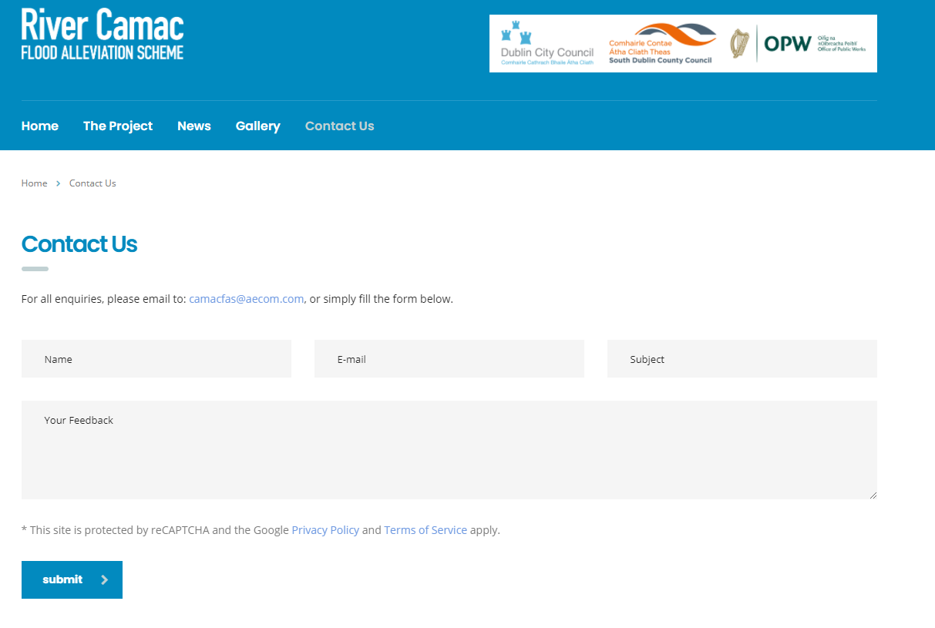
The Camac Project – What Next……
Public Consultations
Continuous news updates on project website www.camacfas.ie
Online Virtual Meeting Updates
2 Formal Consultations
Presenting the updated flood extents and possible suite of options – Seeking feedback on these
Proposed final option
* Delivery method of these is dependent on Covid-19 and will be continually reviewed.

Slide 16
The Camac Project – What do you want to know?
Questions & Answers

