Slide 1


Headed Item 19:
Energy Efficiency
Retro-Fit Programme
Council Meeting
12th April 2021

Slide 2

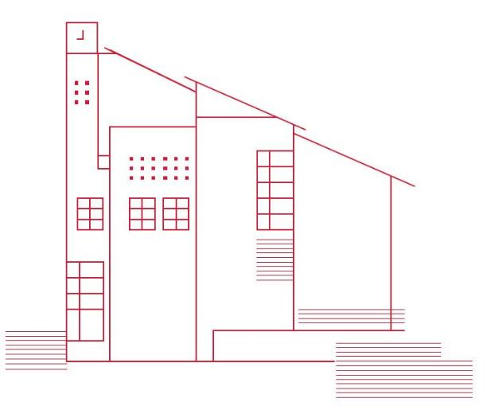
Energy Efficiency/Retrofitting Programme (EERP) 2021
Energy efficiency/retrofit works to achieve B2 BER (or ”cost optimal” equivalent) across 500,000 homes nationally from 2021 to 2030
Includes “deep” retrofit of 36,500 social homes by 2030 (2,400 in 2021)
Minimum of 91 homes in South Dublin in 2021
Initial €35m fund nationally for 2021 (possible further €10m)
Average funding per property €27k
€27k x 91 homes = €2,457,000 allocation for SDCC +project management costs
Max. funding per property:
  €38,900: Mid Terrace and Apartments
  €45,400: End Terrace, Bungalow & Detached/Semi Detached House
Can include homes with previous EERP works (“shallow” retrofit)

Slide 3
SDCC Housing Stock
  91 homes in 2021 national programme = 1% of SDCC stock
  Over 9,700 homes but BER data for <50%
  88%+ properties estimated at “C” or lower / 539 with “B2”+
  Majority of housing stock built pre-1990s
  2,200 homes in EERP Phase 1 Works (45 “B”, 1,382 “C”)
  2,500+ homes at “B2”+ by 2030 under new programme
Year Built | Indicative BER | % Housing Stock
1970's or before | D / E | 18%
1980's | D | 45%
1990's | C | 6%
2000's | C | 24%
2010+ | B | 7%

Slide 4
Planned/Cyclical Maintenance Programmes
Covid restrictions have prevented commencement of initial 200 homes to receive Windows & Doors replacement:
Airlie, Arthur Griffith, Foxdene, Greenfort, Harelawn, Kilcronan, Kilmahuddrick (North of Naas Road); Allenton, Avonbeg, Avonmore, Bawnlea, Bolbrook, Brookview, Castle Park, Cloonmore (South of Naas Road) & selected additional priority cases
Average Cost of €8k per home
Programme will need to be aligned with EERP works
Boiler Replacements (€1.25m annually in maintenance budget)
Need to consider how this will sync with EERP Programme
Safety works, painting programme, kitchen replacements etc.

Slide 5
Typical Costings / Considerations
Cost Estimates to achieve “B2” BER or Cost Optimal standard | End Terrace/ Semi Detached | Mid Terrace | Current “C” Rated Homes
External Insulation | €20k | €12k | n/a
Windows & Doors | €8k | €8k | €8k
Heat Pump | €13.5k | €13.5k | €13.5k
Projected Total Cost per home | €41.5k | €33.5k | €21.5k
Blend of properties required to achieve €27k average spend
Heat pumps – increased maintenance/replacement costs
Impact on tenants – works / change / access
External insulation – not suitable in all areas / less durable
Existing planned maintenance programmes & re-lets

Slide 6
SDCC 2021 EERP Submission
Three weeks to make submission to DHLGH (March deadline)
Mix of typology/age/BER/location requiring varying levels of retrofit (average funding / to inform future programmes)
Overlap & complement Windows & Doors / Relets works
C & D rated properties previously included in Phase 1 EERP
Be ready to utilise additional funding……
Location | 1-Bed | 2-Bed | 3-Bed | 4-Bed | Totals
Kilmahuddrick Cres | 17 | 1 |  |  | 18
Oldcastle Drive |  |  | 7 | 7 | 14
Allenton Drive |  | 9 | 31 | 3 | 43
Sarsfield Close | 16 |  |  |  | 16
Greenfort |  |  | 22 | 4 | 26
Liscarne Dale | 6 | 4 |  |  | 10
Willbrook Park | 4 |  |  |  | 4
Castletymon Court | 7 | 3 | 6 | 1 | 17
Cushlawn Park |  |  | 39 | 1 | 40
Re-lets |  | 2 | 9 | 1 | 12
Totals | 50 | 19 | 114 | 17 | 200

Slide 7
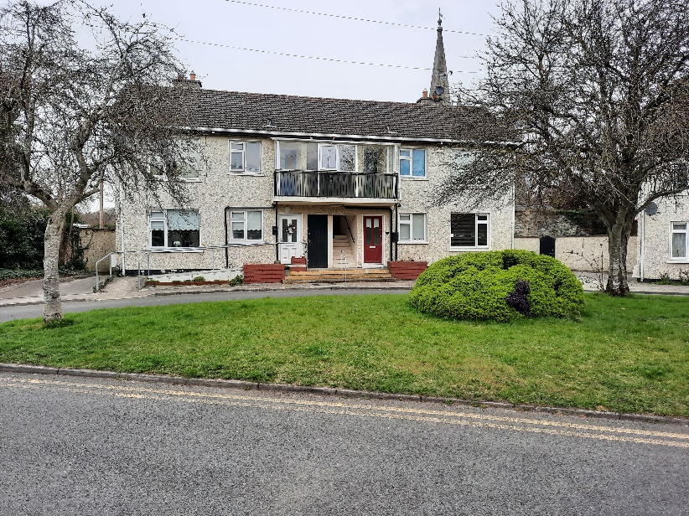
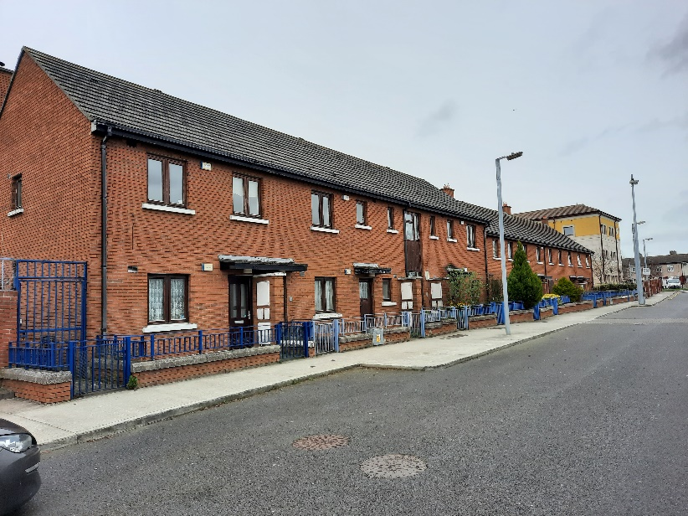
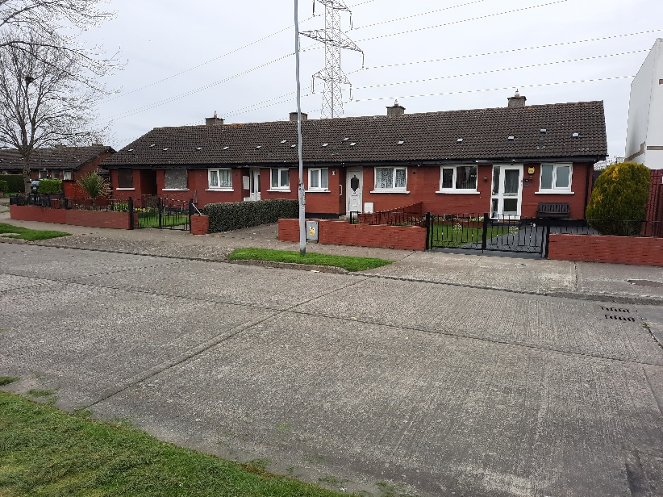
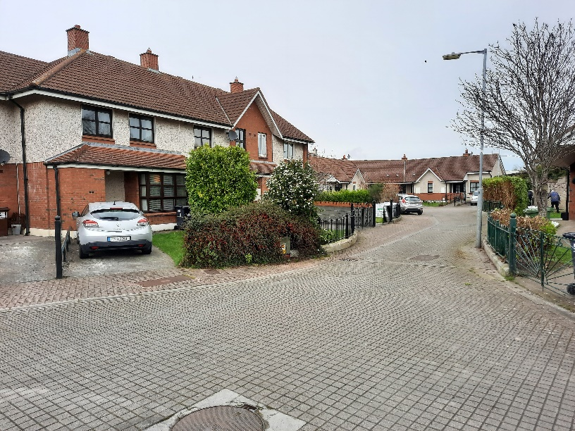
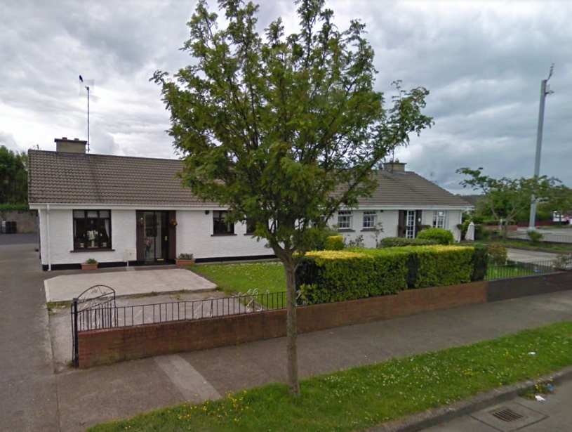
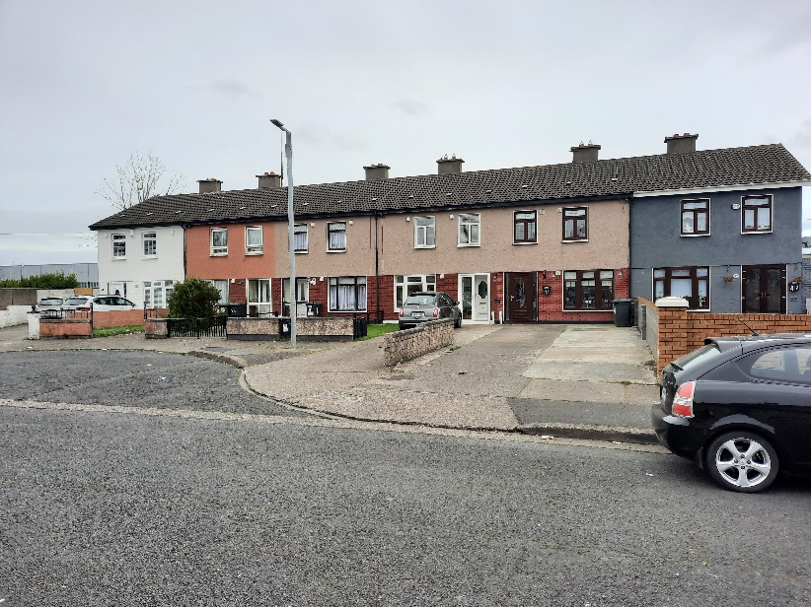
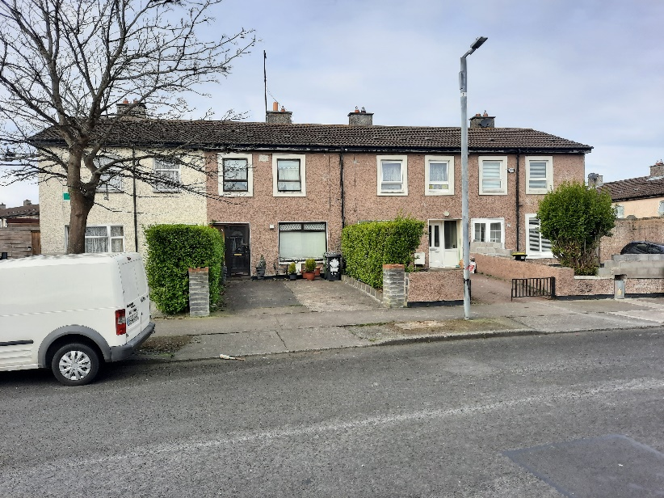
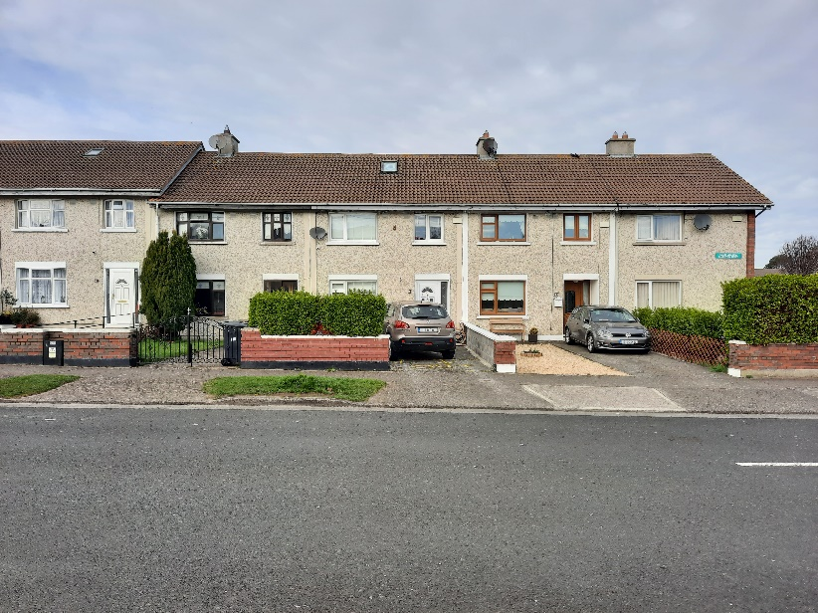
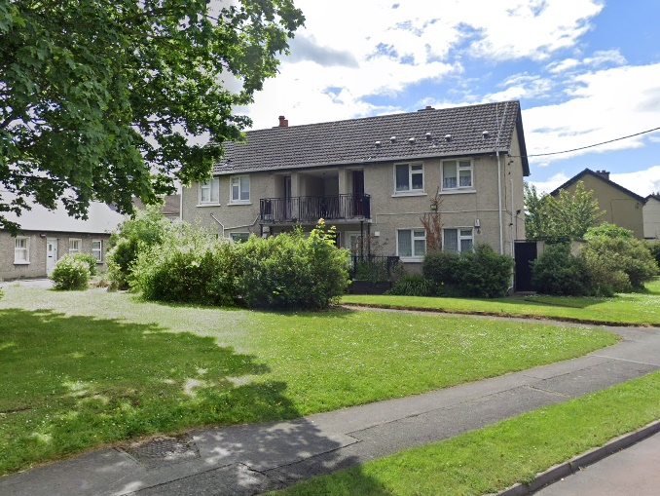

SDCC 2021 EERP Submission
Sarsfield (1970)
16 Older Persons’ Homes
Liscarne (2001)
10 (1&2 Bed) Homes
Kilmahuddrick (1984)
12 (1 & 2 bed) Homes
Castletymon (1995)
17 (1,2,3, 4-Bed) Homes
Oldcastle (1985/1998)
14 (3/4-Bed) Group Homes
Greenfort (1984)
26 (3&4 Bed) Homes
Cushlawn (1980)
40 (3 Bed) Homes
Allenton (1985)
43 (3 Bed) Units

Slide 8
Programme Delivery
Pre-works BER certs & pre-works surveys on all homes to ensure works will achieve minimum “B2”/Cost Optimal BER
Post-works BER certs and energy savings/carbon reductions reporting
LGOPC-led national procurement under a Dynamic Purchasing System
Works in batches of 20-40 homes on phased basis from June to Oct ‘21
Survey 500+ homes in 2021 for 2022 programme
Target to double for to 182 properties in 2022 with works to be scheduled from April to September
Communications with tenants / local Councillors & social media / updates capturing Pre-Works, Progress & Post-Works
Measures & reporting to Council / SPC
  Expenditure per property
  Number of homes reaching “B2”/Cost Optimal Equivalent
  Number of homes with Windows & Doors / Heat Pumps / Insulation

Slide 9
Update 12th April 2021
Based on our initial submission, DHLGH issued a revised allocation to SDCC on 9th April as follows:
Allocation | Homes to be Retrofitted | Total Allocation
Initial Allocation (Feb 2021) | 91 | €2,457,975
Additional Approval | 26 | €709,079
Revised Allocation (April 2021) | 117 | €3,167,054
No change to average unit allocation of approx. €27k
Final list of homes to be confirmed with DHLGH (may be constrained by ability to get pre-works BERs)
Project management costs still tbc

