Slide 1
SHD Application SHDABP-309658-21 Presentation to Rathfarnham acm 13th April 2021
Applicant greg mcginn, aai walkinstown ltd
Location chm premises, ballymount road lower

Slide 2
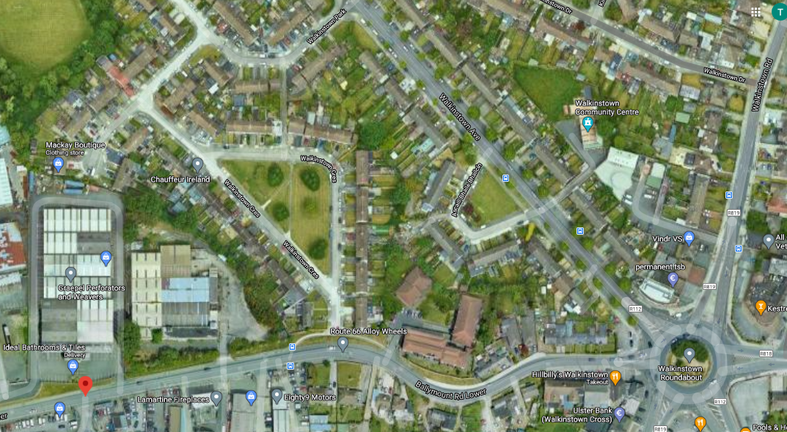

Slide 3
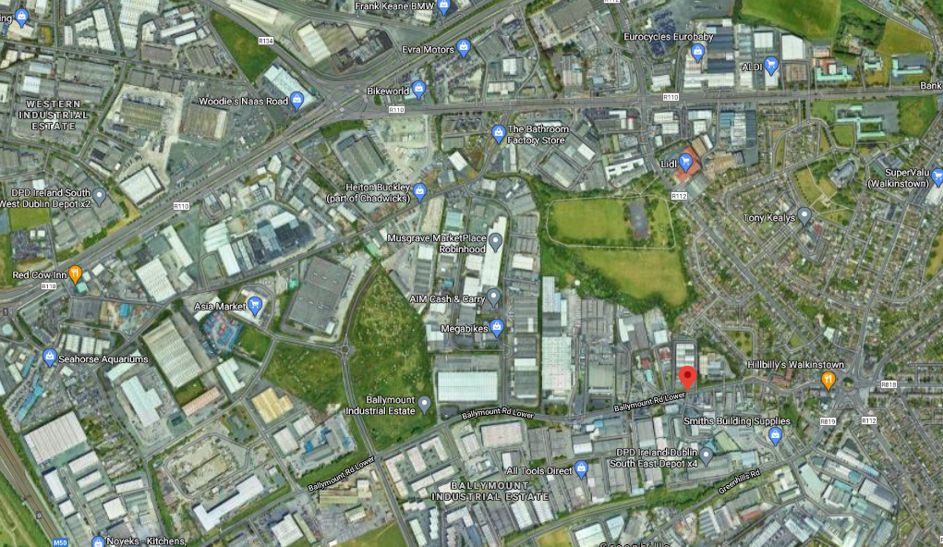

Slide 4
Timelines
SHD Lodged with ABP: 10th March 2021
5 Week Submissions/Observations 13th April 2021 (by 5.30pm)
8 Week SDCC report due to ABP 4th May 2021
16 Week Decision due from ABP 29th June 2021

Slide 5
Consultations
SHD1SPP007/19 S247 1st Pre-Planning Meeting held with SDCC on 2nd April 2019
SHD1SPP018/19: S247 2nd Pre-Planning Meeting held with SDCC on 2nd July 2020
SHD2ABP-307788-20 Pre-Planning Meeting held with An Bord Pleanála, SDCC and the applicant on 2nd December 2020

Slide 6
Overview of the proposed development - 1
Demolition of an existing warehouse/factory building and ancillary outbuildings/structures
Construction of a residential development of 171 apartments (contained in 2 blocks), comprising:
59 x 1-bedroom apartments (1 bed x 2 person) 35%
103 x 2-bedroom apartments, 60%
2 bed x 3 person (14 units) 8%
2 bed x 4 person (89 units) 52%.
7 x 3-bedroom apartments (3 bed x 5 person) 4%
2 x studio apartments 1%
Dual Aspect 36.8% (63 units), North Single 12.9% (22 units), South Single 23.4% (40 units), East/West Single 26.9% (46 units)
Supporting tenant amenity facilities (gym, lounges and meeting room), café, creche,
Landscaping, public realm improvements, outdoor amenity areas,
Under-podium car parking, bicycle racks, bin stores, ancillary plant, and roof mounted solar panels.
Vehicular access to the proposed development will be provided via a relocated entrance from Ballymount Road Lower.
EIAR Screening Report carried out by HW Planning

Slide 7
Overview of the proposed development - 2
Site Area 9,308
Height Range 2-8 Storeys
Density 183 Dwellings per hectare
Total sqm of development 21,612.7m2
Creche 259.8m2 (Creche Playground 228m2), Child Capacity 25 children
Café 106.8sqm
Communal Area Gym(182.5m2), Lounges 1&2(130.4sqm & 54.9m2), Meeting Room(106.5m2)
Amenity Area 1,476m2 (Podium) 1,073m2 (Linear Park East)
Car parking spaces 69
Bicycle parking / Motorbike stands 384 / 10

Slide 8
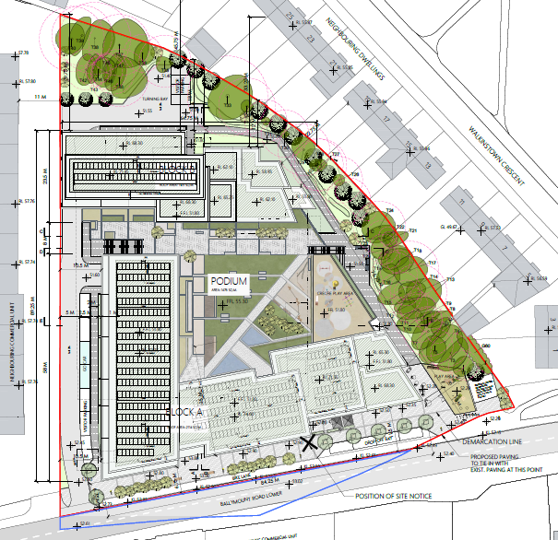
Site Layout

Slide 9
Boundary distances

Slide 10
Building distances

Slide 11
Ground floor plan

Slide 12
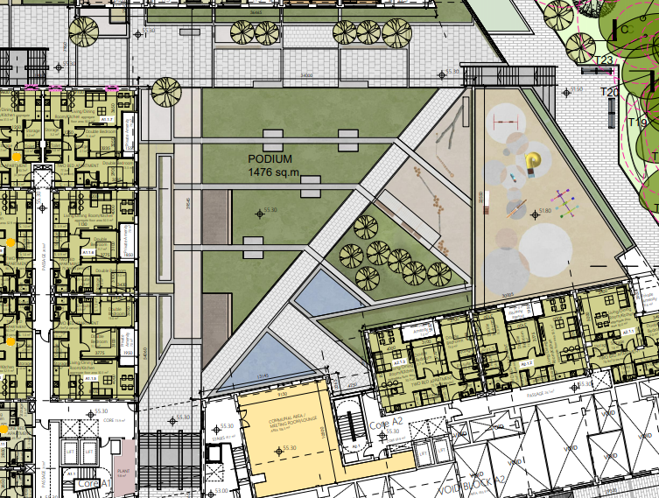
Podium
Including landscaping and children’s play area

Slide 13
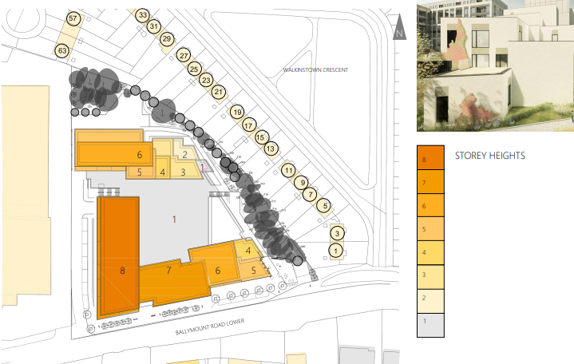
Height Overview
Rising from 2 storeys at the eastern side of the site to 6 storeys to the north and 7-8 storeys to the south and west.

Slide 14
Northern Elevation

Slide 15
Southern elevation – Ballymount Road Lower

Slide 16
Eastern Elevation

Slide 18
Part 1. Notice issued by the board under section 6(7) summary of tri-partite meeting 2nd December 2020
Regard to SLO 1 of the South Dublin County Development Plan.
The density of 200 units per hectare may be considered high. Justification required at application stage.
The subject site is not identified for tall buildings exceeding five storeys in an approved plan. A rationale for the height should be provided at application stage.
Potential of overbearance, overshadowing and overlooking will need to be fully assessed and further details provided at application stage. Caution should be used against reliance on tree planting as a form of mitigation.
Consideration how the development addresses Ballymount Road Lower, including landscaping. Requirement of a more active frontage to Ballymount Road Lower – direct access to non residential uses – active streetscape.
Notes:
Density: It may represent a substantial increase relative to the existing residential development in the vicinity.

Slide 19
Part 2. Notice issued by the board under section 6(7) summary of tri-partite meeting 2/12/20
Open space, quantum, (open space v private space) functionality and layout should be further detailed in documentation provided with the application.
Clarification required regarding proposals of dual and single aspect within the development.
Further daylight/ shadow analysis is required to demonstrate that all the open spaces will have sufficient daylight to provide usable spaces with high amenity value.
Issue of nuisance, noise impact and air quality needs to be considered (impact on proposed residents from adjacent industrial/commercial uses)
Proximity of site to SEVESO sites needs to be addressed.
Irish Water (IW) submission notes upgrades to the wastewater system are required
Materials and microclimate report to be supplied

Slide 20
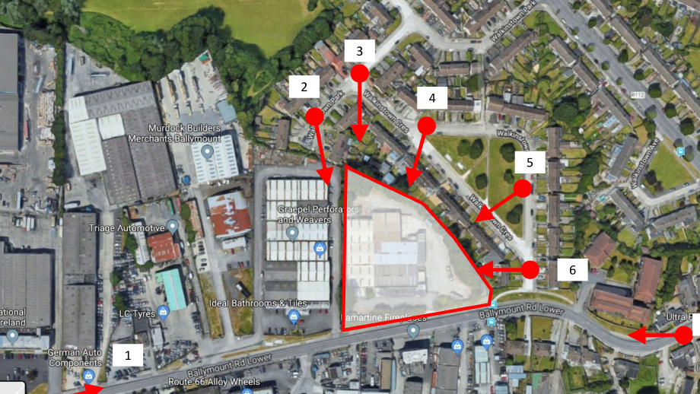
Photomontages
1. East
2. South from Walkinstown Pk
3. South from corner
4. S-West from Walkinstown Cr
5. West from Walkinstown Cr
6. West from entrance
7. West from along Ballymount Rd Lower

Slide 21
View 1 Eastwards

Slide 22
View 1 Eastwards

Slide 23
View 2 Looking southwards from Walkinstown Park

Slide 24
View 2 Looking southwards from Walkinstown Park

Slide 25
View 3 Looking south from the corner of Walkinstown Park and Crescent

Slide 26
View 3 Looking south from the corner of Walkinstown Park and Crescent

Slide 27
View 4 Looking south-west wards from Walkinstown Crescent

Slide 28
View 4 Looking south-west wards from Walkinstown Crescent – Year 0

Slide 29
View 5 – looking west from walkinstown Crescent

Slide 30
View 5 – looking west from walkinstown Crescent – Year 0

Slide 31
View 6 Looking west from walkinstown crescent

Slide 32
View 6 Looking west from walkinstown crescent – Year 0

Slide 33
View 7 – Looking north-westward from Ballymount Road Lower

Slide 34
View 7 – Looking north-westward from Ballymount Road Lower

Slide 35
Summary:
Proposal: 171 apartments, Creche, café, Communal area (gym, lounges, meeting room)
Site Area: 9,308m2
Density 183 dwellings per hectare
Height Range 2-8 Storeys
Total sqm of development 21,612.7sqm
Amenity Area 1,476sqm (Podium) 1,073sqm (Linear Park East)
Car parking 69
Bicycle parking / motorbike stands 384 / 10

Slide 36
Legislation
This presentation is in accordance with Section 8 of the Planning and Development (Housing) and Residential Tenancies Act 2016
A summary of the views of the elected members on that proposed development will be included in the Chief Executive’s Report in accordance with Section 8.
The members are invited to make their views.

