Slide 1
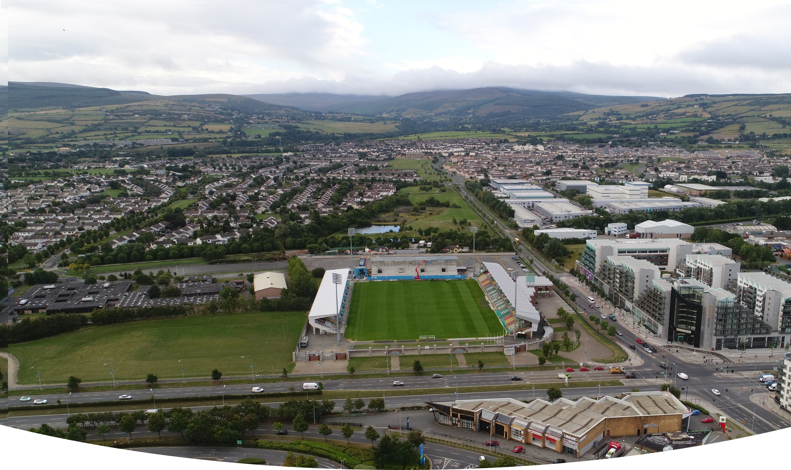
COUNCIL MEETING April 2021
Proposed Part 8 Sean Walsh Park Astro Pitch
Context for the Project
National plans, including National Development Plan, Project 2040 Building Irelands Future, National Planning Framework, SDCC Development Plan, Tallaght Local Area Plan.
November 2018, Government launched Urban Regeneration and Development Fund a flagship element of Project 2040
SDCC’s application successful in receiving funding for projects in Tallaght’s Core Urban Centre
Delivery of these projects will raise the profile of Tallaght and create a sense of pride and place for Tallaght and enhance the liveability and revitalisation of the town centre.
URDF Funded Projects:
New Innovation Square,
Innovation Centre,
Upgrade and regeneration of Chamber Square and associated pedestrian link
Tallaght Stadium 4th Stand,
Tallaght Mobility Hub,
Belgard Link Roads
Astro Pitch for Sean Walsh Park.
Prepared on behalf of South Dublin County Council

Slide 2
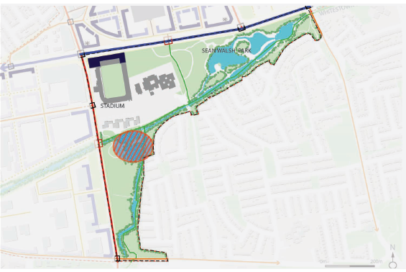
Sean Walsh Park Astro Pitch LAP context
Policy for Recreational Facilites in Tallaght LAP 2020
It is policy of the Council to support and facilitate the expansion of Tallaght Stadium and encourage a wide range of uses and events including the development of all-weather playing facilities and expansion of recreational facilities in Tallaght Town Centre (Objective CF 7).
Playing pitches constitute a major proportion of the facilities available. However, increased levels of rainfall and future predicted rainfall means that grass based pitches are unusable for an increasing amount of time each year. This situation has affected Tallaght, where many pitches have been unplayable for almost 6 months at a time. The development of all-weather facilities with floodlighting for year round and night time use would be a valuable addition to the amenities available in the area. The location of such facilities should take into account the impact of floodlighting on wildlife and residential amenities.
Objectives of Tallaght Local Area Plan 2020
Town Park:
Enhanced, multi-purpose high quality urban park with high levels of accessibility to surrounding areas and strong connections with the larger green infrastructure of the Plan area.
TP1: Consolidate and enhance amenity function of Sean Walsh Park.
TP2: Balanced provision of active and passive recreation.
TP6: Provision of all-weather playing pitches.
TP10: That any consideration of the siting of astro-pitches in Seán Walsh Park shall be subject to an Ecological Impact Assessment having regard, in particular, to the wetland area in the west of the park.
Map of Town park taken from Tallaght LAP 2020.

Slide 3
Sean Walsh Park Astro Pitch sports pitch strategy context
Recommendations from Sports Pitch Strategy for Tallaght LAP
Provide an Artificial Grass Pitch (AGPs) to increase provision, usage and provide for training need
AGP’s provide increased pitch capacity to meet increased population growth in higher density/ urban locations
Position at Strategic locations, particularly at new planned development and high population areas; to facilitate high use, late evening use and flood lighting.
provide all weather, year-round facilites.
meet demand for increased match play
meet demand for training provision which is not currently being met.
remove training pressure from grass pitches with resultant higher standard of grass pitches.
The multi-use nature of AGP pitches should lead to efficiencies in use; GAA, Soccer and Rugby High capital outlay required; need to ensure value for money
Provision to be made for replacement / repair over lifetime of the facility
.

Slide 4
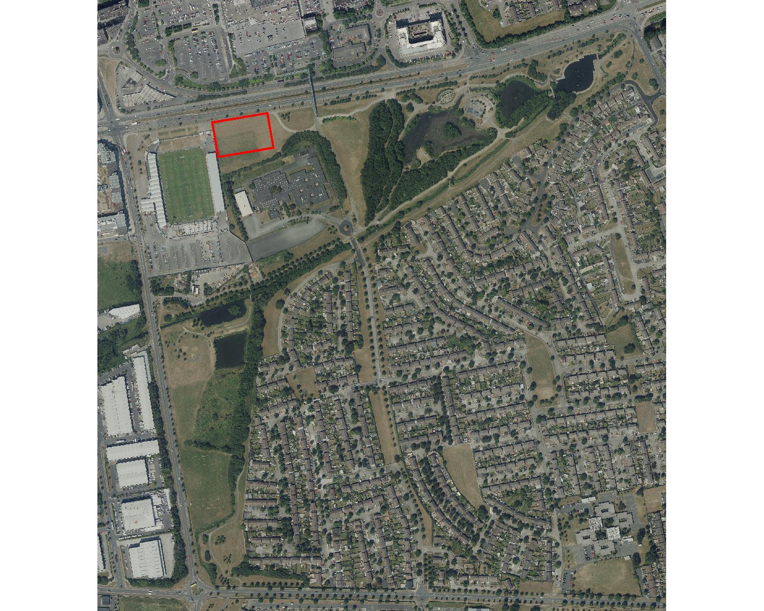
Sean Walsh Park Astro Pitch location plan
Proposed Location:
Located in one of SDCC’s larger neighbourhood parks
Close to Tallaght town centre and its facilities (shops, restaurants, adjacent parking, public transport routes and stops, walking and cycling routes.)
Adjacent to high capacity access roads.
Adjacent to areas already subject to high levels of artificial lighting (Tallaght Stadium, N81)
Adjacent to areas already subject to elevated noise levels (N81, Tallaght Stadium)
Adjacent to Tallaght Stadium ‘Sports Hub’ location
Central location; high profile and easy access, adjacent to school.
Over 30 clubs using council facilites within 5km of the proposed location.
Passive surveillance ensured at this location.
Other options considered Southwards into Sean Walsh Park:
Increased ecological concerns.
Further from supporting facilites
Increased likelihood of adverse impact on adjacent residential estates. (Lighting, Noise)

Slide 5
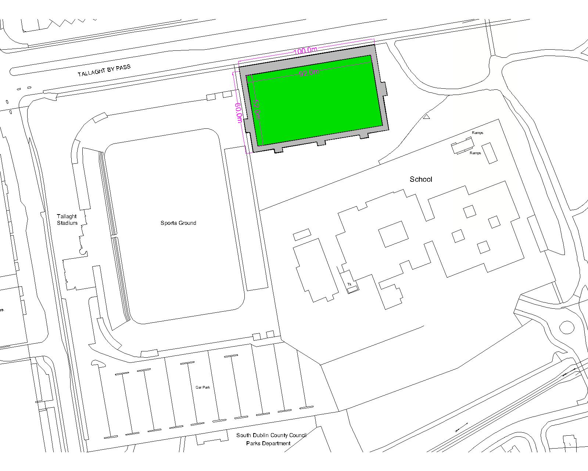
Sean Walsh Park Astro Pitch proposal
Proposed Design
Size: Artificial Grass Pitch facilitating a full sized soccer pitch.
3G Astro pitch surface to enable year round use.
Multi Sport: Surface designed to facilitate GAA and rugby training as well as Soccer
Flexibility: Markings will allow for full sized 11 aside soccer and smaller sized soccer games (7 or 9 a side) as well as markings to support training for GAA and rugby teams
Proposal allows for a spectator area but layout of park with adjacent bank provides a ready made ‘amphitheatre effect’ for the pitch facilitating spectators / club members and enlivening this section of Sean Walsh Park.
Proposed LED Flood lighting to extend hours of use

Slide 6
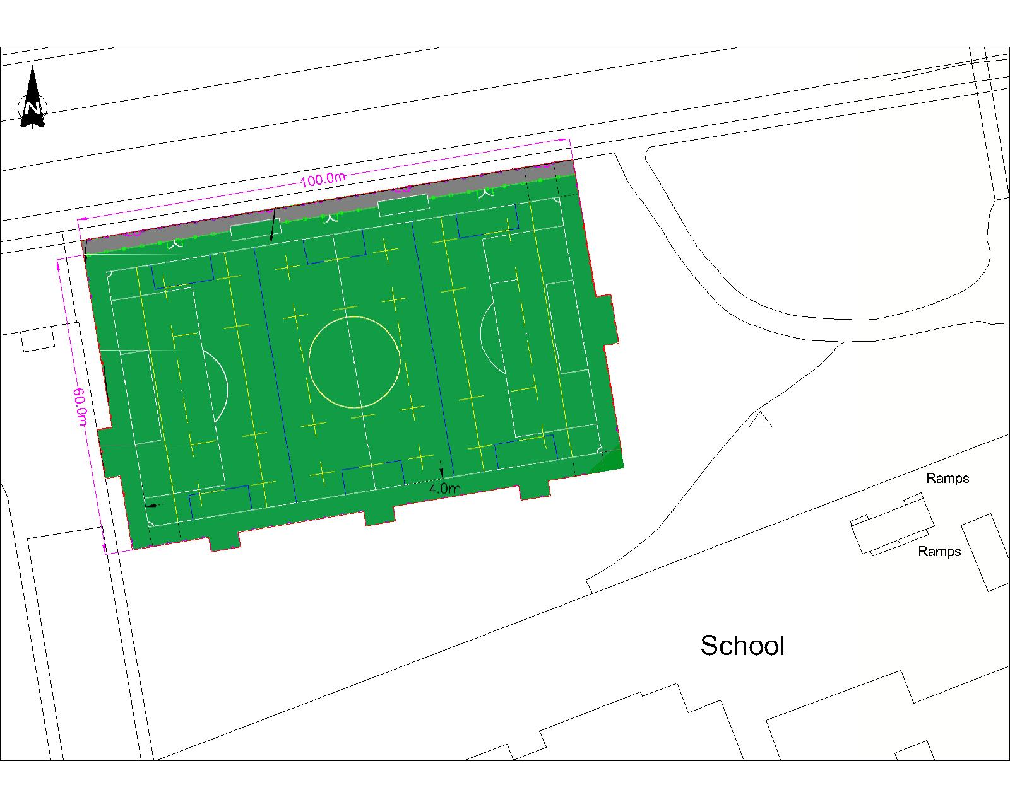
Sean Walsh Park Astro Pitch proposal
Preliminary Design
Topographical and other site investigations completed
Preliminary Design drawings being finalised for Part 8.
Ecological Screening and Ecological impact Assessment Reports being finalised for Part 8

Slide 7
Sean Walsh Park Astro Pitch proposed part 8
Summary:
Funded by URDF
Supported by Tallaght LAP and Sports Pitch Strategy
Preliminary design and environmental reporting being finalised.
Next Steps:
Part 8 to be put on public display

