Slide 1
Headed item report to the meeting of the Tallaght Area Committee on 22 March ‘21. Assessment of issues at Whitestown Stream through Jobstown.

Slide 2
Background and purpose of report
Background
The issues of illegal dumping and burning of waste, the illegal operation of scramblers and the driving of stolen cars in the green spaces adjacent to the Whitestown Stream in Jobstown have been raised many times over the years by local elected members.
The matter was placed on the agenda of both the January and February ‘21 meetings of the Tallaght area committee, the members of the committee requested that the matter be dealt with by way of a headed item report at the March meeting and that it would remain on the agenda of the area committee meetings as a headed item until such time as a set of measures to resolve these problems are agreed and implemented.
This report is intended as an initial report to establish the issues which are in need of attention. Further reports will be presented to the area committee as necessary to set out measures proposed and to update the members on progress.
There is currently no provision either in the revenue or capital budgets for a programme of works to address these issues. It is intended that this process will lead to agreement on a set of measures which can be costed and considered through the budgetary process later in the year.

Slide 3
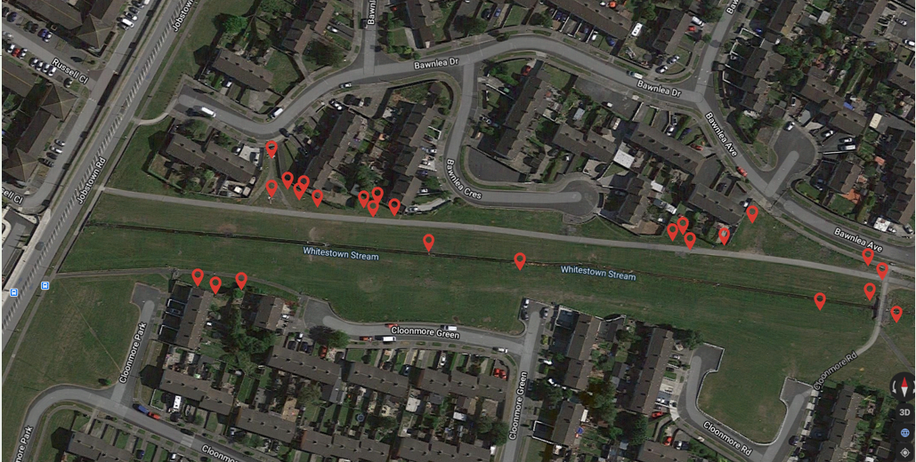
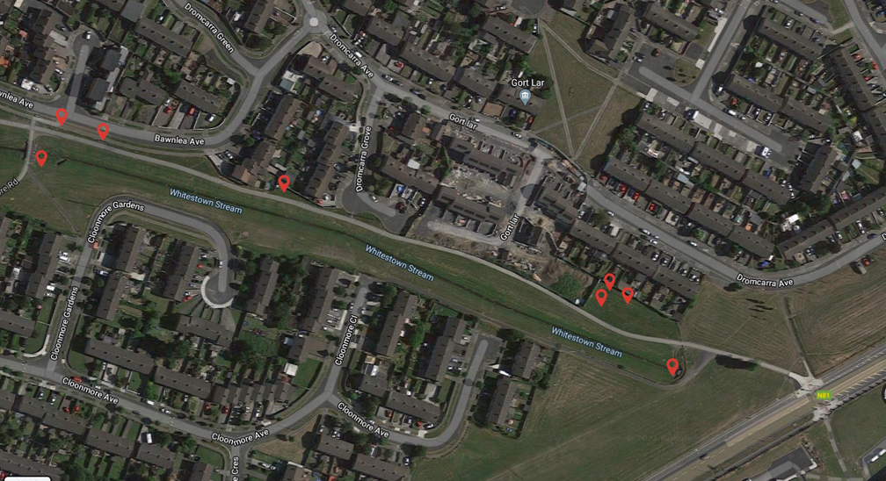
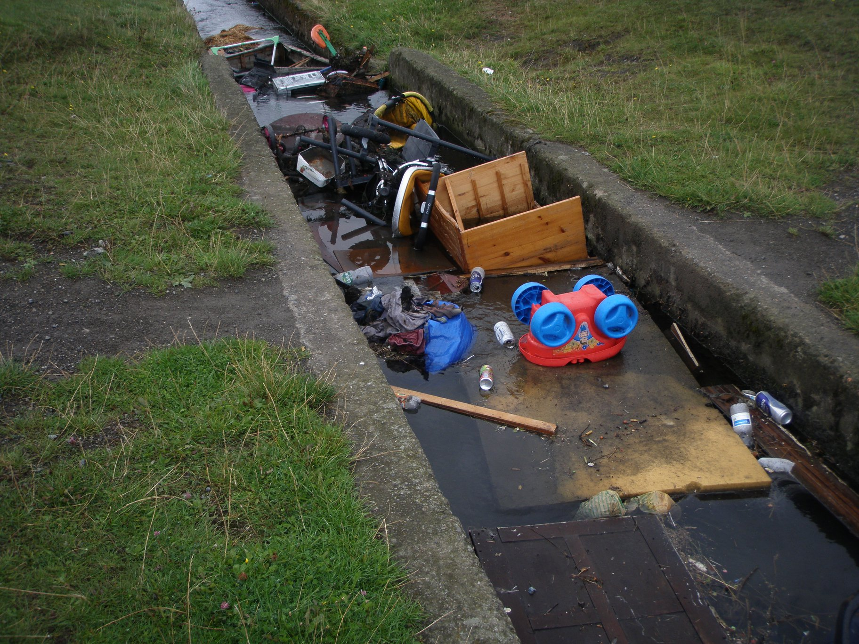
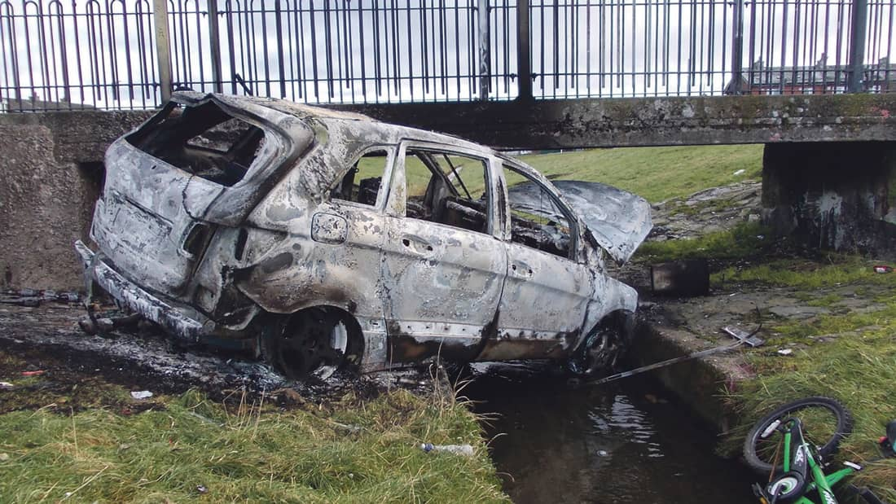
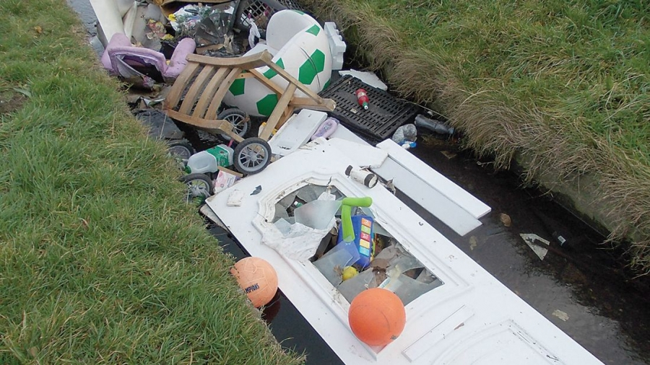
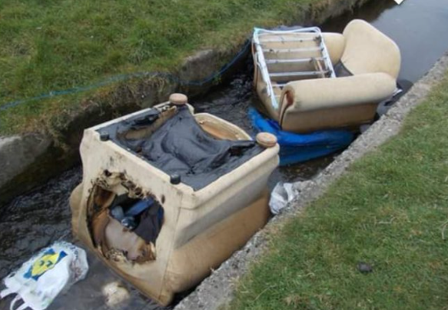
Dumping & Burning Locations
L1
L2
L4
L3
Photos from SDCC Archives

Slide 4
Illegal dumping and burning of waste
Repeated inspections of the area were carried out between February and March ‘21. Information gathered during those visits identified the 4 locations marked L1 to L4 and described below as the primary locations for illegal dumping and burning of waste. Dumping is also taking place directly into the stream with items including stolen vehicles being burned there also.
L1 is the pedestrian access route from Bawnlea Drive to Whitestown Stream.
L2 is a ‘hidden corner’ adjacent to Bawnlea Drive and Bawnlea Crescent.
L3 is the area adjacent to Cloonmore Park and Cloonmore Green.
L4 is the area leading from Bawnlea Avenue, across the stream and on to Cloonmore Road.
It is proposed to consider if any of these locations or routes can be closed off in some manner, to prevent illegal dumping and burning of waste from continuing there.

Slide 5
Clean up activity
SDCC Drainage Section report that they carry out weekly clean ups of the area, removing all types of dumped items from the stream itself.
The Public Realm Section also carry out weekly clean ups of the green spaces.
In excess of 100 SDCC clean ups take place each year with an estimated 60 to 80 tonnes of waste removed.
A local voluntary environmental group carry out additional regular clean ups, also removing waste items from the stream.
SDCC litter wardens respond to a large volume of litter and dumping complaints relating to the area, including reports of burnt out cars disposed off in the stream which have the potential to cause pollution of the watercourse and ultimately the lakes in Sean Walsh Park and the Dodder River downstream.

Slide 6
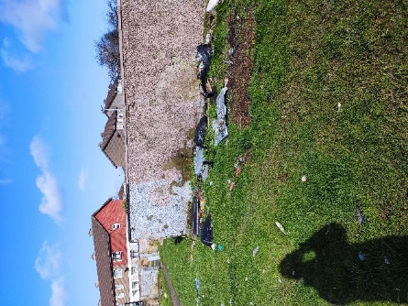
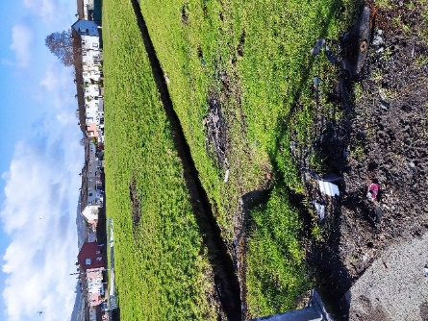
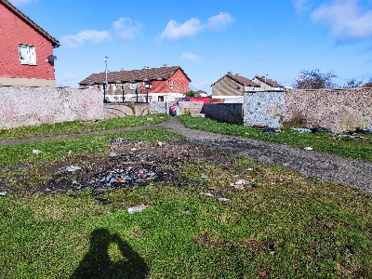
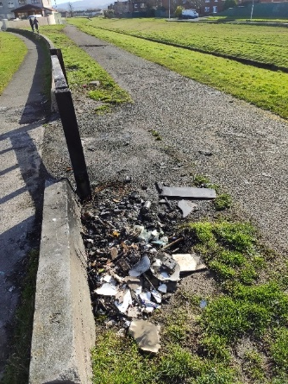
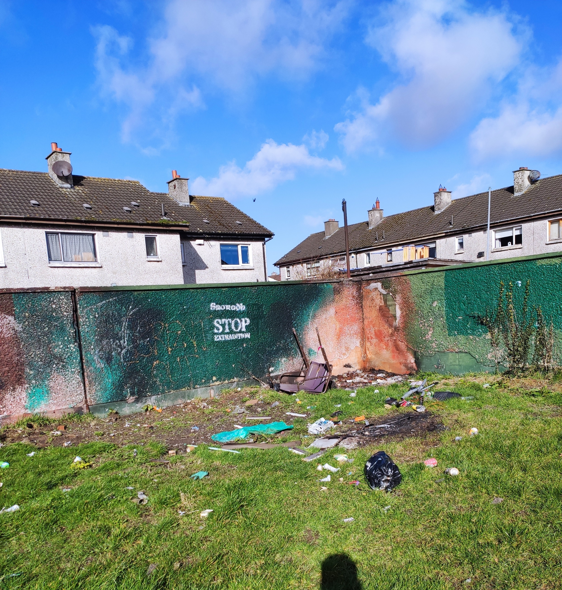
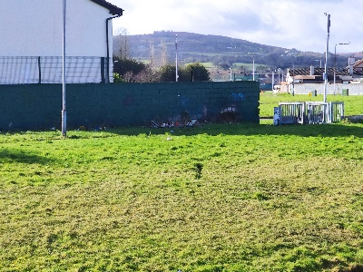
Illegal dumping and burning of waste
L4
L1
L1
L3
L4
L2

Slide 7
Summary of locations and lengths of low boundary wall that can be easily crossed.
Bawnlea Dr to Jobstown Rd to Cloonmore Pk 150m
Bawnlea Crescent 63m
Bawnlea Avenue 160m
Dromcarra Grove 160m
Cloonmore Green 128m
Cloonmore Road 120m
Cloonmore Gardens 100m
Cloonmore Close 15m
Cloonmore Avenue 15m
Cloonmore Avenue to Dromcarra Avenue 100m Total 1.01 km

Slide 8
Other boundary and access issues
Domestic property boundaries which are adjoining the low stub wall around the Whitestown Stream green space will require examination and a solution.
Pedestrian entrances from within housing areas leading down to the Whitestown Stream green space will also require examination and a solution (for example at Bawnlea Drive).
A new decorative stone wall was built at the infill housing in Dromcarra, however adjacent to this are timber bollards which readily allow access for scramblers.
There is a total of 20 access points to the area for pedestrians, all of which have the potential to allow access for scramblers. These will all require closer examination and a method of treatment identified.
There are a number of heavy duty swing barriers which allow access for grass cutting equipment to the green area. These may also allow scramblers to gain access by going under them, and this issue will need to be examined.

Slide 9
Further issues
Graffiti and illegal burning of waste have defaced boundary walls of domestic properties in some locations.
The pedestrian bridge linking Bawnlea Avenue and Cloonmore Road is in poor condition from an aesthetic point of view.
The Public Lighting Section have been asked to examine the public lighting system which is in place and to advise if improvements are necessary.
There is a footpath running the entire length of the green space on the Bawnlea/Dromcarra side. This is not the case on the Cloonmore side, the footpath runs only as far as Cloonmore Close at one end and Cloonmore Green at the other.
The footpath surface on the Bawnlea/Dromcarra side is in poor condition due to repeated burning of waste and burning of stolen cars, an overlay of substantial sections of path is required.
Extensive areas of green space have been badly damaged by the repeated burning of waste in the same locations.

Slide 10
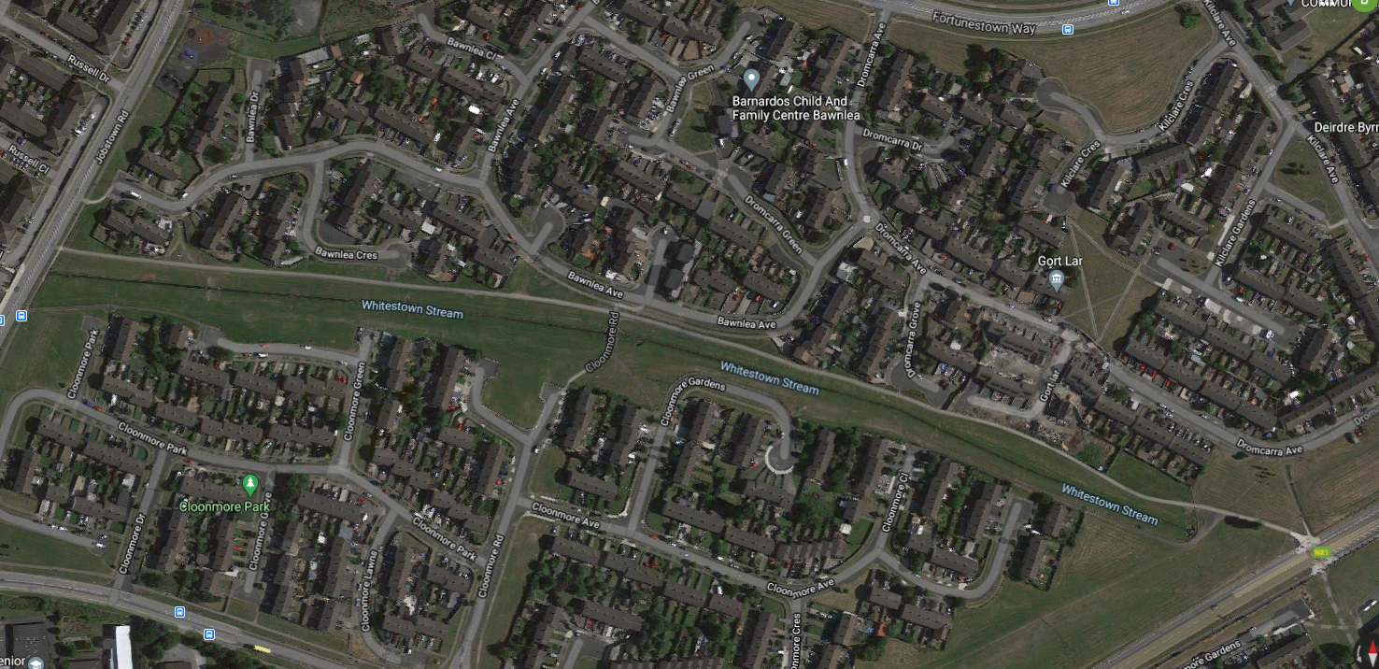
Stub Walls & Access Points

Slide 11
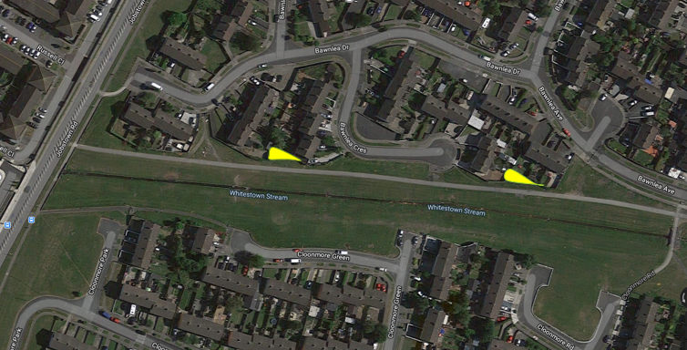
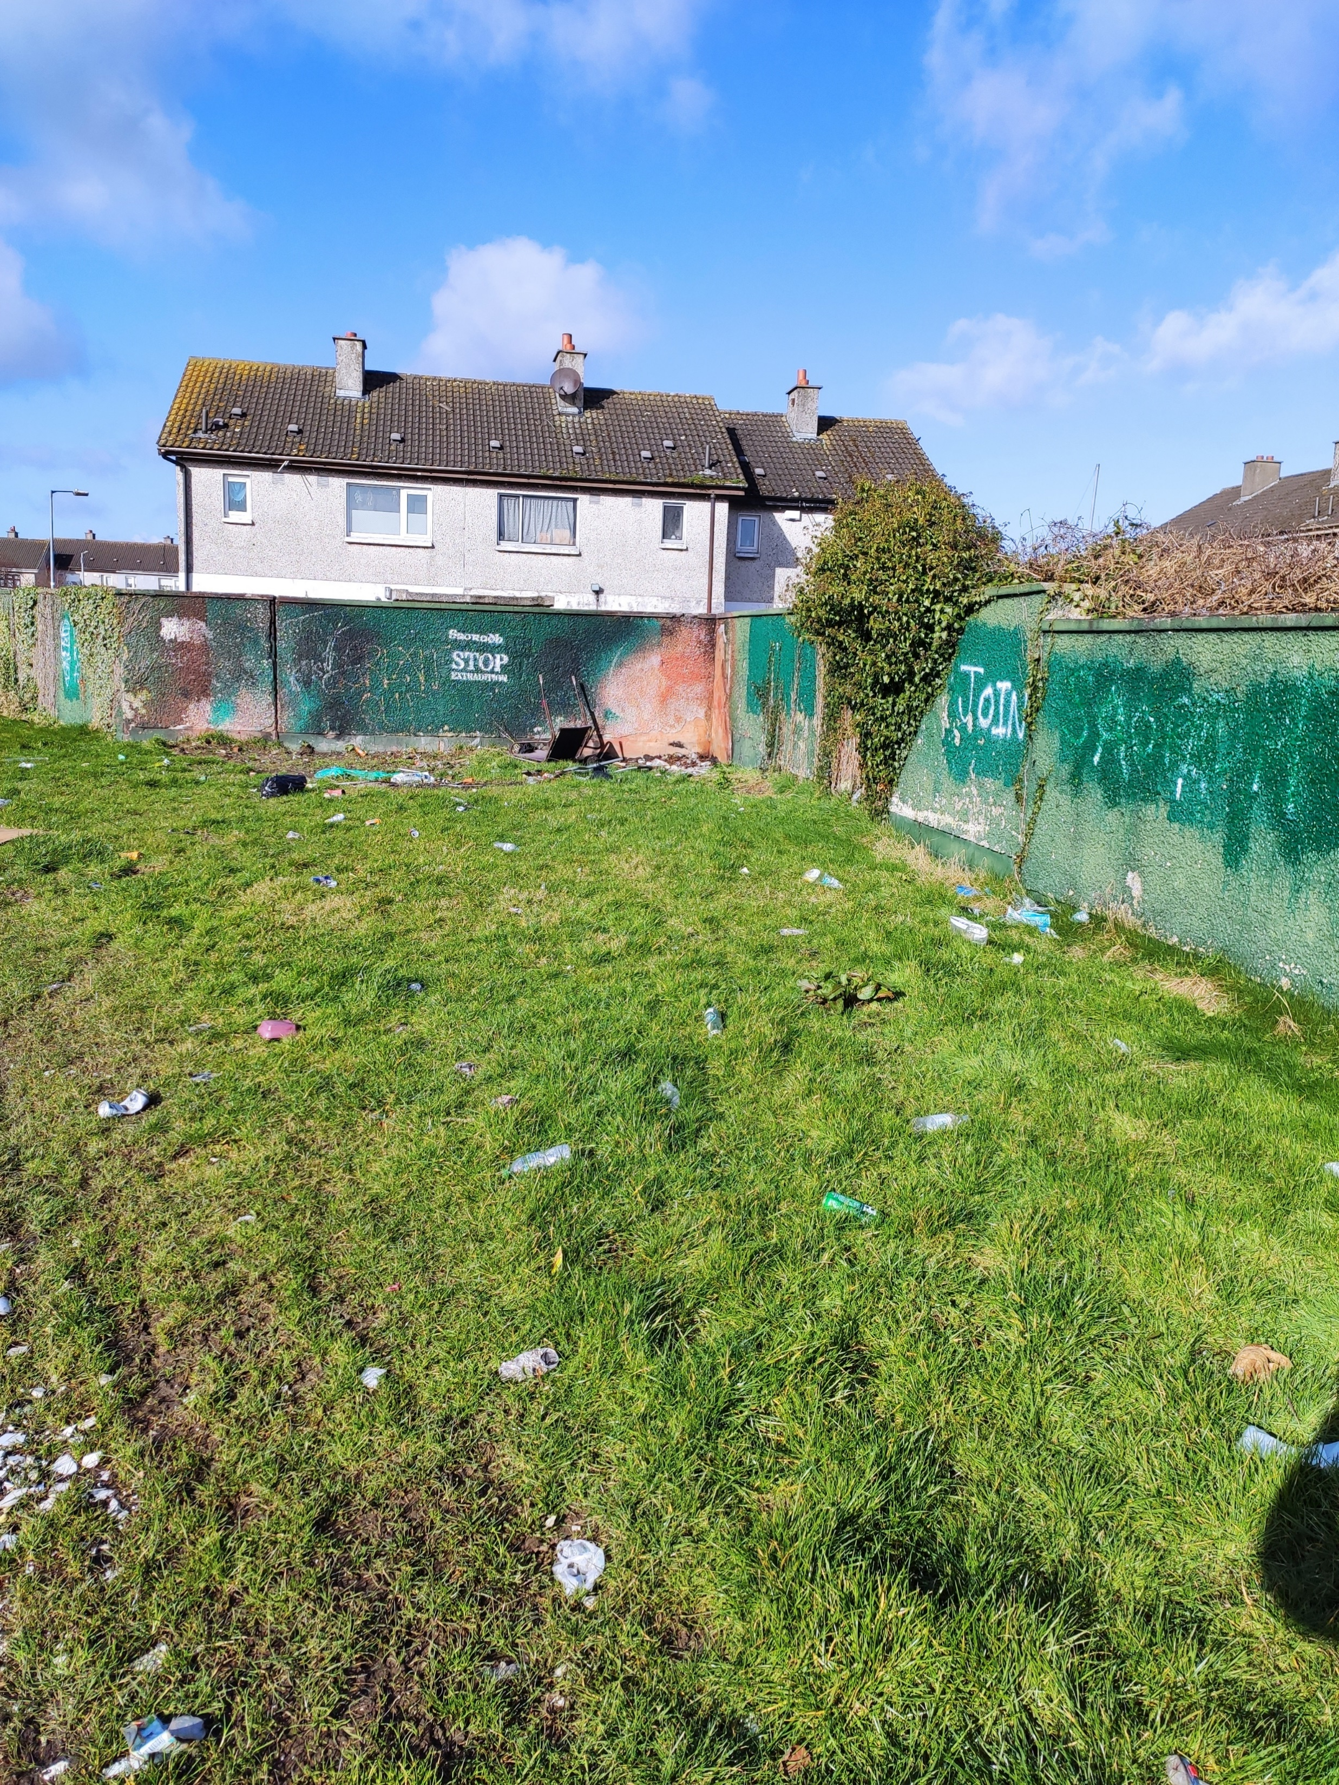
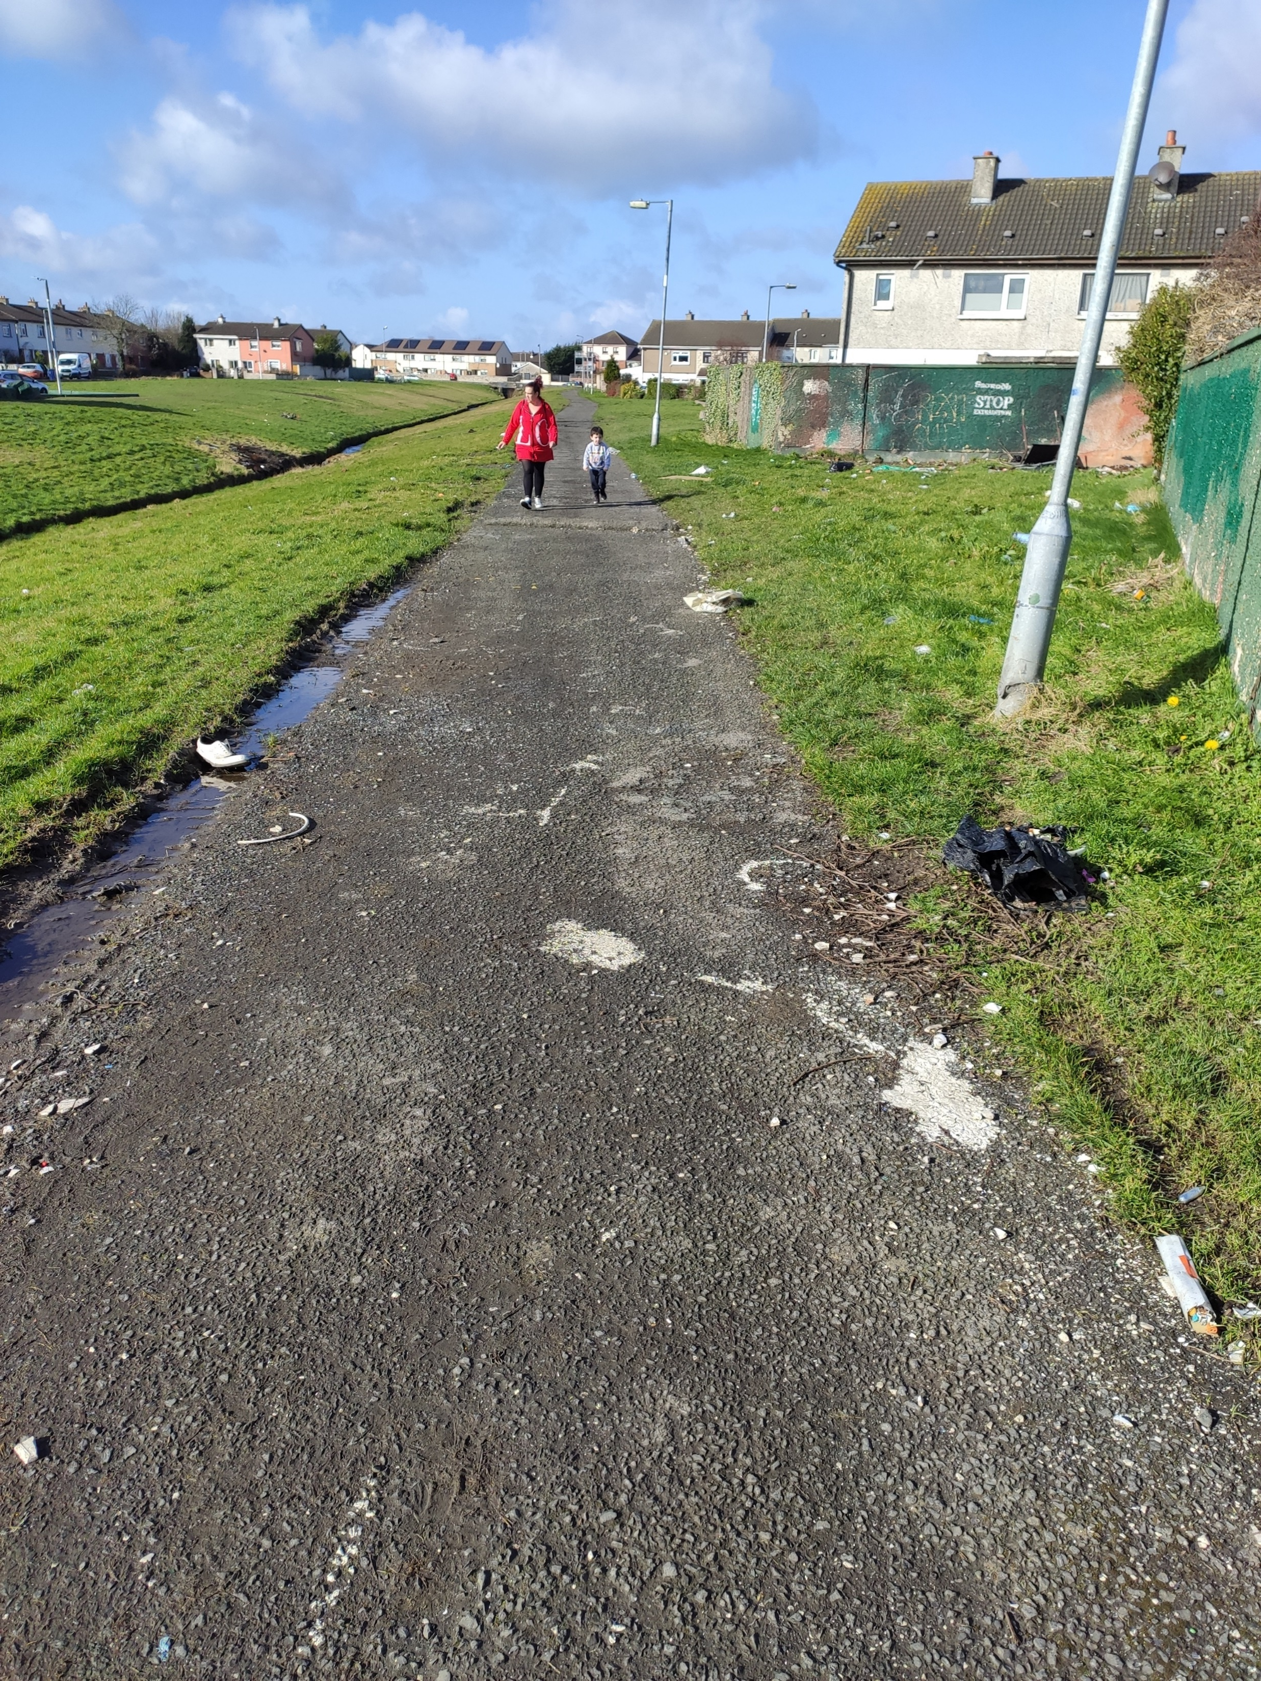
Hidden corners & dumping

Slide 12
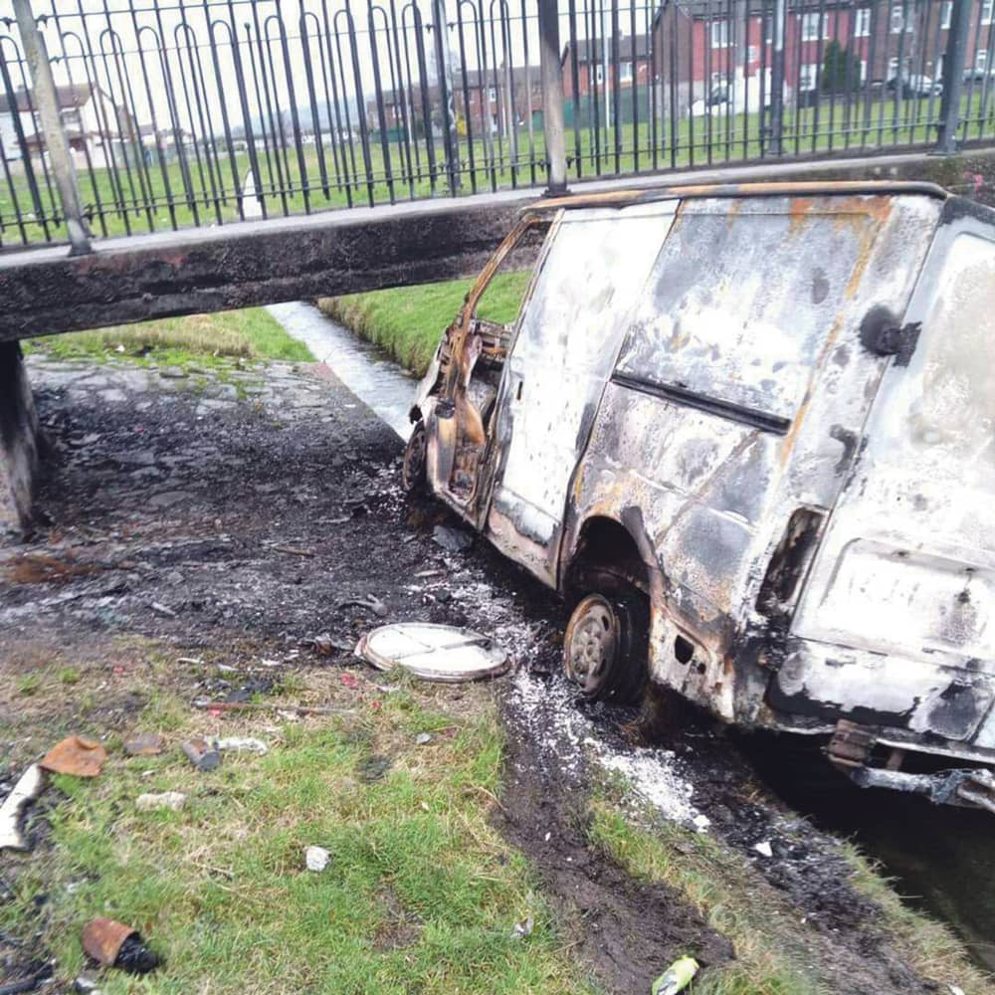
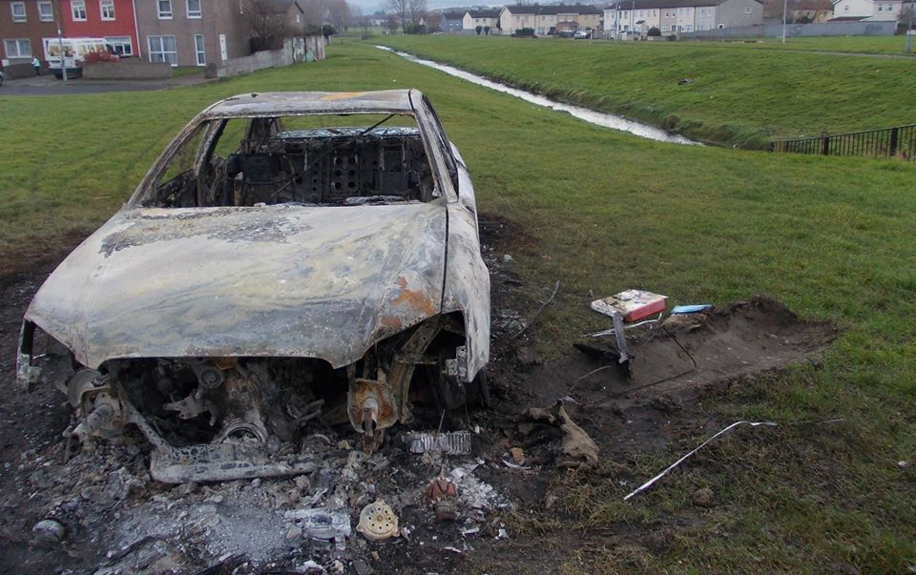
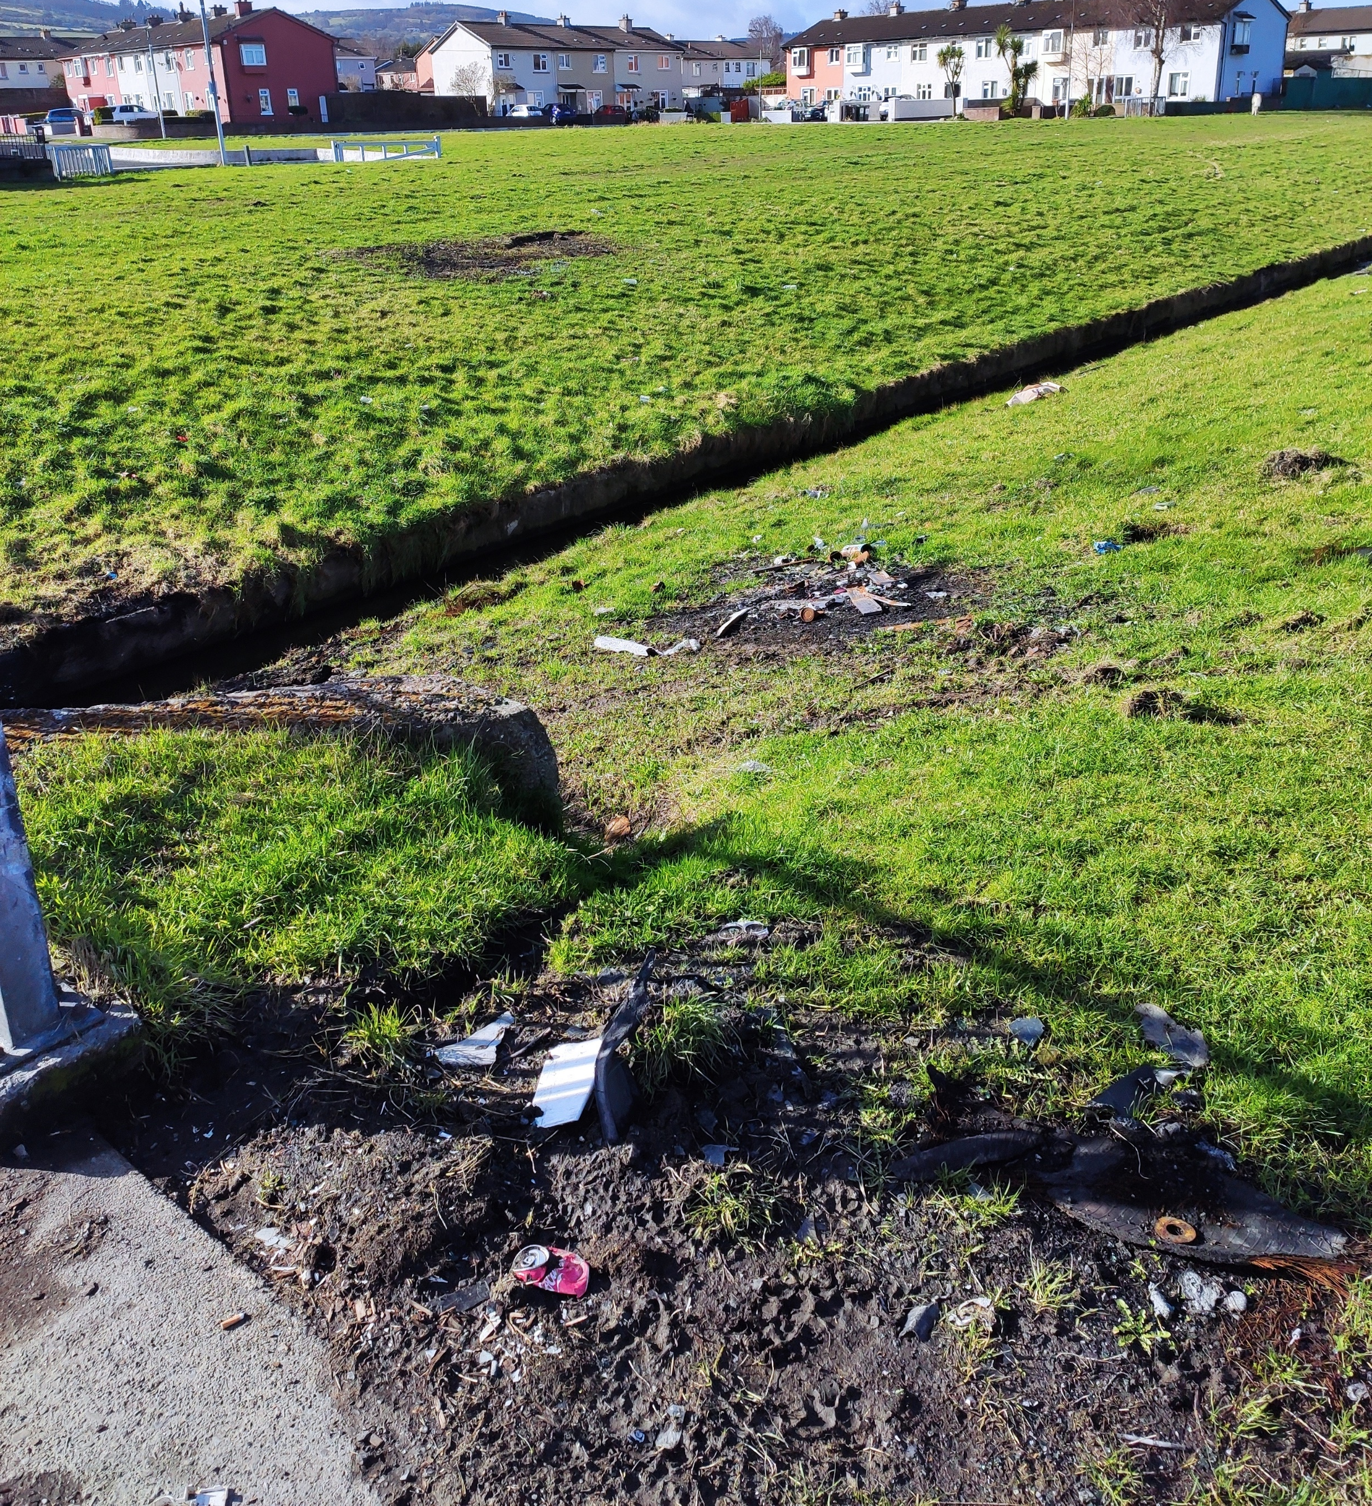
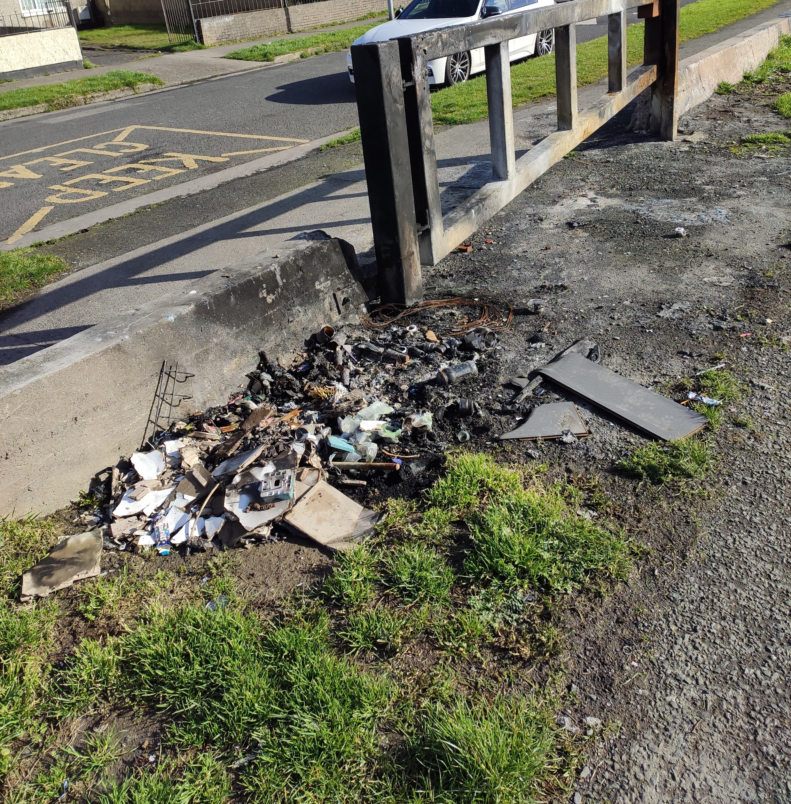
Evidence of burning of waste and stolen cars.

