Slide 1
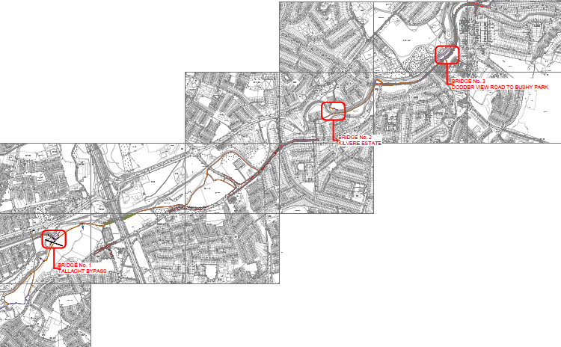
DODDER GREENWAY Dodder Road Lower

Slide 2
Greenway Update
Approx 2 months remaining in the bridges phase
Next phase on site is to link the bridges within our parks
Remaining phase is the on-road links

Slide 3
Bridge 1 – Firhouse Road

Slide 4
Bridge 2 – Kilvere Estate
Notes:
Connects Tempelogue Village to the greenway in Kilvere Park

Slide 5
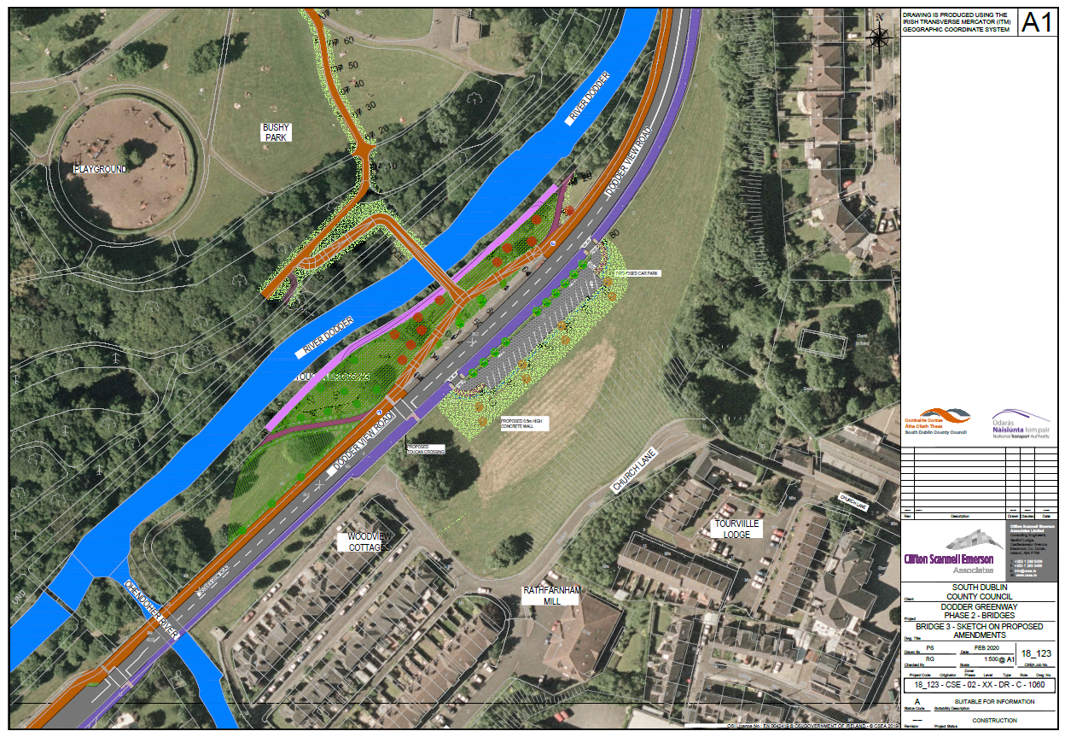
Bridge 3 – Bushy Park
Notes:
Bridge 3 is to the rear of Rathfarnham Village and connects Rathdown Avenue through Bushy Park and onto the greenway

Slide 6
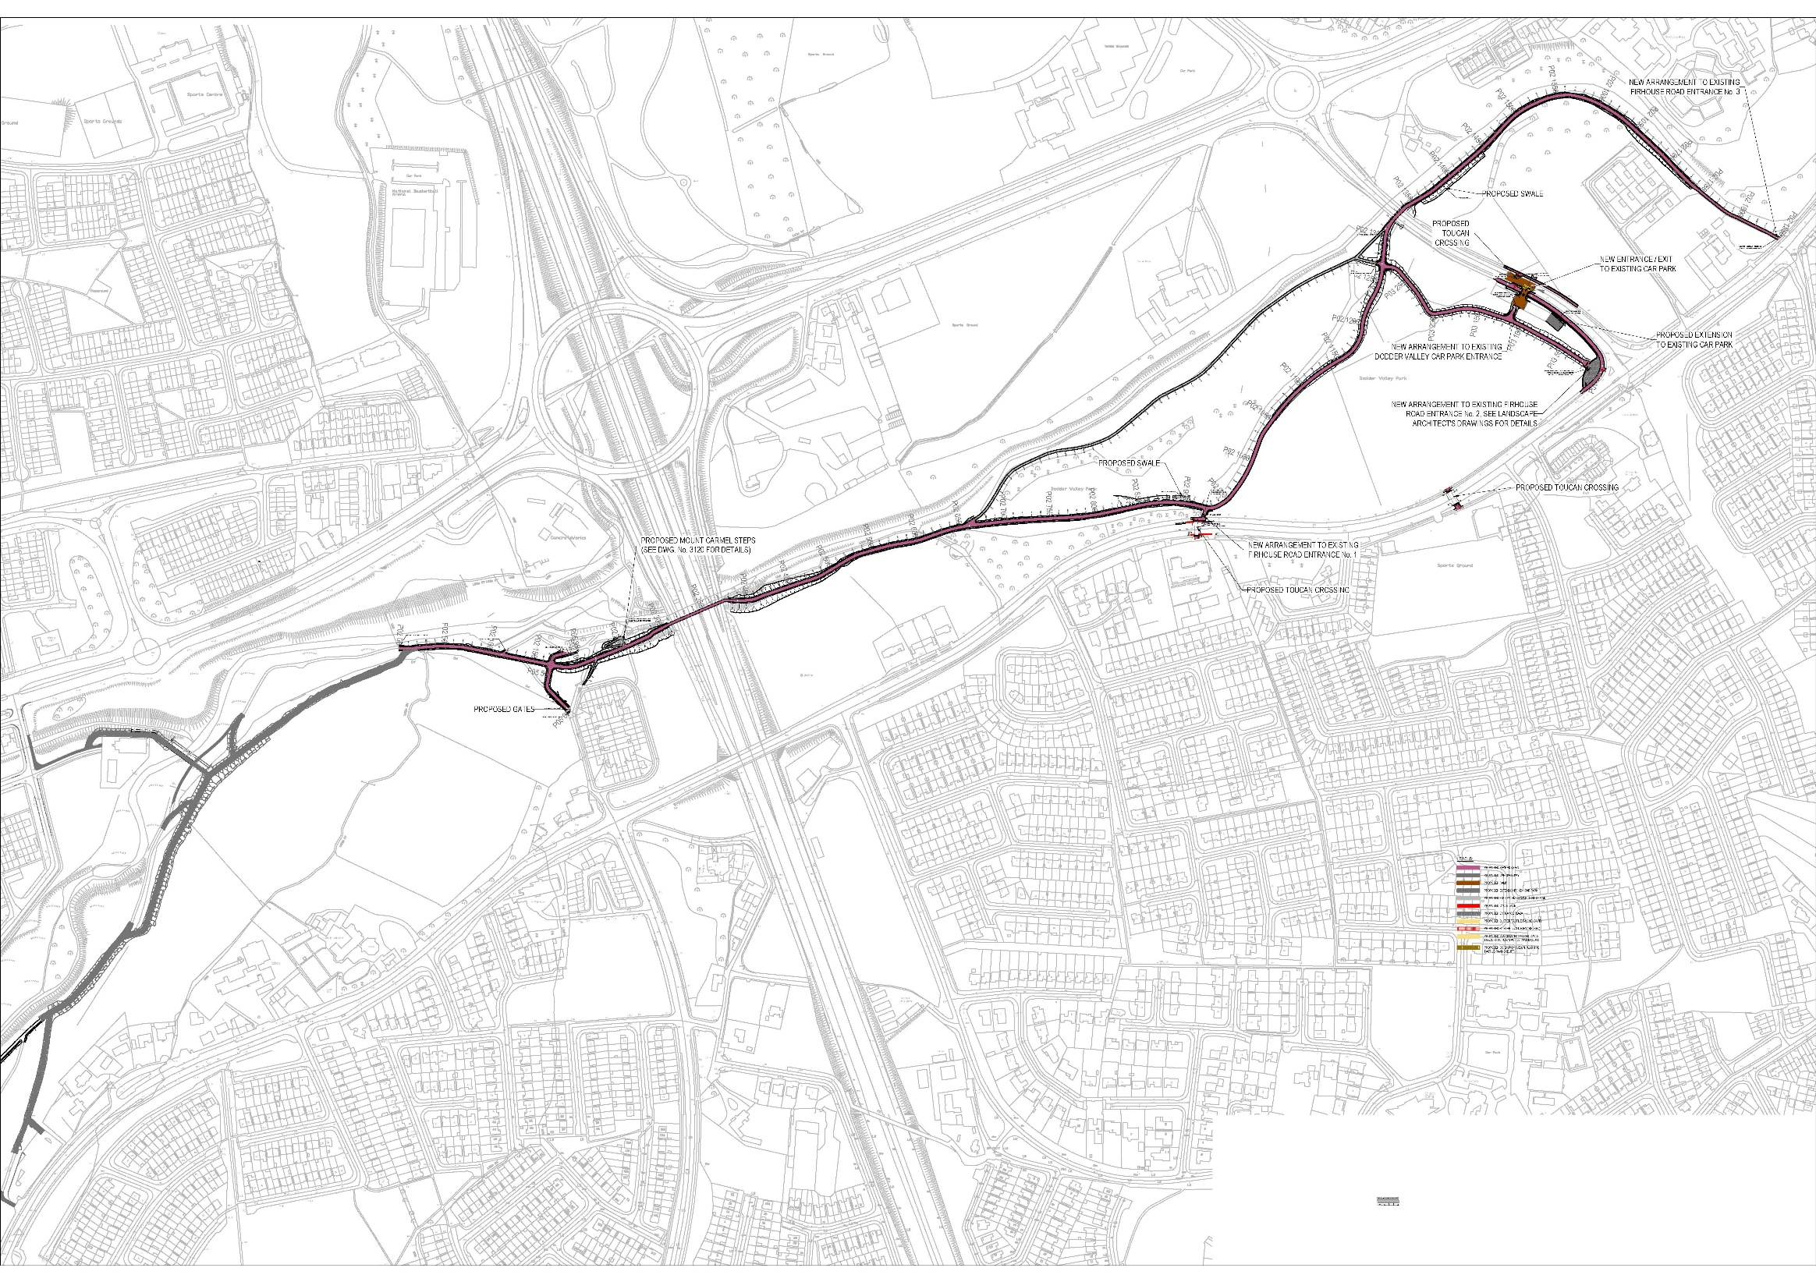
Next Phase Commencing

Slide 7
Dodder Road Lower Project Background
Residents approached SDCC expressing concerns with:
Traffic speed
Use of the road as a so called ‘rat run’
Concerns of how narrow the current pedestrian and cycle facilities are
Issues with transient parking by park users & school drop offs

Slide 8
What is Proposed
Amending the vehicle carriageway to one way and rationalising traffic calming to reduce traffic speeds, reduce traffic volumes and increase the safety of pedestrians and cyclists through the provision of additional space.

Slide 9
Scheme Benefits
Reduced traffic speeds, traffic volumes and associated noise, improved air quality
Safer commuter and social cycling facilities
Safer pedestrian environment
Direct access to the Dodder Greenway, linking cyclists and pedestrians to our linear parks, Dublin’s City Center and beyond

Slide 14
Thank you

