Slide 1

Cycle South Dublin
Consultation Process

Slide 2
Vision for making South Dublin County one of Ireland’s most cycle friendly counties
Providing a comprehensive and connected cycle network
Making cycling a more achievable mode of transport for all adults and children
Improving the cycling identity of the County

Slide 3
Cycle Priorities
Existing (on-going upgrades to the existing network)
Soon (projects between years three to four)
Later (projects between years six and eight)
Now (projects to be delivered over the next two years)
This draft identifies 4 Project Priorities

Slide 4
Consultation Process
Received Directly
5
Survey
401
Portal Submissions
31
The Council undertook public consultation from Tuesday 17th November to Friday 18th December 2020.
In conjunction with the submissions to be made on the Consultation Portal, a Survey was also opened. The survey was tailored to hear views on the Cycle South Dublin Programme and suggestions on priorities. Submissions were also received directly.
A total of 437 valid submissions were received.

Slide 5
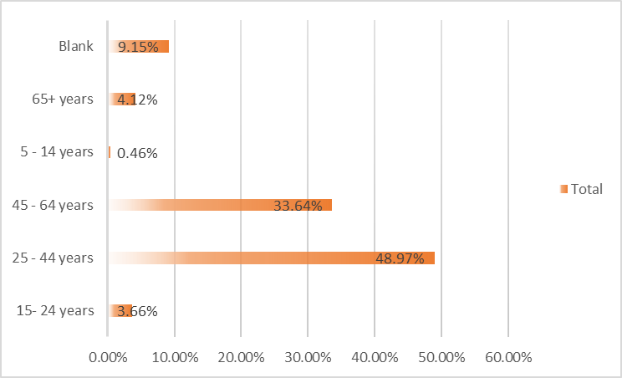
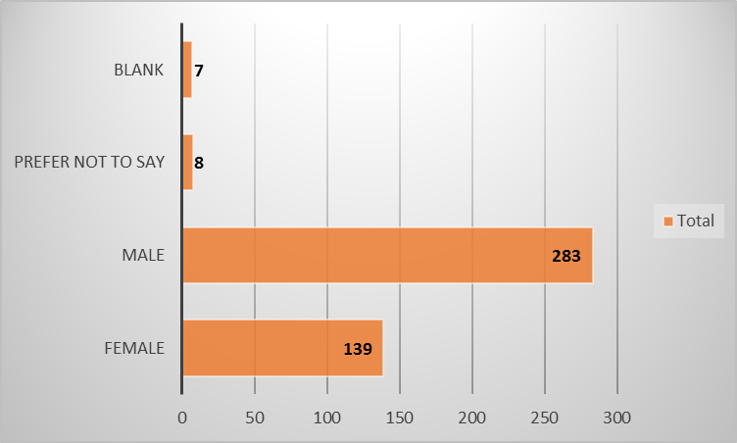
Participants

Slide 6
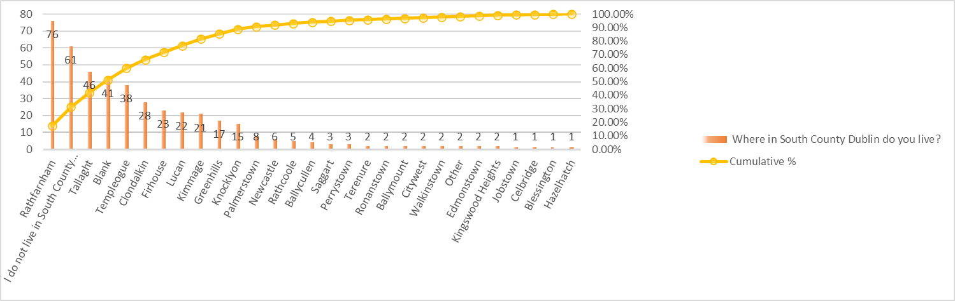
Participants
14%
9%
14% do not live in SDCC area
9% did not specify a location
48% of the remaining respondents from only 5 areas
  Rathfarnham
  Tallaght
  Templeogue
  Clondalkin
  Firhouse

Slide 7

Survey Questions
Do you support the installation of new safe cycling routes in the County
Would you consider cycling more often once the proposed routes within the CySD programme are in place
Do you want to make a comment on 'CySD Cycle South Dublin - A Programme of Work’
Would you like to add any further information on the proposed new safe cycling routes?
This Photo by Unknown Author is licensed under CC BY

Slide 8
10 Categories
30 Subcategories
1556 Comments
437 Responses

Slide 9
CySD Response Feelings
83% Support New Safe Cycle Routes
Less than 1% were not supportive of New Safe Cycle Routes
5% of overall responses contained negative comments

Slide 11
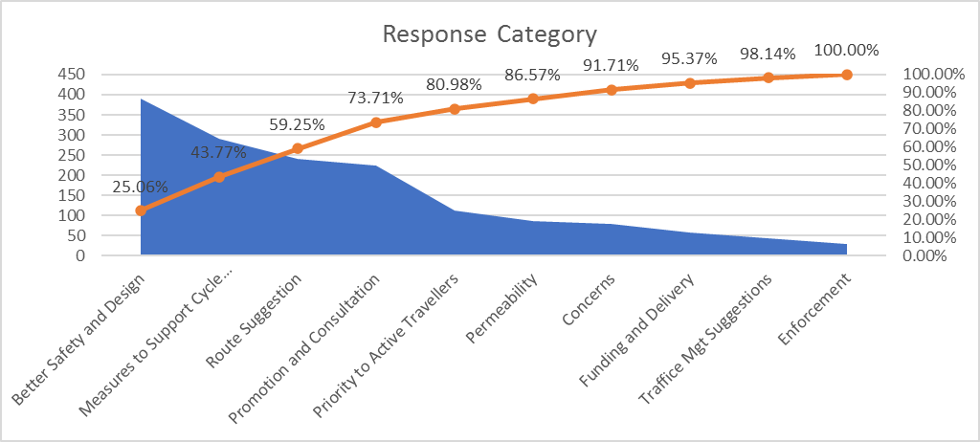
Comments Raised
Per Category (10 Categories)
390
Better Safety & Design
291
Measures to Support Cycle Networks
25%
19%
Route Suggestions
241
15%
Accounts for 59% of the total comments

Slide 12
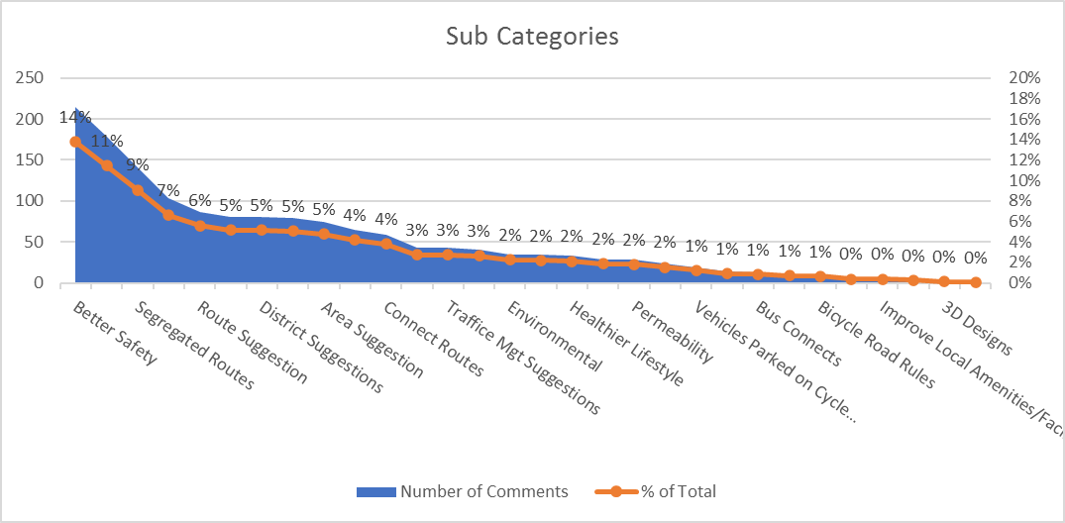
Comments Raised
Per Sub-Category (30 sub categories)
Represents <1% each
14% Better Safety
11% Promoted the Programme
9% Segregated Routes

Slide 13

Thank you

