Slide 1
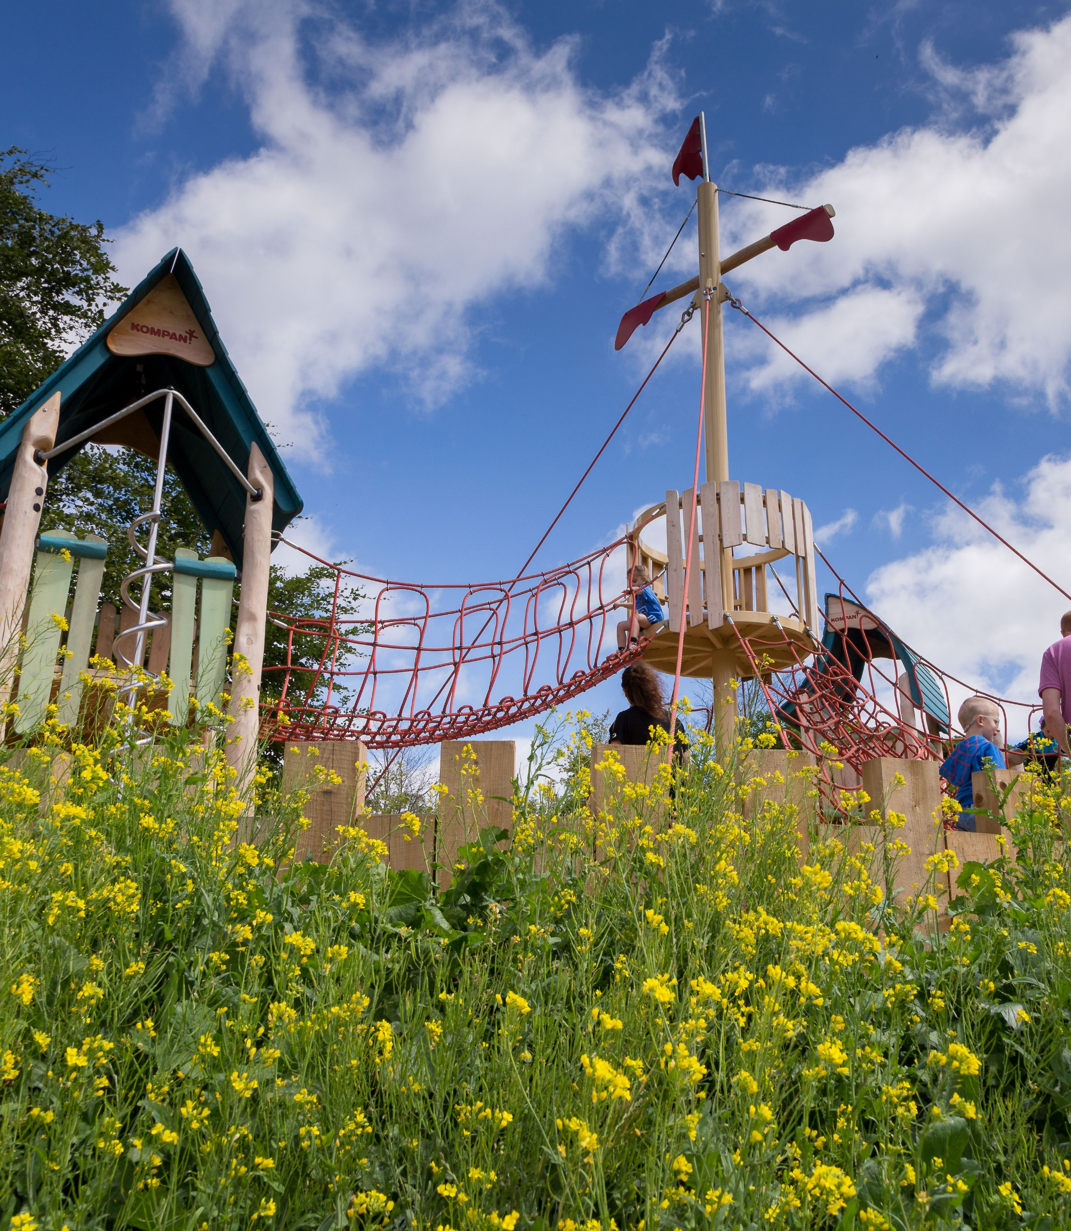
Parks and Open Space (POS) Strategy
EWCC SPC
16 02 2021

Slide 2
PARKS AND OPEN SPACES: Are fundamental in contributing to a high quality of life for those living, working and visiting the County. They provide habitats for ecological processes, a focal point for active and passive recreation, promote community interaction and help mitigate the impacts of climate change.
Define Open Space standards
Quantity
Access
Quality
Benchmarking of Standards
Application of Standards to South Dublin neighbourhoods (as per county development plan)
Draft Development Plan Policies and Objectives being developed

Slide 3
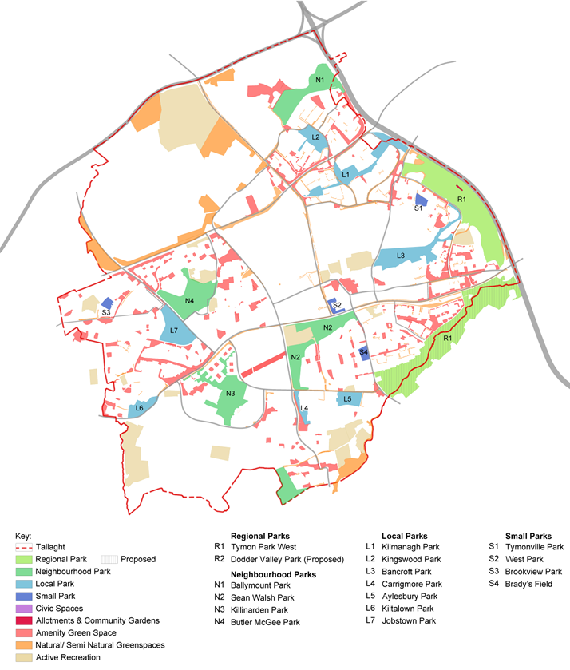
Parks and Open Spaces Strategy
Type | Park | Area (ha)
Regional Parks | Tymon Park West | 128.83
 | Dodder Valley (Proposed) | 118.31
 | Totals | 247.14
Neighbourhood Parks | Ballymount Park | 21.15
 | Sean Walsh Park | 21.86
 | Killinarden Park | 20.81
 | Butler McGee Park | 20.67
 | Totals | 84.49
Local Parks | Kilnamanagh Park | 15.52
 | Kingswood Park | 6.71
 | Bancroft Park | 18.00
 | Carrigmore Park | 2.38
 | Aylesbury Park | 5.15
 | Kiltalown Park | 5.49
 | Jobstown Park | 13.34
 | Totals | 66.59
Small Parks | Tymonville Park | 1.73
 | West Park | 1.42
 | Brookview Park | 1.40
 | Brady’s Field | 1.91
 | Totals | 6.46
Amenity Green Space | Various | 118.72
Natural/semi-natural | Various | 92.90
Applying the Standards: Tallaght
Quantity

Slide 4
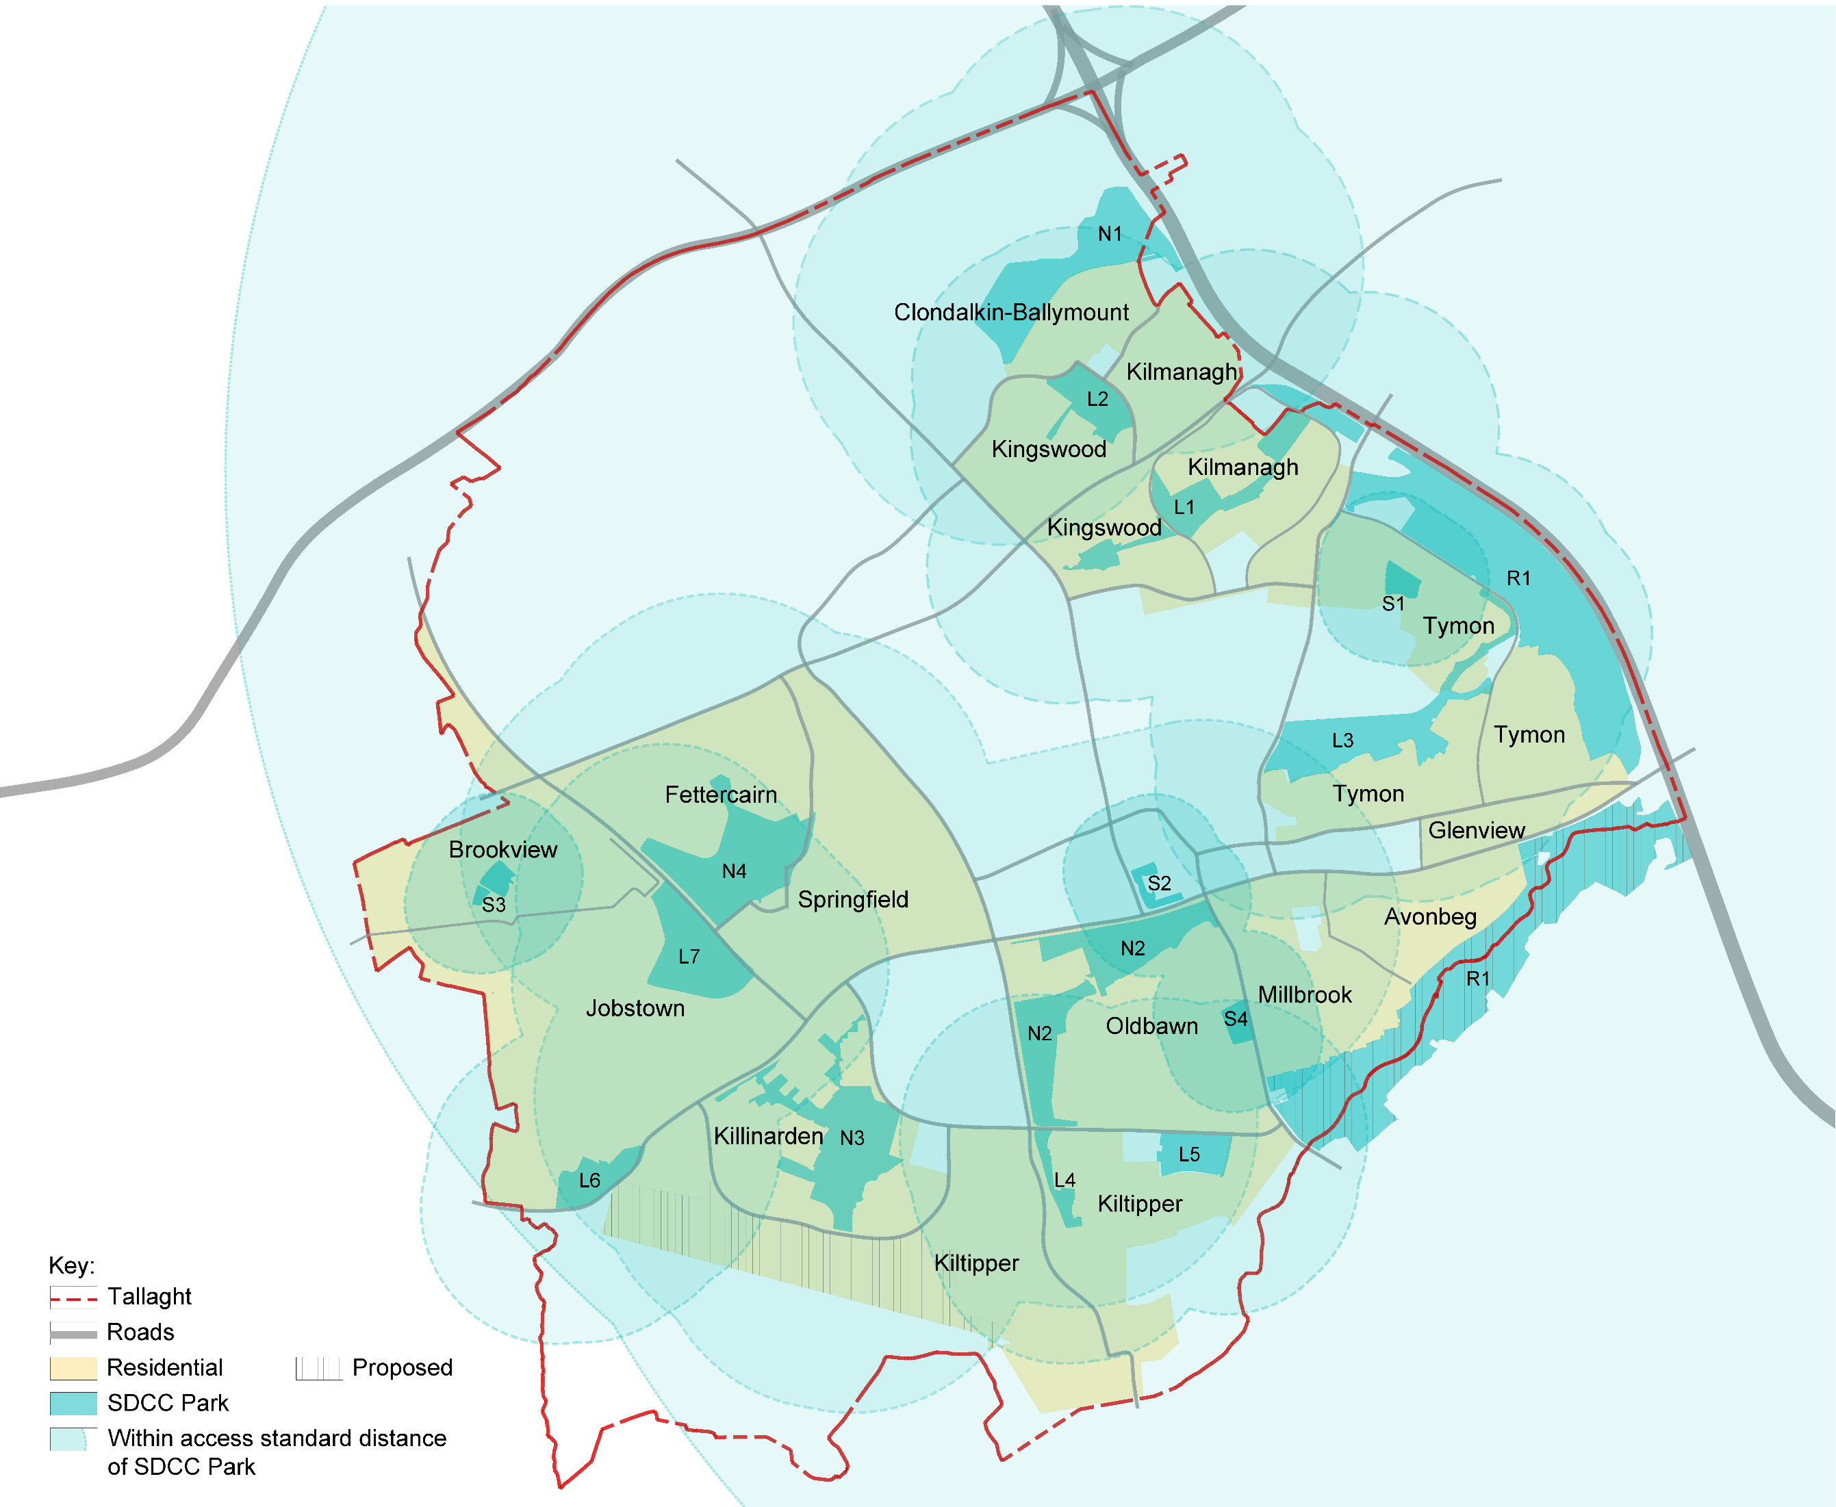
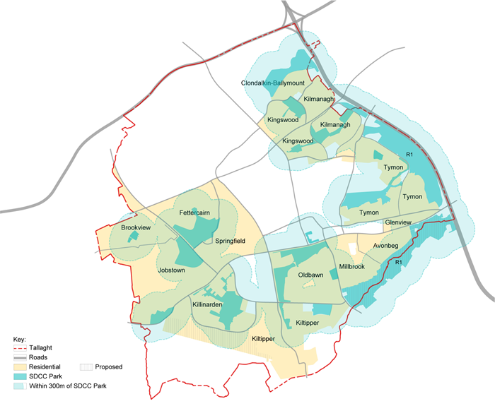
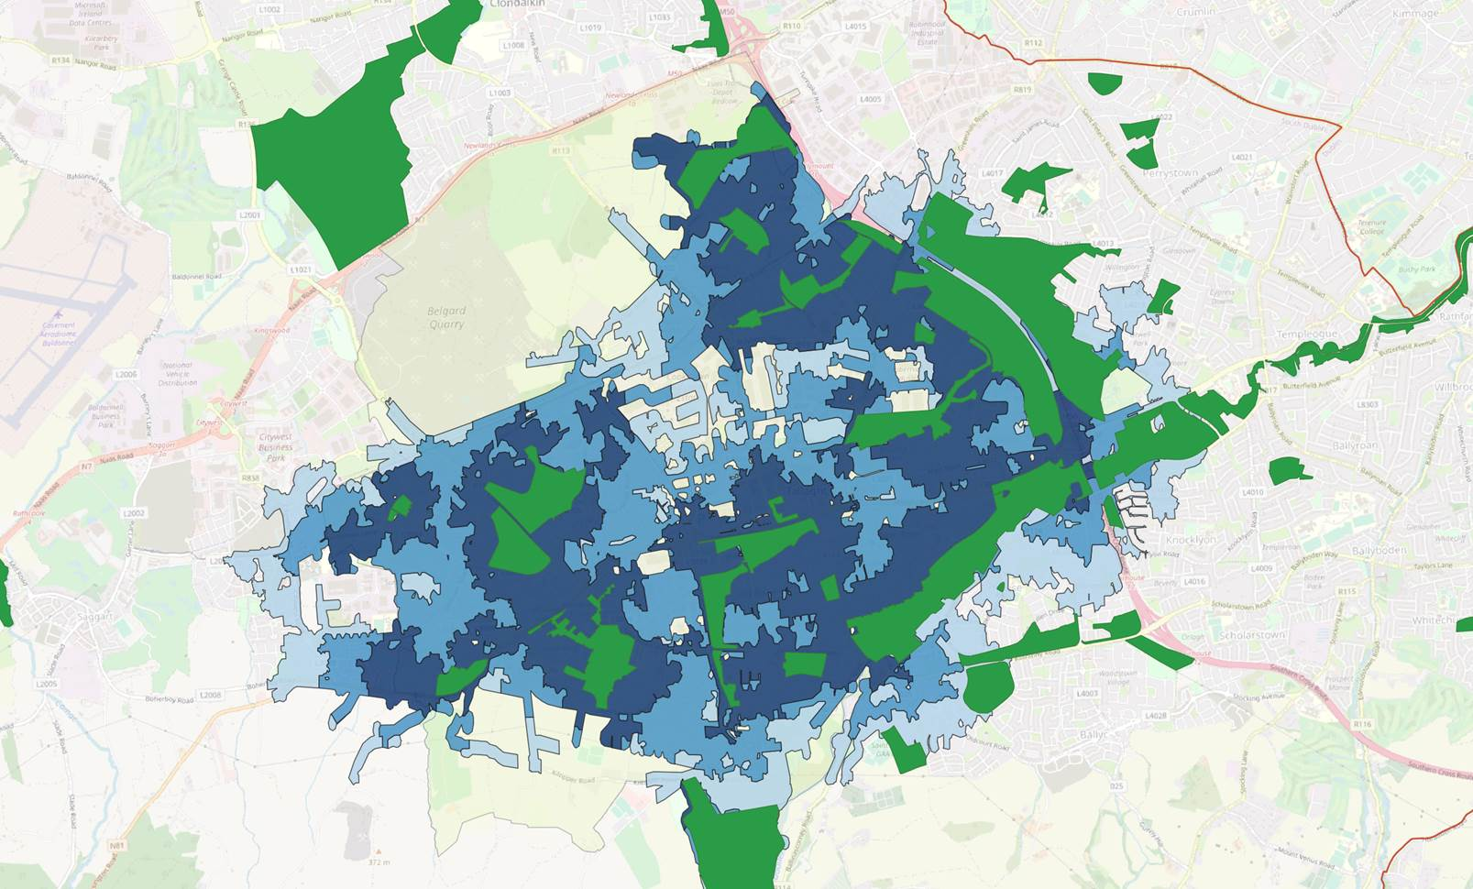
Parks and Open Spaces Strategy
Applying the Standards: Tallaght
Accessibility
Within prescribed walking thresholds of all SDCC Parks
Within 300m band of all SDCC Parks
Information is being refined
Applying the Access Standards: Public Parks
Within the Tallaght neighbourhood there is an existing well-distributed network of public parks.
There are no residential areas in the neighbourhood that do not have access to a park within the prescribed walking thresholds.
Note:
Initial access thresholds and assessments are being up-dated in line with walkability bands created by SDCC using 'Open Street Maps' to give truer walking routes and catchments.
Adding a 300m band (to existing public parks only)

Slide 5
Parks and Open Spaces Strategy
Quality Standards
A Welcoming Place
1. Welcoming entrances
2. Good and safe access
3. Signage
4. Equal access for all
Healthy, Safe and Secure
5. Safe and accessible equipment and facilities
6. Personal security
7. Appropriate provision of facilities
8. Quality of places
Management
9. Clean and well-maintained
10. Litter and waste management
11. Grounds maintenance and horticulture
12. Building and infrastructure maintenance
Potential for Biodiversity
13. Linkages to GI network
14. Native tree and shrub planting
15. Hedgerows
16. SuDS features (incl. integrated wetlands)
17. Natural water features (including stream re-profiling)
For the purpose of this strategy, a locally set quality assessment is being undertaken for each area of open space. Scores are given against a basic expected level of quality/maintenance, potential for biodiversity and community value, as shown.
The assessment scores each criteria out of 10 in accordance with the scale:
Because some criteria will not be relevant to every site, it is necessary to discount those that are not from the scoring and to express the final quality score as a percentage:

Slide 6
Methodology and programme: GI Strategy and POS Strategy being delivered in tandem 2 separate but complementary documents POS has a separate consultation process. Relevant POS policies and actions will be incorporated into the CDP.
STAGE 1
Scoping of Project and Summary Report
August 2020
STAGE 2
Desktop Investigation, Surveys and Mapping
August-October 2020
STAGE 3
Interim Report(s), Analysis, Mapping
Sept 2020-May 2021 with submission of policy and mapping information in line with requirements of CDP key dates.
STAGE 4
Final Report – Draft reports, Consultation, Finalised Mapping, Findings, Recommendations & Action Plans
Feb 2021-March 2022

Slide 7
Parks and Open Space (POS) Strategy
Thank you

