Slide 1
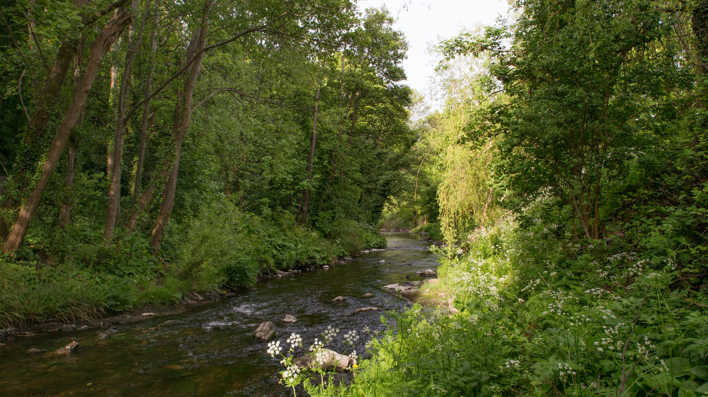
Green Infrastructure (GI) Strategy Update
EWCC SPC
16 02 2021

Slide 2
GREEN INFRASTRUCTURE ……“a strategically planned network of natural and semi-natural areas with other environmental features designed and managed to deliver a wide range of ecosystem services such as water purification, air quality, space for recreation and climate mitigation and adaptation.”…….
These 5 Key Themes, relevant to GI will frame the policies and objectives within the County Development Plan and allow us to identify opportunities to improve the GI network:
Biodiversity
Sustainable Water Management
Climate Resilience
Recreation and Amenity (Human health and wellbeing)
Landscape (Natural and Cultural Heritage)

Slide 3
GI Strategy and County wide Network
A GI strategy will: “form the basis for the identification, protection, enhancement and management of the Green Infrastructure network within the County.”
Case Studies are underway to inform policy development. 5 areas representing different Green Infrastructure Network Characteristics will assist in generating relevant policies for similar areas.

Slide 4
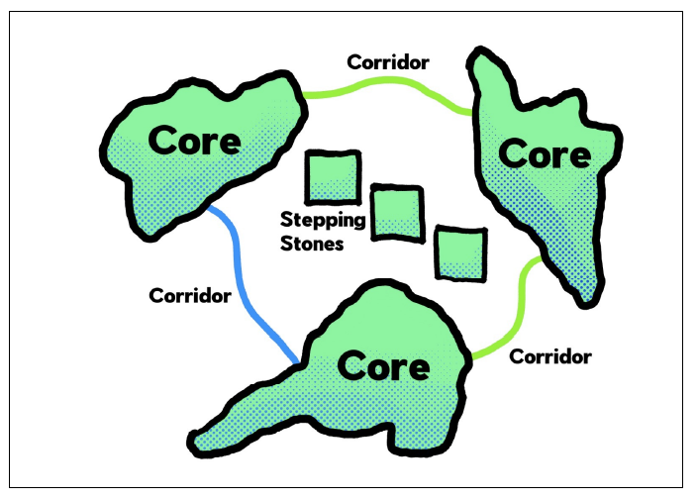
GI Chapter Development
The draft GI Chapter is being developed as follows:
Introduction:
Context setting / definition
Green Infrastructure within CDP: Position of GI within Overarching Themes
Overarching vision / policies
Review of Existing GI Strategy
Link with new GI Strategy / SCOT analysis
Proposed Strategy
Short piece on approach
Spatial Framework
Corridors, hubs, stepping stones etc. (mapping)
Thematic Policies and Objectives
Also informed by case study work
Climate Action Audit
Spatial Framework
Format:
The GI strategy chapter in the County Development Plan contains the policies and objectives relating to GI.
An accompanying document gives a review of existing GI policies, background and supporting information, case studies etc.

Slide 5
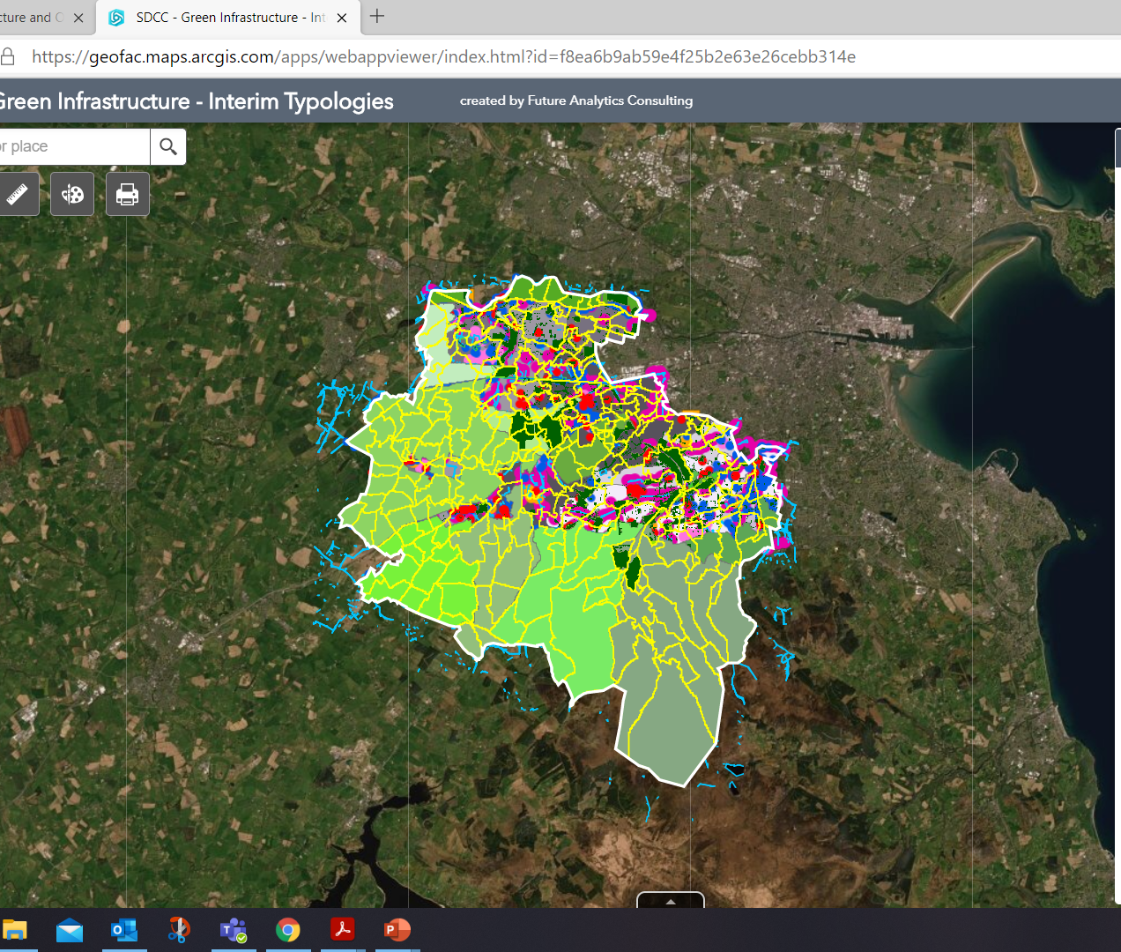
Mapping Framework
The GI Strategy will have accompanying mapping:
Maps adopted with the County Development Plan showing layers of Green Infrastructure and how they relate to the Plan.
This will be represented in the CDP document diagrammatically.
It will also be supported by the background GIS mapping that SDCC can keep updated to monitor changes and improvements to GI networks over time.

Slide 6
Methodology and programme: Consultation and adoption of GI strategy is in tandem with CDP review to allow for incorporation of policies and actions in CDP. A Parks and Open Space Strategy is being delivered in tandem but has a separate consultation process.
STAGE 1
Scoping of Project and Summary Report
August 2020
STAGE 2
Desktop Investigation, Surveys and Mapping
August-October 2020
STAGE 3
Interim Report(s), Analysis, Mapping
Sept 2020-May 2021 with submission of policy and mapping information in line with requirements of CDP key dates.
STAGE 4
Final Report – Draft reports, Consultation, Finalised Mapping, Findings, Recommendations & Action Plans
Feb 2021-March 2022

Slide 7
Green Infrastructure (GI) Strategy Update
EWCC SPC
16 02 2021

