Slide 1
Ecconomic Development Enterprise & Tourism Development SPC
10th February 2021

Slide 2
H-I 2. Work Plan 2021
Grange Castle – future development, marketing and contribution to Economic Development of the County
The Innovation Centre -future plans and project updates.
Tourism projects at the Dublin Mountains and Rathfarnham Castle Courtyard and related County promotion projects.
The development and expanded use of Tallaght Stadium, branding and marketing updates.
Joint meeting with Arts SPC on the cultural aspects of some of the Tourism projects.
Enterprise and Business Supports – updates and initiatives
Local Economic and Community Plan

Slide 3
H-I 3. Project Roll Outs: Innovation Centre
Part 8 secured for the development on SDCC land east of the new link road connecting Fourth Avenue and Belgard Square North, Tallaght Decrmber 2020 last
New four storey structure, 300m2 which will accommodate;
Town hall, reception and café at street level engaging with new Public Square
Three levels of flexible office accommodation - to support start up enterprise.
Project Build Timeline
Start late Qt 3 2021
Completion End Qt 42022

Slide 4
Innovation Centre-Scale Model (indicative)

Slide 5


H-I. Tourism Projects:
Rathfarnham Castle
Castle Stables and Courtyard - Rathfarnham
Tender process in respect of the proposed uses
and opportunity at this location failed to identify
a preferred bidder.
• Council currently reviewing the process with the consultants with a view to bringing the project back to the market in late 2021, subject to appropriate market conditions.

Slide 6
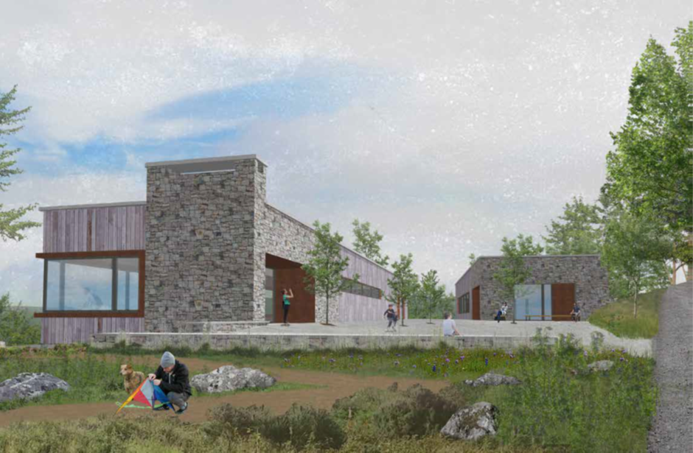
H-I. Tourism Projects:
Dublin Mountains Visitor Centre
Dublin Mountains Visitor Centre
Received planning permission by ABP in June, 2020.
A third party commenced a judicial review of the
decision.
High Court granted leave in November 2020.
Judicial review hearing listed for 08/06/2021.

Slide 7
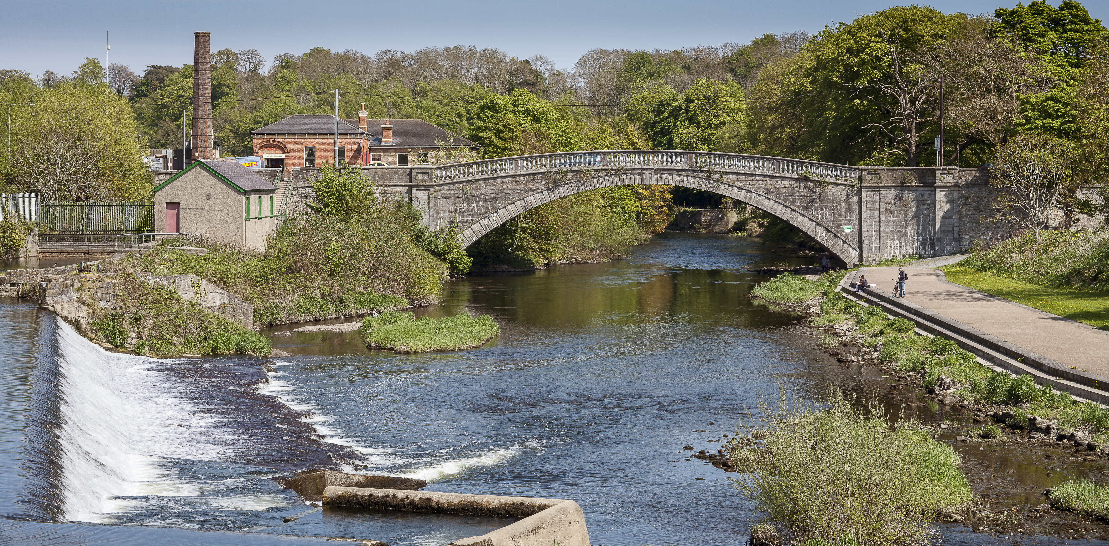
H-I. Tourism Projects:
Destination Towns – Lucan
Destination Towns – Lucan
• Fáilte Ireland allocated €500,000 to SDCC for
Lucan.
Funding to improve the attractiveness and tourism appeal of the town.
Multi-disciplinary design team appointed January, 2021.
Tender to devise a Product Development Plan for Lucan issued in February, 2021.

Slide 8

H-I. Tourism Projects:
Round Tower Visitor Centre
Round Tower Visitor Centre
• Closed 12/03/20 in line with the Government’s recommendation.
• East Village Coffee commenced trading in mid October, 2020
offering a limited service in line with restrictions.
• The exhibition reopened to the public on 02/12/2020 in line with Government guidelines but closed on 24/12/2020 under level 5 restrictions and remains closed.
• Fáilte Ireland ‘Surprising Stories’ scheme is currently underway. Includes creating an audio guide for both adults and children, develop an all-weather, open-air event space which can accommodate increased visitor capacity, and refreshing room 8 to facilitate temporary exhibitions.

Slide 9

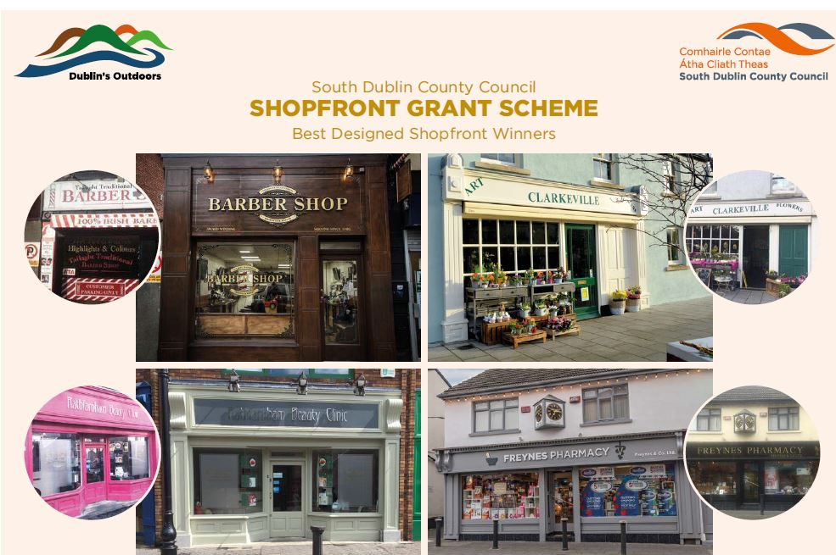
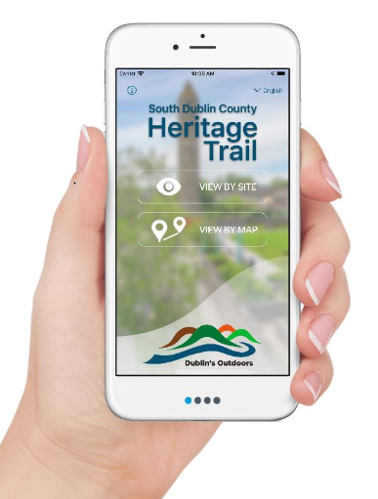
H-I. 3 Other Projects
Work has commenced on exploring the development of a self guided app for Tallaght.
Continue to identify events and festivals subject to Covid-19 restrictions.
Shopfront Grant scheme continues

Slide 10
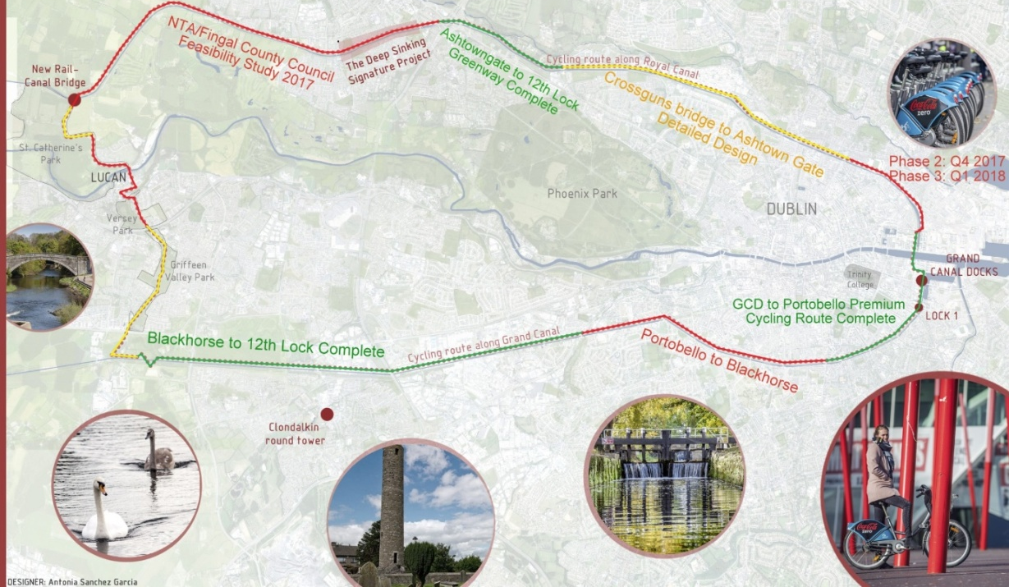
H-I. 3 Other Projects: Canals/Greenways
Canal Loop feasibility study is underway.
  Circa 40km city cycle loop
  Partnership with South Dublin, Fingal, Waterways Ireland and NTA to deliver a feasibility study and preferred option on the route.
Grand Canal Greenway funding options being reviewed with Waterways Ireland & Fáilte.
  The proposed Greenway will utilise the route of the existing towpath on the northern side of the Canal between the 12th Lock and Hazelhatch Bridge at Celbridge.
  Part 8 approved

Slide 11
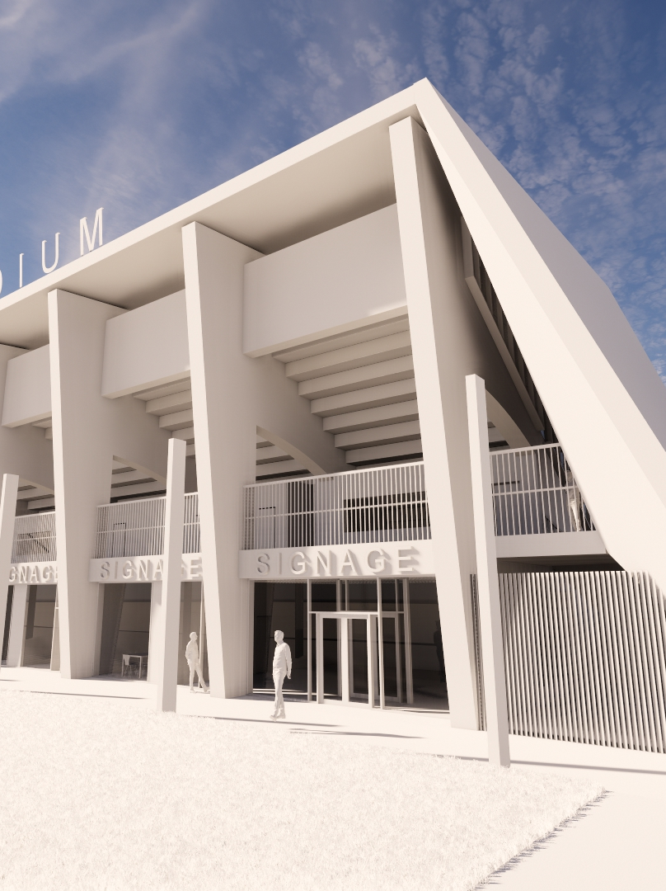
H-I. 3 Project Roll Outs – Tallaght Stadium
Tender for construction to be published by end Q2 2021.
  New North Stand, modifications to the Corporate areas of the Main Stand,
  Modifications to the wheelchair accessible seating area of the South Stand,
  Changing Places Facility within the South Stand.
Tender was advertised in Q4 of 2020, for Design Build contract for the pre cast concrete structure for North Stand. The contractor appointed will be novated as a specialist sub contractor to the Main Contractor, [tender process Q2 2021].
Construction expected to commence Q4 of 2021.
c. 15 months to complete, with all works due for completion during Q1 2023.

Slide 12
H-I. 4 A.O.B.

