Slide 1
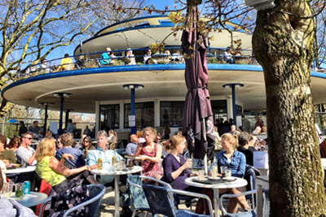
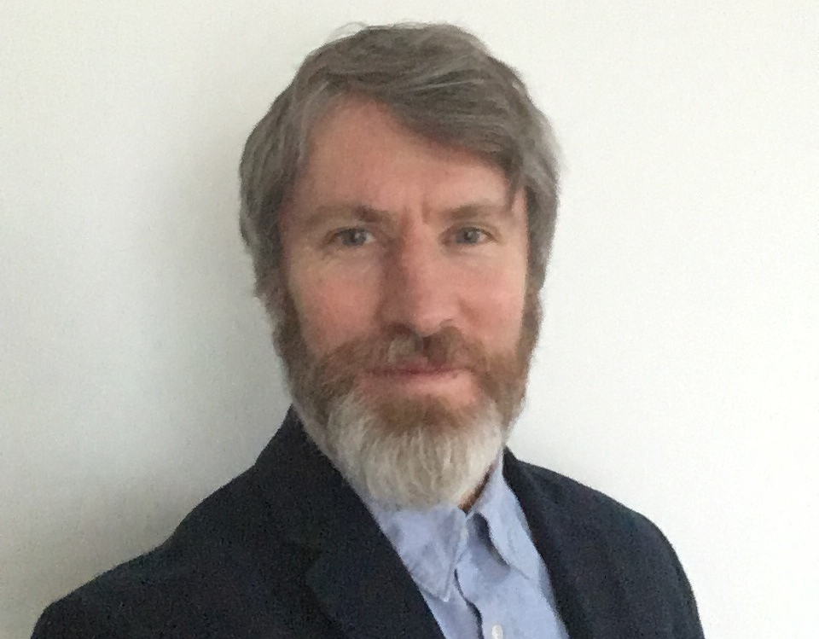
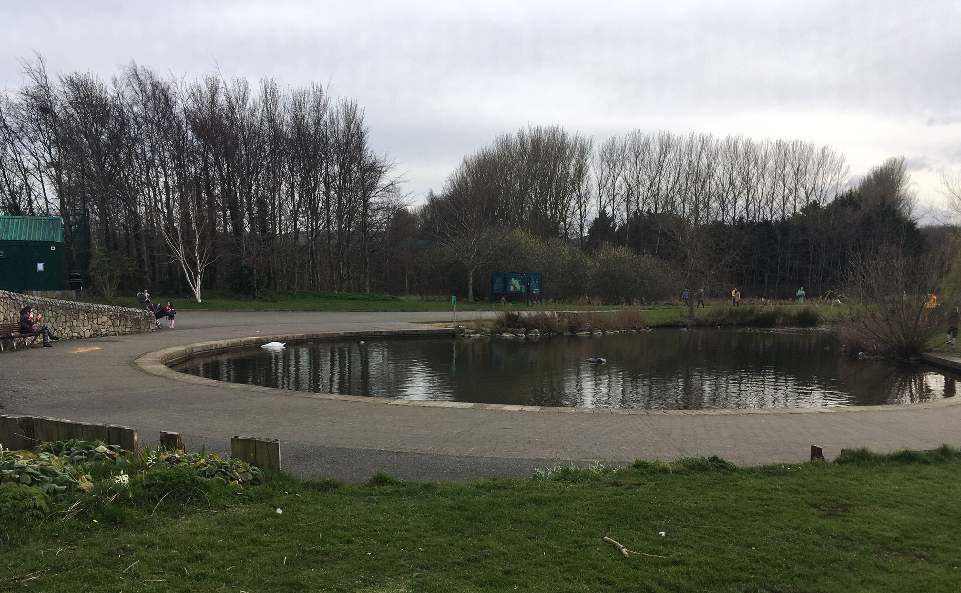
TYMON PARK INTER-GENERATIONAL CENTRE
ARCHITECTURAL SERVICES, PUBLIC REALM & COMMUNITY– 01/02/2020 – BRIEFING
With Audio Narrative – click on speaker symbol on each slide for audio narrative
or on Notes tab below for written narrative
Presented by Aidan McNamara
Architectural Services. SDCC
Notes:
INTRODUCTION
Hello. My name is Aidan McNamara of the Architectural Services Department in South Dublin County Council.
This presentation is a briefing on the forthcoming proposal for the Tymon Park Intergenerational Centre for the Templeogue area which we are working on with the Public Realm and Community Sections.
An Intergenerational, active aged, age friendly facility, encouraging social interaction between younger and older members of the Templeogue community was agreed by the Elected Members a number of years ago.
The centre will provide multi-functional space and café, to cater for all generations for a range of activities, which will embrace and enhance its setting in Tymon Park.

Slide 2
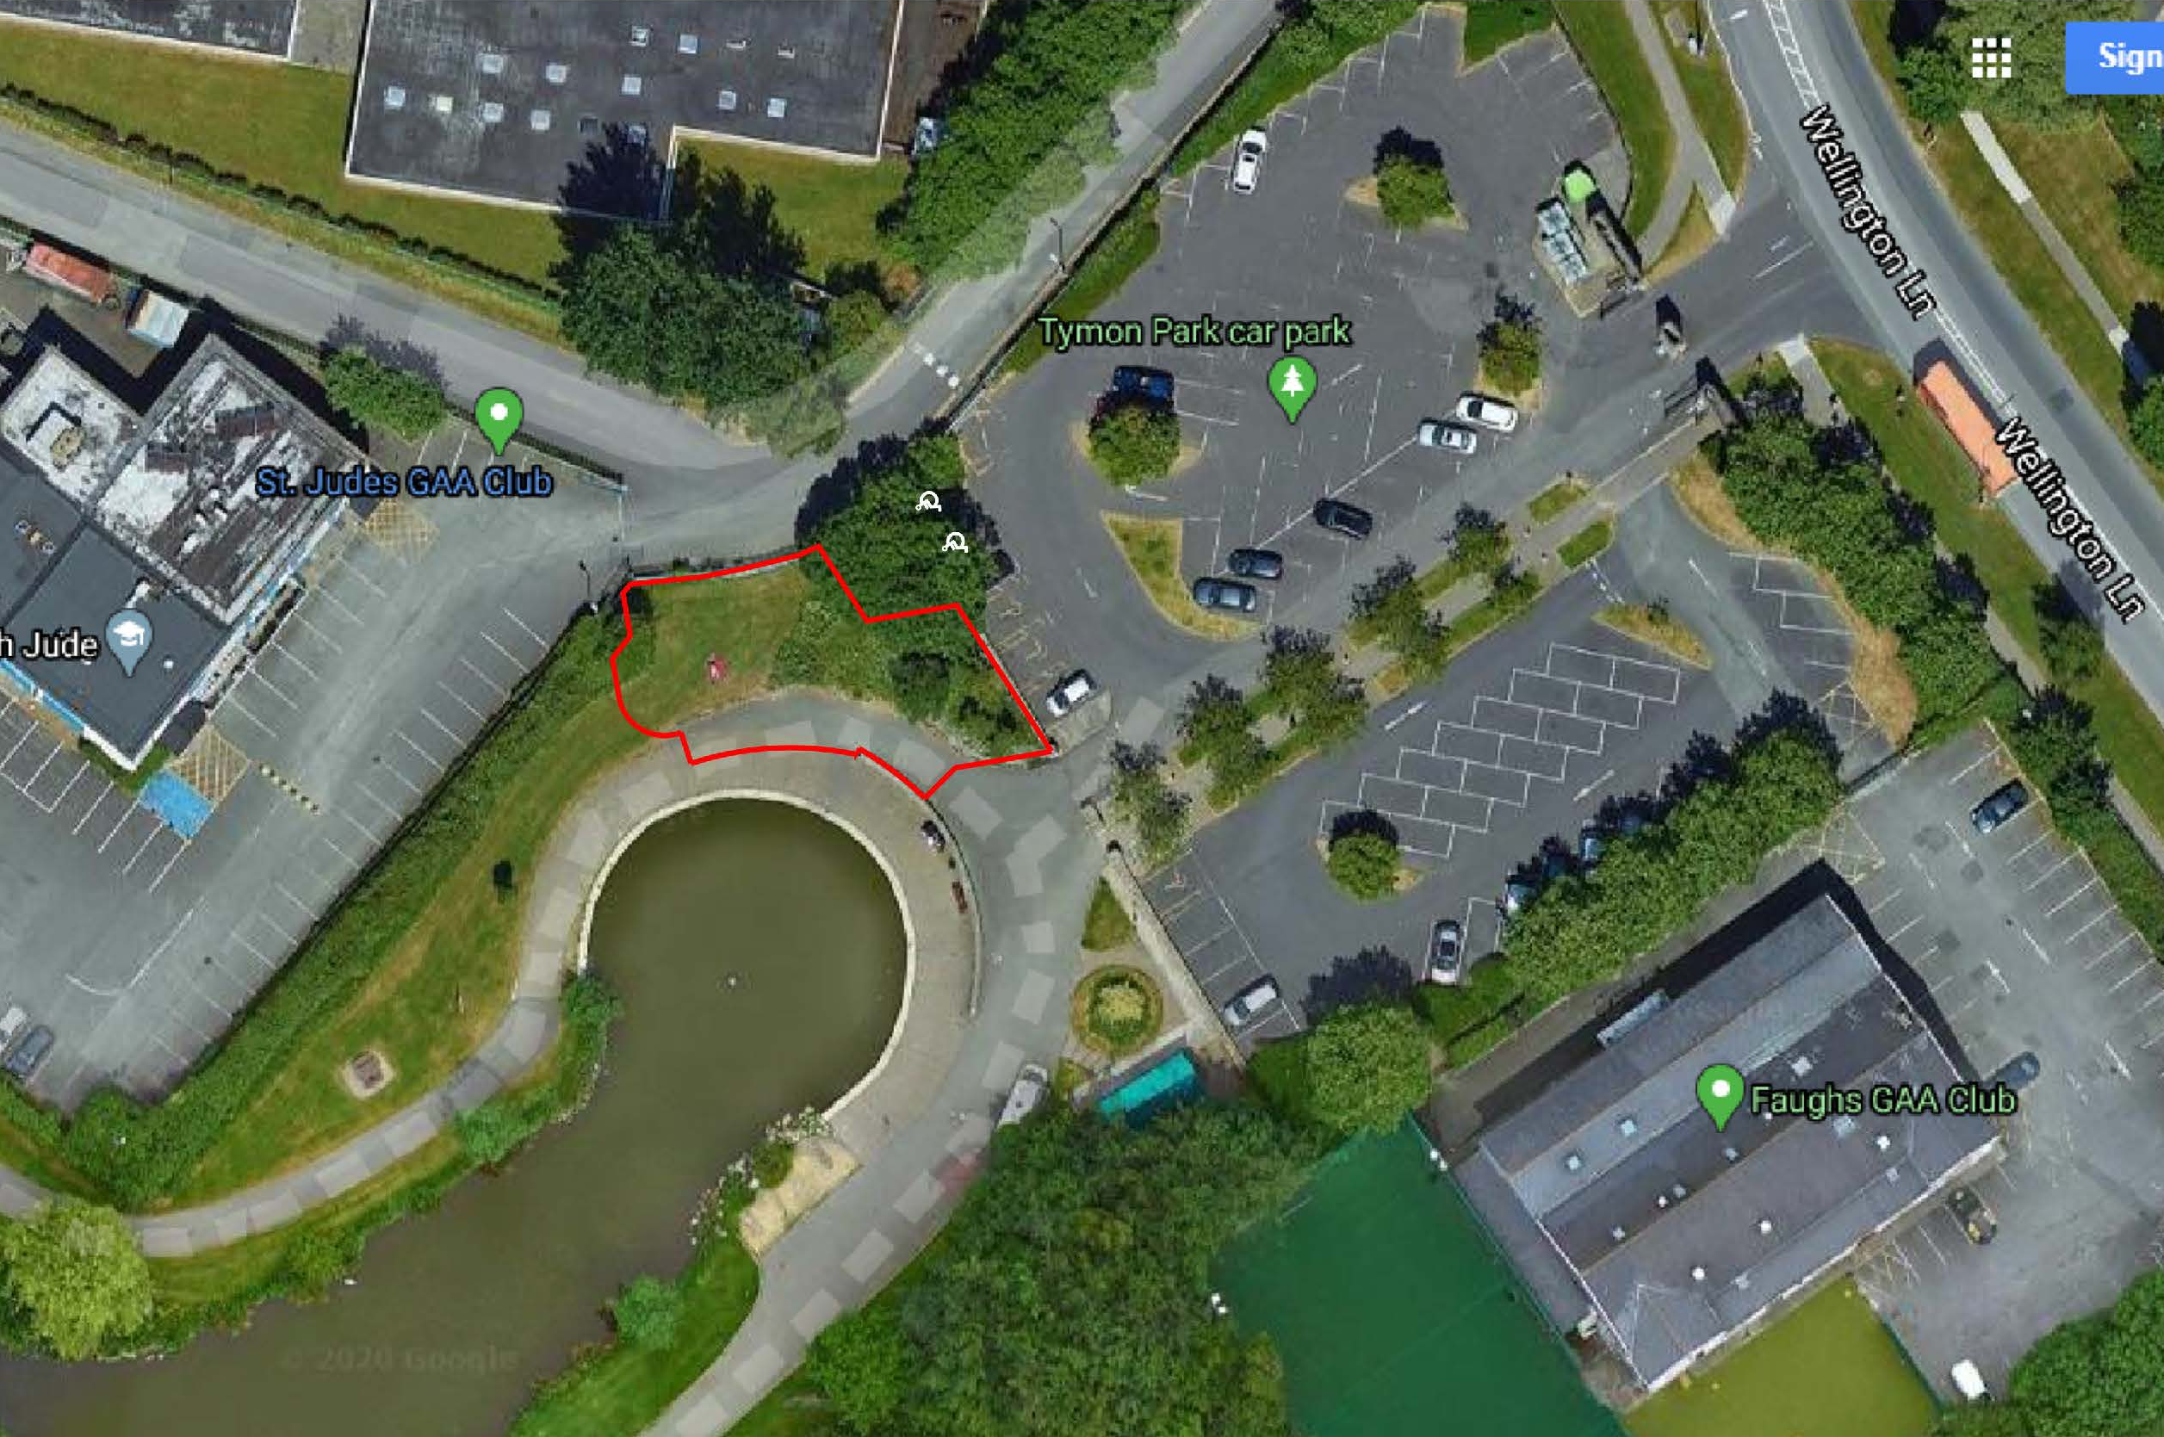
SITE LOCATION
Adjacent to Car Park and Pedestrian Entrance
South Facing
Overlooking the Lake
N
CYCLE
PARKING
SITE
Notes:
LOCATION & SITE
The initial location examined for this facility was Templeogue House.
This has since been reviewed and a new, optimal location for the delivery of this facility has been identified at the Wellington Road entrance to Tymon Park.
This location has a number of advantages:
It’s a busy, high profile location in the park.
It utilises the existing entrance and car park.
And the park is within walking distance of Templeogue village and other nearby centres.

Slide 3
PROPOSED PLAN
The centre can be accessed from the car park via the Multi-functional space and from the park via the Cafe
N
CYCLE
PARKING
Notes:
PROPOSED PLAN
The proposed centre accommodates flexible-use both inside and outside the facility. The Intergenerational Centre provides a medium-sized, multi-functional community space; which can be divided by a partition into 2 smaller, self-contained rooms if required.
The centre will have an entrance from the car park as well as the park which will allow it to be used independently of park opening hours.
It has a complimentary cafe with indoor seating and an outdoor terrace which is sheltered by a feature canopy, overlooking the existing lake, which provides space for outdoor seating and activities.

Slide 4
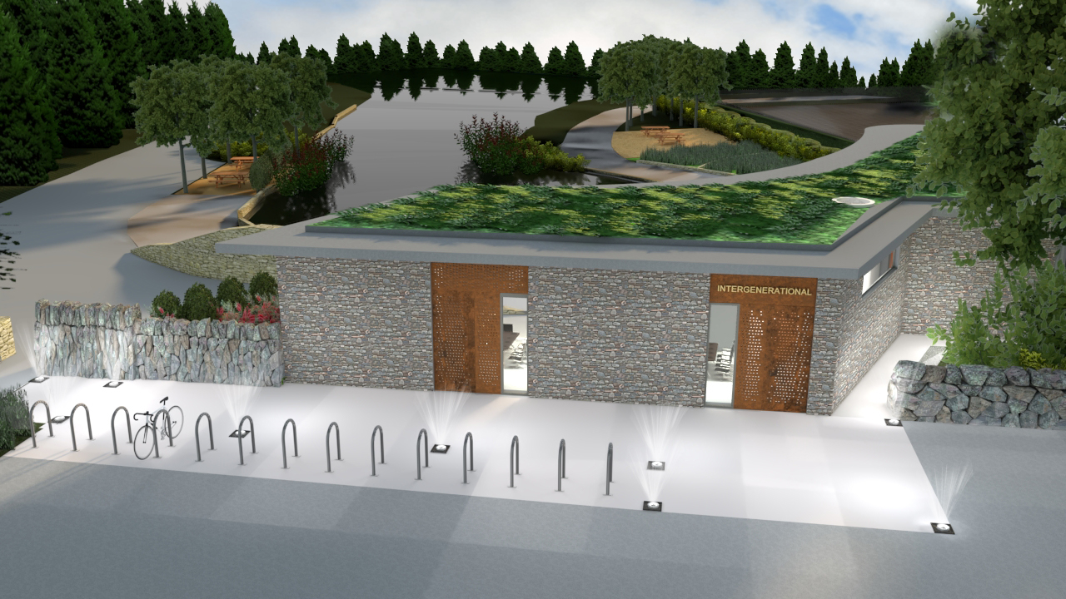
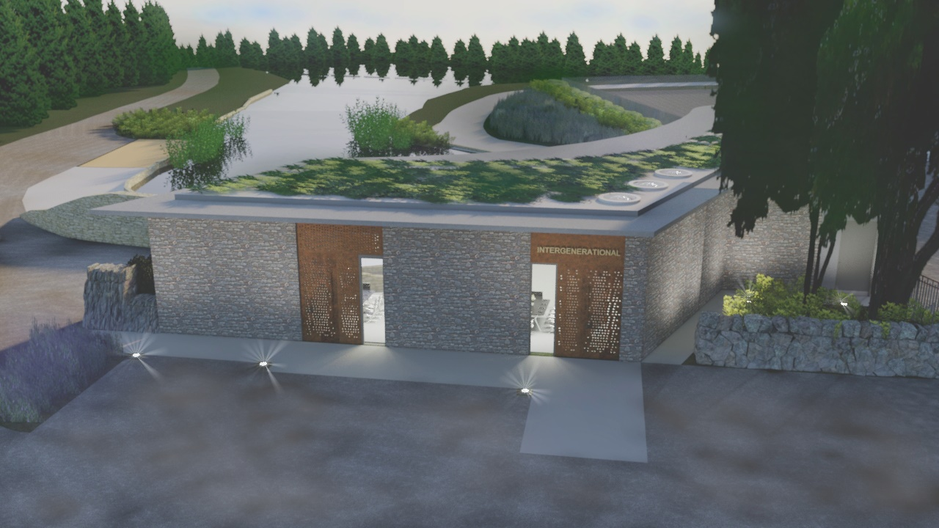
3D IMAGES – CAR PARK/ ENTRANCE VIEW
The multi-function space of the building faces the car park and entrance.
The new stone wall of the building forms part of the parks stone wall.
It is a solid and secure face with feature entrance openings.
Notes:
CAR PARK VIEW
The Multi-function space element of the centre addresses the car park and entrance.
The new stone wall of the building will form part of the parks stone wall.
It will be solid and secure in appearance with feature entrance openings

Slide 5
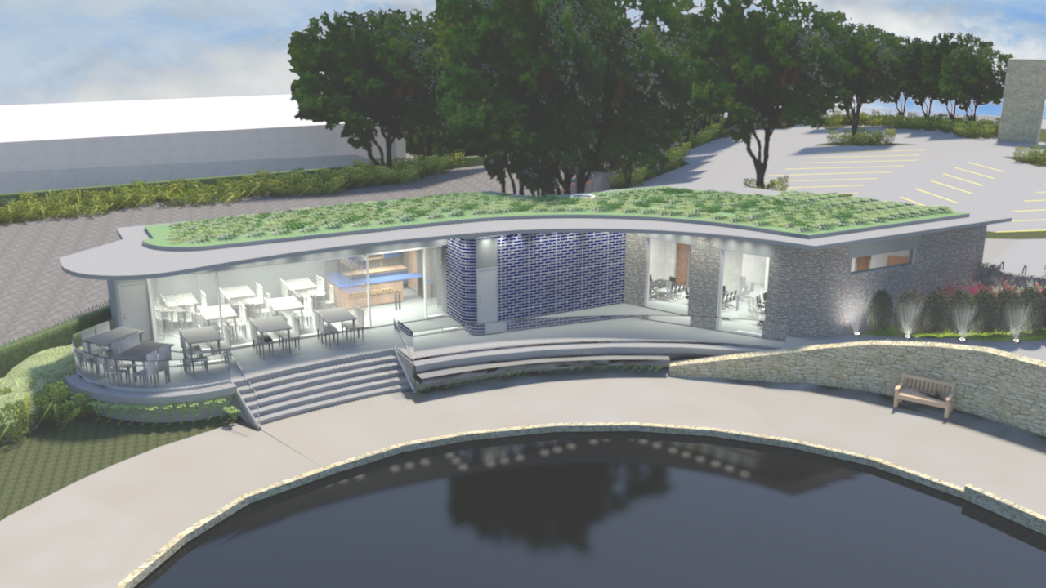
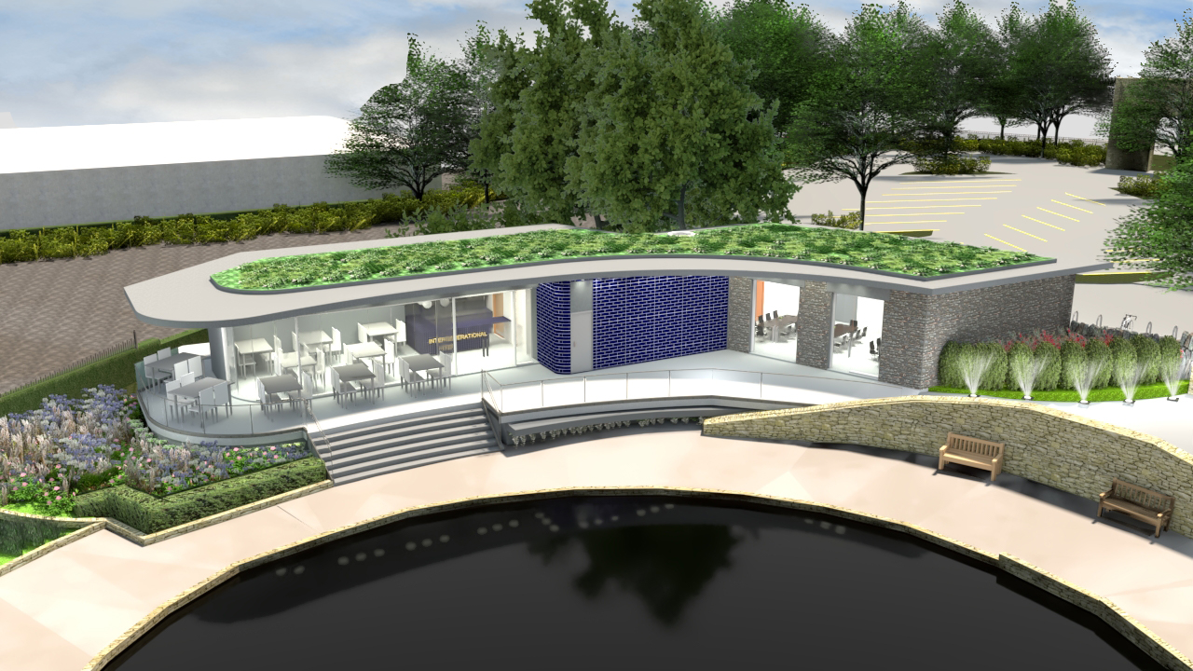
3D IMAGES – PARK VIEW
The Café element opens onto a substantial terrace and the park
with the feature roof canopy allowing sheltered outdoor seating and activities.
Notes:
PARK VIEW
The centre opens to the park with its substantial terrace and feature canopy, embracing a south facing aspect and a close relationship and view of the lake The proposed green planted roof helps to integrate the facility into the park’s landscape.

Slide 6
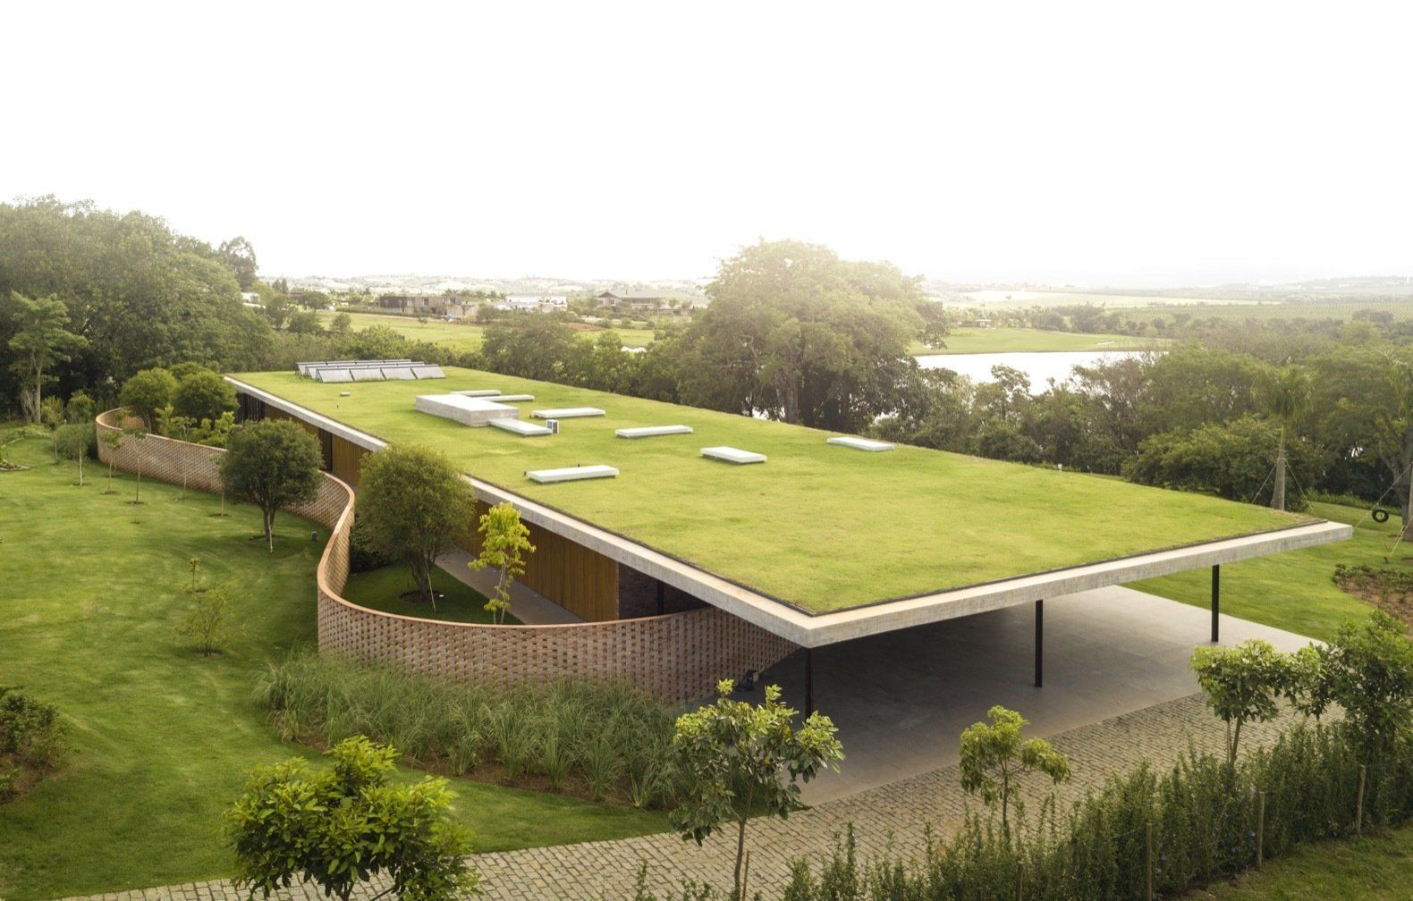
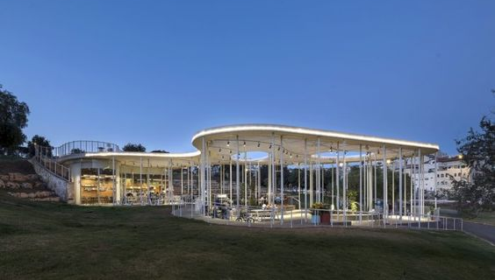
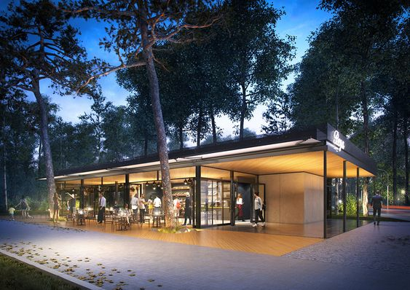
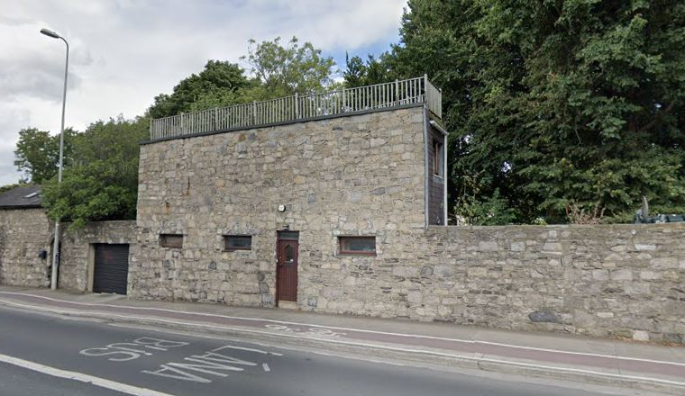
BUILDING REFERENCES
Green Roof canopy integrating the building
into its landscape
Feature curved roof canopy in parkland
Park pavilion with Canopy Roof and Glazed Wall.
Building as part of stone boundary wall
Notes:
BUILDING REFERENCES
These reference examples show similar buildings integrated into their parkland settings with feature canopies sheltering outdoor terraces

Slide 7
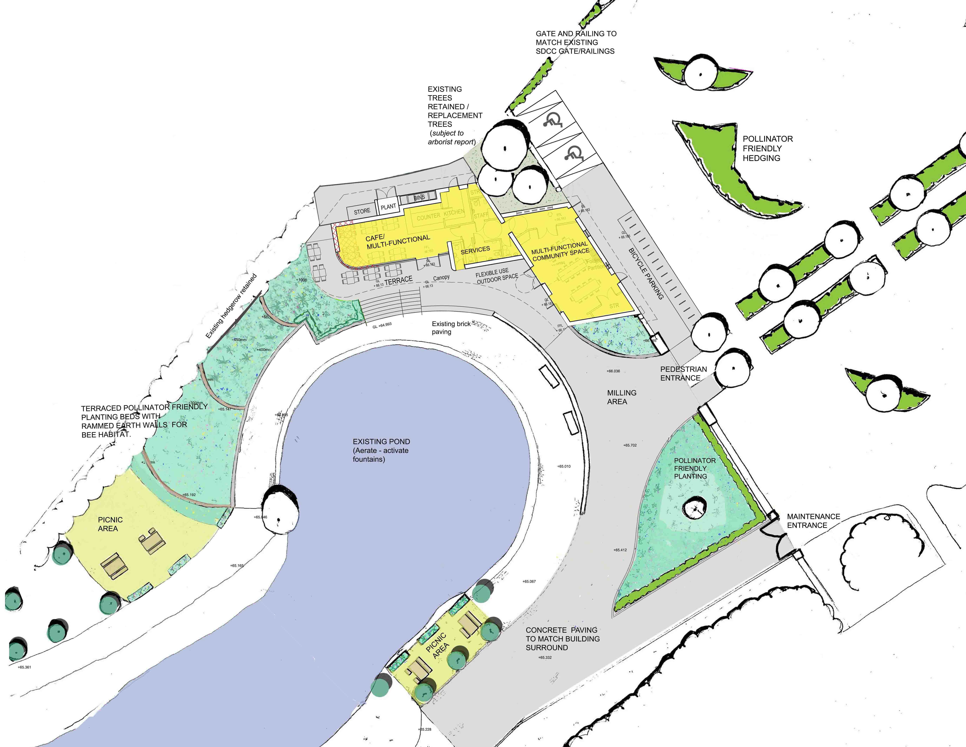
PROPOSED SITE PLAN & LANDSCAPING
The centre opens onto a substantial south facing sheltered terrace which overlooks the lake.
N
CYCLE
PARKING
Notes:
LANDSCAPING PLAN
The landscape plan for the proposed centre, developed by the Public Realm Team, ensures the building is integrated into its wider parkland setting.
It realigns the vehicular route; upgrading the walking route into the park from Wellington Road and provides an enhanced pedestrian entrance to the park flanked by the new building.
It puts emphasis on pedestrian and wheelchair access and provides cycle parking.

Slide 8
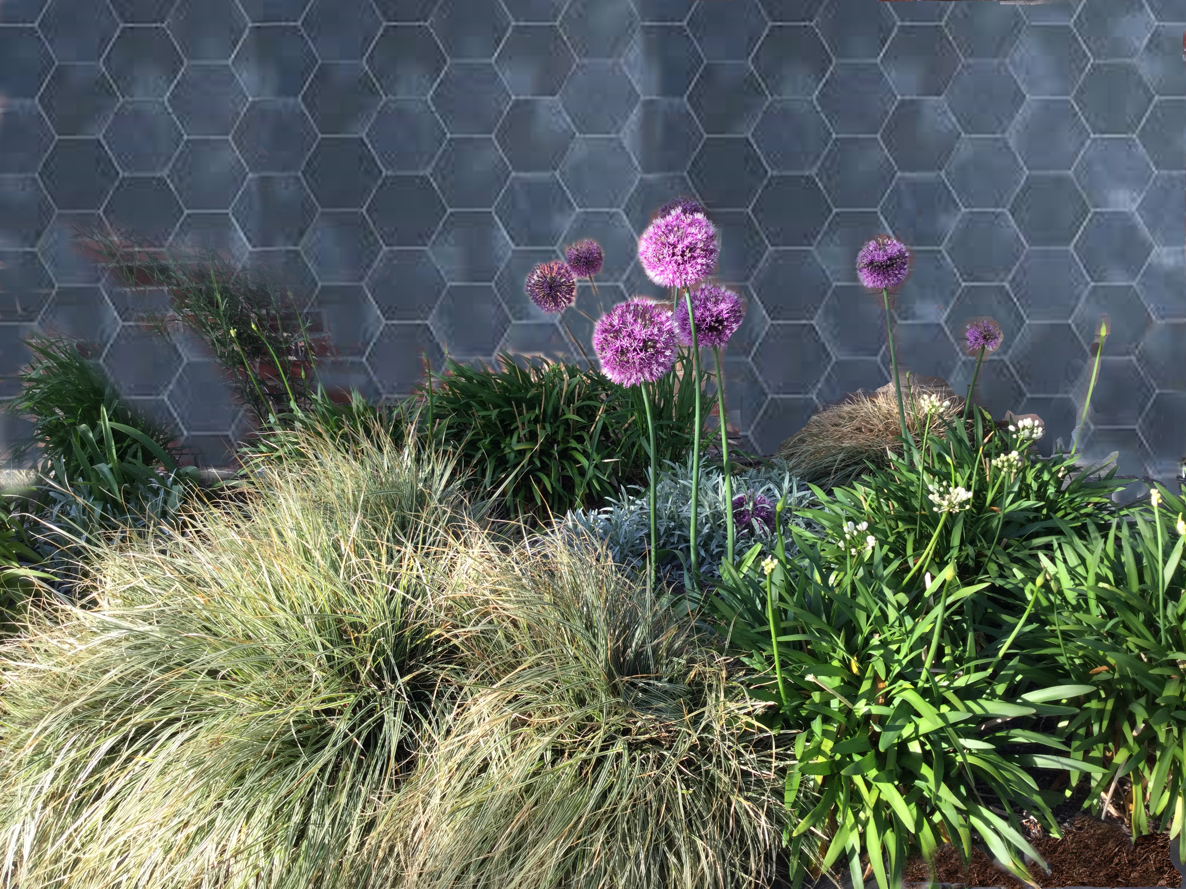
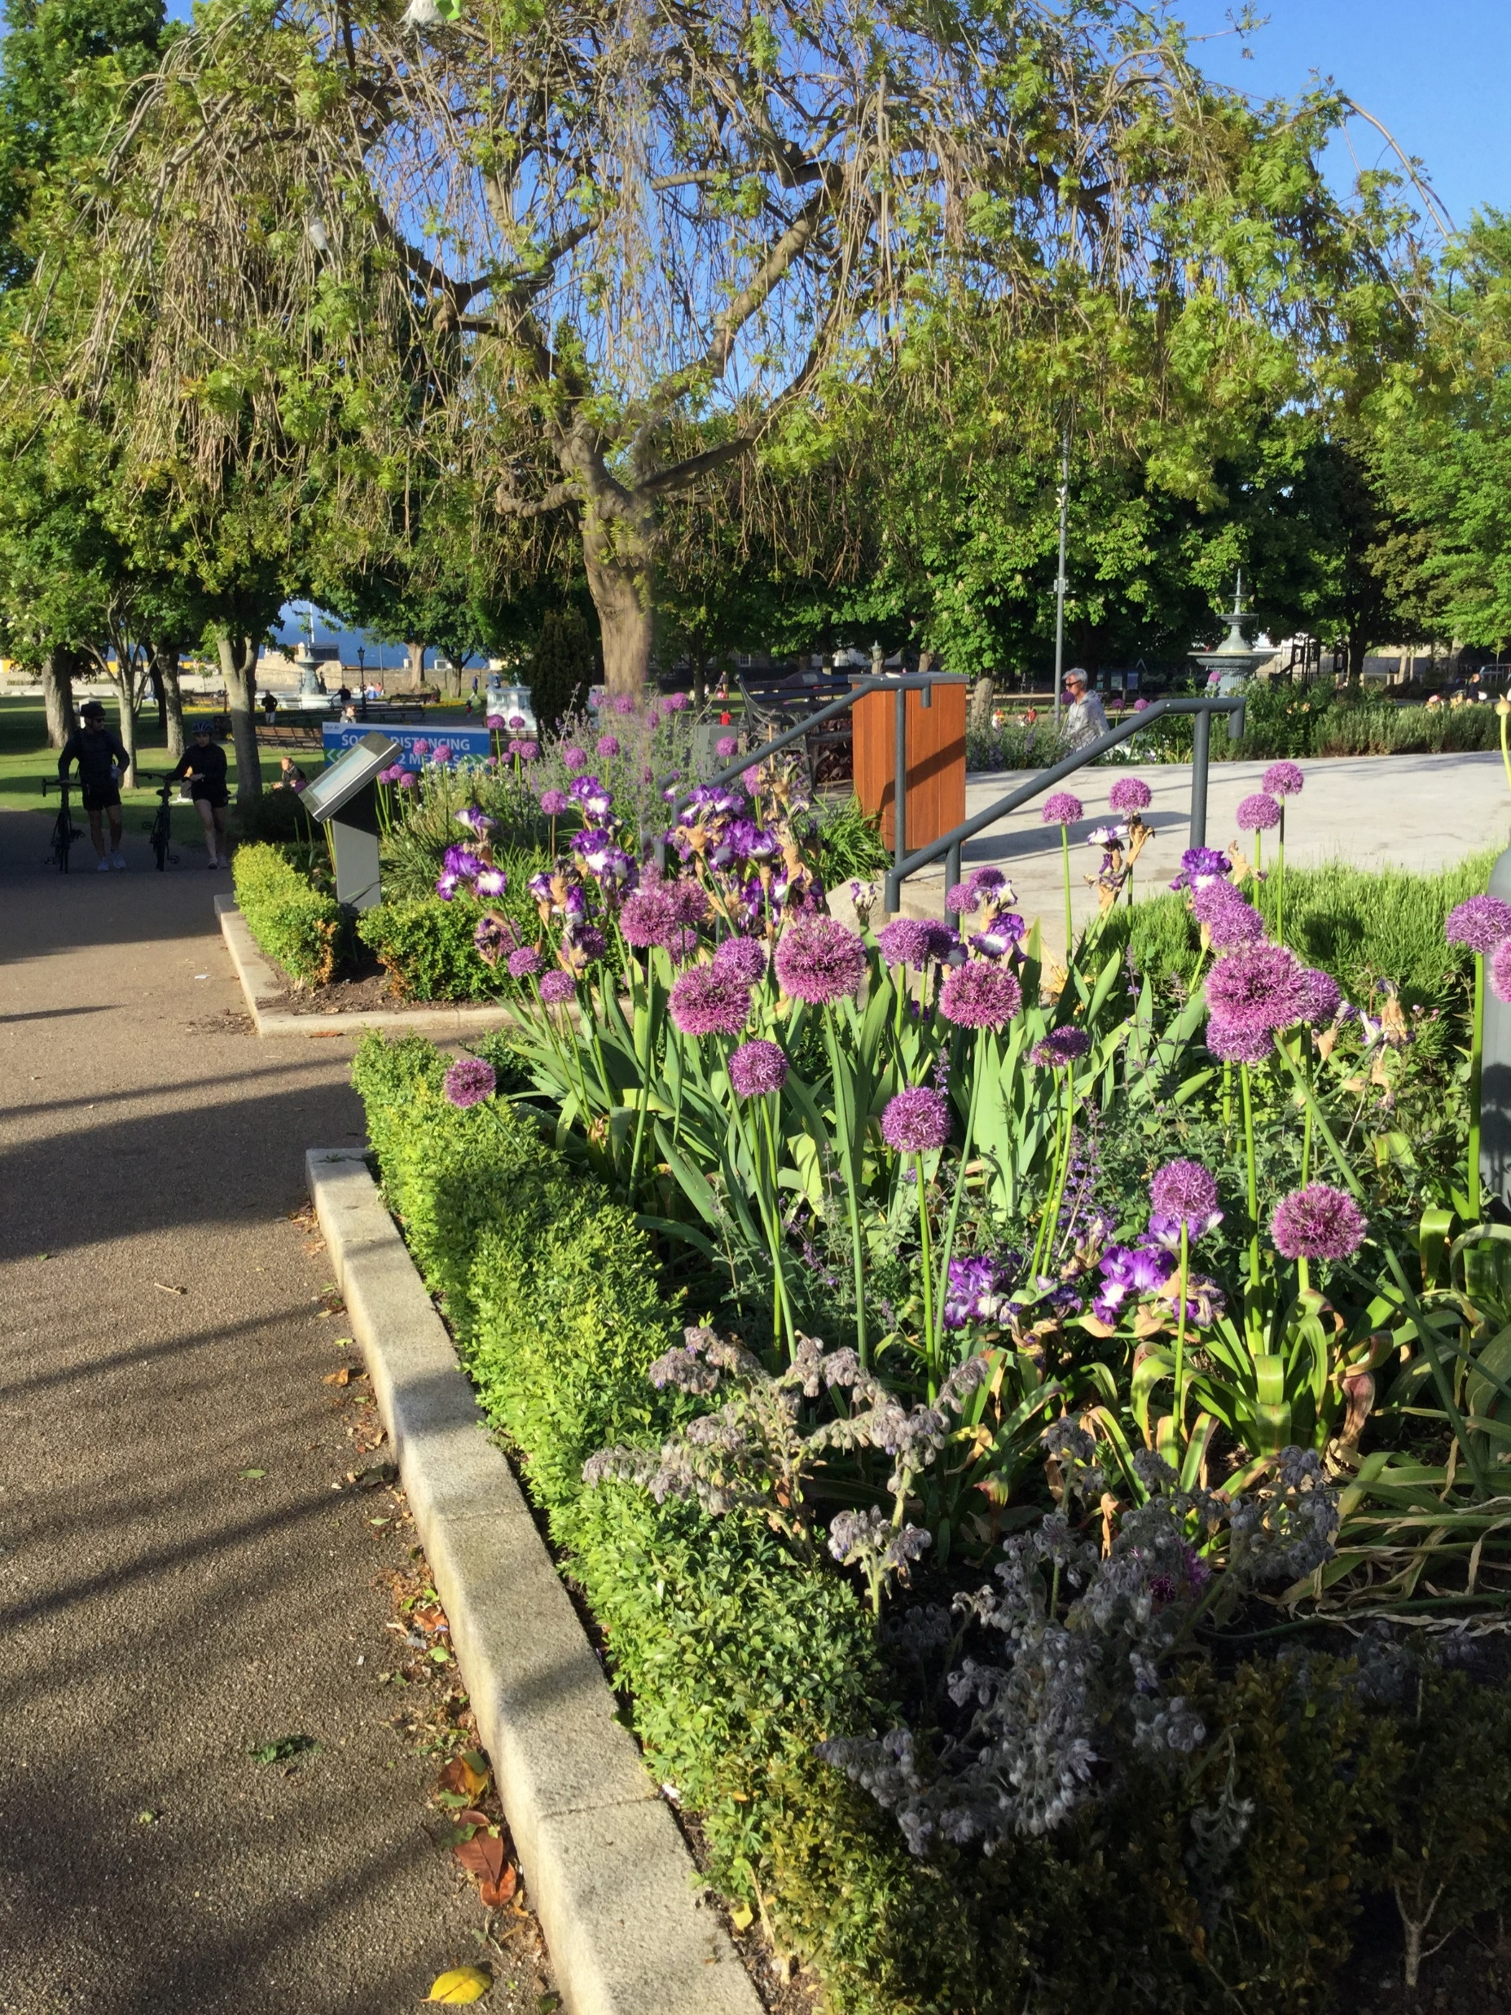
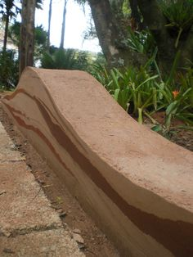
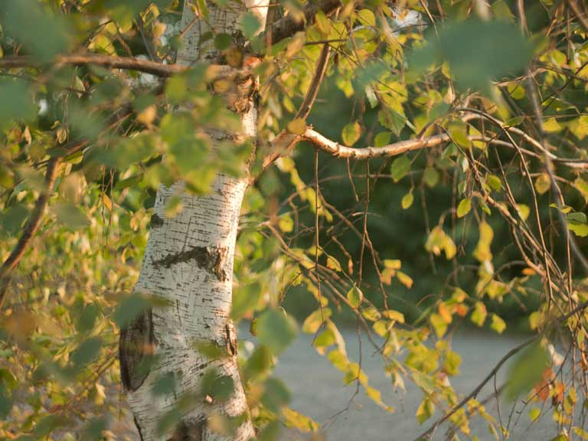
LANDSCAPE REFERENCES
Pollinator friendly planting retained by concrete kerbs & low walls that double as seating,
concrete paving to match building surround.
Rammed earth walls create
solitary bee nesting sites
& retain terraced planting.
Pollinator friendly wild bee planting
Maximise retention of existing trees.
New tree planting.
Notes:
LANDSCAPING EXAMPLES
The landscaping will retain existing trees wherever possible and also provide compensatory planting.
It will provide seating as part of the landscape
and it will enhance the pollinator planting within the area.

Slide 9
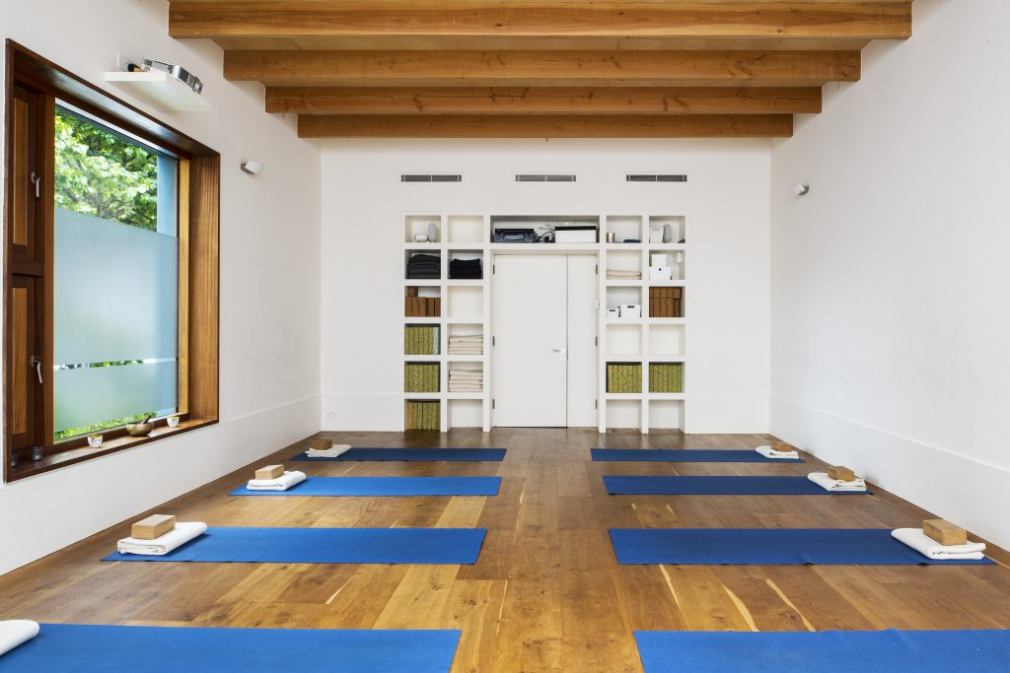
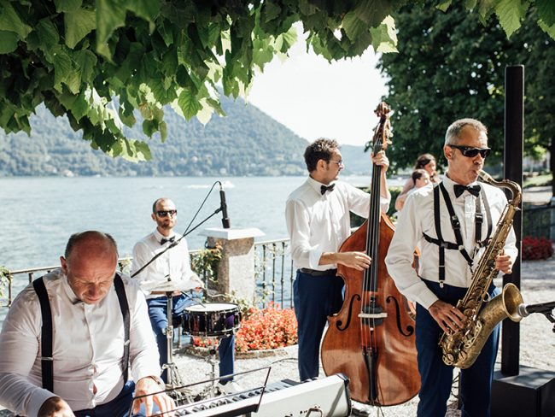
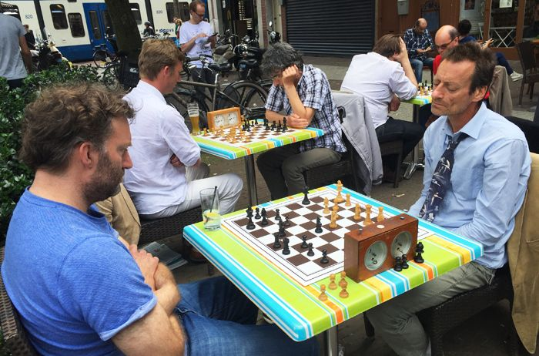
USE REFERENCES- FLEXIBLE MULTI-USE ACTIVITIES
Café/ Tearooms
Yoga Studio
Music Events
Board Games
Notes:
USES
The intergenerational concept develops the idea of a multi-use facility that is adaptable to a variety of purposes.
There are a number of larger function rooms in the surrounding area that cater for the demand for larger gatherings, so this facility is designed for use of small to medium sized groups that require a flexible space for community-type use.
Examples of such uses are:
Active aged and age friendly Groups
Parent and child Groups
Yoga and Pilates classes and keep-fit groups.
Indoor or outdoor performances
Friends of Tymon Park, Tidy Town and Residents Groups
Study Groups, Grind classes and Education groups
Reading, Knitting, Bridge and other card or board games groups
And other small or medium community groups or meetings.
The programming of events and use will be under the management of our Community Services Department.

Slide 10
NEXT STEPS
Preparation and Submission of Part 8
THANKYOU
Notes:
NEXT STEPS
The South Dublin County Council capital budget has made provision of €1.29 million for the proposed Intergenerational Centre at Tymon Park.
We are currently preparing the Part 8 and aim to submit this by the end of Quarter 1, 2021.
We hope we have demonstrated that the proposed Tymon Park Intergenerational centre will meet the needs of the area for a multi-functional facility for all generations, for a range of activities, which embraces its Tymon Park setting and enhances the users experience of the park.
Thank you for your time.

