Slide 1
SHD Application Ref: SHD3ABP-308985-20
Applicant: Cairn Homes Properties Ltd
Location: Cooldown Commons.
Presentation to: Tallaght ACM 25th Jan 2021
Jim Johnston
Senior Executive Planner

Slide 2
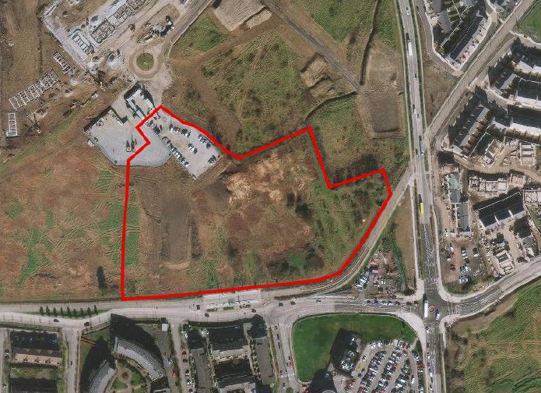

Slide 3
Timelines
SHD Lodged with ABP on 21/12/2020
5 Week Obs by 5.30pm on 02/02/2021
8 Wks SDCC report due to ABP 23/02/2021
16 Week Decision due from ABP 20/04/2021
Consultations
S.247 pre-planning meetings were held with SDCC on SHD1 SPP028/19 on 17/12/2019
A pre-planning meeting SHD2ABP-307008-20 was held on 18th June 2020 with An Bord Pleanala, the applicant and SDCC.

Slide 4
Proposed Development
The proposed development comprises:
construction of 429 residential units, a café (c.210 sq.m), offices (c.500 sq.m), retail units (2 of c.290 sqm and c.250 sqm) and residential amenity area (c.520 sqm), within 9 blocks ranging in height from 1 – 15 storeys.
The residential comprises: 111 no. 1 bed units, 288 no. 2 bed units, 30 no. 3 beds (all with associated private balconies/terraces to the north/south/east/west elevations).
286 car parking spaces (178 at basement and 108 at surface level) along with 650 cycle parking spaces.
The development will provide public and communal open spaces throughout including a public plaza adjoining Fortunestown Luas stop.
Provision of vehicular, pedestrian, and cyclist accesses to the site, including pedestrian bridge to the public park (under construction) to the east.
The application includes for all landscaping, ESB substations, plant areas, bin storage, surface water attenuation and all other site development works, and site services required to facilitate the proposed development.

Slide 5
Proposed Development (continued)
The proposed development seeks to amend SHD permission ABP-302398 -18 (under construction to the west), replacing 32 permitted duplex apartments along with associated amendments to internal roads and open spaces. The current proposal also replaces permission SD16A/0078 previously granted on this site.
An Environmental Impact Assessment Report has been prepared in respect of the proposed development.

Slide 6
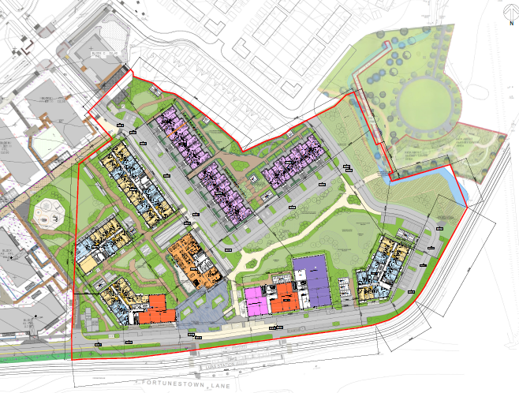
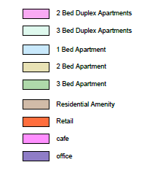

Slide 7
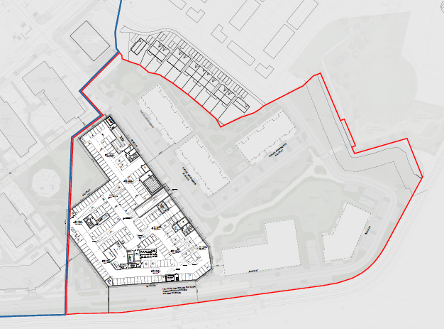

Slide 8
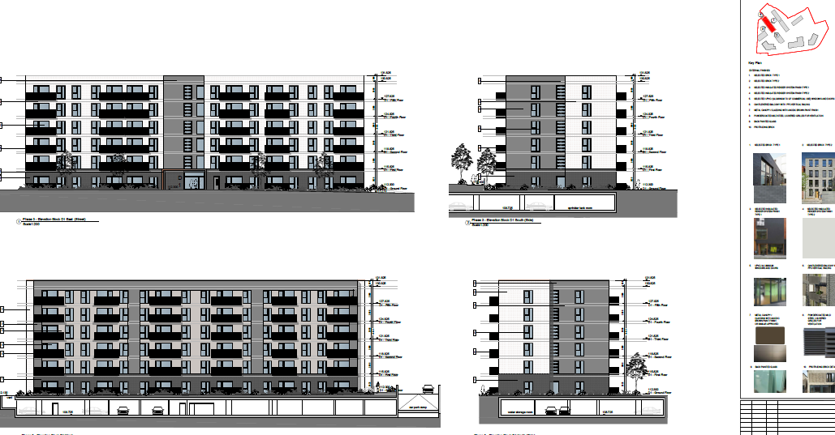
Block D1

Slide 9
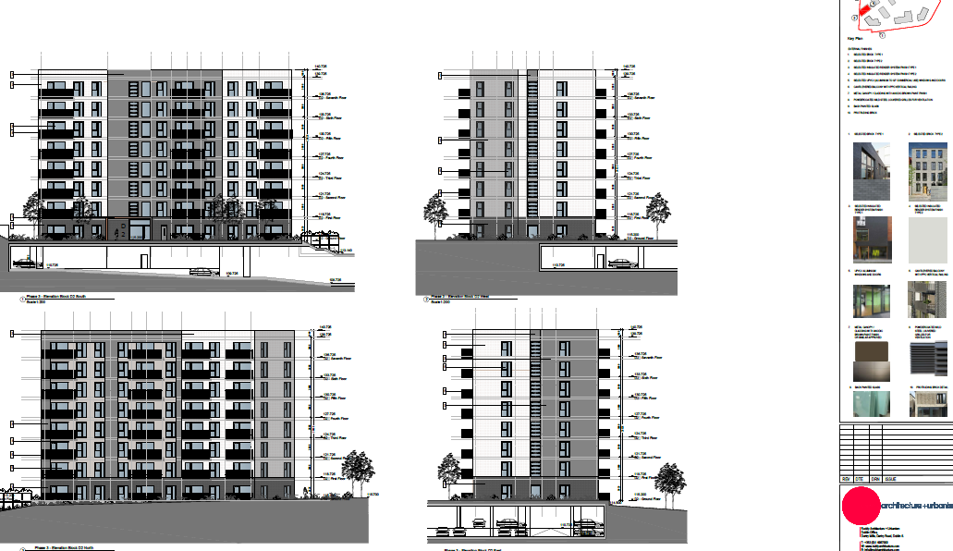
Block D2

Slide 10
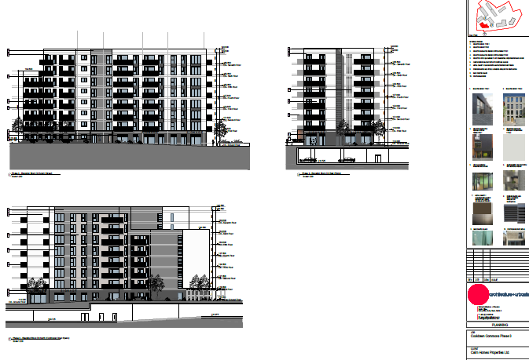
Block D3

Slide 11
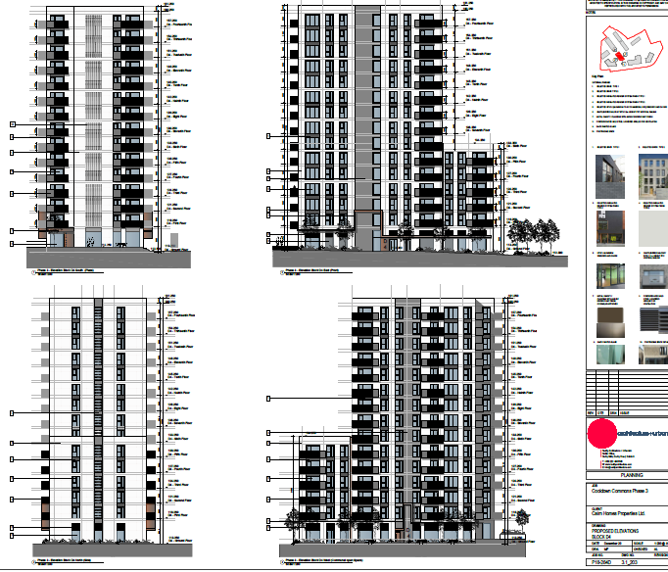
Block D4

Slide 12
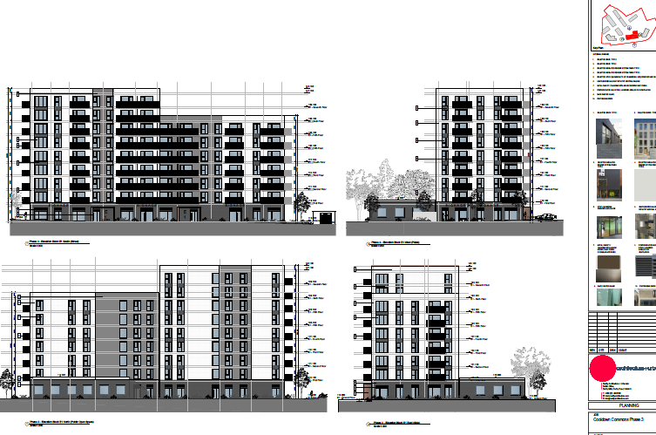
Block E1

Slide 13
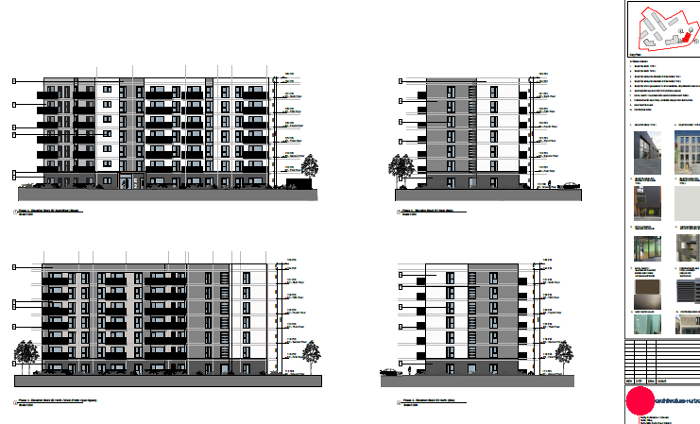
Block E2

Slide 14
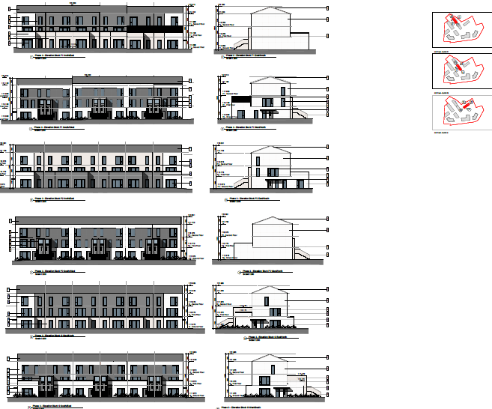
Block FI, F2 and G

Slide 15
ABP comments – the Bord requested that the following issues be addressed
1. consistency with the Development Plan/Local Area Plan and any material contravention of these plans.
2. residential amenity (both existing and future residents of nearby development and future occupants), addressing any potential overlooking of the permitted development to the north-east of the site, from the proposed duplex units. Drawings showing the relationship between the proposed development and nearby existing and permitted residential development including:.
- daylight/sunlight impacts,
- overshadowing,
- overbearing
- noise
- analysis of wind microclimate at ground level
3. site services and flood risk referred to in Water Services report dated 1st May 2020, and Irish Water report dated 18th May 2020 regarding SuDS and third party consents for foul and water infrastructure.
Flooding details including existing drainage ditch flows through the site and how this will be maintained post-development. Any history of flooding on or around the site.

Slide 16
4. issues raised by the Roads Department in their report dated 28/04/2020, including:
- details/purpose of the 4.8m wide road to the north of the Luas Stop;
- a reduction in the rate of car parking proposed on the site
- drawings showing links to adjacent sites, including the link/footbridge connection to the proposed neighbourhood park to the east of the site
- revised entrance proposals to the basement car park or further justification for the single entrance as proposed;
- Mobility Management Plan;
- Public Lighting Scheme;
- Construction Management Plan.
5. A landscaping plan which sets out proposals for hard and soft landscaping including street furniture and addresses issues in Parks report atd 11/05/2020 including details of play and fitness items; SuDS features; planting plan and cross-sections.
6. Landscape and Visual Impact Assessment with photomontages and CGIs
7. Viability Study for the proposed retail unit.
8. A Social Infrastructure Capacity Report.
9. A site layout plan showing ‘Taking in Charge’ areas
10. AA Screening report.

Slide 17
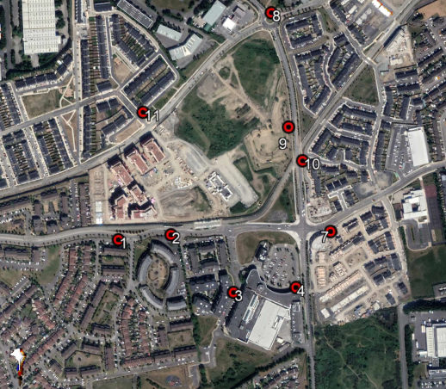

Slide 18
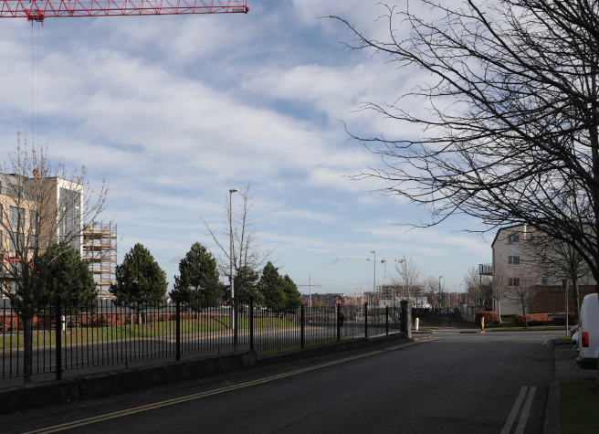
View from south west

Slide 19
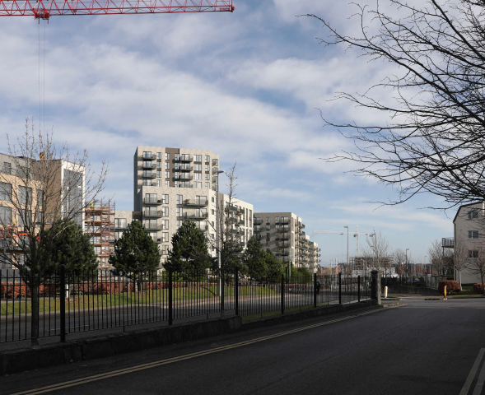

Slide 20
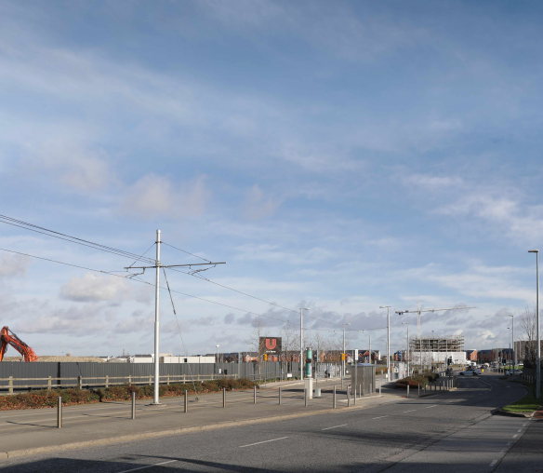
View from south west

Slide 21
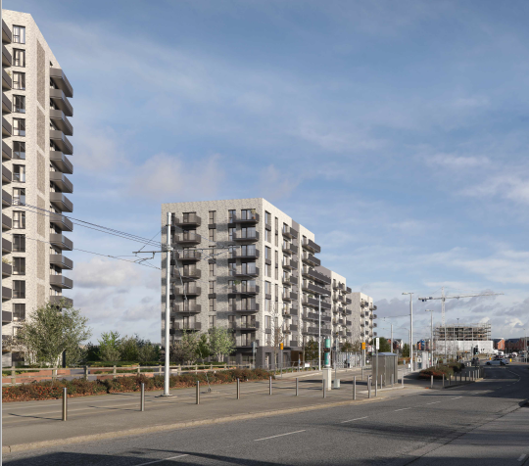

Slide 22
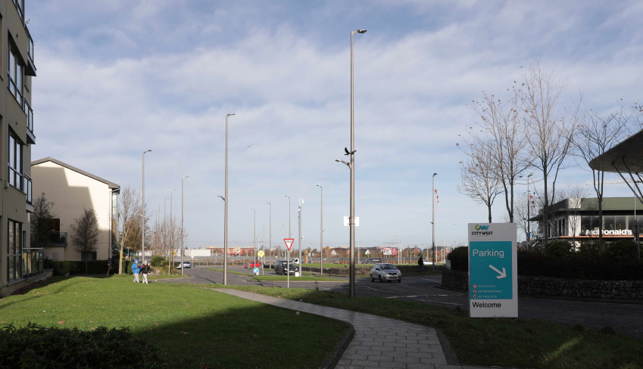
View looking north from beside McDonalds

Slide 23
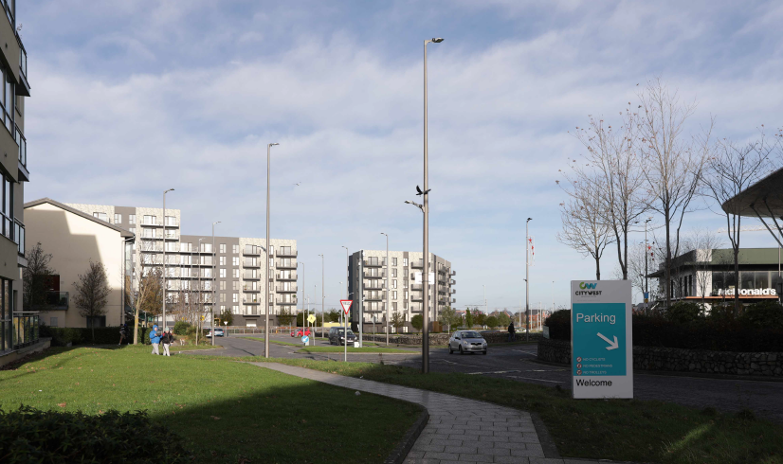

Slide 24
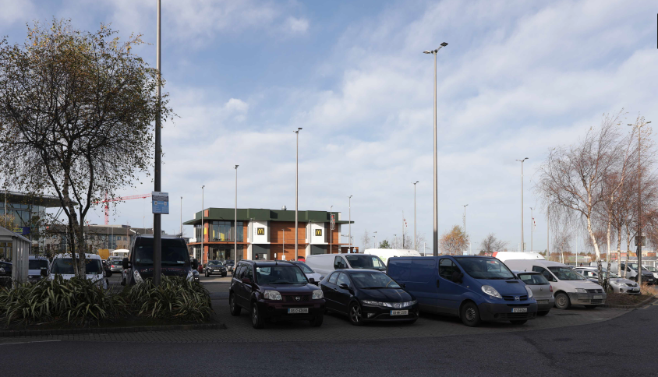
View looking north west (McDonalds in foreground)

Slide 25
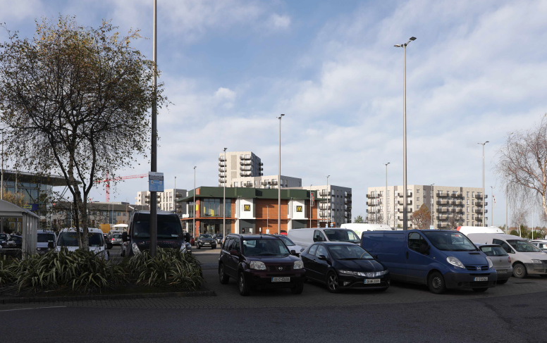

Slide 26
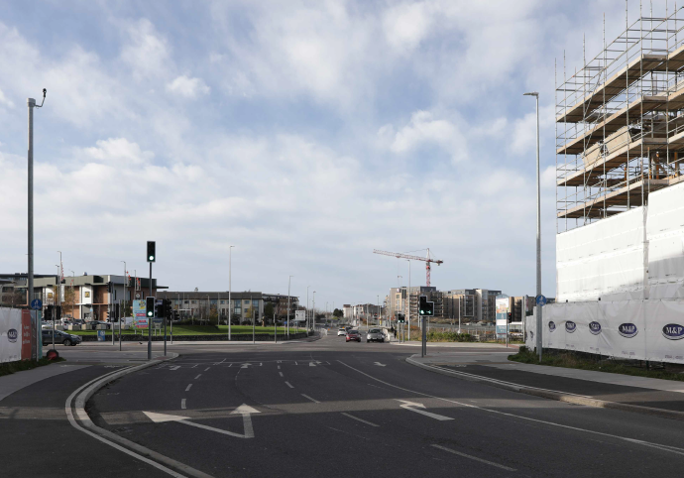
View looking west – (Citywest shopping centre to left)

Slide 27
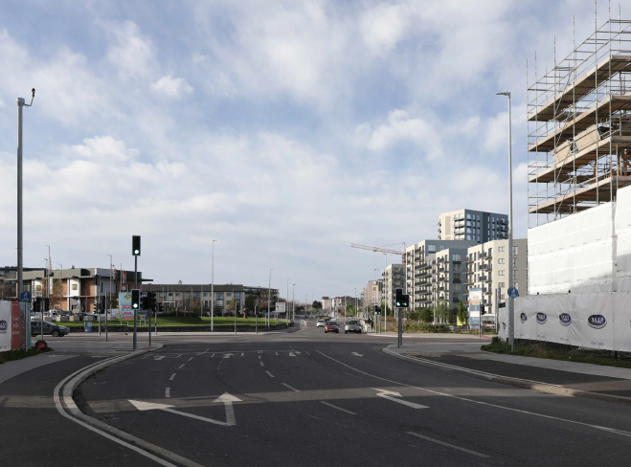

Slide 28
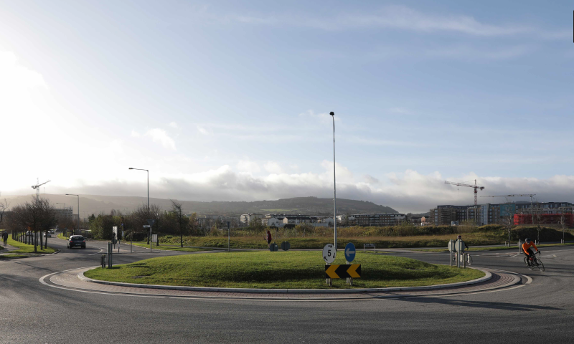
View looking south towards mountains

Slide 29
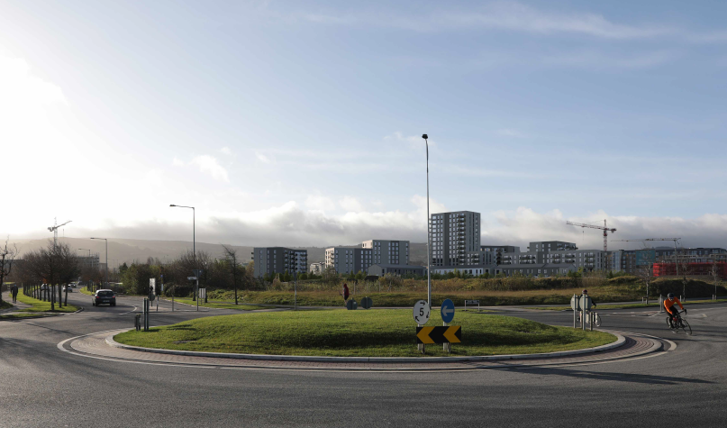

Slide 30
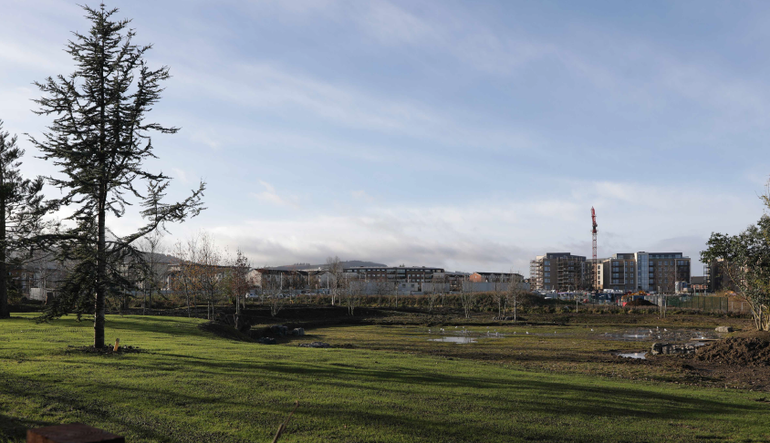
View looking south west with mountains in background

Slide 31
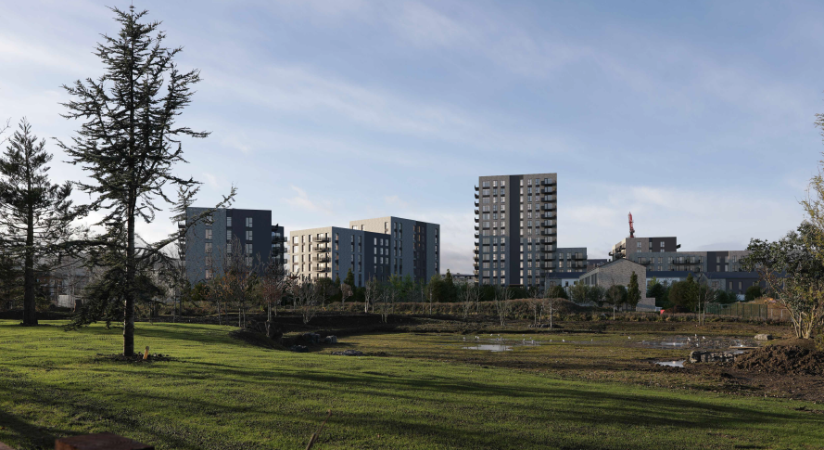

Slide 32
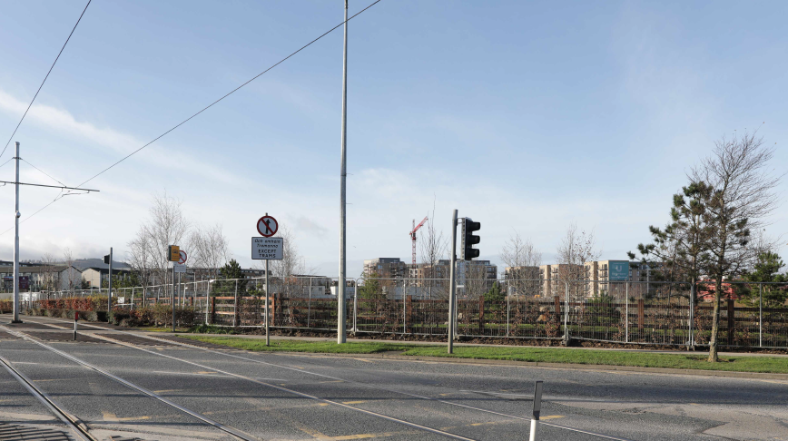
View west from luas line

Slide 33
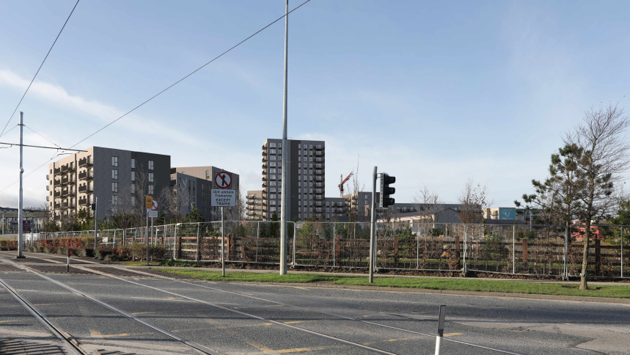

Slide 34
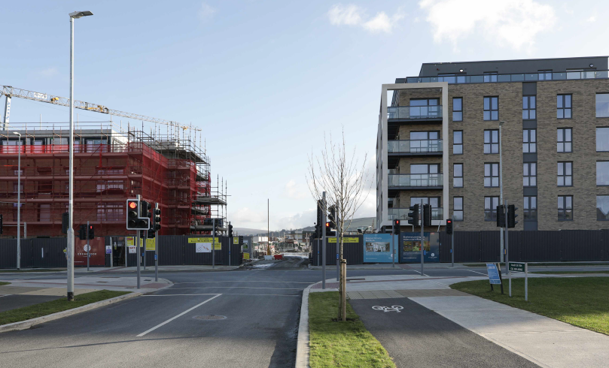
View south looking into site

Slide 35
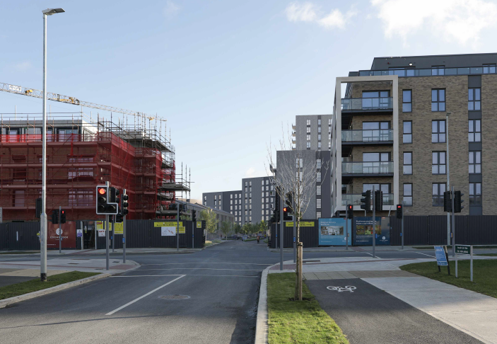

Slide 36
Statistics for Proposed Development
Proposal - 429 residential units comprising:
111 1-bed (26%)
288 2-bed (67%)
30 3-bed (7%)
Site area – 3.404 ha
Density – 126 units per ha
Plot ratio – 1.27
Site coverage – 22%
Height – 9 blocks from 1 to 15 storeys
Dual Aspect apartments – 59%
Public and communal open space – 10,482sq.m.(31%)
Car parking – 286 (108 surface;178 basement) Cycle parking - 650
Non-residential use – café (210sq.m), offices (500sq.m), retail units (2 of 290 sqm and 250 sqm)

Slide 37
Thank You
Questions

