Slide 1
Part 8 Report on Public Consultation for the proposed development of an Integrated Constructed Wetland in Kilnamanagh.
Meeting of South Dublin County Council
11th January 2021

Slide 2
Presentation Outline
This presentation is a brief summary of the Part 8 proposal, the summarised submissions received during the public consultation process, the responses by the CE to those consolidated submissions and finally a recommendation by the CE.
This presentation draws from the Chief Executive’s Report on this Part 8.

Slide 3
Project Outline
The development will consist of the construction of an Integrated Constructed wetland (ICW) and associated landscaping, totalling approximately 1.3ha at Kilnamanagh.
To treat and improve surface water quality, before discharging to the Kilnamanagh Stream.
Proposed works to include wetland planting scheme to optimise stormwater treatment and integrate the benefits from its associated wetland infrastructure to deliver a wide range of environmental returns, such as the protection and enhancement of biodiversity, the delivery of good ecological status of rivers, the protection of fisheries and improved landscape aesthetics.

Slide 4
Project Outline
Proposed new surface water piped links between the existing surface water system and the Integrated Constructed Wetland and perimeter fence, a new surface water outfall to the Kilnamanagh Stream, reprofiling of levels and landscaping within the green space.
All ancillary site development and landscaping works, including biodiverse planting, furniture, and pathways.

Slide 5
Part 8 drawings and reports
Plans and reports for the proposed development are shown on the following links:
Summary Report Kilnamanagh ICW PART 8
Drawings Kilnamanagh ICW Part 8
AA Screening Report Kilnamanagh ICW Part 8
EIA Screening Report Kilnamanagh ICW Part 8
Ecological Survey Report Kilnamanagh ICW Part 8
Archaeological Assessment Report Kilnamanagh ICW Part 8
Site Notice Kilnamanagh ICW Part 8
Newspaper Notice Kilnamanagh ICW Part 8

Slide 6
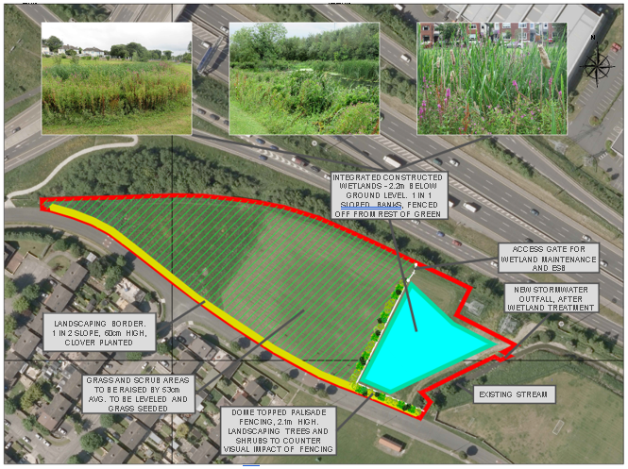
Site Location and Context

Slide 7
Public Consultation Submissions
Plans and particulars of the proposed development were on public display for over six weeks from 5th November 2020 to 18th December 2020 (inclusive). During the public consultation, information on the integrated constructed wetland (ICW) development was disseminated to the public and submissions were invited.
Submissions
Submissions were categorised into the following:
No. | Category of Submission | Count
1 | Loss of (unofficial) pitch for Kilnamanagh AFC/effect on club | 88
2 | Alternative space for children (query) | 68
3 | Support of ICWs as a concept | 14
4 | Loss of playing space for children (not KAFC specific) | 9
5 | Housing estate not suitable for ICWs (suitable for parks only) | 6
6 | Health & Safety concerns due to depth of ICW | 6
7 | Anti-social behaviour concerns | 4
8 | Statutory consultee submissions | 2
9 | Footballs lost to enclosed wetland | 1

Slide 8
Submissions
All submissions can be viewed using this Link
There was one hundred and three (103) including one from Inland Fisheries Ireland (IFI), one from Transport Infrastructure Ireland (TII), and one from Kilnamanagh AFC Link
IFI have requested to see the detailed design to endure that the riparian zone is protected and that it is an environmentally sensitive design. All construction work must be done in line with a detailed site-specific Construction Environmental Management Plan (CEMP) and requested environmental monitoring of the local stream. Both request will be complied with if the project progresses.
TII have enquired if the proposal will affect drainage at the M50 which it will not.

Slide 9
Submissions
There were a significant number of submissions from parents of children associated with Kilnamanagh AFC (KAFC) and those submissions expressed concerns about the temporary or permanent loss of the unofficial pitch operated by KAFC at the green space which the proposed wetland will encroach upon.
Council staff met with KAFC on site and subsequently prepared a landscape drawing (next slide) showing a size compliant pitch (90mx45m) in the green space after completion of the development which Kilnamanagh could apply for an allocation.
While the wetland and associated landscaping is under way the Council suggested KAFC could apply for an allocation of a vacant pitch (No.128) in Tymon Park.
Other concerns related to appropriateness of a wetland in a housing estate, health and safety, and anti-social behaviour. These are addressed in the CE report.

Slide 10
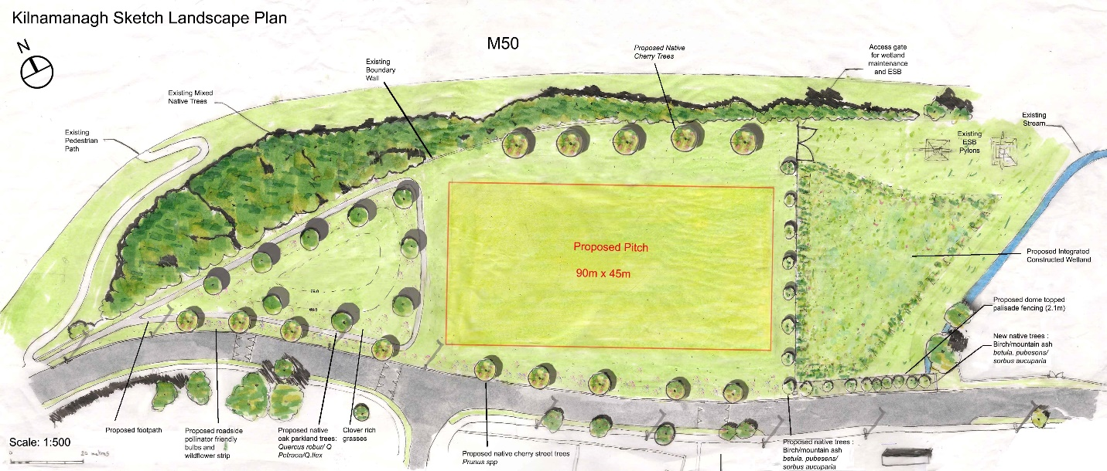
Landscape drawing

Slide 11
Recommendation in CE Report
The CE Report recommends the follow:
“As the proposed development is in accordance with the proper planning and sustainable development of the area, the Council approves the development of an integrated constructed wetland (ICW), new stormwater outfall to the Kilnamanagh Stream and associated landscaping on Council owned lands in Kilnamanagh, Tallaght, Dublin 24”

Slide 12
Summary
Submissions fully addressed in the CE Report.
Proposal considered to be in accordance with proper planning and sustainable development of the area.
Recommendation to Council to proceed with the proposed Integrated Constructed Wetland.

