Slide 1
Part 8 Report on Public Consultation for the proposed development of an Integrated Constructed Wetlands in Dodder Valley Park.
Meeting of South Dublin County Council
11th January 2021

Slide 2
Project Outline
Development of works totalling approximately 1.6ha at Dodder Valley Park
Build two new Integrated Constructed Wetlands coded DR033 (Drawing: DURL-SDCC-DVP-D008) and DR035 (Drawing: DURL-SDCC-DVP-D009)
To treat and improve surface water quality, before discharging to the River Dodder.
Proposed works to include wetland planting scheme to optimise stormwater treatment and integrate the benefits from its associated wetland infrastructure to deliver a wide range of environmental returns, such as the protection and enhancement of biodiversity, the delivery of good ecological status of rivers, the protection of fisheries and improved landscape aesthetics..
Proposed new surface water piped links between the existing surface water system and the Integrated Constructed Wetlands and a new surface water outfall to the River Dodder doe wetland DR033. Reprofiling of levels and small landscaping berms within the two proposed ICW green areas.
All ancillary site development and landscaping works, including biodiverse planting, furniture, and pathways.

Slide 3
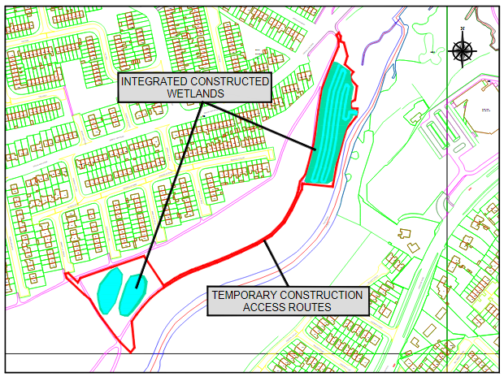
Site Location and Context

Slide 4
Public Consultation Submissions
Plans and particulars of the proposed development were on public display for over six weeks from 5th November 2020 to 18th December 2020 (inclusive). During the public consultation, information on the integrated constructed wetland (ICW) development was disseminated to the public and submissions were invited.
Submissions
There were two submissions, one from Inland Fisheries Ireland (IFI) and one from the Tallaght Community Council (TCC).
IFI highlighted that ICW’s are only part of the solution and the door-to-door inspections and encouraging proper connection of grey water to the foul sewer is also important.
IFI have requested to see the detailed design to endure that the riparian zone is protected and that it is an environmentally sensitive design. All construction work must be done in line with a detailed site-specific Construction Environmental Management Plan (CEMP).
IFI also suggested a comprehensive water quality programme of physico-chemical and biological parameters in order to confirm the treatment performance of the ICW and the impacts on the receiving waters.

Slide 5
Submissions (contd)
The Tallaght Community Council’s submission is supportive of wetlands generally but questioned the siting at the locations chosen and queried why other location were not chosen.
The submission supports the ICW on the sloped site but had a number of concerns in relation to the second site.
The Heritage of the site and the history of Mills was raised.
The existing sports use and conflict with nature of a wetland with these uses.
TCC requested that the wetland bring colour to the park and not just shades of green.
Sightlines for personal safety were raised, as were fly-tipping and the type of fencing proposed.

Slide 6
Submission Response
Response to IFI
Work in relation to door-to-door inspection and encouraging proper connection to the foul sewer is also part of the Dublin Urban Rivers Life Project (DURL) and will be progressing as part of the DURL project.
During design process the DURL project will liaise with IFI through the process.
The requirement for a detailed site specific Construction Environment Management Plan (CEMP) will be included in the tender process and in place for the construction phase should the development be approved.
Finally in relation to a comprehensive water quality programme, water quality monitoring is currently happening and will continue throughout the DURL project.

Slide 7
Submission Response (Contd.)
Response to TCC
The siting of the proposed wetland went through a detail process in order to achieve this goal and there were only a limited number of locations meeting the requirements.
Archaeological Assessment of the location was carried out for the sites.
In relation to the compatibility with other uses such as sport and recreation, the ICW can add to the amenity value and the enjoyment of the park for park users.
The ICW will be planted with some flowering species as outlined in the Summary report, the items raised in relation to dumping and fencing will be assessed during the design process should planning be granted.

Slide 8
Summary
Submissions fully addressed in the CE Report.
Proposal considered to be in accordance with proper planning and sustainable development of the area.
Recommendation to Council to proceed wit the proposed Integrated Constructed Wetland.

