Slide 1


Headed Item 11
Part 8 Report on Public Consultation for Proposed Development of Social Housing at Lindisfarne, Clondalkin.
Meeting of South Dublin County Council
14th December 2020

Slide 2

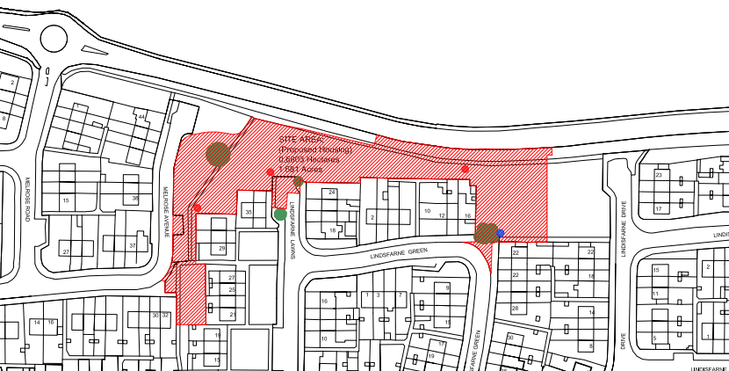
Site Location

Slide 3
Public Consultation
Six-week public consultation 27th Aug-8th Oct
Sixty submissions received
Overview of Submissions
Loss of open space, trees
Roads, traffic and parking
Design, density and location
Submissions from statutory bodies
Consultation
Non-planning related matters
  Separate family resource centre proposal
  Facilities/park development

Slide 4
Responses to Submissions:
Reduced number of homes from 28 to 19
More 1- & 2-bed homes, less 3-bed homes
More single-storey homes, three-storey blocks omitted
Design minimizes overlooking of existing homes
Retention of more open space, trees
Enhanced landscaping & planting
Assessment for pedestrian crossing & ramps
Sufficient parking included in proposals
Statutory body recommendations agreed
Statutory consultation process & additional consultations
Nothing agreed or implied for family resource centre
Cuthbert’s Park, playspace/teenspace, Grand Canal Park

Slide 5
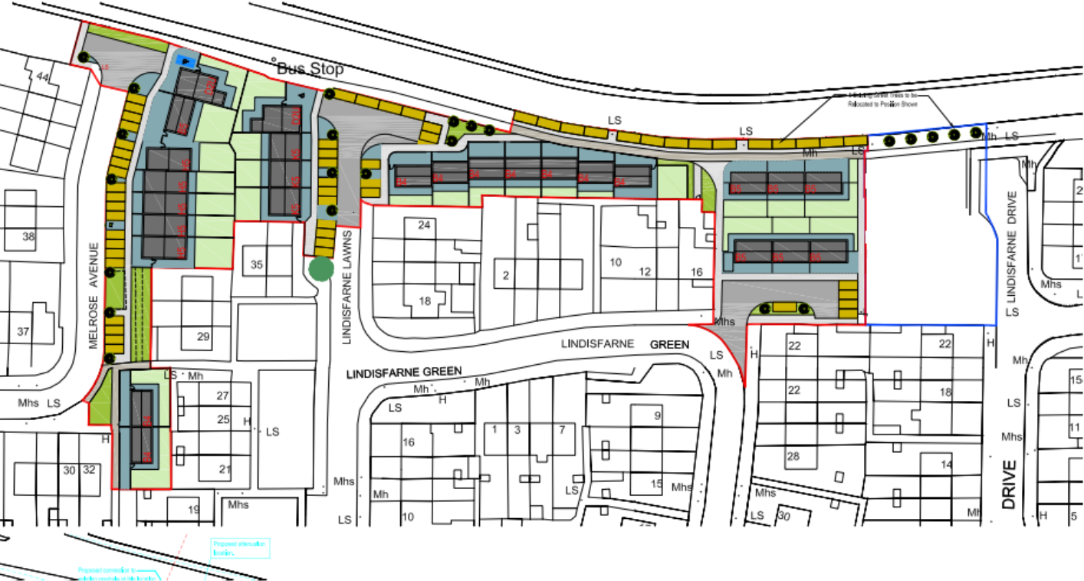
Original Design

Slide 6
Revised Proposed Design

Slide 7
Schedule of Accommodation
Type | Original | Revised
1-Bed | 2 | 3
2-Bed | 0 | 4
3-Bed | 26 | 12
Total | 28 | 19

Slide 8
Summary
Submissions fully addressed in CE Report
Proposal considered to be in accordance with proper planning & sustainable development of the area
Recommendation to proceed with the proposed development with amendments
Next Steps if Part 8 Approved
Seek project approval & funding from DHLGH
Develop detailed design & tender for design/build
Commence construction in late 2021

