Slide 1
SHD Application Ref: SHD3ABP-308763-20
Stocking Lane, Ballyboden, Dublin 16.
Applicant: MacCabe Durney Barnes Ltd.
Location: Stocking Lane, Ballyboden, Dublin 16.
Presentation to: Rathfarnham, Templeogue, Firhouse, Bohernabreena ACM 8th Dec 2020
Jim Johnston
Senior Executive Planner

Slide 2
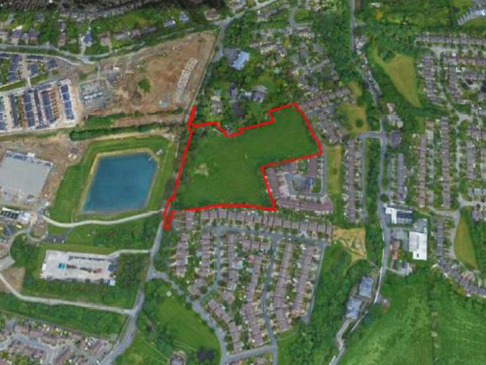

Slide 3
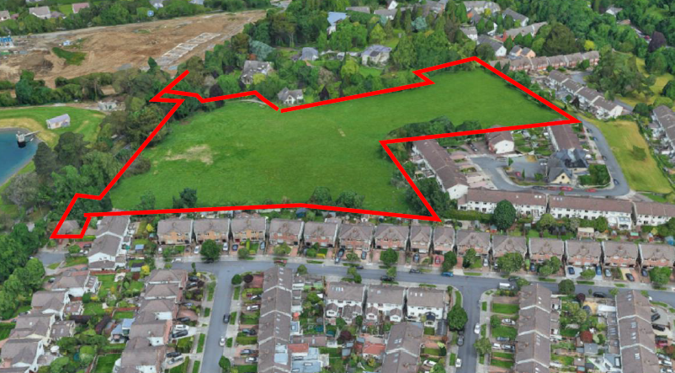

Slide 4
Timelines
SHD Lodged with ABP on 26/11/2020
5 Week Obs by 5.30pm on 08/01/2021
8 Wks SDCC report due to ABP 01/02/2021
16 Week Decision due from ABP 26/03/2021
Consultations
S.247 pre-planning meetings were held with SDCC on 01/04/19 and 18/06/19
A pre-planning meeting was held on 27/11/19 with An Bord Pleanala, the applicant and SDCC.

Slide 5
Proposed Development
• 131 residential units including:
- 21 houses (11 no. 4-bed; 10 no. 5-bed) of up to two-storey plus roof storey.
- 51 duplex apartment units (11 no. 1-bed; 23 no. 2-bed; 17 no. 3-bed) in seven blocks of up to three-storeys.
- 59 apartments (18 no. 1-bed; 38 no. 2-bed; 3 no. 3-bed) in three apartment blocks up to four-storeys.
• A creche of c. 128 sqm at the ground floor of Block L.
• A shop of c. 65 sqm at the ground floor of Block G, with associated storage.

Slide 6
Proposed Development (continued)
• A total of 167 car parking spaces, of which:
- 88 are at surface level and 79 in the basement under apartment Blocks F and G.
- 5 are dedicated visitor parking spaces.
• A total of 288 cycle parking spaces and 5 no. motorcycle spaces.
• A new vehicular access onto Stocking Lane.
• A new vehicular and pedestrian/cycle access to the Springvale estate to the east.
• New roads, footpaths and cycle paths and connections within the site
• A new pedestrian crossing on Stocking Lane to the north west.
• The expansion and upgrade of the existing pedestrian crossing on Stocking Lane to the south west.
The development also includes landscaped private and public open space, boundary treatment, lighting, play area, an ESB substation, site drainage works and all ancillary site development works above and below ground.

Slide 7
ABP comments
1. Design and configuration of the layout
The creation of strong urban edges along Stocking Lane.
Justification for the provision of open space at the north-western section of the site if this strategy is to be pursued.
an improved design approach that addresses a sense of enclosure along the west-east Boulevard. This may involve reducing the separation distances between the front elevations of the houses along the street or increasing the height of the units.
elevational design and materials which respect the receiving environment and the orientation and location of blocks and houses as they address internal roads within the scheme.
2. Pedestrian/cycle links and legal consents
indicate the provision of pedestrian/cycle links to the existing infrastructure along Stocking Lane to the north and south of the site and consideration of the legal consents required to achieve this.

Slide 8
ABP comments (continued)
3. Open Space
indicate the provision of high-quality open space provision, in particular the location of kick-about areas and MUGA.
Indicate the integration of surface water proposals which respect the nature and form of the proposal and support the integration of Surface Water Drainage Systems (SuDS).
4. Vehicular Links
provision of a vehicular linkages to adjoining lands. Explore the feasibility of providing a vehicular access to Springvale which may require re-profiling of the site to provide this vehicular access to the east.

Slide 9
ABP comments (continued)
A Rationale for the proposed residential density and housing mix with regard to the SDCC Dev Plan and policy in ‘Guidelines for Planning Authorities on Sustainable Residential Development in Urban Areas’ (including the ‘Urban Design manual’, The Apartment guidelines 2018 and the Building Heights Guidelines 2018
A housing quality assessment which includes information on the proposed apartments required by the 2018 Guidelines showing how the apartments comply with these guidelines. A building lifecycle report for the proposed apartments.
A report on DMURS and cycling issues; car parking strategy and mobility management plan; Traffic and Transport Impact Statement
Residential amenity (existing and future) (drgs showing cross sections between proposed development and contiguous development)
Visual impact with Computer generated images, materials and finishes
A Flood Risk Assessment and draft construction management and waste management plan
A site layout plan showing proposed Taking in Charge Areas
Further details on public open space (delineating public, semi private and private spaces). Landscaping, boundary and surface treatment

Slide 10
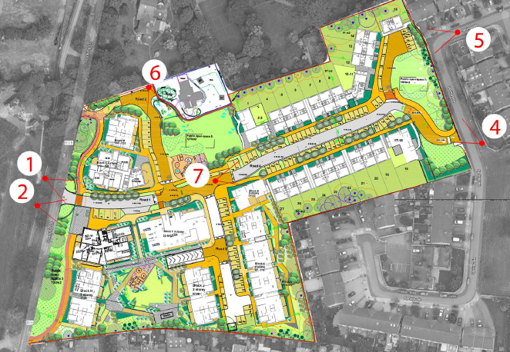

Slide 11
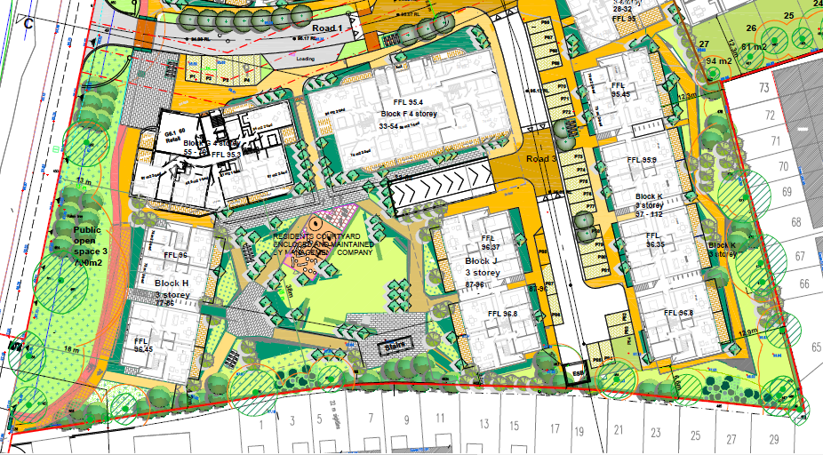

Slide 12
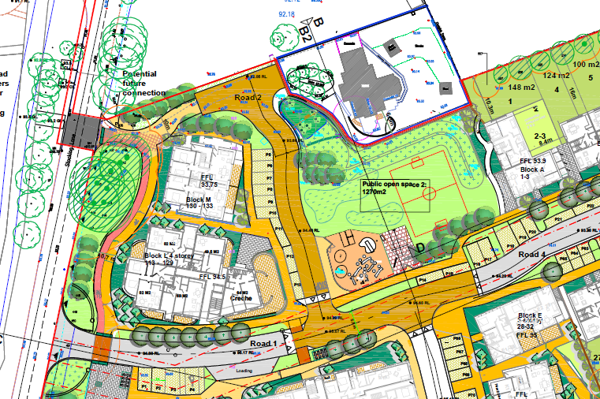

Slide 13
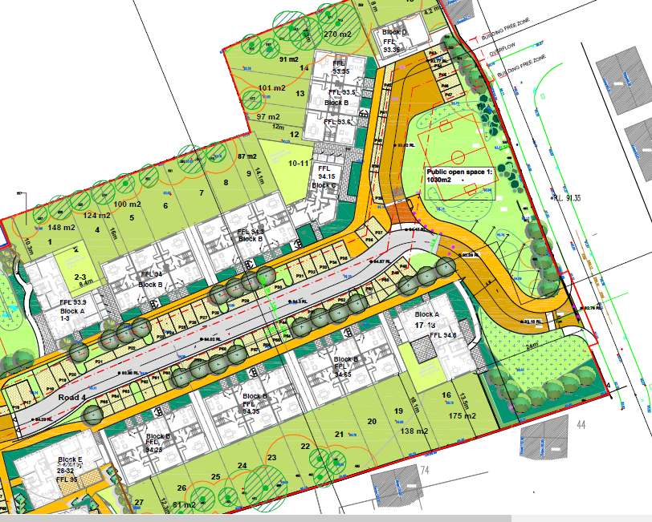

Slide 14
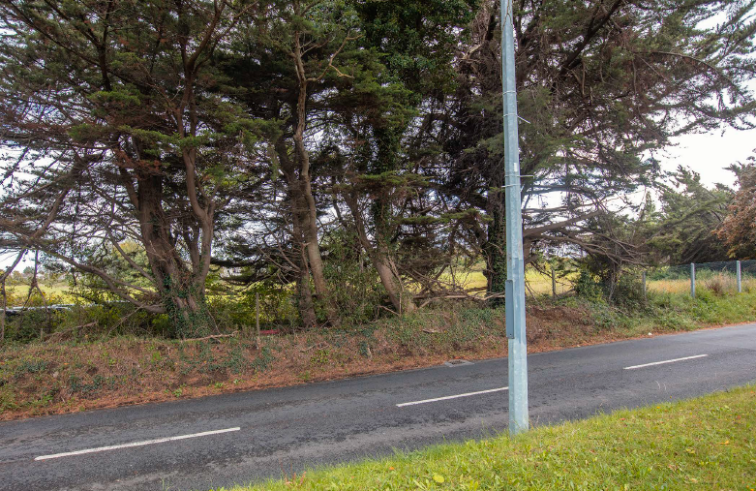

Slide 15
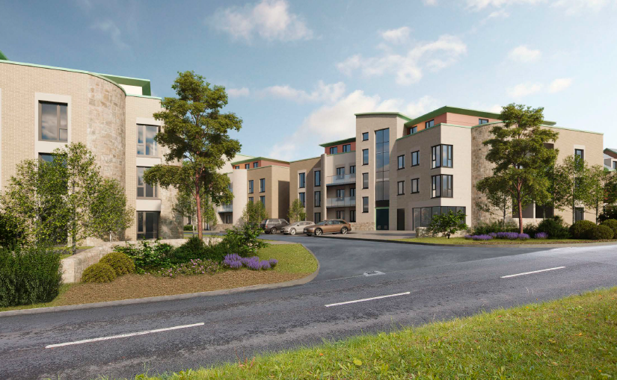
Stocking Lane

Slide 16
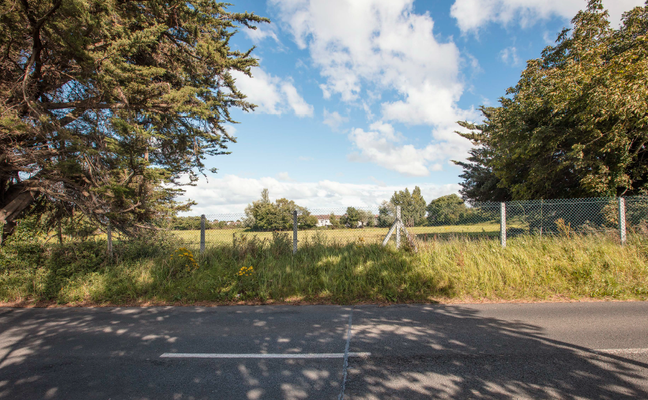

Slide 17
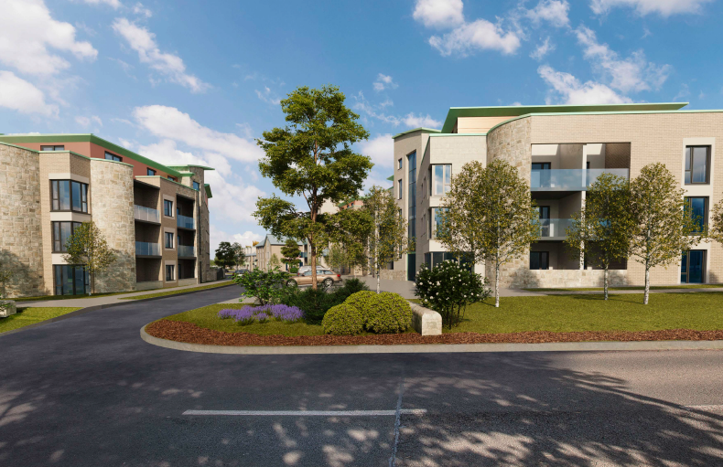

Slide 18
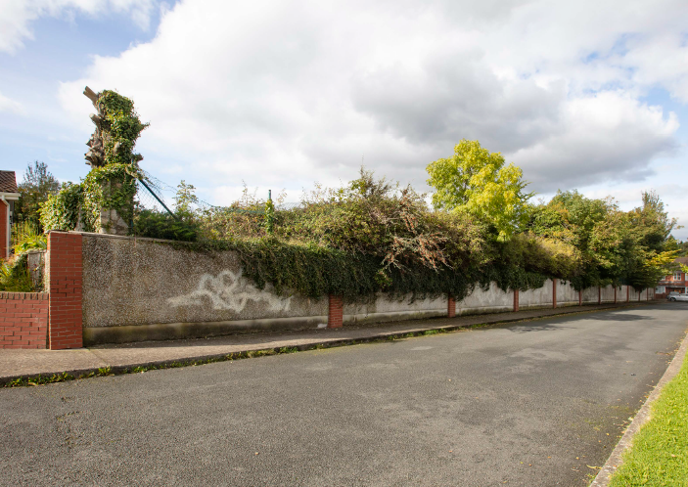

Slide 19
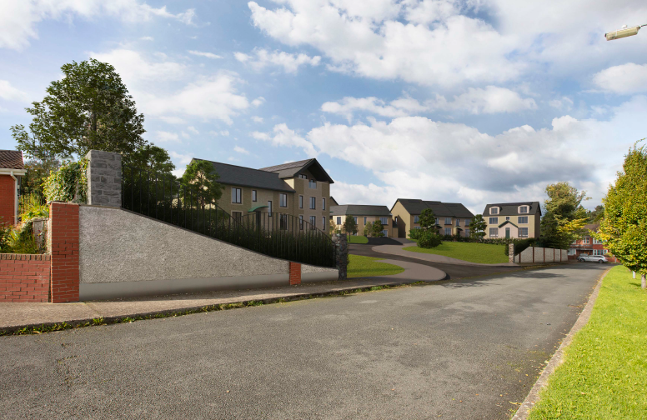
Springvale leading to Edmonstown road

Slide 20
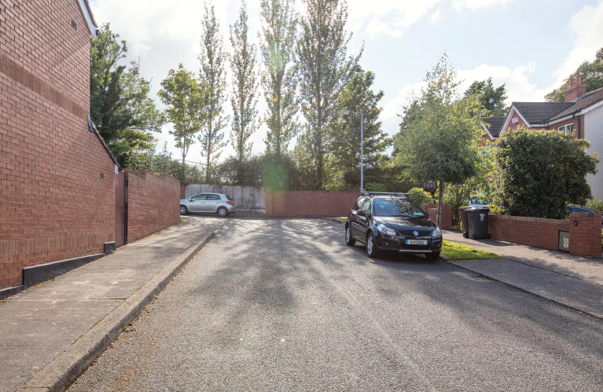

Slide 21
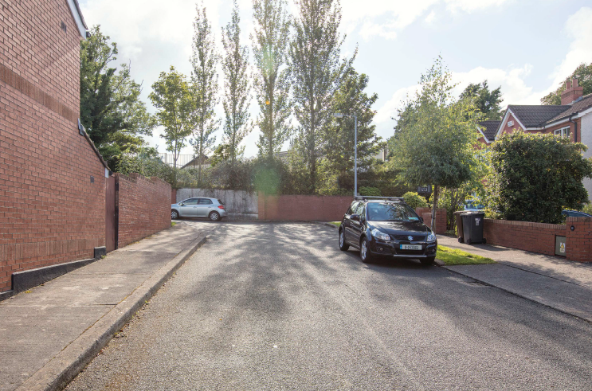

Slide 22
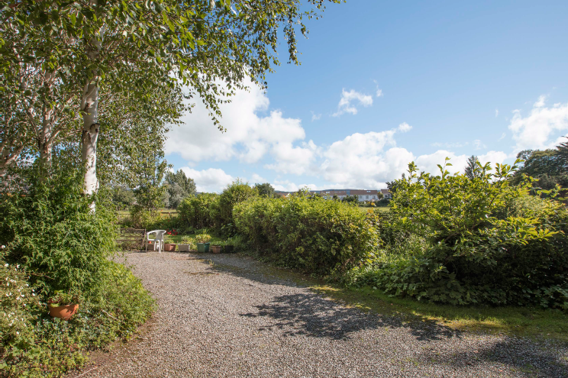

Slide 23
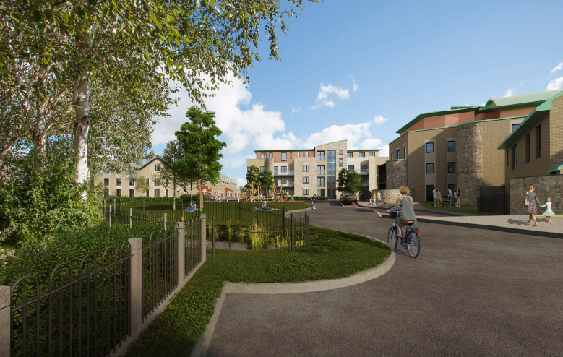

Slide 24
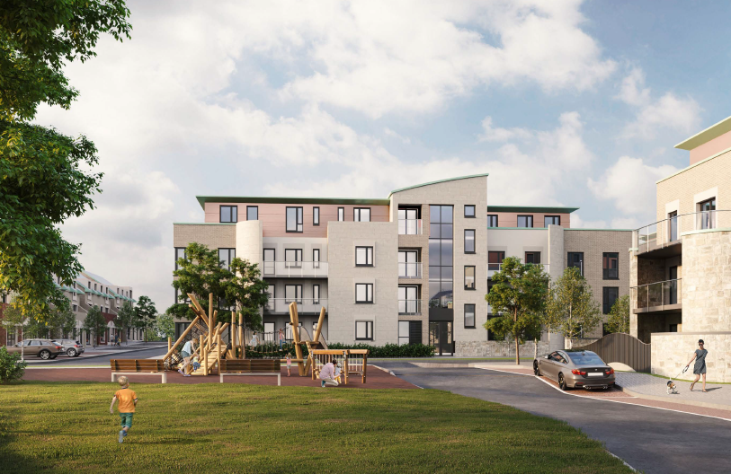

Slide 25
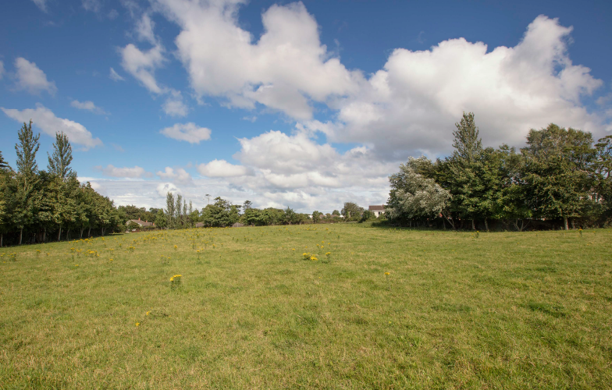

Slide 26
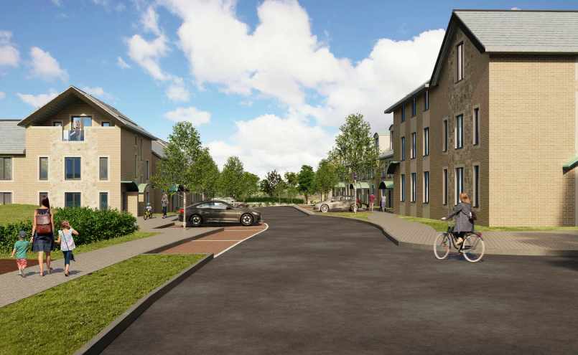

Slide 27
Statistics for Proposed Development
Proposal - 131 residential units comprising:
21 houses
11 4-bed (8%)
10 5-bed (8%)
110 apartments (includes 51 duplex apartments)
29 1-bed (22%)
61 2-bed (47%)
20 3-bed (15%)
Site area – 2.47 ha
Density – 54.3 units per ha
Plot ratio – 0.54
Site coverage – 20%
Height – two to four storeys
Dual Aspect apartments – 82%
Public open space – 12% (0.3ha)
Communal open space (Apartments and duplex) – 3,661sqm
Car parking – 167 Cycle parking - 288
Ancillary to residential use – management office (24sqm)
Non-residential use – Creche (128sqm) and Shop (65sqm)

Slide 28
Thank You
Questions

