Slide 1
Tallaght Stadium
Tallaght Stadium Update
Economic Enterprise & Tourism Development SPC
December 2020

Slide 2
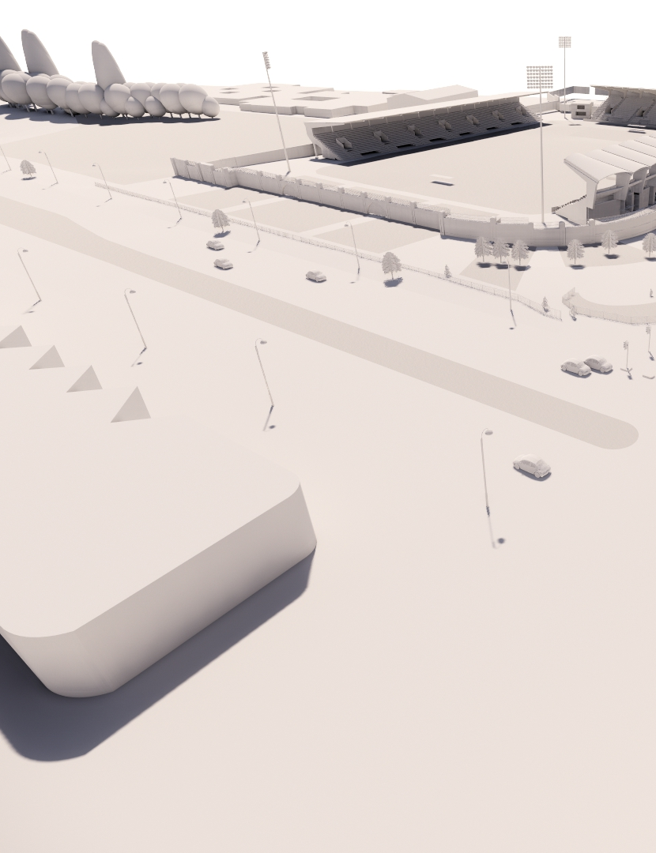
Tallaght Stadium
Part 8 Approved October 2020 County Council
New North Stand
Remodelling to West Stand
Accessible seating to South Stand
Changing Places facility approved for South Stand

Slide 3
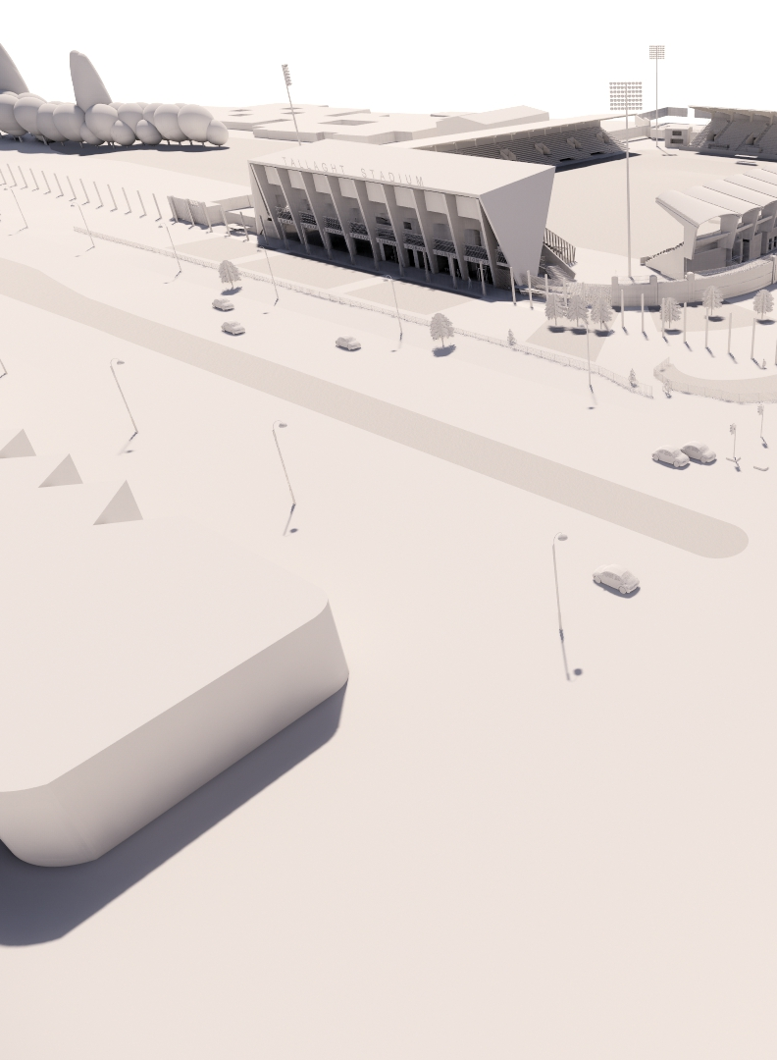
Aerial View North Stand

Slide 4
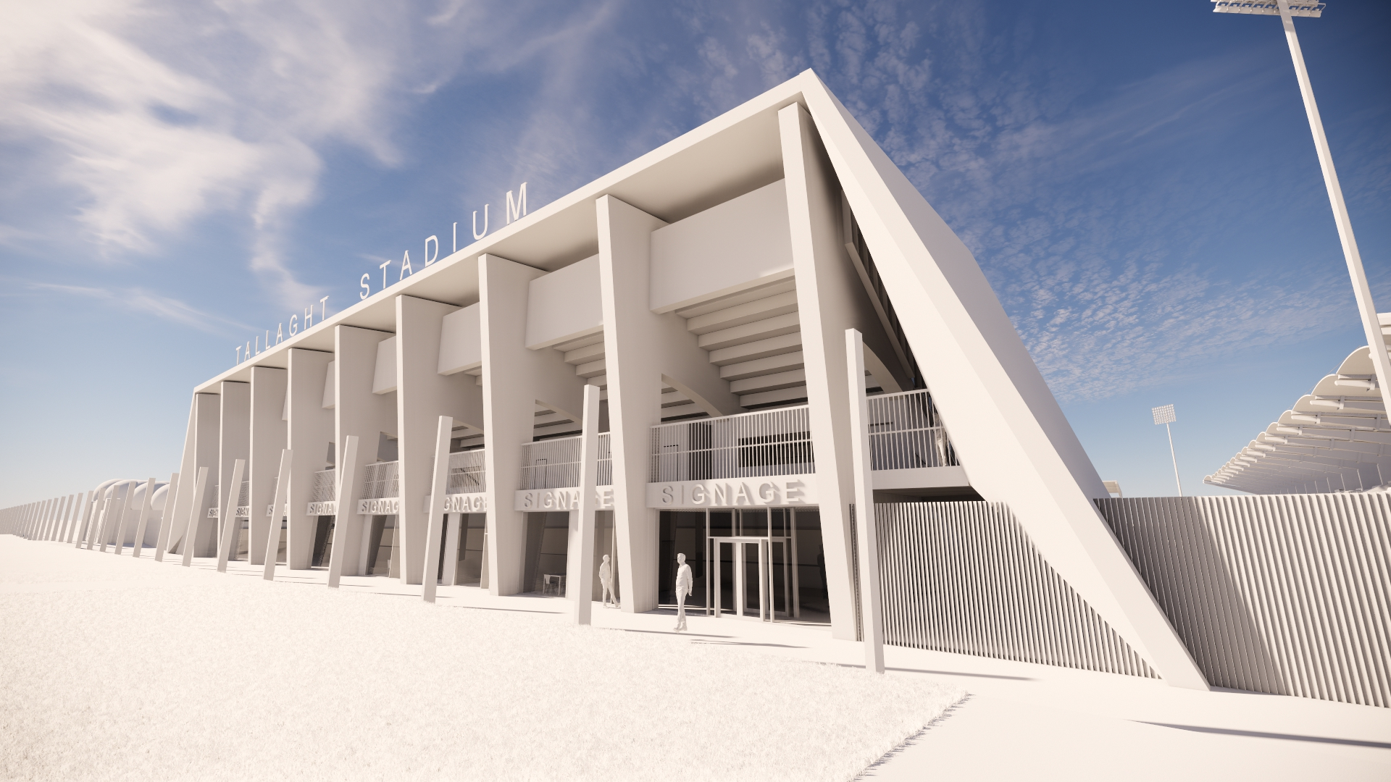
Tallaght Stadium
Street View [N81] North Stand

Slide 5
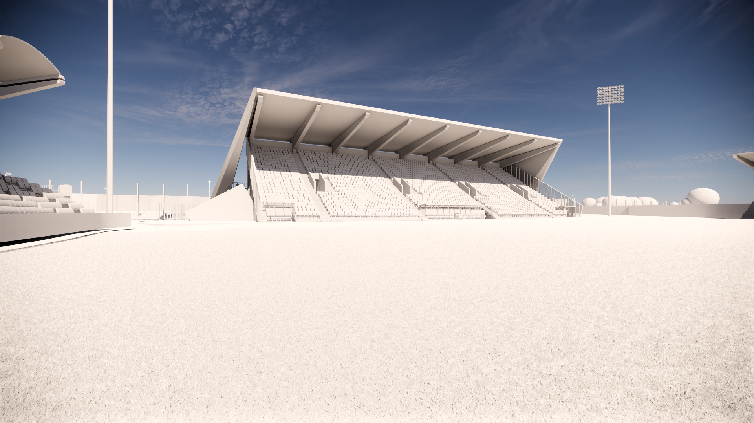
North Stand Pitch View

Slide 6
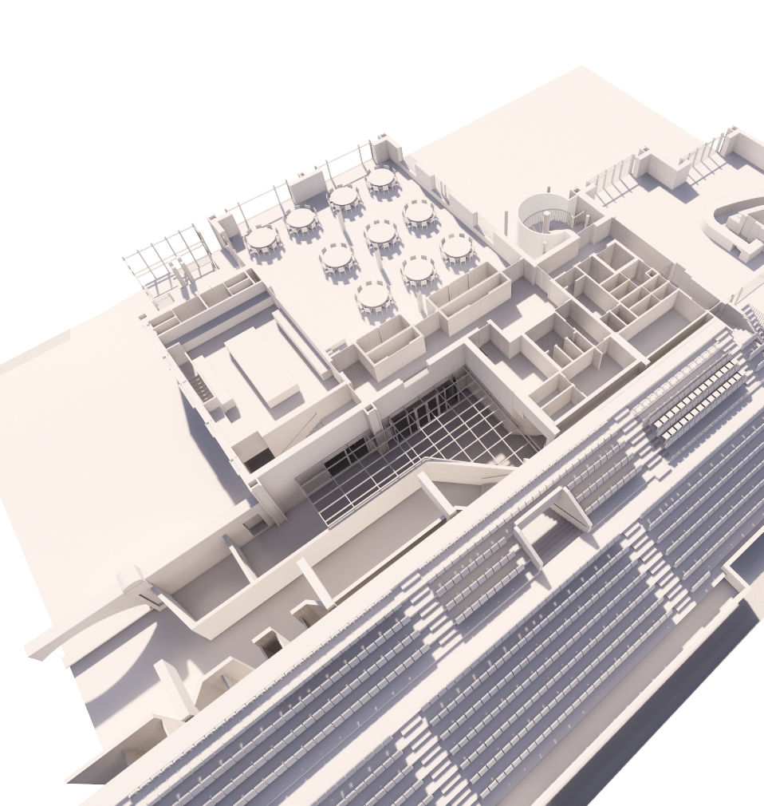
West Stand First Floor –
Remodelled Corporate Area

Slide 7
Next Steps:
Detailed design
2020-2021
Tender
1. Pre-Cast Concrete 30/10/2020
2. Construction Tender2021
Construction commencement Q4 2021
Capacity increase to 10,000

