Slide 1

8,714 Homes Over 10 years
€235m Funding Application
38% Social & Affordable Homes
€2.3bn Regeneration Project

Slide 2
Clonburris URDF Proposal
URDF Proposal
€235m Funding Application
3 Partners (Cairn Homes, Quintain & Kelland Homes
25% Match Funding
Key Timelines
URDF Application Submitted: June 2020
URDF Expected Decision: Q3/Q4 2020
Strategic Road Planning Application: Q3/Q4 2020
Housing
8,714 Homes
c.2500+ SDCC Dwellings
c.600 Private Part V units
c.600 Private Affordable homes
c.5,000 Private Residential Units
Delivery Target Timelines
Commence Delivery 2021
Phase 1 (south of rail-line): 4,780 Units By c.2027
Phase 2 (north of rail-line): 3,934 Units By c.2030
Infrastructure
Strategic Roads & Utility Corridors
Bridges & Link Streets
Community Centres
Regional & Local Parks
Community Centres & Park Hubs
Water, Foul & Surface Water Services
Delivery Target Timelines
Overall Delivery: 2020 - 2027
South Link Road: 2020 – 2022
Grand Canal Park: 2022 - 2024
Kishoge Community Facility: 2021 – 2023
Griffeen Valley Park: 2024 – 2026

Slide 3
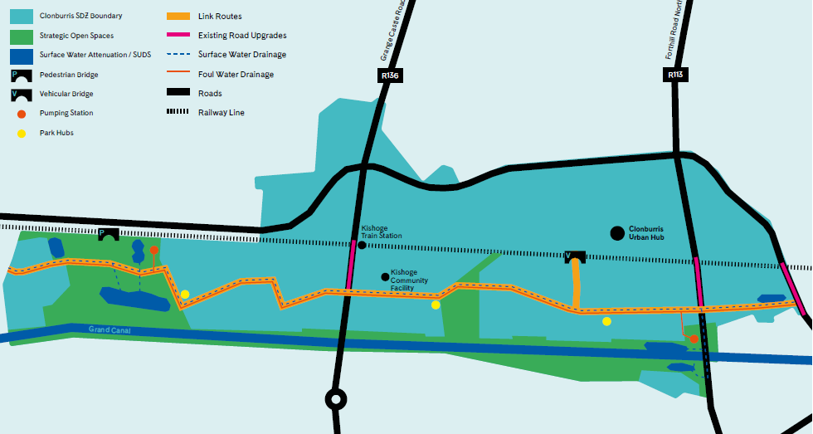
Phase 1: Infrastructure Programme South of the Railway
North
South

Slide 4
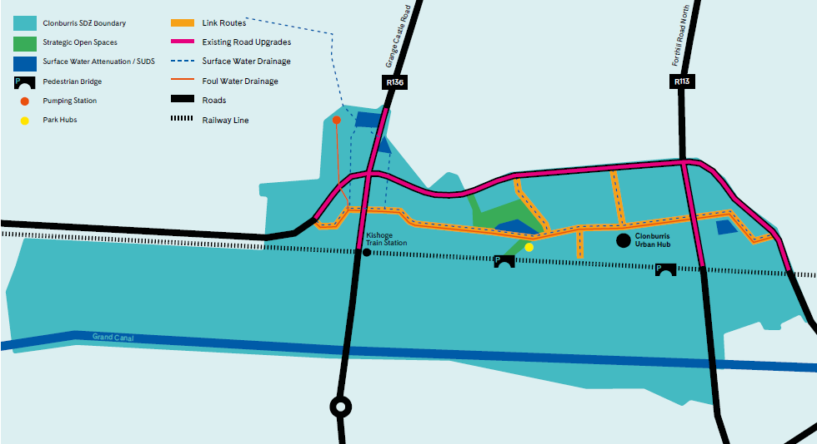
Phase 2: Infrastructure Programme North of the Railway

Slide 5
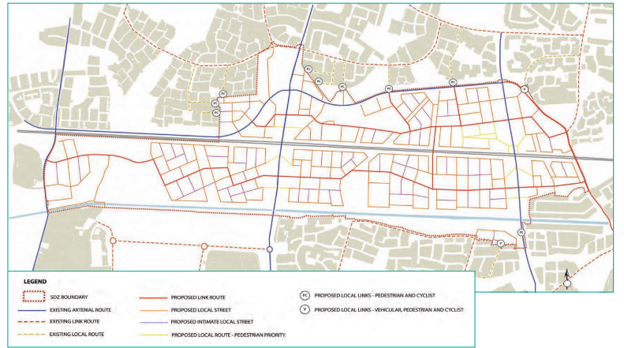
Clonburris SDZ Updates
Fire Station
Griffeen School
Southern Link Road
Kelland Homes
IW Pumping Station
Cairn Homes
SDCC

Slide 6
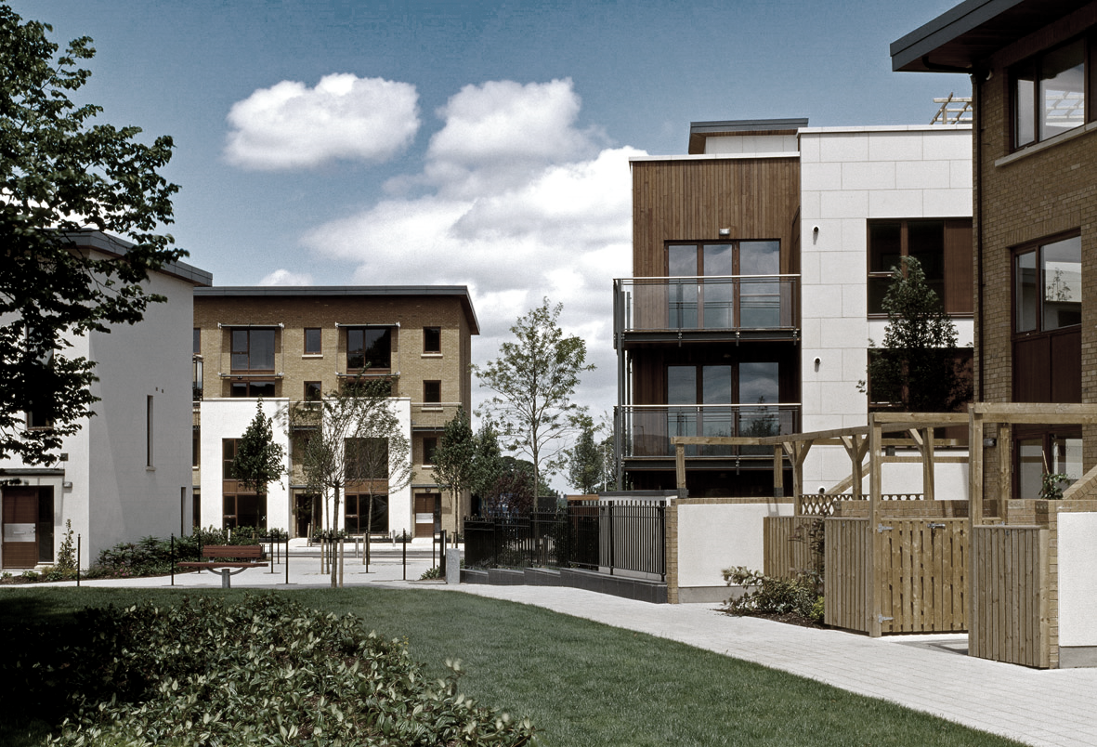
Adamstown URDF Proposal
585 Homes
By 2024
€12m Funding Application
20% Social & Affordable Homes
€220m Investment
URDF Proposal
€12m Funding Application
3 Partners (Cairn Homes, Quintain & McGreevy and Sons)
25% Match Funding
Housing & Infrastructure
585 Homes: 2021 - 2024
Central Boulevard Park (c.€5m): Q2 2023
Civic/Library Building (c.€4m): Q4 2022
Town Centre Plaza (c.€3m): Q4 2022

Slide 7
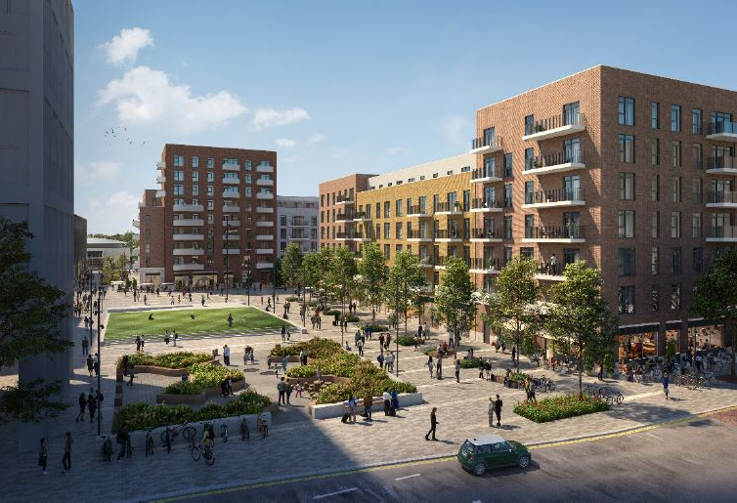
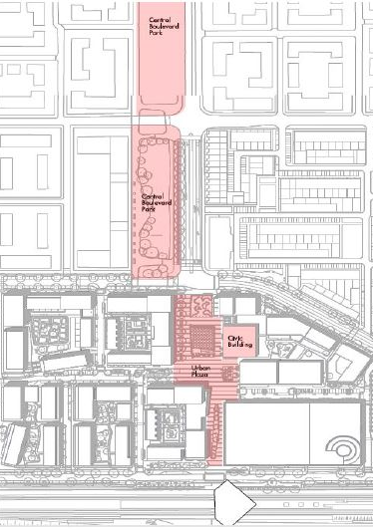
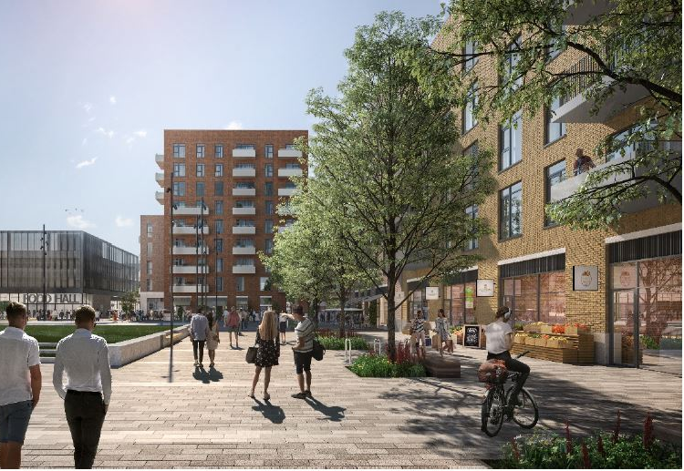
Priorities
Central
Boulevard
Park
Priority 1 – Town Centre Projects
Plaza: €3.35m
Civic Building: €3.93m
Housing: 329 of 585 Homes
Planning: Majority Secured
Completion: 2023
Priority 2 – Central Boulevard
The Park: €5.68m
Housing: 256 of 585 Homes
Planning: Pre-planning
Completion: 2024
Civic
Building
Plaza
Train station

Slide 8
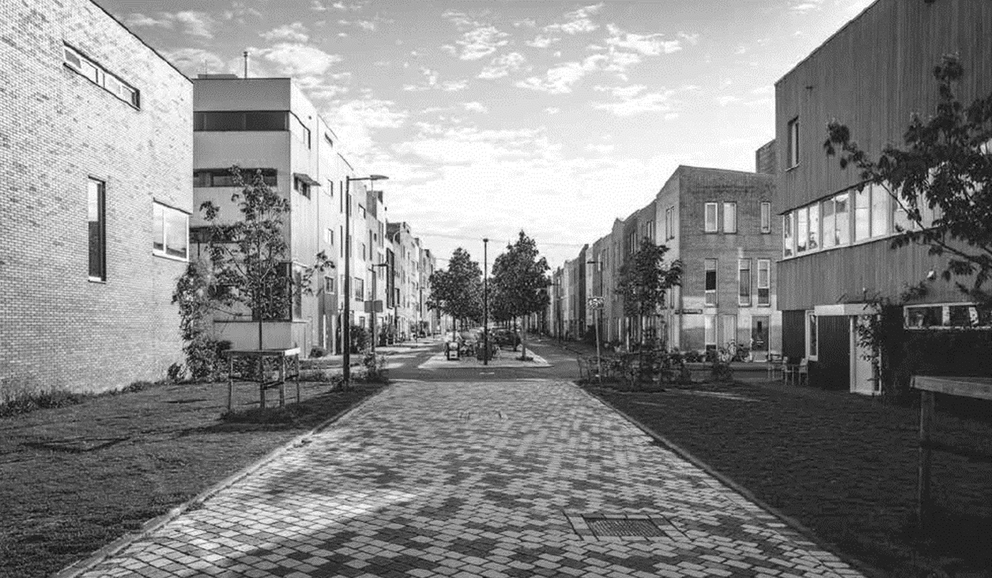
Key Stages
URDF Application Submission
29th May 2020
SDCC Presentation to URDF Steering Committee
30th September 2020
Recommendation of URDF Steering Committee to Minister
November 2020
Outcome (Cabinet / Minister Decision)
December 2020 / January 2021

Slide 9
Questions

