Slide 1
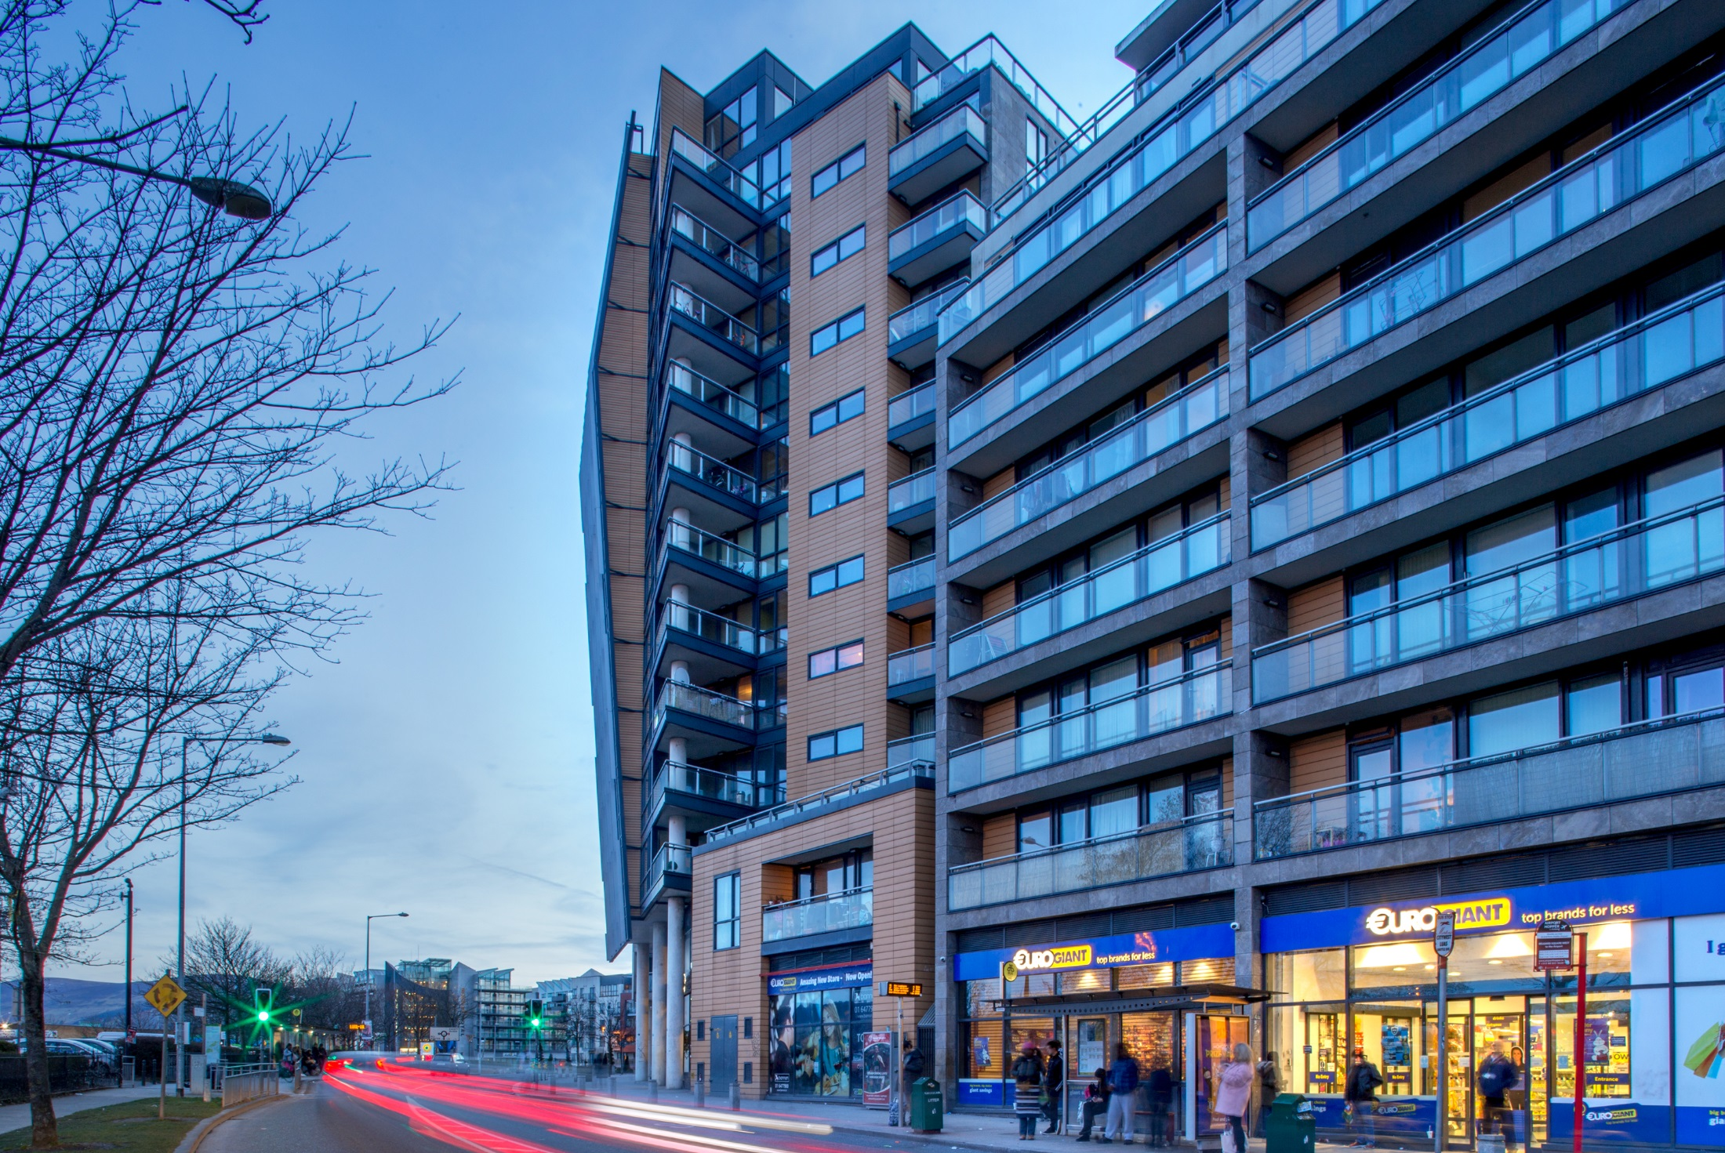
Tallaght LAP Updates
Land Use Planning
& Transportation
SPC Meeting
27th November 2020
17:30

Slide 2
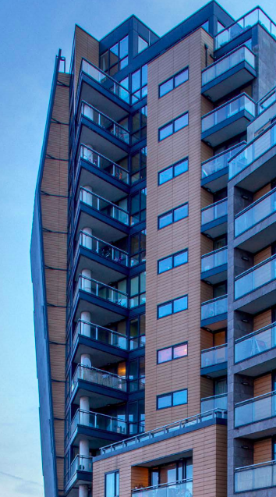
Vision & Overarching Objectives
Vision: “An inclusive and vibrant Town Centre, a connected and accessible place with an attractive built environment for families of all kinds, workers, visitors and tourists. A place where people can live, work, visit and have fun in lively and liveable spaces.”
Delivery of between 3,000 and 5,000 new homes.
Delivery of a mix of new employment spaces.
Improvements to the street network including extensions to Airton Road and Cookstown Road.
Enhancement of existing green spaces and the creation of a network of public open spaces.
Development of new transport interchange.
Provision of cycling and pedestrian infrastructure links.

Slide 3
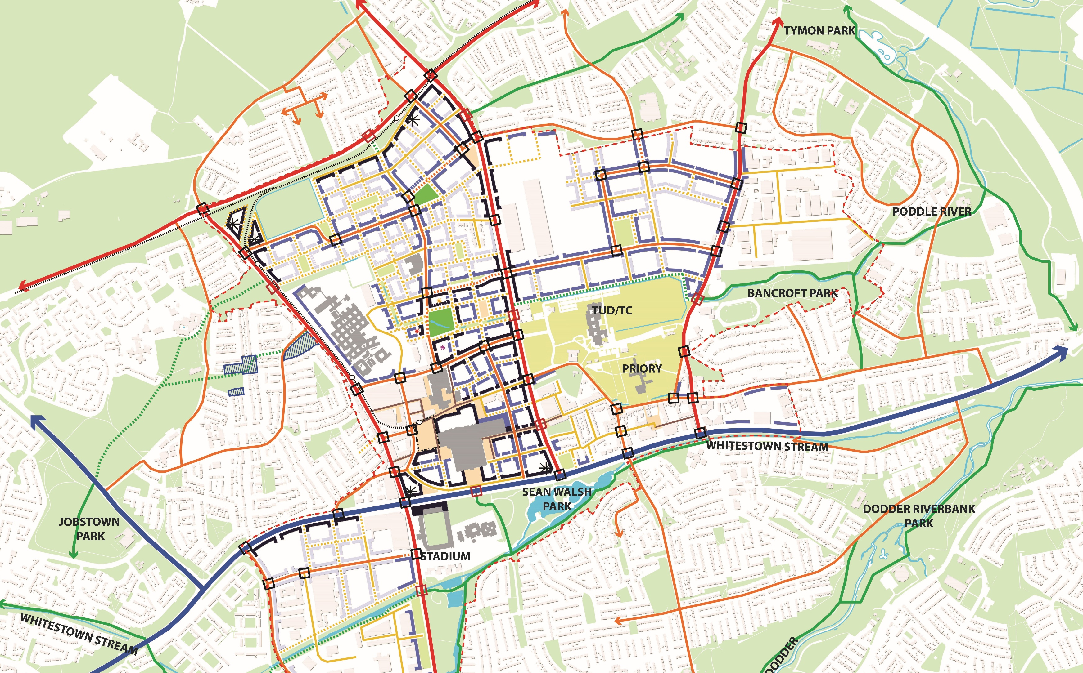
LAP Urban Structure
370 Hectares
8 Neighbourhoods

Slide 4
SDCC Initiatives

Slide 5
Affordable Housing
The development will consist of the construction of 133 affordable rental apartments with a community facility (c 12,918m2 ) in three blocks ranging from three to eight storeys.
Part 8 approved at October meeting.
NEXT STEPS
Fire safety certificate and disability access certificate applications.
Q1 2021
Tender process.
Q2 2021
Starting on site for construction.
Q3-4 2021

Slide 6
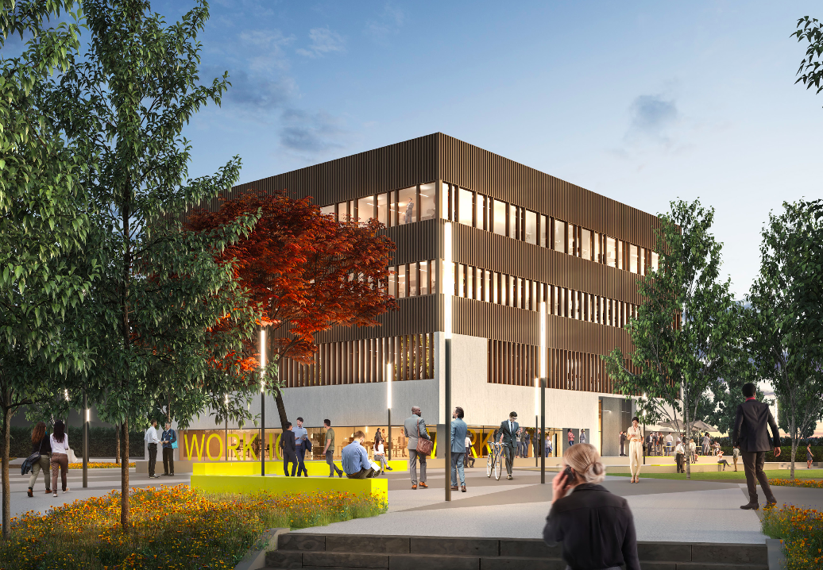
Innovation Hub
The building is 4 storeys high – 3 floors of lettable office space over a publicly-oriented ground floor.
Part 8 process ongoing.
Submission closing date - 12th November 2020.
NEXT STEPS
Going before council for Part 8 decision.
December 2020

Slide 7
Tallaght Stadium North Stand
Proposed capacity of 2,500 to include covered universal accessible seating above pitch level, with an overall footprint area of 1,700 sq.m.
The capacity of the Stadium will increase to 10,000 spectators, once development completed.
Part 8 approved at October meeting, with modifications.
NEXT STEPS
Detailed design and tender preparation work by the consultant architects.
Ongoing
Tender process.
Q2 2021
Construction start.
Q3-4 2021

Slide 8
Tallaght Public Realm
The Public Realm projects links up 5 spaces that will create a permeable and user friendly space at:
Chamber Square
County Hall Pedestrian Link
Belgard Square North Pedestrian Crossing.
School Pedestrian Link
Innovation Square
Part 8 approved at October meeting.
NEXT STEPS
Will be progressed to detail design on completion of a cost check which is currently being finalised.
Q4 2020
Tender process.
Q1 2021

Slide 9
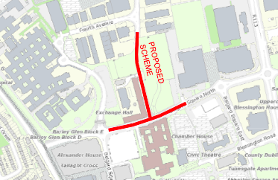
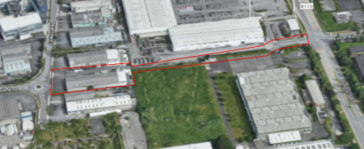
Belgard Road North
Direct link between Belgard Square North and Cookstown Industrial Estate.
Signalised T-junction at Belgard Square North. The proposed road scheme is approximately 102 metres in length.
Construction to finish in Q1 2021.
Airton Road Extension
Extension of Airton Road to link in with new north-south Link Road and provide alternative access to rear of Tallaght Hospital.
In the process of acquiring lands.
XX

Slide 10
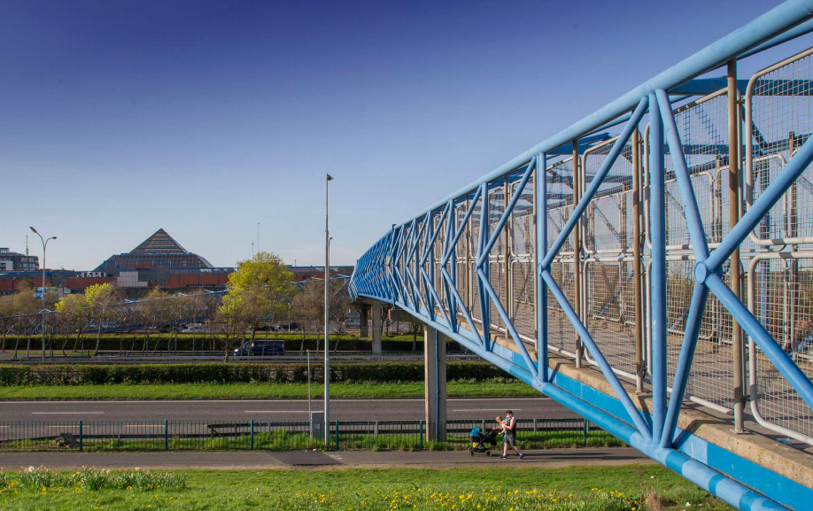
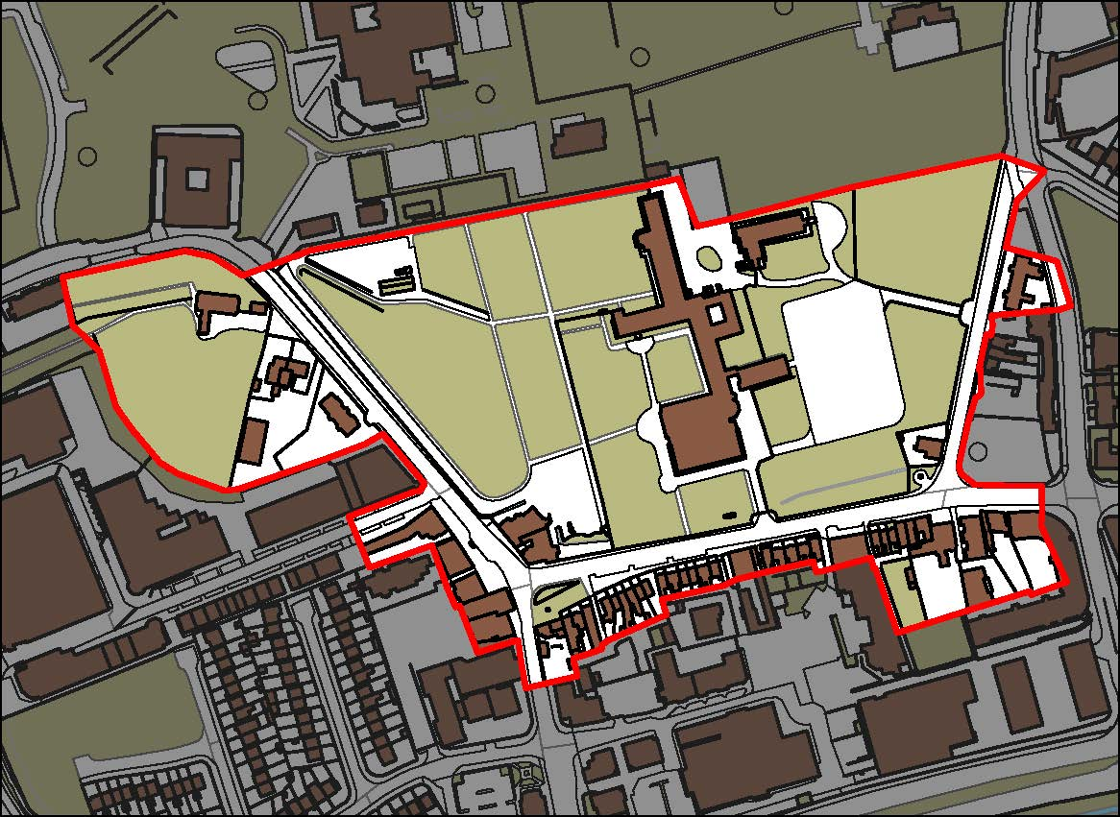
N81 Integrated Planning Strategies
Potential solutions for an integrated approach to movement across and to the N81 for sustainable transport.
Scoping Report, Desktop review and Stakeholder consultation completed.
Evidence base surveys to undertake:
Collision Data, Traffic Surveys, Pedestrian Surveys.
TBC in 2021
NEXT STEPS
Proposed Scheme and Plans.
Tallaght Village ACA
Guidance document for properties within the Architectural Conservation Area - Tallaght Village (mix-use) and Balrothery Cottages (residential).
Document to raise awareness and provide clear advice to owners and business in ACAs of the development control requirements and to highlight the important and advantages of an ACA.
NEXT STEPS
Draft document is being finalised before being designed for publishing standards.
Q1 2021

Slide 11
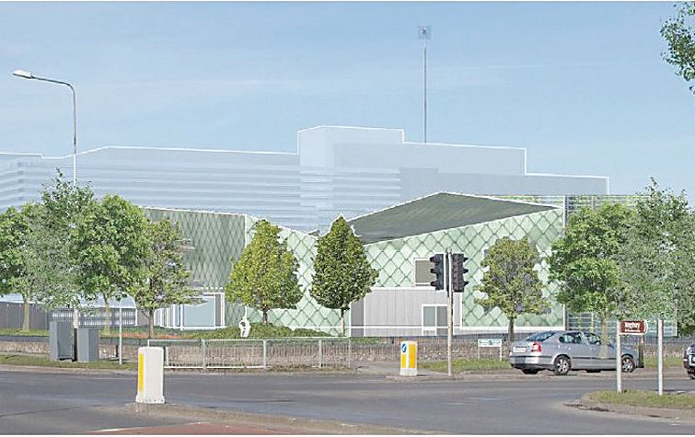
Tallaght District Heating
Waste heat from a local data centre to be utilised to heat South Dublin County Council’s public buildings, as well as other residential and commercial buildings in the Tallaght town centre area.
Fortum have been appointed as the Design, Build, Operate and Maintain (DBOM) contractor
NEXT STEPS
Starting on site for construction.
Q1 2021

Slide 12
Private Sector Proposals

Slide 13
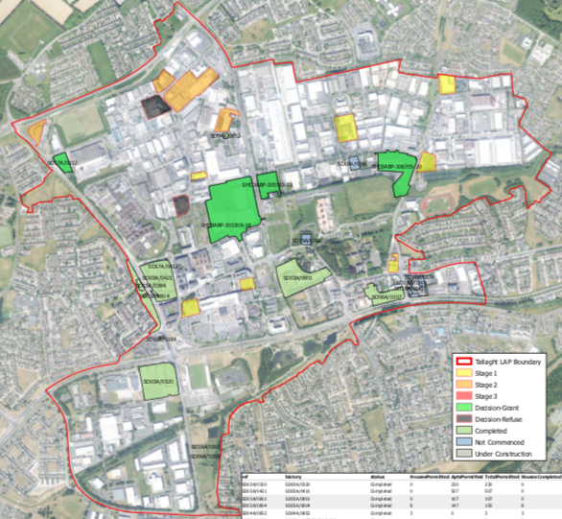
Planning Applications
Total Apt. Permitted (since 2017) | 1,561
Of which are SHDs Approved Units | 1,464
Under Construction | 19
Student Bed spaces | 403
SHD Stage 3 – Unit 66 & 67 4th Ave, Cookstown Lodged with ABP on 12.10.20 Decision due date: 09.02.21 | 252 BTR Apt.
SHD Stage 1 – Lands at Greenhills Road Pre-Application Lodged with SDCC and ABP on 18.11.20 Meeting TBD | 236 BTR Apt.
Q4 2020 / Q1 2021

Slide 14
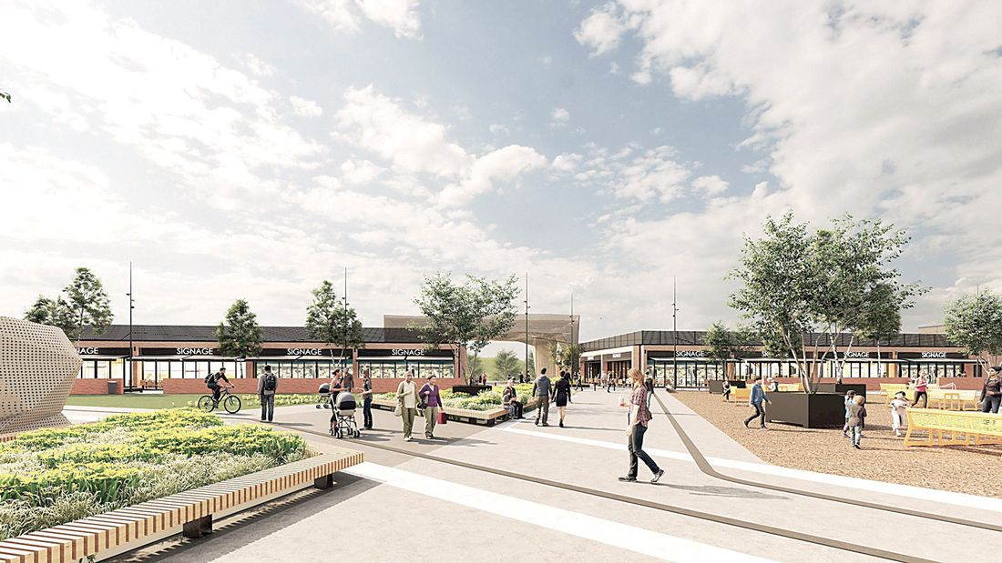
The Square Shopping Centre
c.10,000 Sqm. Extension
Plaza & Food Market Area

Slide 15
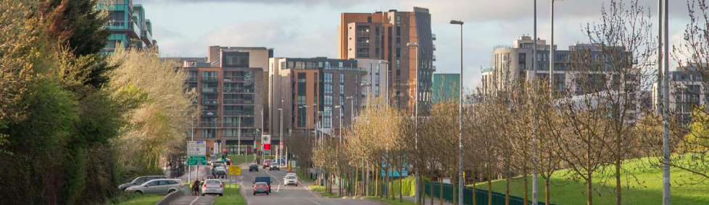
Moving Forward
Progressing studies and strategies arising from the LAP.
Ongoing engagement with the private sector to activate key sites within the LAP.
Ensuring the delivery of SDCC led projects.
Ensuring that the core objectives of the Development Plan are taken into consideration for the Tallaght Neighbourhood.

