Slide 1

Presentation to the SDCC Environment and Climate Change Strategic Policy Committee meeting of 25th November 2020 on the topic of Water Quality
A brief overview of the EPA report - Water Quality in Ireland 2013-2018
including a summary of water status in South Dublin County

Slide 2


Water Quality in Ireland report 2013-2018
National
Only 53% of our surface water bodies have satisfactory water quality.
Since 2015 there has been a net decline of 5.5% in river water quality in Ireland
A summary YouTube video produced by the EPA’s Dr Shane O’Boyle can be viewed at https://www.youtube.com/watch?v=-y9hqG6tNiw
South Dublin County
55% of our river water bodies have Good water quality.
Since 2015 there has been a net improvement of 7% of status of water bodies in the County
Notes:
However: the changes in water quality varied across the country with some counties showing a particularly significant declines
Put the absolute and relative change for your county in bullet 3; for example in Kilkenny, between the recent sampling periods overall water quality dropped by 16%, however Good status declined by 27% in relative terms (i.e. 2015 v 2018 river water bodies), this illustrates the speed of the drop and the highlights urgency to take action in this county.

Slide 3
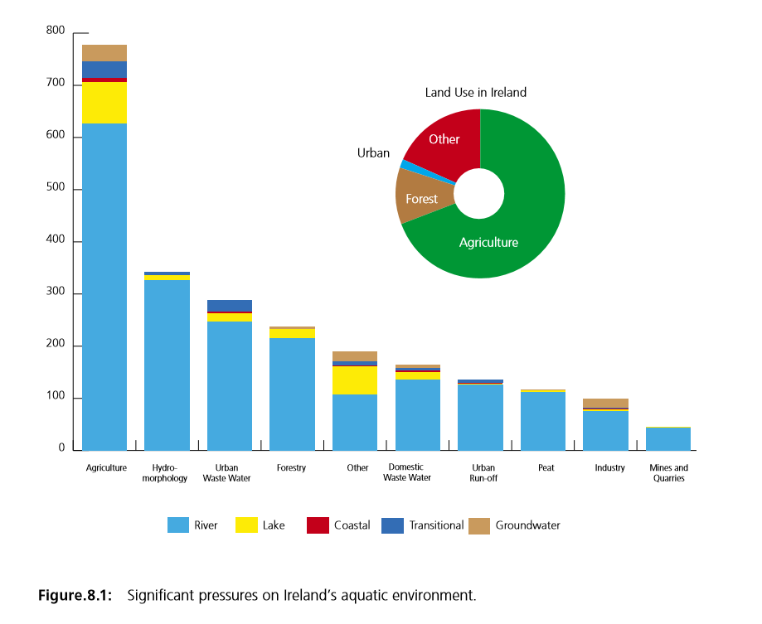

National View of Pressures
Notes:
Figure 8.1 from Water Quality in Ireland 2013-2018. These are combined data nationally. It would mbe helpful to have an understanding of what is changing locally (population, industry, forestry, herd no, landscape changes etc) to account for where there has been significant changes (also this information will help with next Characterisation).

Slide 4

Useful websites and links relevant to report
Websites and links where this Water Quality report and its theme’s are elaborated include the:
Catchments website which includes work by the Local Authority Waters and Communities Programme (https://www.catchments.ie/ ),
The EPA website ( https://epa.ie/ ) is an excellent source of water quality information and a good map viewer can be found at (https://gis.epa.ie/EPAMaps/Water ), and

Slide 5

South Dublin County (11 river waterbodies)
River | Water Body code | Evaluation Period 2010-2015 Status | Evaluation Period 2015-2018 Status | Change
Brittas | 010 | Moderate | Good | Improved
Camac | 010 | Good | Good | Unchanged
 | 020 | Moderate | Moderate | Unchanged
 | 030 | Poor | Poor | Unchanged
 | 040 | Poor | Poor | Unchanged
Dodder | 010 | Good | Good | Unchanged
 | 020 | Good | Good | Unchanged
 | 030 | Good | Moderate | Deteriorated
 | 040 | Moderate | Poor | Deteriorated
Owendoher | 010 | Moderate | Good | Improved
Griffeen | 170 | Moderate | Good | Improved
Notes:
This information is available on www.catchments.ie (Data/ Dashboards)

Slide 6

South Dublin County (Lake and Groundwater waterbodies)
Lakes | Water Body code | Evaluation Period 2010-2015 Status | Evaluation Period 2015-2018 Status | Change
Glenasmole Upper |  | Good | Good | Unchanged
Genlasmole Lower |  | Good | Good | Unchanged
Groundwater | Water Body code | Evaluation Period 2010-2015 Status | Evaluation Period 2015-2018 Status | Change
Dublin |  | Good | Good | Unchanged
Kilcullen |  | Good | Good | Unchanged
Notes:
This information is available on www.catchments.ie (Data/ Dashboards)

Slide 7

Current surface water quality status
Overall Water Quality Water Body Status in South Dublin County (rivers, Lakes and groundwater)
% and number
GOOD STATUS WATER BODIES IN SOUTH DUBLIN COUNTY
High 0% (0)
Good 67% (10)
Moderate 13% (2)
Poor 20% (3)
Bad 0% (0)
Include:
Upper Dodder
Owendoher
Upper Camac
Griffeen
From the status assessment period 2010/2015 to 2015/2018 there was a overall 7% improvement to Good status for rivers, lakes and groundwater in South Dublin County.
Unpolluted
Impacted

Slide 8

What happens now !
South Dublin County Council continues to implement its Water Quality work programme including Industrial, Farm and Septic Tank Inspections,
The Council will also continue to response to all Water Pollution incidents,
The Council is currently implementing the Dublin Urban Rivers LIFE project (www.urbanriverlife.ie ) and not only will this project ensure significant water quality improvements for the project’s focus rivers but will also have long lasting water quality improvement beyond the term of that project.
The Council will work with state departments, national agencies, voluntary groups and individuals to advance water quality improvements in the county.
South Dublin County Council is currently working with the EPA on selecting the waterbodies of interest in the next River Basin Management Plan cycle – 2022-2027.
Finally, the public will be asked to participate in the development of the next River Basin Management Plan and such consultations are typically available at https://www.housing.gov.ie/search/sub-topic/water-framework-directive
Notes:
This modified based on slide provided by Tipperary County Council, customise as appropriate for your local authority. Note for SWMI - The consultation period closes on Friday, 26 June 2020.

Slide 9

Summary
South Dublin County Council is steadily improving water quality in the county and through sound environmental analysis has short and long term projects and work programmes to continue this improvement trend in the next River Basin Management Plan cycle 2022-2027.

