Slide 1
SHD Application Ref: SHD3ABP-308398-20
Applicant: Steelworks Property Developments Ltd.
Location: 66 - 67 4th Ave, Cookstown Ind Est.
Presentation to Tallaght ACM 23rd Nov 2020
Jim Johnston
Senior Executive Planner

Slide 2
Timelines
SHD Lodged with ABP on 13/10/2020
5 Week Obs by 5.30pm on 16/11/2020
8 Wks SDCC report due to ABP 07/12/2020
16 Week Decision due from ABP 09/02/2021
Consultations
S.247 pre-planning meeting was held with SDCC on 25/06/20
A pre-planning meeting was held on 26/06/19 with An Bord Pleanala, the applicant and SDCC.

Slide 3
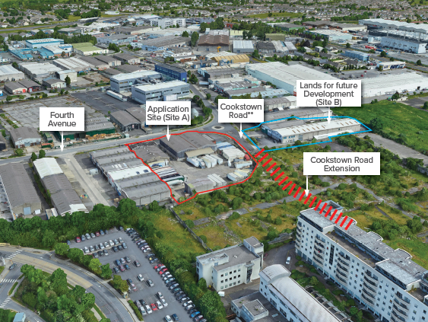

Slide 4
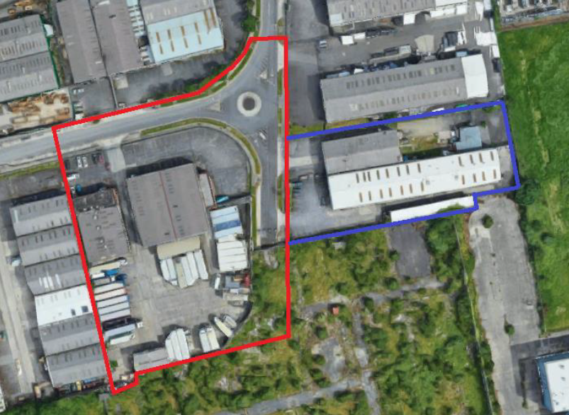

Slide 5
Proposed Development
(i) Demolition of the existing industrial buildings (2,518sq.m);
(ii) construction of:
(a) 252 ‘build-to-rent’ apartments (comprising 50 studios, 96 one-bed apartments; 100 two-bed apartments and 6 three-bed apartments) in a two to nine storey development. Each apartment has associated private open space in the form of a ground floor terrace or a balcony and has access to 613sqm of internal communal amenity space (including a concierge and management facilities, communal gym, flexible meeting rooms, library/co-working space, lounge, cinema/multimedia room and external covered game area); 1792sqm of external communal amenity space at first and second floor levels; and a 65sqm external covered communal amenity area at first floor level. The development is served by an under-croft carpark accessible from the south-western corner of the site providing a total of 73 parking spaces (including 58 standard spaces, 10 go-car spaces and 5 mobility impaired user parking spaces) and 500 bicycle spaces at ground floor level (372 resident spaces and 128 visitor spaces); and
(b) 2 commercial units (comprising of a 95sqm unit accommodating a café/restaurant and a 145sqm unit accommodating Class 1, 2 and 8 uses as per the Planning and Development Regulations, 2001-2019, as amended) and a 275sqm crèche, with associated 86sqm play area, at ground floor level;

Slide 6
Proposed Development (continued)
(iii) road, junction and streetscape upgrade works along Fourth Avenue and Cookstown Road, including the installation a signalized junction at the intersection of Fourth Avenue and Cookstown Road;
(iv) Construction of a temporary access road along the southern site boundary; and
(v) associated site and infrastructural works are also proposed which include: foul and surface water drainage; attenuation tanks; lighting; landscaping; boundary treatment; plant areas; ESB substations; and all associated site development works.

Slide 7
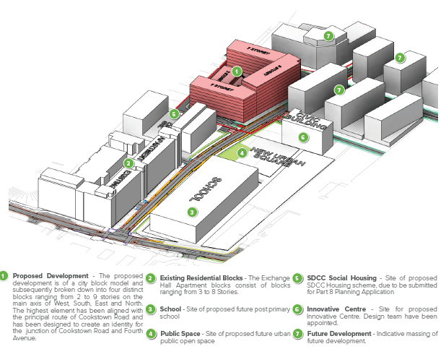

Slide 8
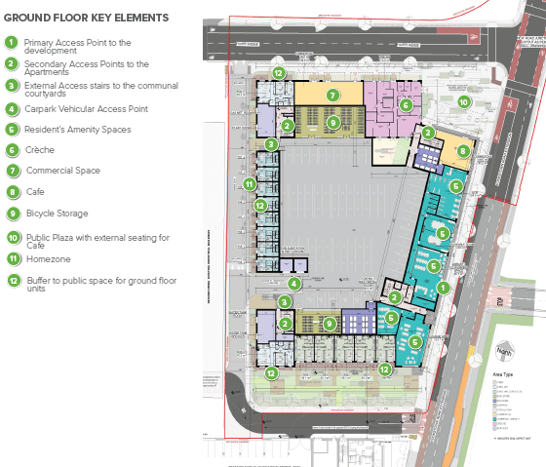

Slide 9
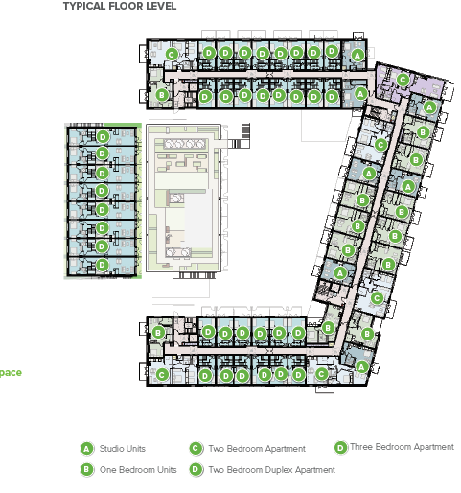

Slide 10
ABP comments
1. Height, density and unit mix
Further consideration of the documents as they relate to height and residential density.
applicant must be absolutely satisfied that the development would not conflict with emerging local policy guidelines in terms of any proposed Local Area Plan.
A planning rationale/justification for the proposed unit type/mix should be submitted
2. Road improvements in the area
‘Further consideration of the documents as they relate to planned roads improvements in the area.
3. Integration of site with surrounding area
Further consideration should be given in relation to the design rationale/justification outlined in the documents as it relates to the integration of the proposed development with adjacent permitted and emerging development.

Slide 11
ABP comments (continued)
4. Residential Amenity
Details on internal layout of the proposed development, having particular regard to the provision of resident support facilities and amenities and their location within the overall development
The provision of a variety of facilities should contribute to the creation of a shared environment where individual renters become more integrated and develop a sense of belonging with their neighbours in the scheme.
5. Finishes and Materials
demonstrate that the external finishes, materials and detailing of the proposed buildings, together with the landscaping and surface/boundary treatments of the outdoor spaces would be of a sufficient quality to ensure that the proposed development makes a positive contribution to the character of the area over the long term.
6. Public and Communal Open Space
Details of usability and hierarchy of such spaces, ease of access and consideration of any impact in terms of overlooking issues that may arise to units at ground floor level should be considered.

Slide 12
Further ABP comments
Daylight/Sunlight analysis
Photomontages and cross sections
Traffic Impact Assessment report
water and waste water details
Construction and Demolition Waste Management Plan
Covenant or legal agreement to ensure that the development remains in use as Build to Rent accommodation. There shall be a requirement that the development remains owned and operated by an institutional entity and that this status will continue to apply for a minimum period of not less than 15 years and that similarly no individual residents units are sold or rented separately for that period

Slide 13
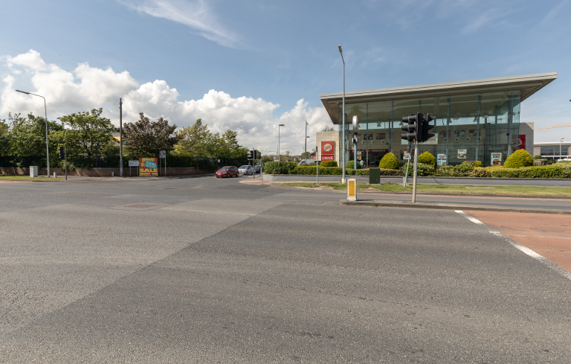

Slide 14
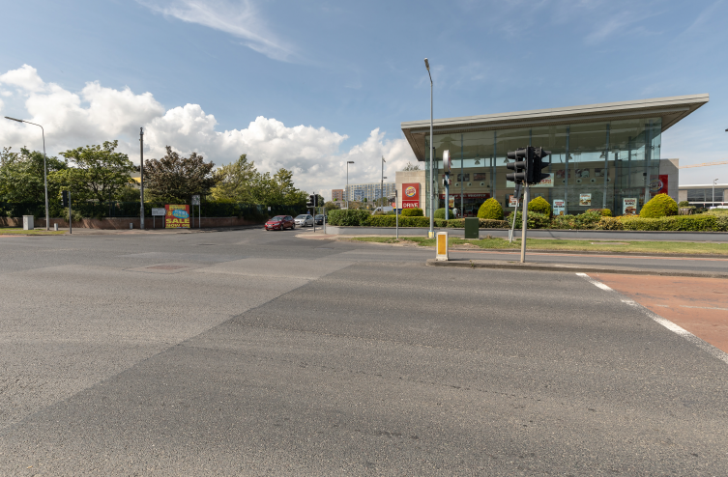

Slide 15
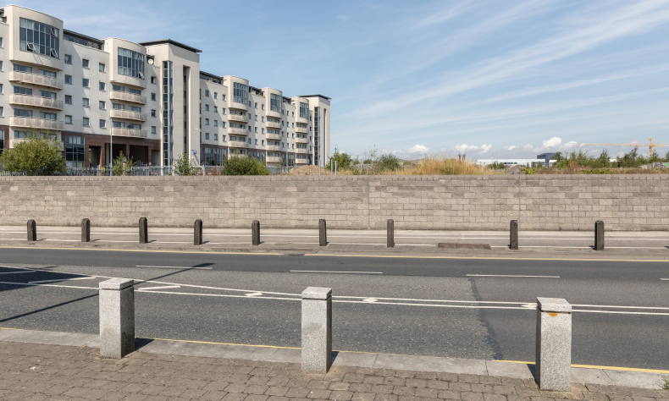

Slide 16
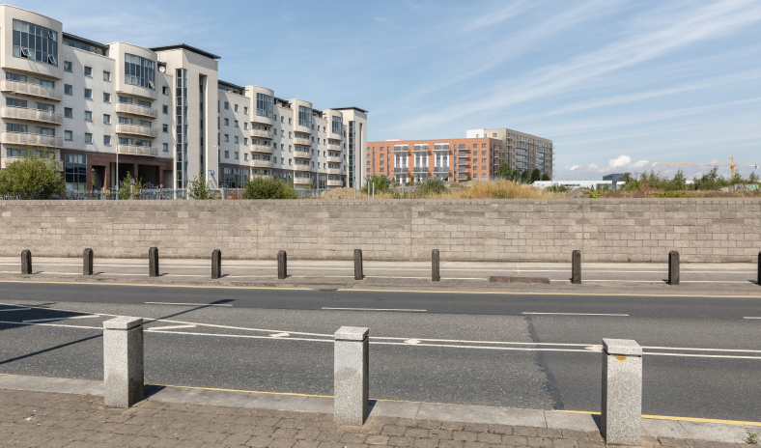

Slide 17
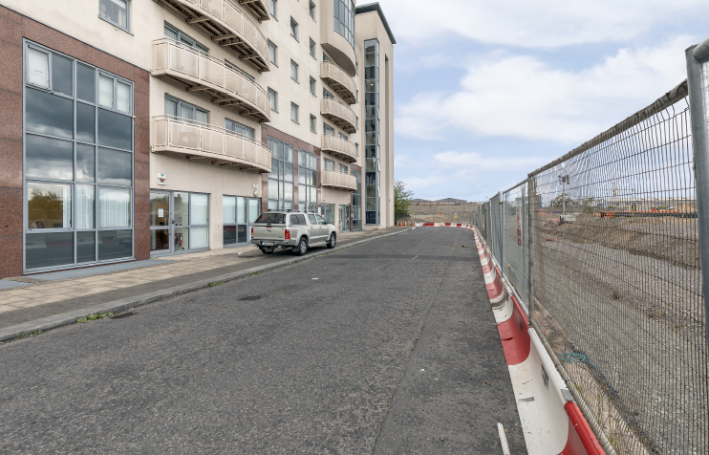

Slide 18
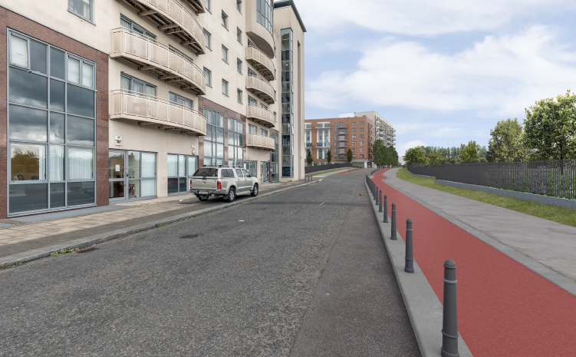

Slide 19
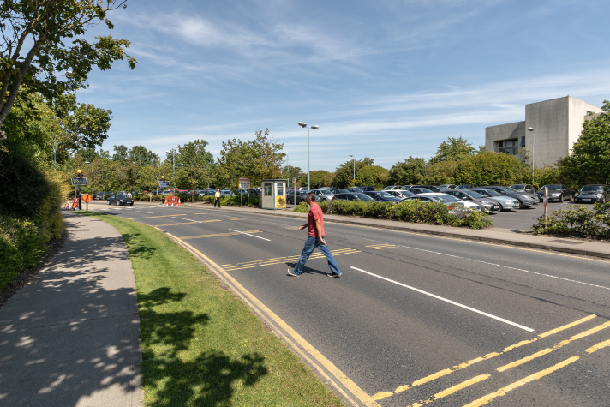

Slide 20
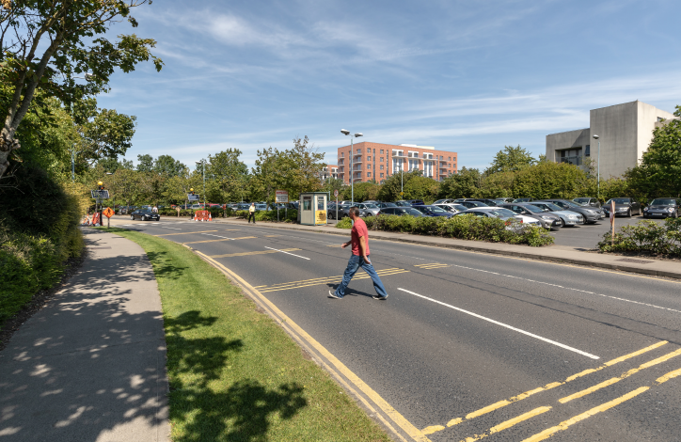

Slide 21
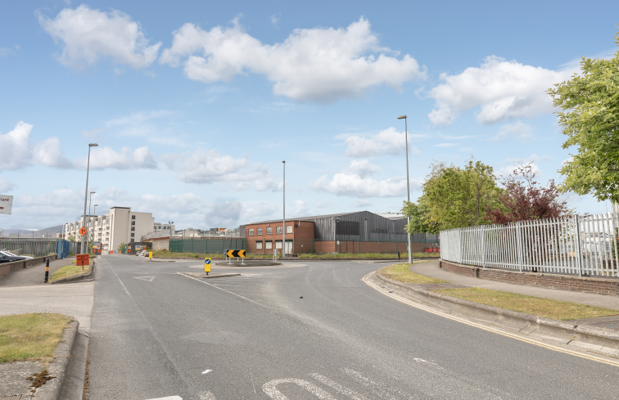

Slide 22
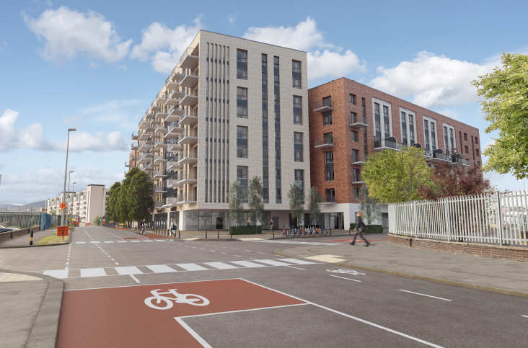

Slide 23
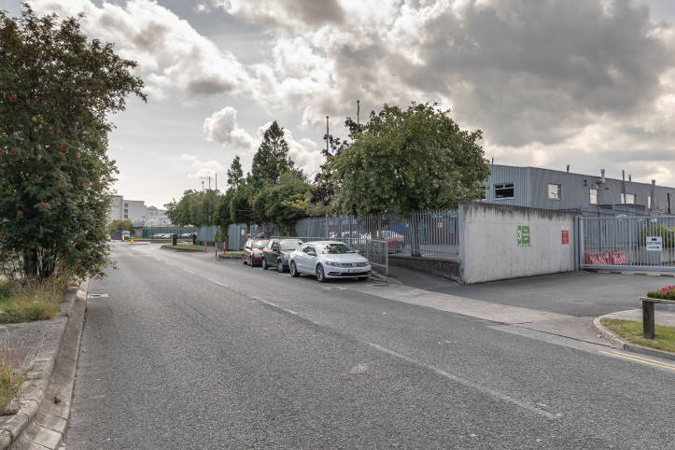

Slide 24
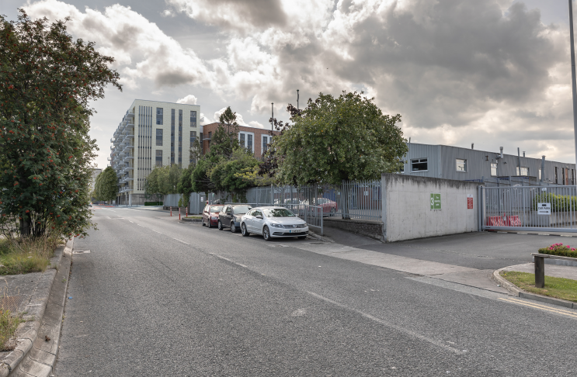

Slide 25
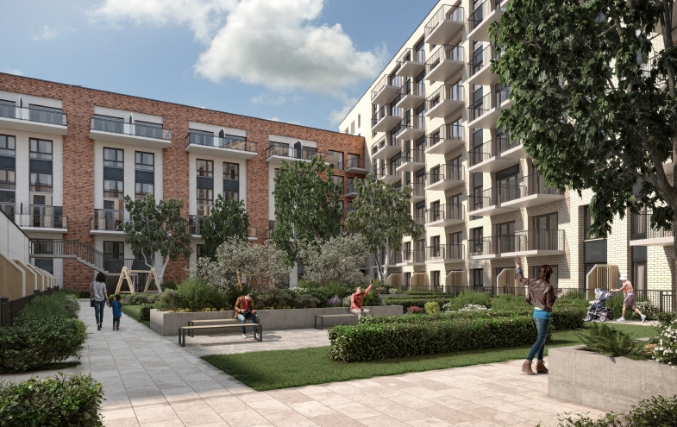

Slide 26
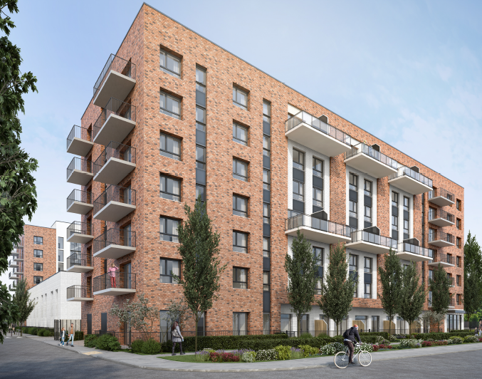

Slide 27
Statistics for Proposed Development
Proposal - 252 ‘build-to-rent’ apartments
50 studios
96 one-bed apartments
100 two-bed apartments and
6 three-bed apartments
Site area – 1.1 ha
Density – 356 units per ha*
Plot ratio – 2.95*
Site coverage – 69%*
Height – two to nine storeys
Dual Aspect – 125 units (49.6%)
Public open space – 14% (540sqm public plaza in the north-east corner of site and 470sqm of p.o.s. adjacent to site’s southern boundary).
Car parking - 73 (including 58 standard spaces, 10 go-car spaces and 5 mobility impaired user parking spaces)
Cycle parking - 500 at ground floor level (372 resident spaces and 128 visitor spaces)
*Based on the site area in the ownership of the applicant

Slide 28
Thank You
Questions

