Slide 1
DART+ South West
South Dublin County Council
18th November 2020

Slide 2
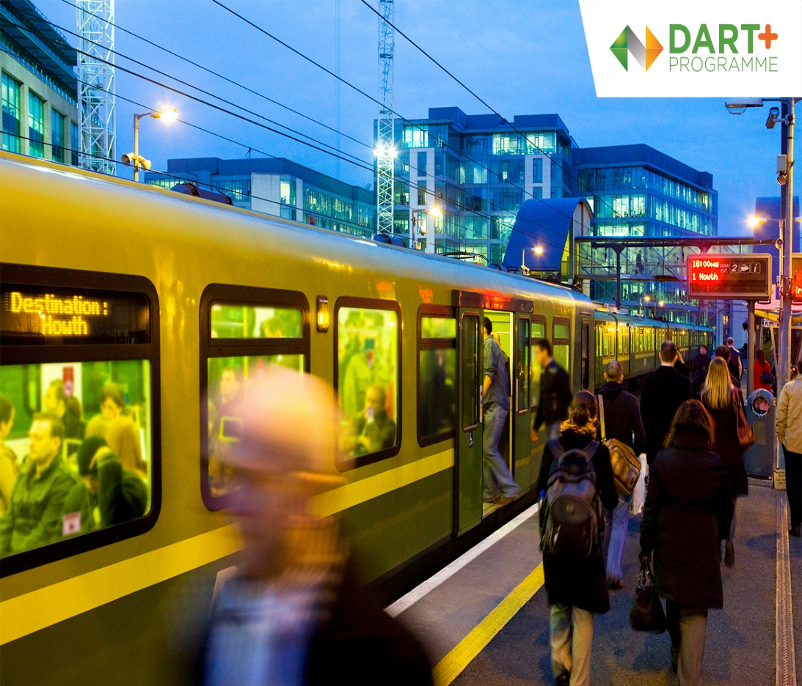
DART+ South West Team
Iarnród Éireann
Ricardo Santos – Programme Manager
Mark Conroy - EIA and RO Manager
Jane Cregan – Corporate Communications IE
TTA Team
Leah Kenny – RO Lead

Slide 3
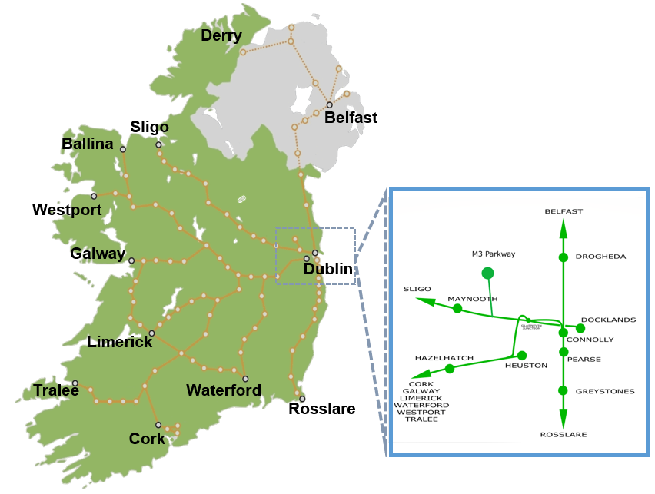
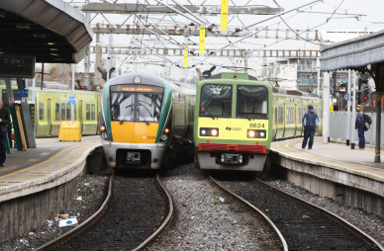
Current Iarnród Éireann Network
Northern Line - City Centre
Belfast Intercity
Dundalk/Drogheda Commuter
Malahide/Howth Northern DART
Sligo Line – City Centre
Sligo Intercity
Longford, Maynooth & M3 Parkway Commuter
Cork Mainline – City Centre
Cork, Limerick, Galway, Waterford, Tralee, Westport Intercity
Portlaoise, Portarlington, Kildare Newbridge, Carlow, Hazelhatch–Heuston/Grand Canal Dock Commuter
South East Line – City Centre
Rosslare/Wexford Intercity
Gorey, Arklow Commuter
Greystones/Bray Southern DART

Slide 4
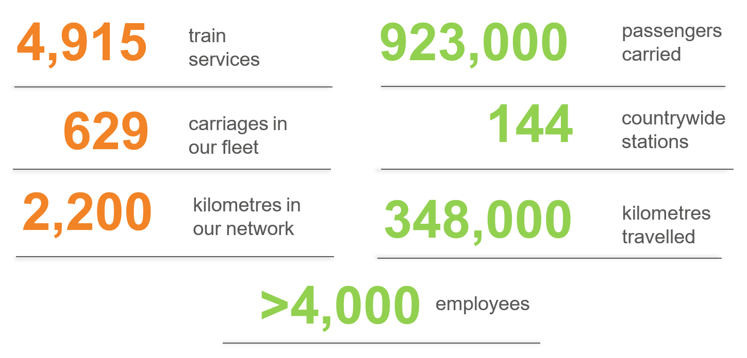
Current Iarnród Éireann Services
Weekly Services

Slide 5
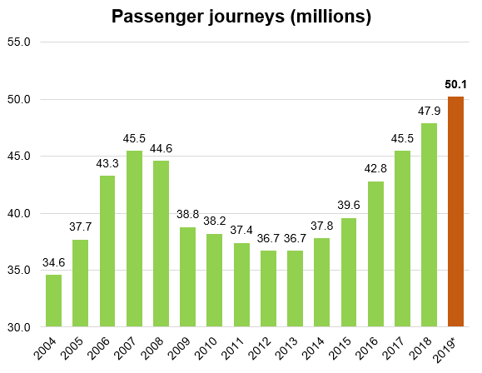
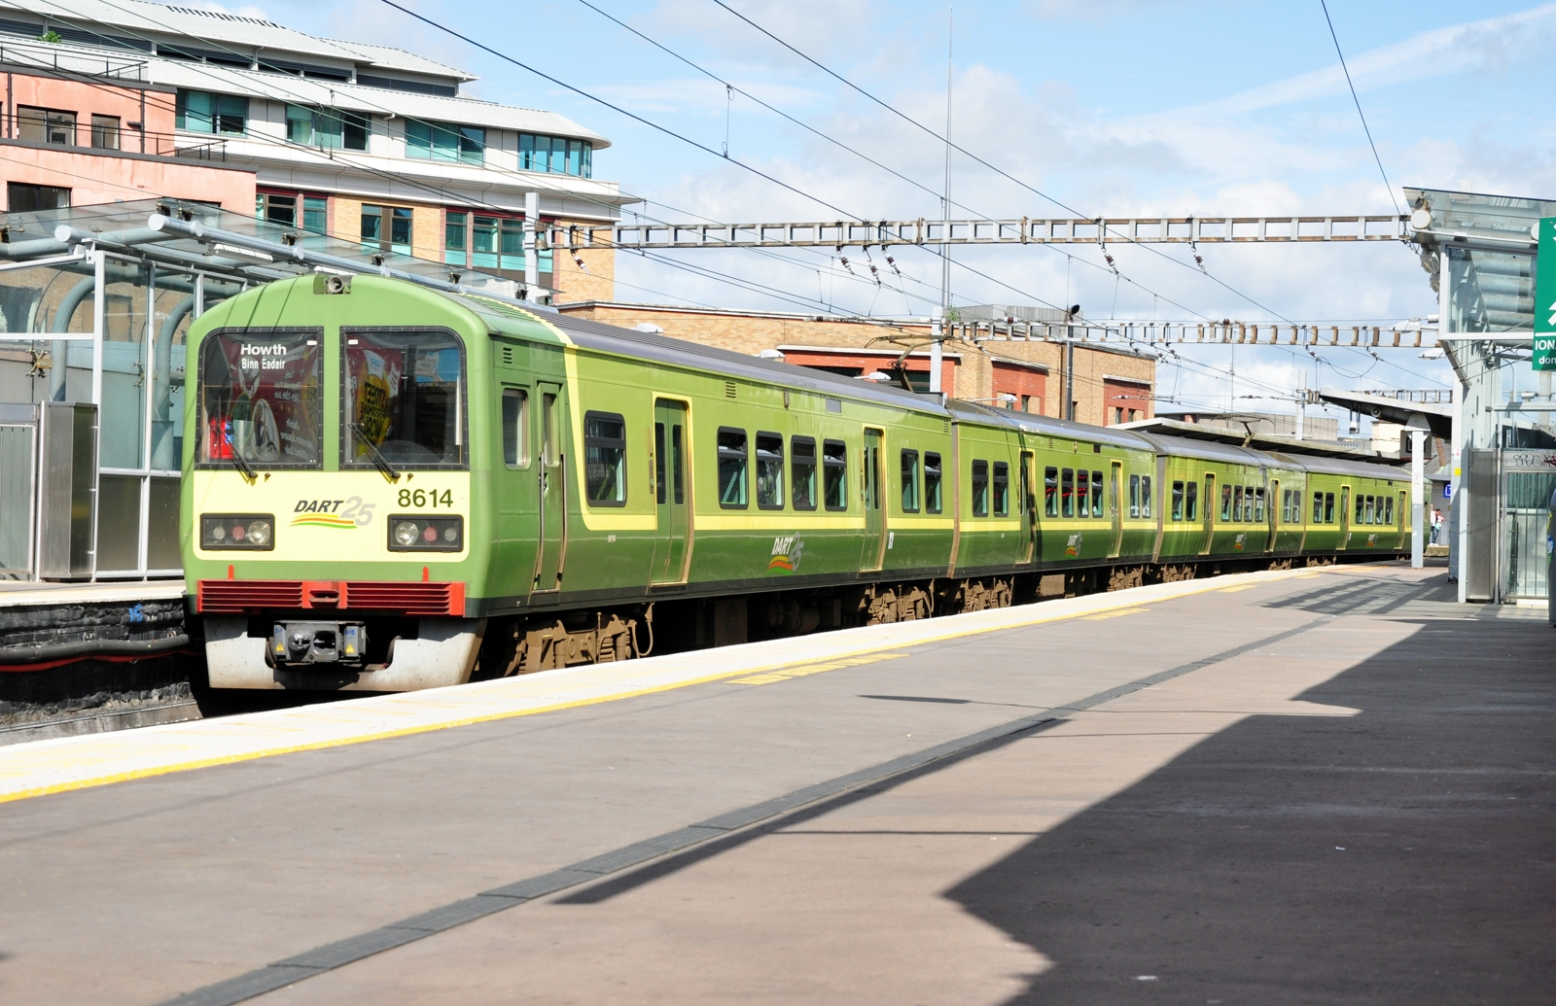
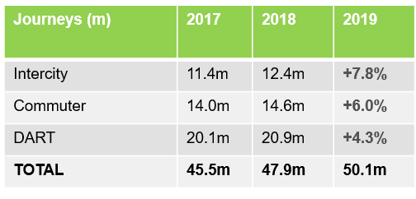
Current Iarnród Éireann Passenger Demand
Future growth will be considered as part of the design process to account for potential changes in public transport behaviour arising from, amongst other factors, Covid-19
(IE are currently liaising with National Transport Authority on this matter)

Slide 6
What is the DART+ Programme?

Slide 7
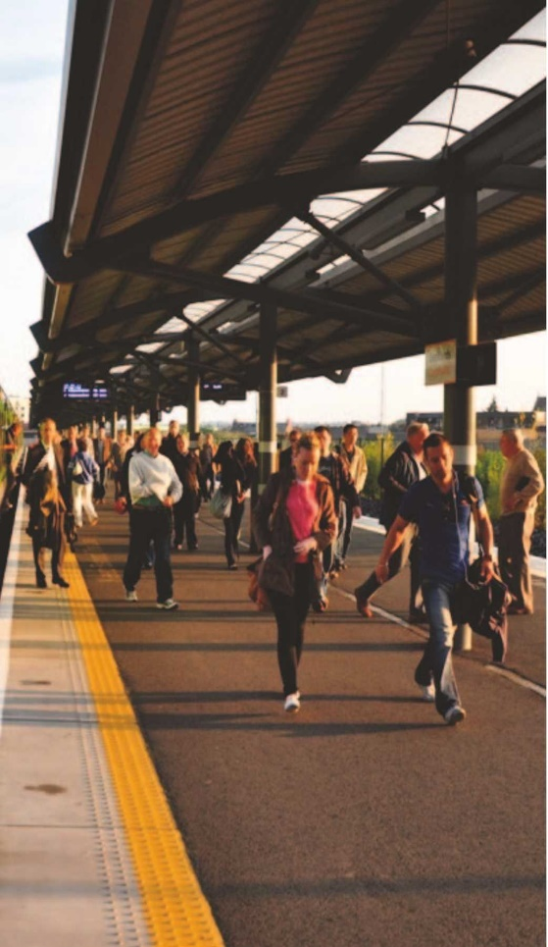
DART+ Programme - Objectives
Support urban compact growth and contribute to reducing transport congestion and emissions in the Dublin region by:
Providing higher frequency & higher capacity electrified rail services;
Provide a higher standard of customer experience;
Cater for existing and projected travel demand and patronage growth;
Improve accessibility to jobs, education and other social and economic opportunities;
Unlock regeneration and development opportunities in proximity to rail corridors;
Deliver an efficient, sustainable, low carbon and climate resilient rail network; and
Assist in achieving Ireland’s emission reduction targets.

Slide 8
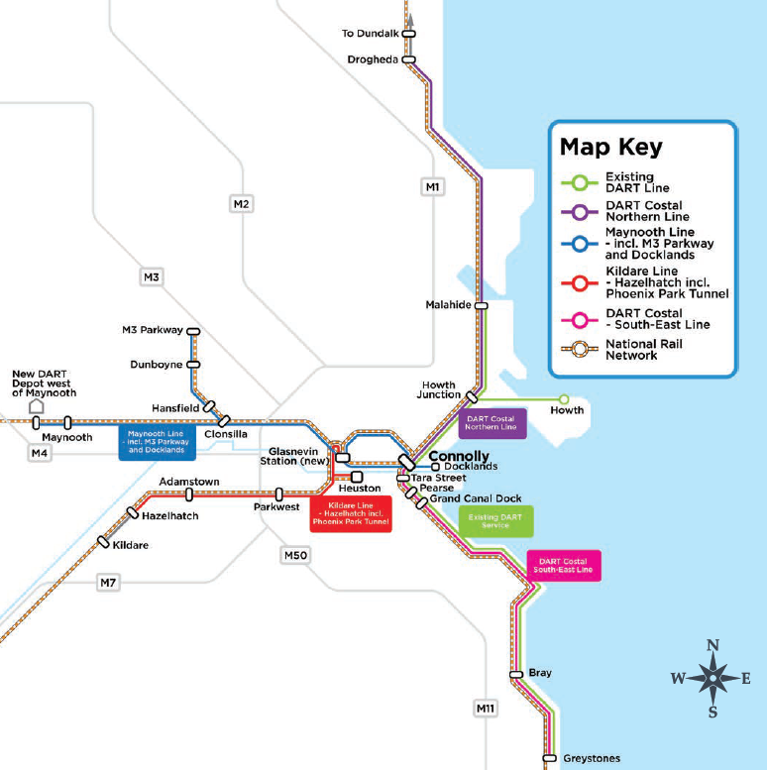
DART+ Programme – Geographical Extent
Current DART network extends from Malahide/Howth to Greystones along 50km railway corridor
DART+ Programme will increase the extent of electrification to 150km of railway corridor
DART+ Programme extends to
Drogheda on Northern Line
Maynooth/M3 Parkway on the Sligo Line
Hazelhatch (Celbridge) on the Kildare Line
Greystones on the Southeast Line
DART+ Programme will increase the frequency of services on the network and will provide high capacity trainsets (i.e. each 8 carriage DART train provide capacity for 1200 passengers).

Slide 9
Why is the DART+ Programme Required?
The 5 key reasons the DART+ programme is needed:
Over-reliance on private car
To improve land-use planning
Lack of integration
To support economic and population growth
To achieve Climate Change targets

Slide 10
What are the Benefits of DART+ Programme
Increased passenger capacity and train frequency: This will enable people to move away from private car use, contributing to alleviation of road congestion and improving quality of life.
Building a more sustainable city: Electric trains will positively assist in the de-carbonisation of the transport sector and enable a transition away from fossil fuels.
Future proofing our Public Transport Network: The DART+ programme will significantly upgrade our existing infrastructure and improve multimodal connectivity through interchange with other public transport networks.
Economic Development: The DART+ programme, will bring, fast, frequent, reliable and sustainable transport to existing communities along the routes, making it easier to travel for work, education or leisure purposes. It will also facilitate the development of new communities that will greatly benefit from the connectivity that DART+ will deliver.

Slide 11
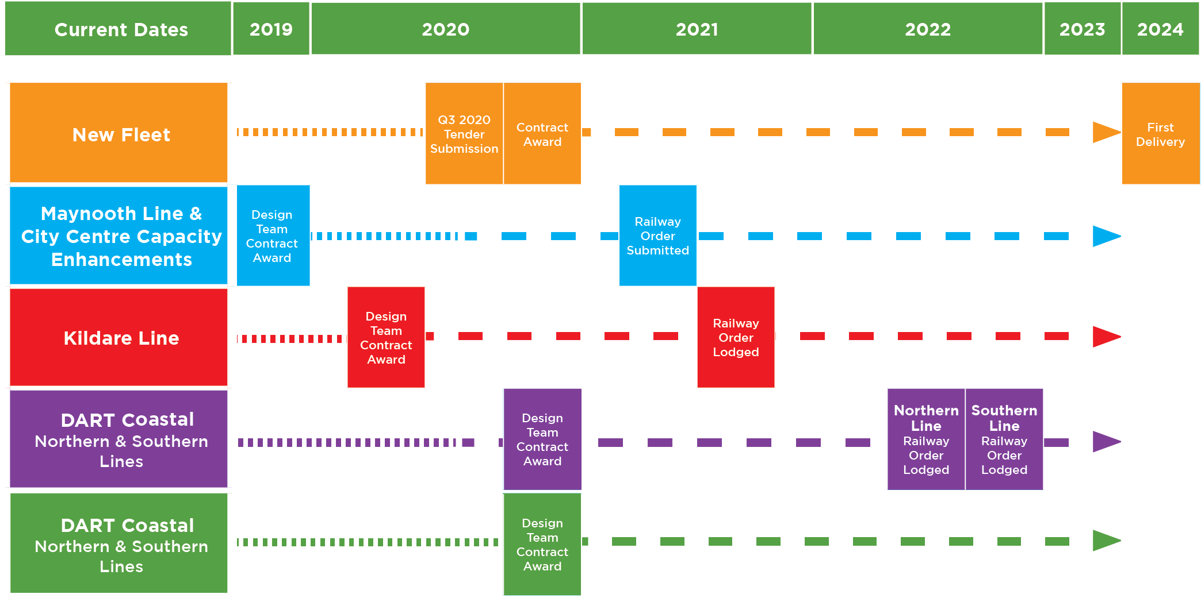
DART+ Programme Timeline

Slide 12
DART+ Programme Vision to support Project Ireland 2040

Slide 13
Transportation and Land Use Policy

Slide 14
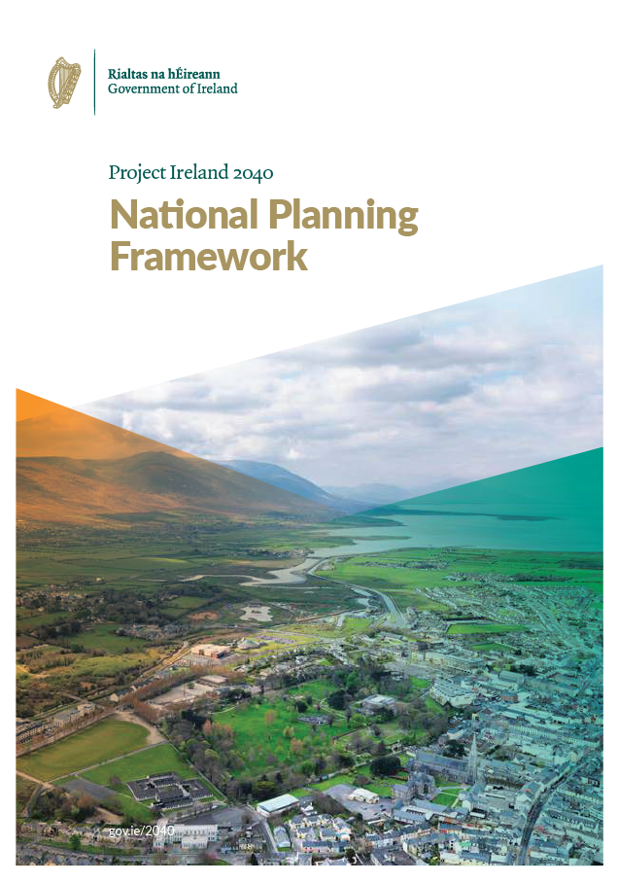
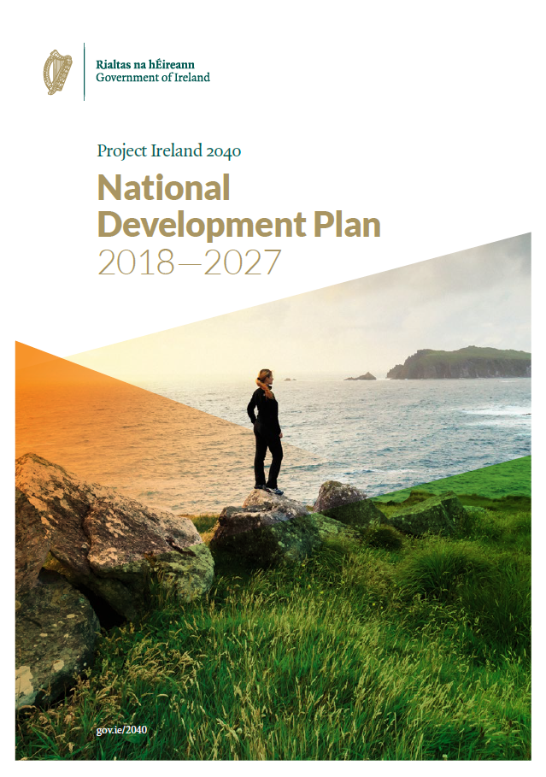
National Policy
DART+ Programme is a key deliverable of National Planning Policy and boosts a number of National Strategic Outcomes of the National Planning Framework and Priorities of the National Development Plan (2018-2027)
“Addressing the legacy of rapid unplanned growth, by facilitating amenities and services catch-up, jobs and/or improved sustainable transport links…”
“Under the National Development Plan investment in public transport infrastructure will be accelerated…”
National Strategic Outcomes
“Delivery of priority elements of the DART Expansion Programme including investment in new train fleet, new infrastructure and electrification of existing lines.”
NSO 1 – Compact Growth
NSO 4 – Sustainable Mobility
“Implement major sustainable-mobility projects such as DART Expansion…”
NSO 8 – Transition to a Low Carbon and Climate Resilient Society
“Promote compact growth and greater integration of policies for land use and transport planning…”

Slide 15
South Dublin County Council Development Plan 2016-2022
CS7 Objective 1: “To support the delivery of sufficient public transport and road capacity to facilitate sustainable new development in Strategic Development Zones”.
TM2 Objective 1: “To secure the implementation of major public transport projects as identified within the relevant public transport strategies and plans for the Greater Dublin Area”
Section 6.1.0 Overarching Policies and Objectives: “Support the NTA in implementing major transport projects such as the reopening of the Phoenix Park Tunnel for rail services, DART Underground and Tallaght Swiftway (Bus Rapid Transport)”.

Slide 16
DART+ South West Overview of Works within SDCC

Slide 17
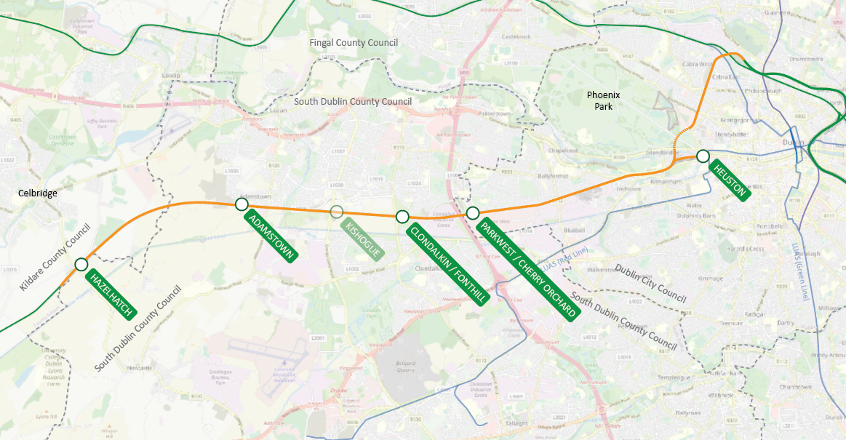
DART+ South West Overview
Notes:
Hazelhatch to Park West: 9km
Park West to Heuston: 6km
Heuston to Glasnevin Junction, via the Phoenix Park Tunnel: 4km

Slide 18
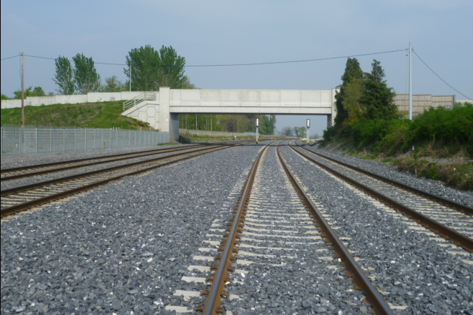
DART+ South West Overview
General
Increase carrying capacity from 4,500 to 13,300 passengers per hour per direction.
Improvements required to increase capacity
Complete 4 tracking from Parkwest to Heuston
Electrify the route from Hazelhatch to Heuston & Glasnevin (via PPT)
Addressing constraints within the Phoenix Park tunnel to support increased frequency of trains
Bridge improvements/re-builds to achieve vertical and horizontal clearances
Re-signal and improve lineside telecommunications, as necessary
Provide stabling infrastructure to maximise rail operational efficiency, for service daily start-up and shut-down
Within SDC Co Co’s area:
Electrification along existing track.
Road bridges – main interventions were made as part of the original Kildare Route Project. Modifications to parapets may be required.
Possible substation location
Signalling and telecoms infrastructure upgrades
Track drainage

Slide 19
Progress / Activities to Date / Programme
Constraints gathering – underway
Engagement with local authorities - now commenced
Optioneering - due to commence
Public Consultation No. 1 – Emerging Preferred Option – Q1 2021
Public Consultation No. 2 – Preferred Option – Q2 2021
Lodgement of draft RO – end Q3

Slide 20
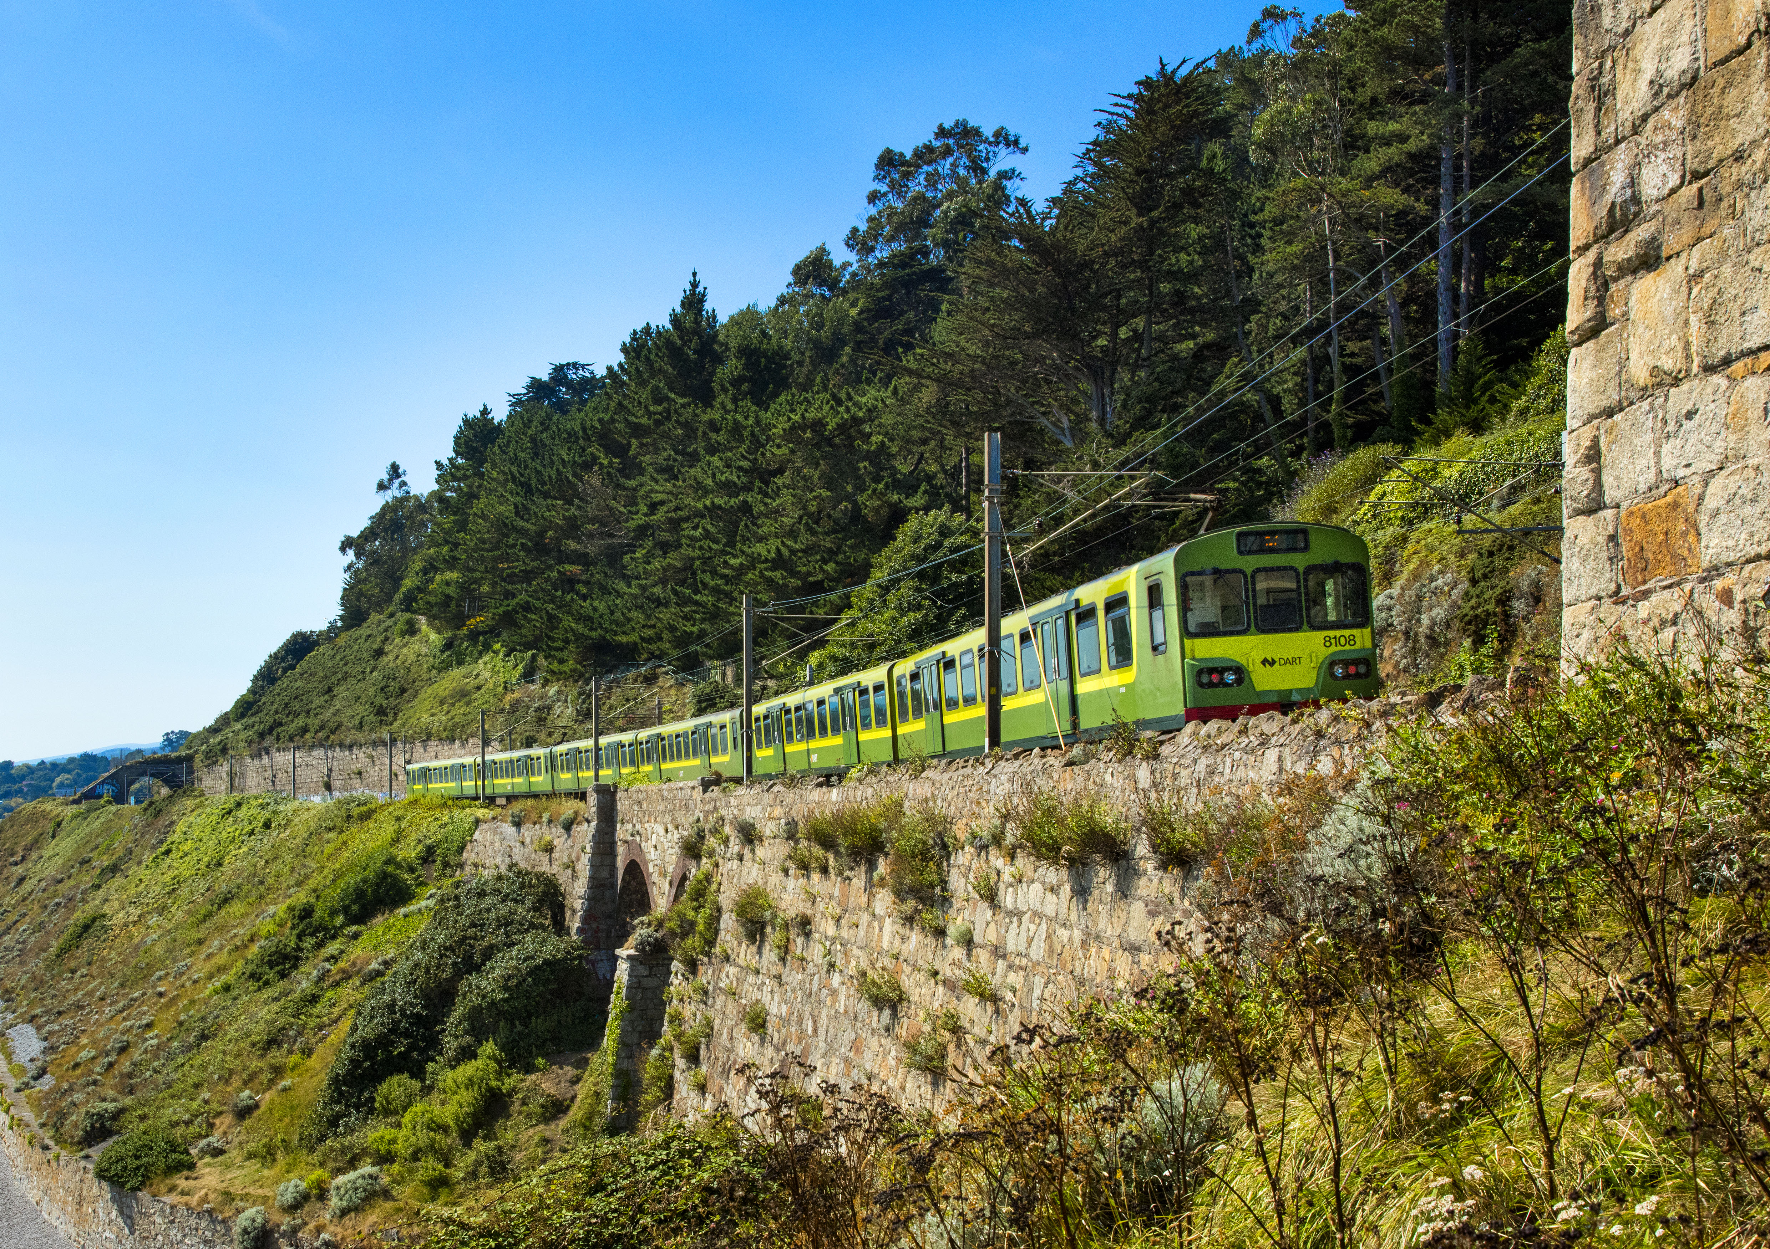
Thank you

Slide 21
DART+ Programme – Legal Statement
© Copyright Iarnród Éireann. All rights reserved. Any information provided herein by Iarnród Éireann is produced for a specific purpose and based on information known at the date of the presentation.
All data, documentation and information concerning the DART+ Programme, as disclosed in this Presentation or discussed by Iarnród Éireann during this Presentation, is strictly private and confidential and may not be disclosed or released to any third party in whole or in part, its servant or agents, without the prior written consent of Iarnród Éireann.
Furthermore the Iarnród Éireann logo or any brand or tradename or trademark (whether registered or not) of Iarnród Éireann or in connection with the DART+ Programme (or the logos, graphics, photographs or any other branding within this presentation) may not be used or permitted to be used in whole or in part without the prior written consent of Iarnród Éireann.
All press releases in connection with the DART+ Programme will be issued by Iarnród Éireann through its Corporate Communications Department at Connolly Station, Dublin 1 and all requests for information and/or press releases in connection with the DART+ Programme should be routed through our Corporate Communications Department.

