Slide 1
School Street Project
9th November 2020

Slide 2
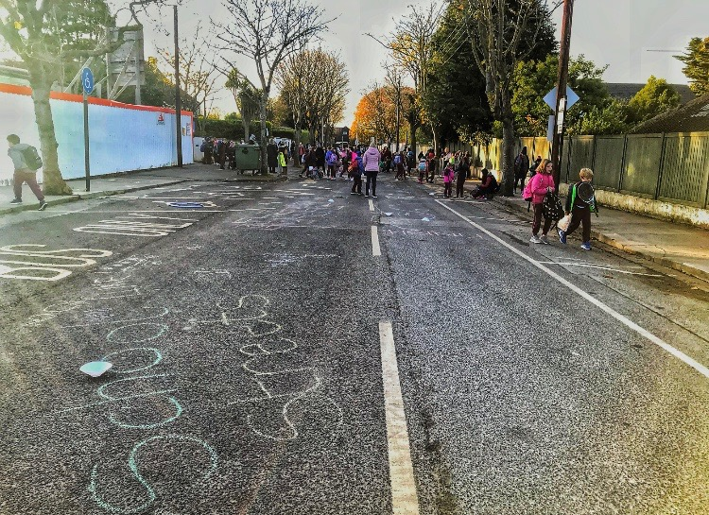
What is a school street?
A road outside a school, or schools, with a temporary restriction on motorised traffic during school drop off and pick-up times. The restriction, generally, applies to school related traffic and through traffic.
Grove Road, Malahide. Photo courtesy of Fingal County Council.

Slide 3
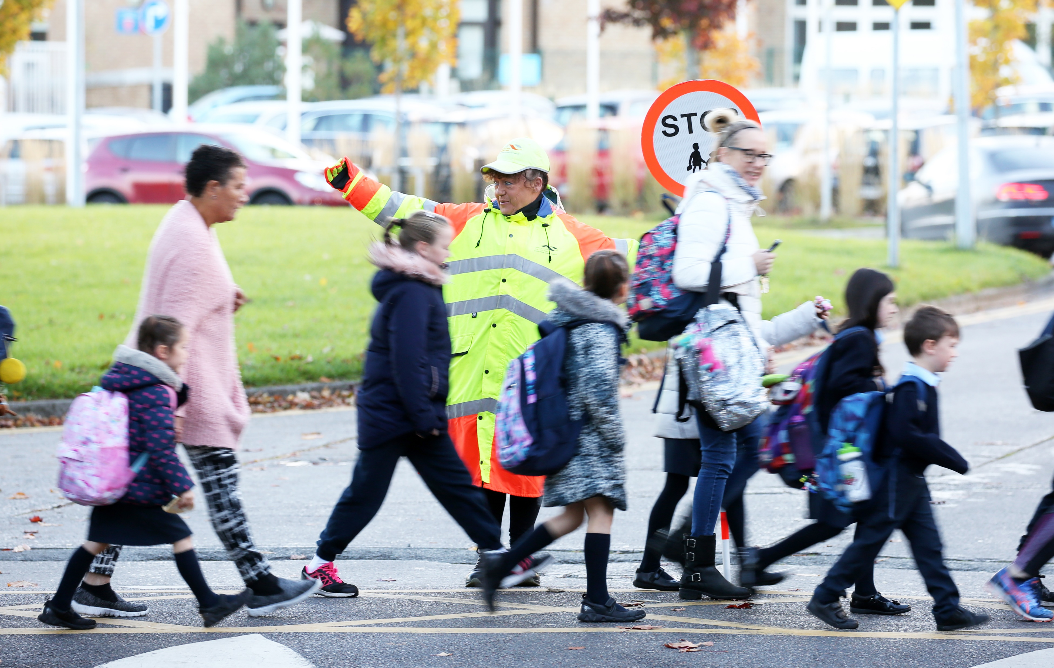
Our aim:
To restrict motorised traffic within an agreed street, or zone, outside the school gate to enhance a safer environment in which children can feel encouraged to cycle, walk or scoot to, and from, school.

Slide 4
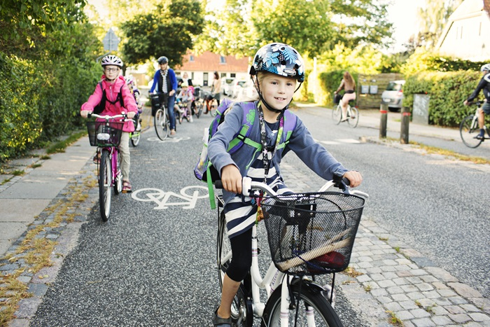
Objectives:
Improve Road Safety
Improve the local environment
Promoting better health

Slide 5
Selection criteria
Primary schools evaluated against following selection criteria:
Presence of School Warden.
Road category: regional, local, residential.
Presence of public transport outside school.
Existing behavioural change programme.
Potential for improved connectivity between school and pupil catchment.
Known traffic related issues outside school.

Slide 6
Schools
As agreed at the October Area Committee Meetings
AREA | Progress to pilot phase | Progress to second phase
Clondalkin ACM | Gaelscoil Chluáin Dolcain – Old Nangor Road. | Talbot S.N.S. – Bawnogue.
LPF ACM | St. Lorcan’s and St. Brigid’s – The Oval | St. Mary’s S.N.S. – Rowlagh
RFTB ACM | Holy Spirit Schools, Limekiln Lane | Bishop Shanahan and Galvin, Templeogue Wood
Tallaght ACM | St. Mark’s S.N.S. and J.N.S. – Springfield | Scoil Maelruain S.N.S. and J.N.S. – Old Bawn

Slide 7
Next steps:
ACTIONS | When?
Council agreement | 9th November
School engagement | December 2020
Supporting consultants in place | January 2021
Survey and analysis work | March 2021
Design work to be completed and agreed | June 2021
Pilot project in place | September 2021

