Slide 1
South Dublin School Street – project update.

Slide 2
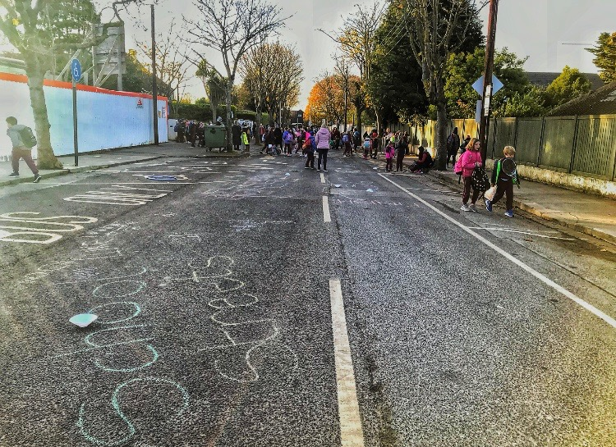
What is a School Street?
A school street is a road outside a school, or schools, with a temporary restriction on motorised traffic during school drop-off and pick-up times. The restriction, generally, applies to school related traffic and through traffic.
Grove Road, Malahide. Photo courtesy of Fingal County Council.

Slide 3
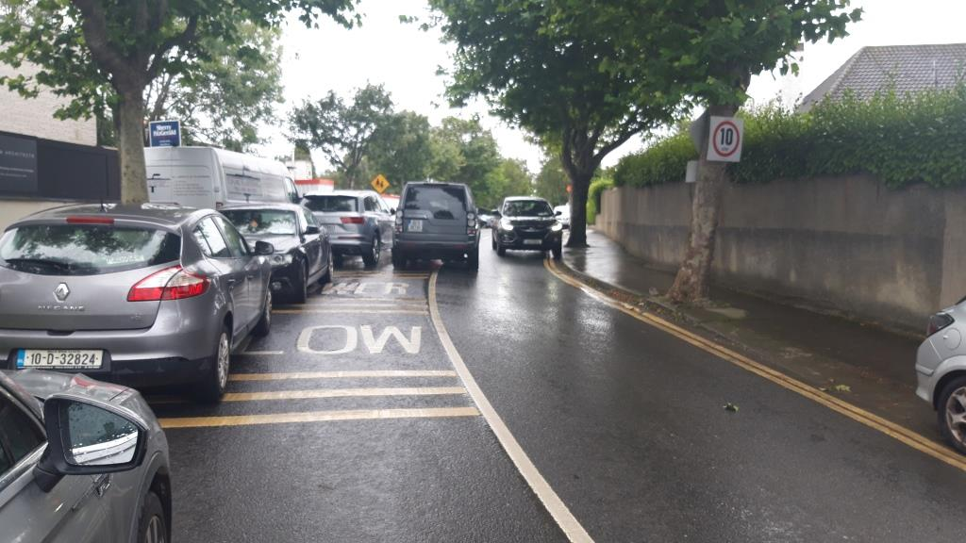
Rational for School Streets
Road Safety - reducing motorised traffic around the school environment makes it safer to cycle, walk and scoot.
Environmental - reducing dependence on the motorised car reduces CO2 emissions, noise pollution and improves air quality.
Health - traffic free environments encourage more people to walk and cycle which improves our physical and mental health.
Grove Road, Malahide. Photo courtesy of Fingal County Council.

Slide 4
South Dublin School Street - Assessment
Primary schools evaluated against following selection criteria:
Presence of School Warden,
Road category: Regional, Local, Residential etc.,
Presence of public transport outside school,
Green-Schools Ireland, Active Schools etc.,
Potential for improved connectivity between school and pupil catchment,
Known traffic related issues outside school.

Slide 5
School Street/Zone* Proposed Project Timeline:
ACM agreement 21st October,
Council agreement 9th November,
Initial School engagement to gauge and agree participation by December,
Procurement of supporting consultants by January 2021,
Survey and analysis February – March 2021,
Design work April – May 2021,
Scheme implementation by September 2021.
*school street/zone

Slide 6
Possible interventions:
Signing and lining,
Barriers to restrict traffic access,
Road realignment,
Improved pedestrian/cycling facilities,
Improved street design.

Slide 7
Clondalkin ACM
Gaelscoil Chluain Dolcáin, Old Nangor Road
School Warden operating outside school,
Local Access,
No bus route outside school, but PT nearby on R134 and R113,
School is involved with Green-Schools and awarded Green-Schools Travel,
Connectivity potential exists but to explored at a greater level during engagement/design phase,
Parking/congestion outside the school.

Slide 8
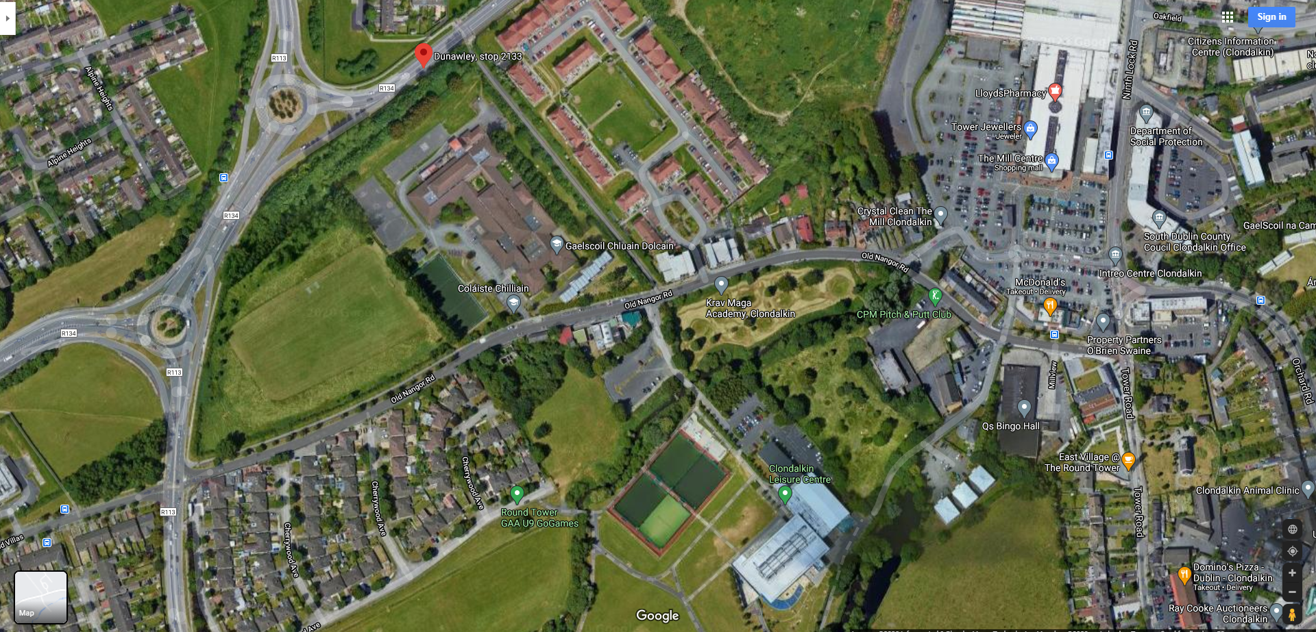
Clondalkin ACM – Gaelscoil Chluáin Dolcain

Slide 9
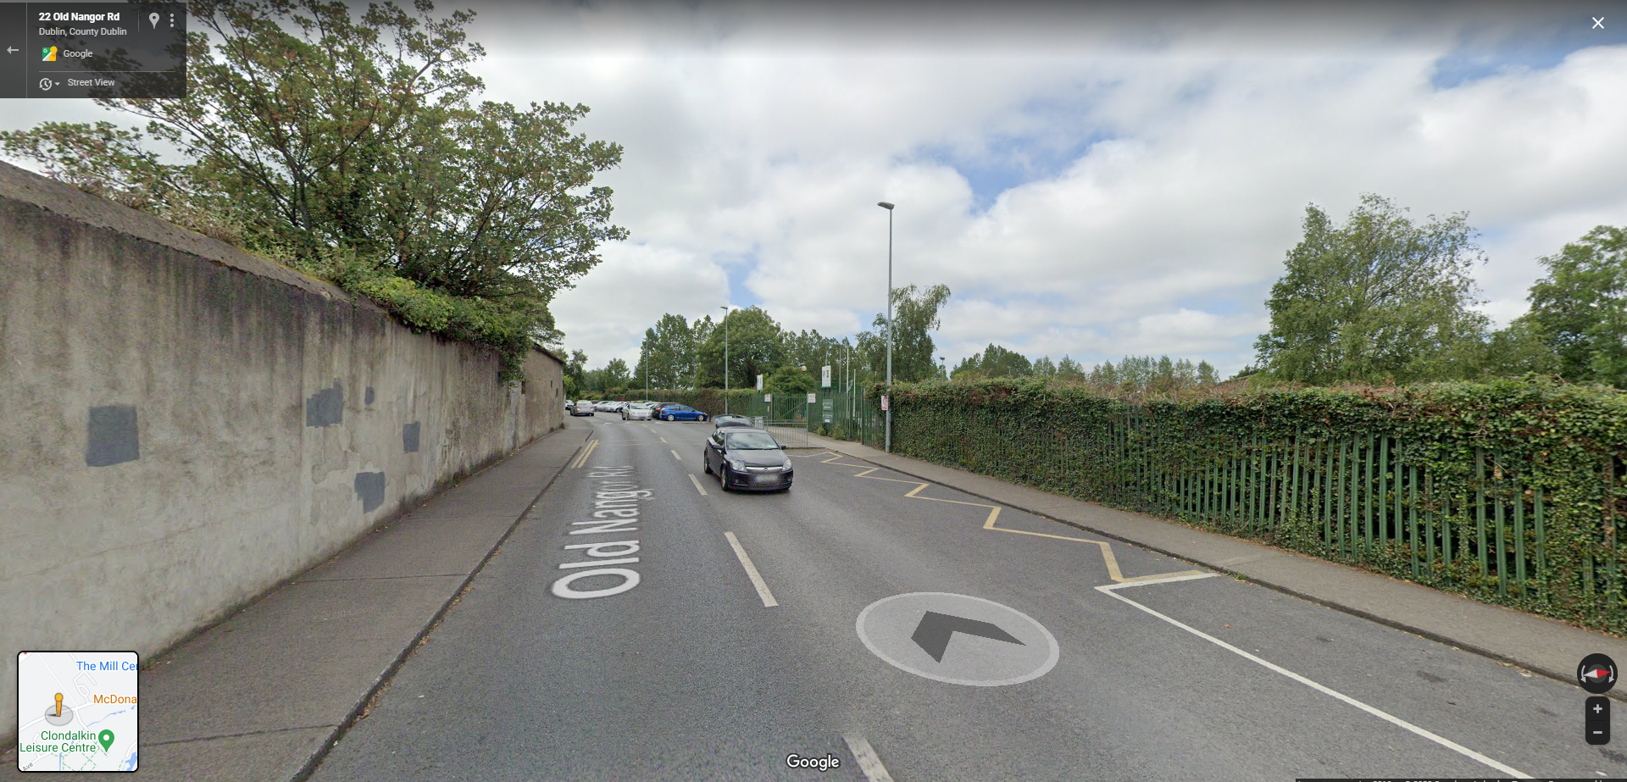
Clondalkin ACM – Gaelscoil Chluáin Dolcain

Slide 10
Clondalkin ACM
Talbot S.N.S.
School Warden servicing two schools Nano Nagle and Talbot S.N.S.
Local Access,
PT nearby on Bawnogue Road,
School involved with Green-Schools and awarded Green-Schools Travel,
Connectivity potential exists but to be explored at a greater level during engagement/design phase,
Parking/congestion issues outside the school.

Slide 11
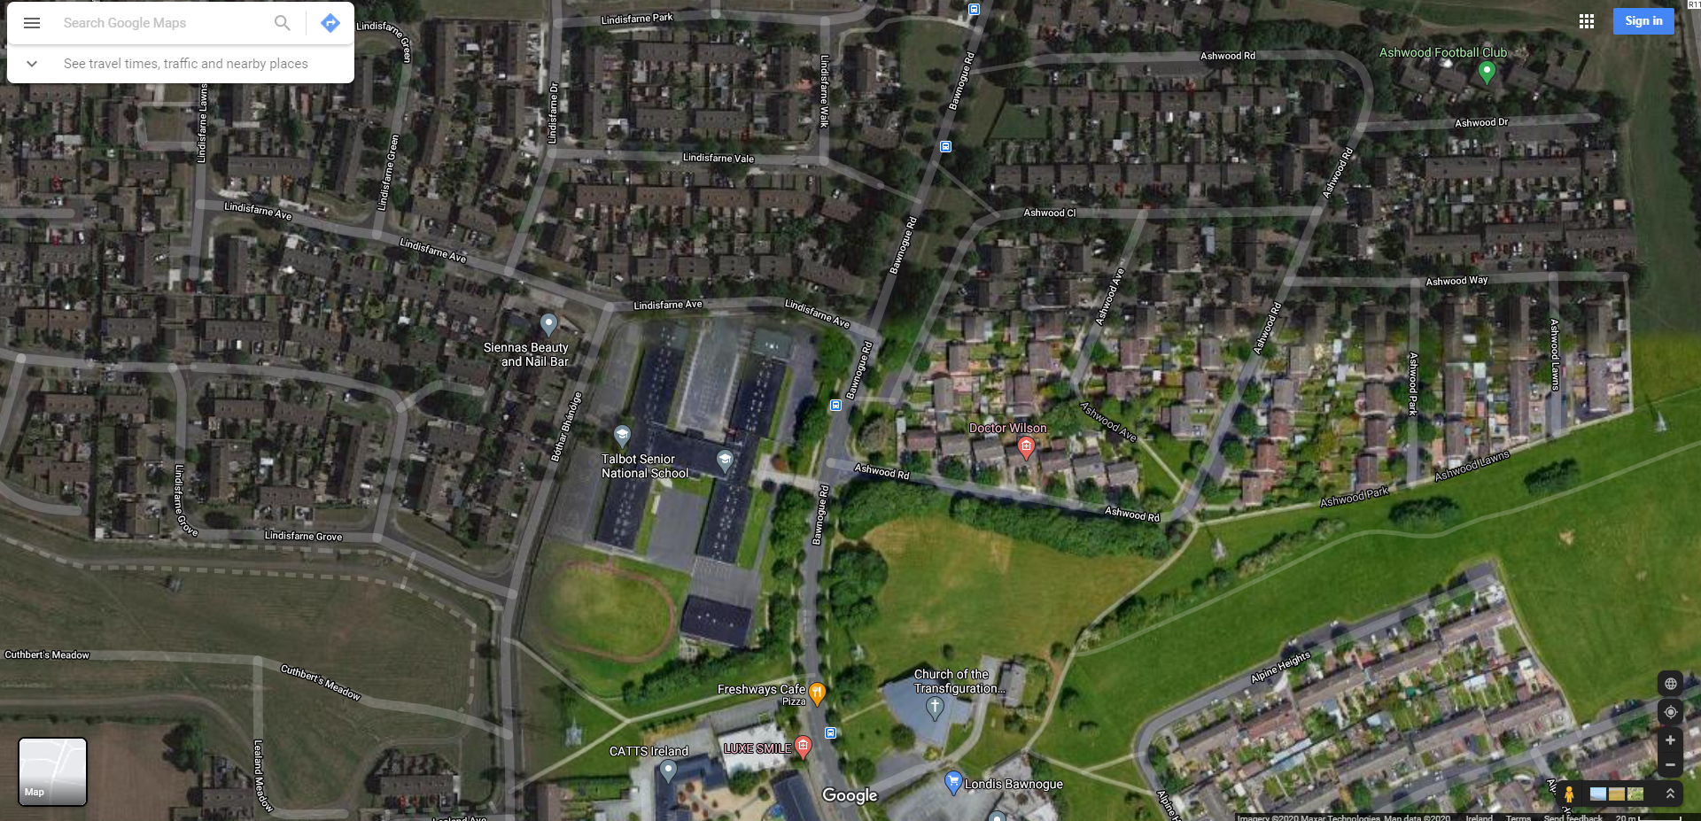
Clondalkin ACM – Talbot S.N.S.

Slide 12
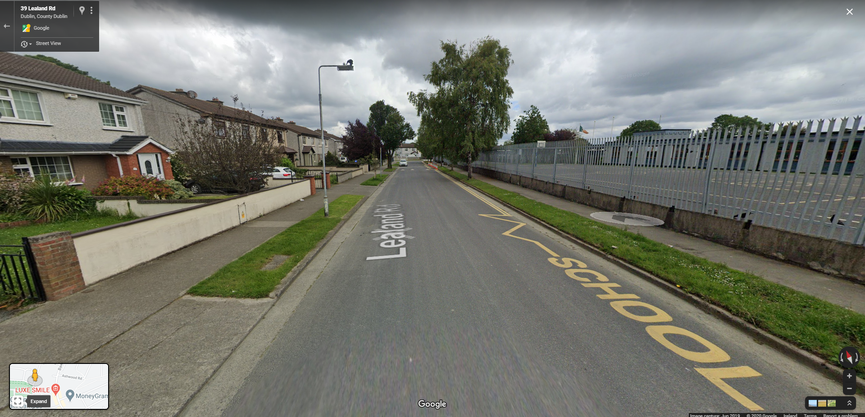
Clondalkin ACM – Talbot S.N.S.

Slide 13
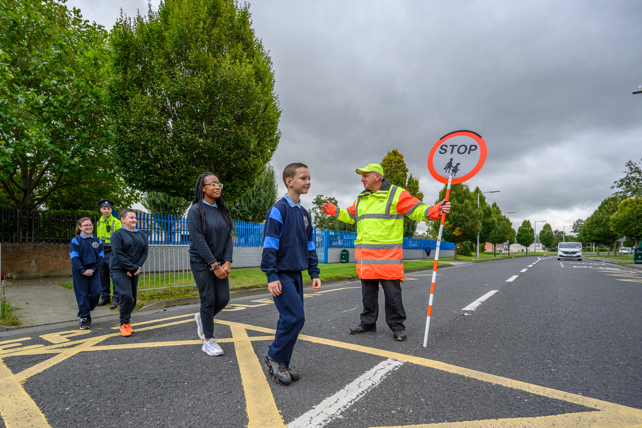
THANK YOU
Q&A

