Slide 1
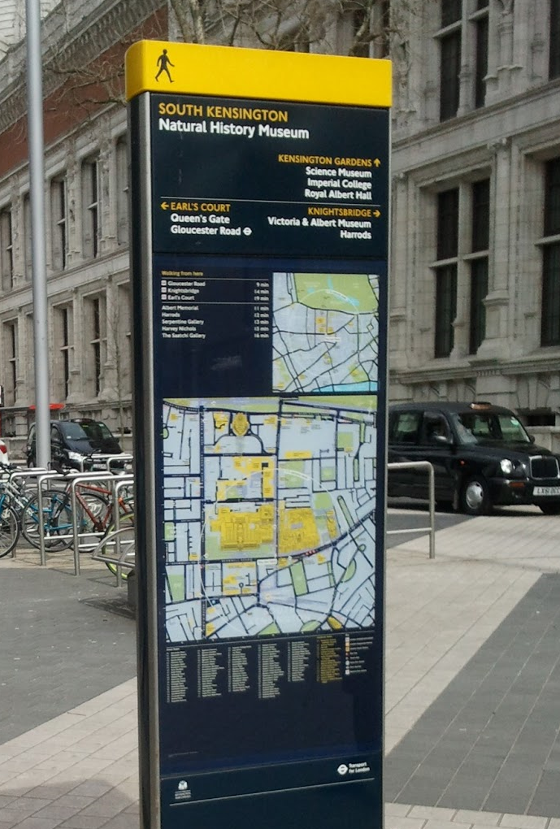
SDCC Directional Signage Strategy
October 2020

Slide 2
Existing and proposed guidance
National - Traffic Signs Manual (DTTAS)
Provides design requirements for the provision of road signs for vehicles
South Dublin - Wayfinding Policy
Provides design guidance for the design and location of cultural and tourist signs as well as setting out the fees and application process
There is currently no guidance on local directional signs and hence there is mismatch of sign types across South Dublin and the Greater Dublin Region
In recognition of this challenge and with the goal of providing consistent guidance across Dublin, Failte Ireland has development a new guide and it is now the Council’s intention to adopt this.

Slide 3
Local Directional Sign guidance
The Council’s Signage Strategy proposes to standardise local directional signage under the following sign types with clear design, location and maintenance requirements:
Finger post signs (as per the Failte Ireland guidance)
Walls signs (as per the Failte Ireland guidance)
Totem signs (as per the Failte Ireland guidance)
‘Welcome to’ signs for the 9 historic village
Bespoke heritage trails

Slide 4
Local Directional Sign guidance
The proposal is to deliver new local directional signage in the following locations
Tallaght as the County Town, 9 historic villages and our District Centres
Key Transport Nodes
Parks and Open Spaces
Heritage and Cultural trails

Slide 5
What will happen next?
A set of specific projects under each of the 4 locations will be discussed with the ACM’s
A final set of projects will be agreed and a design team appointed to work up the detail for each project
The relevant permissions / licences will be secured
Contractors will be appointed to deliver the projects
Alongside this, as new Council projects are delivered, local directional signage will be included as part of the project where desirable.

