Slide 1
Litter Management Plan 2020-2022 January to June 2020
Area Committee Meeting
September 2020

Slide 2
Litter Management Plan 2020-2022
Objectives in the Plan to prevent and control litter through:
Litter and Waste Enforcement and Regulation
Management of the Public Realm
Communication, awareness and education

Slide 3
Litter & Waste Enforcement in the context of Covid 19
March and April 2020 compared to March and April 2019:
33% increase in volume of dumped material collected
13% less litter collected from litter bins
42% more collected from Bottle banks due to increased demand
Increase in complaints related to non disposal of household waste

Slide 5
Actions taken by Environment
Waste collection services throughout the county maintained
Increased Litter Warden patrols
Dumping removed by Public Realm crews
County wide surveillance to identify illegal dumpers
Increased collections from bottle banks

Slide 6
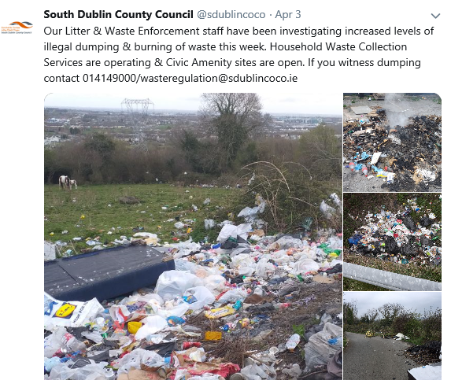
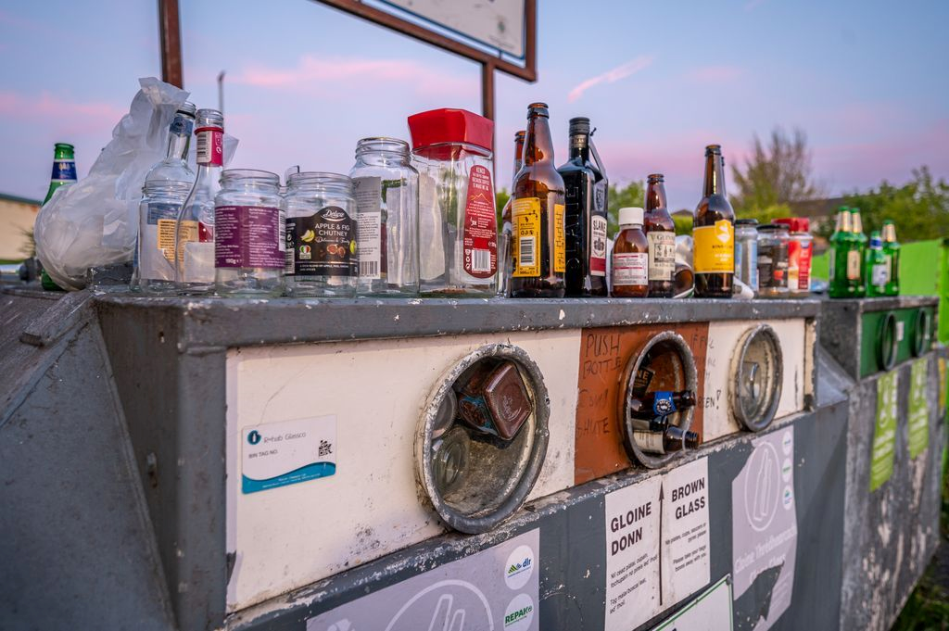
Social Media Campaigns

Slide 7
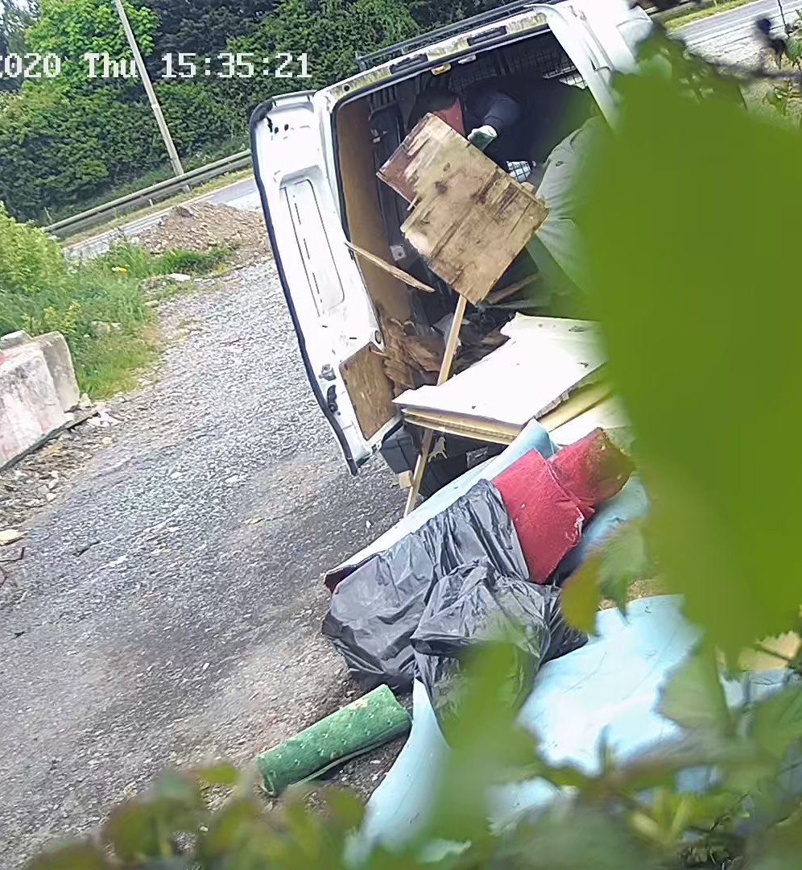
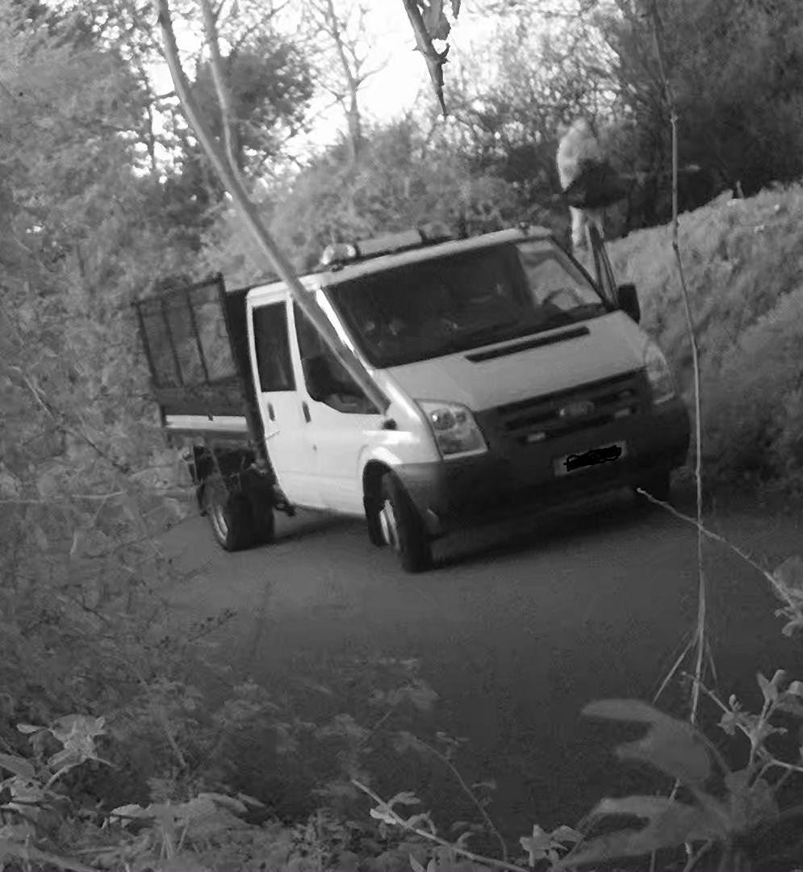

Slide 8
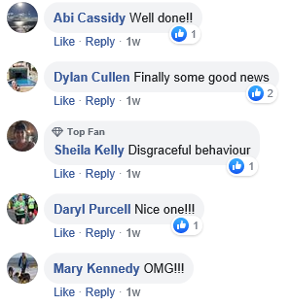
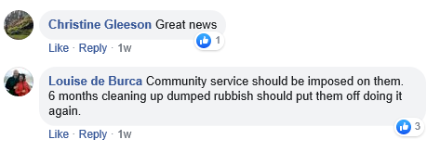

Slide 9
Communication and Awareness
National Spring Clean deferred to June due to Covid 19 – 61 Clean ups carried out
Social Credits Scheme: 13 groups signed up to the minor landscaping programme; 9 received paint and supplies under the paint scheme
Clean ups were suspended in April and May; 785 clean ups carried out up to end of June
22 Schools were awarded Green Flags in May

Slide 10
Dublin Canvas 17 locations across SDCC
Tallaght South
R126 / Fettercairn
Templeogue/Terenure
College Drive, Wainsford Road
Limekiln Road, St James Road
Wellington Lane, Limekiln Rd
Rathfarnham
Rathfarnham Castle, Rathfarnham
Willbrook Road, Rathfarnham (opposite Yellow House)
Tallaght Central
Killinarden House Tallaght
Old Bawn Road/Killininny
Citywest Shopping Centre, Citywest Rd, Citywest
Scoil Aoife, Citywest
Lucan
Griffeen Ave, Balgaddy
Castlegate Way/Adamstown Avenue
Clondalkin
Newland Road/Fonthill Road North, Ronanstown
Woodford Walk, Knockmitten
New Nangor Road/ Woodford Walk, Clondalkin
Fonthill Road – Dunawley
Station Rd/Ninth Lock Road

Slide 11
Thank you

