Slide 1
SHD Application Ref: SHD3ABP-308088-20
Applicant: Cape Wrath Hotel ULC
Presentation to Tallaght ACM 28th Sept 2020
Jim Johnston
Senior Executive Planner

Slide 2
Timelines
SHD Lodged with ABP on 04/09/2020
5 Week Obs by 5.30pm on 08/10/2020
8 Wks SDCC report due to ABP 29/10/2020
16 Week Decision due from ABP 04/01/2021
Consultations
S.247 pre-planning meeting was held with SDCC on 23/01/20
A pre-planning meeting was held on 26/06/20 with An Bord Pleanala, the applicant and SDCC.

Slide 3
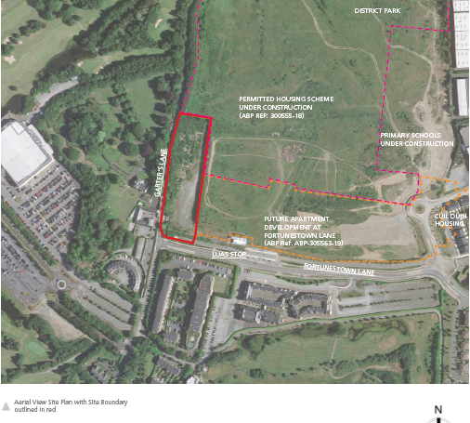

Slide 4
Proposed Development:
224 apartments comprising
82 1 bed units,
121 2 bed units
21 3 bed units
in 4 blocks (Blocks A to D) and all associated public open spaces, communal amenity spaces and private amenity spaces comprising terraces/balconies.
The proposed blocks are arranged over 2 single level basements (accessed via 2 vehicular ramps to east of the site) and comprise 5 to 6 storey blocks with an 8 storey element as part of Block A. Vehicular access to serve the proposed development will be provided via a new access at Garters Lane and will also provide access to lands to the east (development permitted under ABP Ref. PL06S.305563).
191 car parking spaces (180 at basement level and 11 at surface level); 470 bicycle parking spaces (290 No. at basement level and 180 No. at surface level); 1 No. ESB Substation; 1 No. cycle store, hard and soft landscaping, pedestrian and cycle links, boundary treatments, public lighting, bin storage areas at basement, surface water drainage infrastructure and attenuation tanks, and all associated site development and infrastructure works.

Slide 5
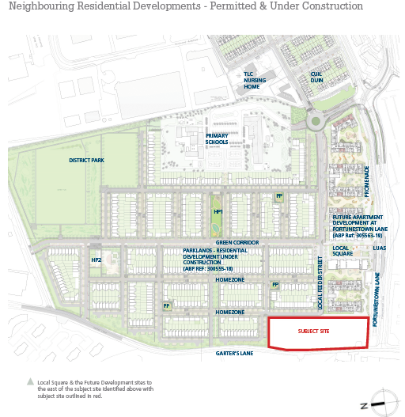

Slide 6
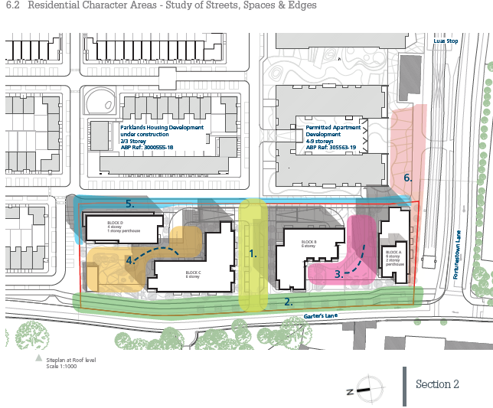

Slide 7
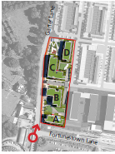
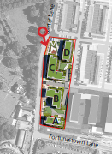

Slide 8
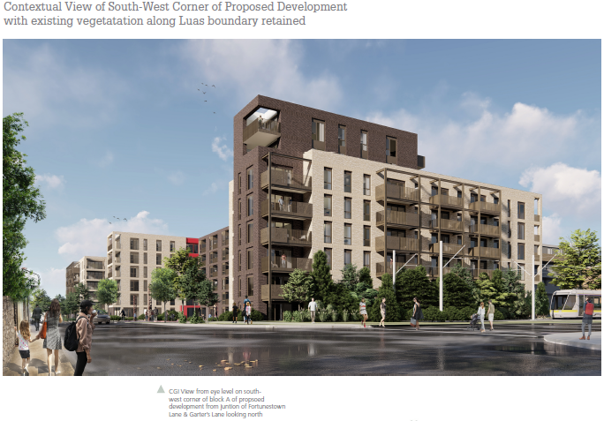

Slide 9
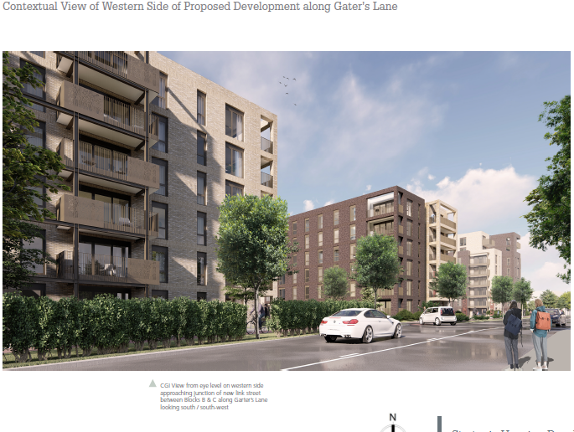

Slide 10
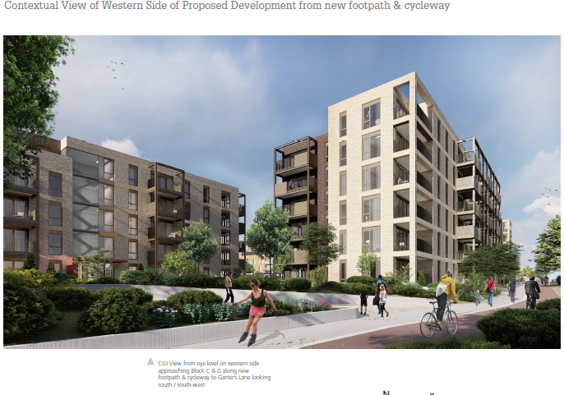

Slide 11
ABP comments:
reports, drawings, computer generated images and photomontage imagery that shows how the proposed development will integrate with existing and permitted development in the vicinity, including:
(a) Cross section drawings along Garter Lane, the Luas line and the eastern boundary of the site that incorporates vehicle access ramps and permitted development.
(b) A detailed landscaping plan
Sunlight/Daylight analysis,
a rationale for the proposed car parking provision, to include details of car parking management, car share schemes and a mobility management plan.
reports that address all aspects of building appearance and durability:
(a) A report on the proposed materials and finishes
(b) A life cycle report

Slide 12
A housing quality assessment which provides the details regarding the proposed apartments set out in the schedule of accommodation, as well as the calculations and tables required to demonstrate compliance with the 2018 Guidelines on Design Standards for New Apartments
drainage details having regard to the requirements of the Water Services Planning Report as indicated in their report dated 20 May 2020 and contained in Appendix C of the Planning Authority’s Opinion.
A site layout plan showing areas to be taken in charge by the planning authority
A public realm strategy regarding the provision of durable and acceptable materials and finishes
A Construction Traffic Management Plan with specific reference to the proximity of the site close to the Luas Line.
Construction and Demolition Waste Management Plan.

Slide 13
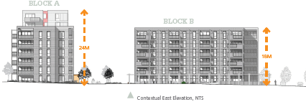

Slide 15
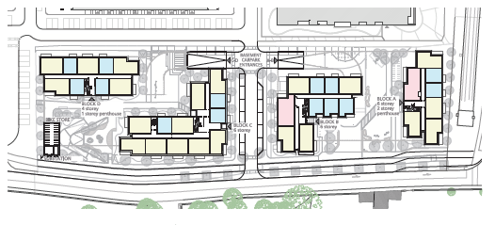
Location of access to the two basement car parks

Slide 16
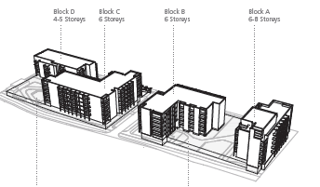
Proposed building heights

Slide 17
Statistics for Proposed Development:
Proposal - 224 apartments
82 1-beds (36.6%)
121 2-beds(54.0%)
21 3-beds(9.4%)
Site area – 1.184 ha (197m x 58m)
Density – 190 units per ha
Plot ratio – 1.65
Site coverage – 30.2%
Height – 5 to 6 storeys with an 8 storey block as part of block A
Dual Aspect – 116 units (51.8%)
Public open space – greater than 14%
Car parking – 180 at basement level
Cycle parking – 290 basement and 180 surface

Slide 18
Thank You
Questions

