Slide 1
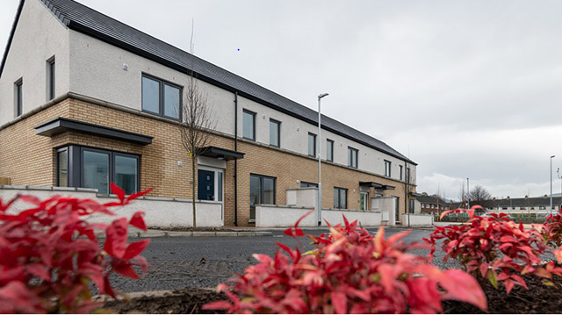
Planned Maintenance Programme Quarter 4, 2020
Housing SPC- 10th September 2020

Slide 2
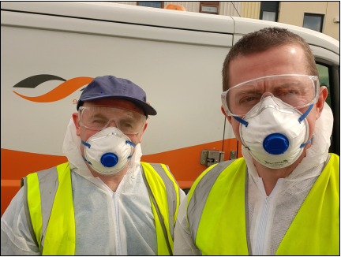
COVID 19 and Planned Maintenance
Consequences
Challenges
Significant impact on the 2020 planned maintenance operations
Works could not commence despite completion of significant procurements for the planned/cyclical maintenance operations
Revised programme of works for the remainder of 2020
Potential increased costs/timeframes
Programme dependent on public health and safety guidelines/restrictions and may be subject to change
Access to homes
Tenants self-isolating, underlying medical conditions, Over 70’s
Staff or Contractors display COVID 19 symptoms
Ensure staff/contractors can carry out works in accordance with social distancing guidelines

Slide 3
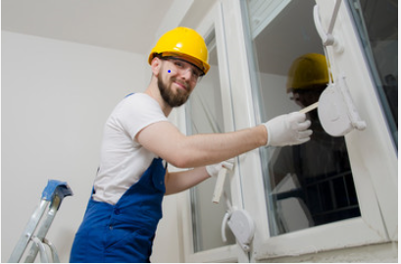
Accelerated Windows and Doors Programme
Projected expenditure of €1.6million in 2020
Commenced Sept 2020 with inspection & listing of 200 homes
Airlie, Arthur Griffith, Foxdene, Greenfort, Harelawn, Kilcronan, Kilmahuddrick (North of Naas Road)
Allenton, Avonbeg, Avonmore, Bawnlea, Bolbrook, Brookview, Castle Park, Cloonmore (South of Naas Road)
Selected additional priority cases
Average Cost per unit: €8,000

Slide 4
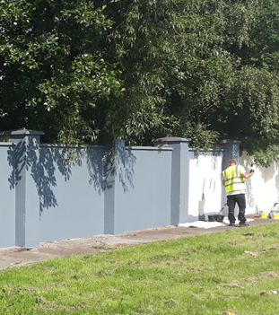
Multi-unit Developments- Communal Door Replacement and Painting: Projected expenditure of €50,000 for the reminder of 2020
The programme will consist of replacement of door/screen/window of communal areas in Mac Uilliam and Balgaddy
The works will also include the provision of new post boxes that are to be installed internally in the blocks in Mac Uilliam
The communal areas are to be painted in each of the areas identified in Mac Uilliam/ Balgaddy. These works will include walls/ceilings/woodwork, handrails etc.
Painting of Older Person’s developments including Liscarne and St. Maelrauns
Removal of graffiti and painting of walls in Mac Uilliam Estate

Slide 5
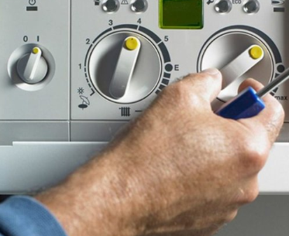
Roof and Canopy Repairs
Boiler Servicing
Investigating & resolve ongoing roof issues in 3 blocks in Balgaddy
Repairing façade, painting and replace gable end glazing of 6 homes at Brookview Rise: €25k
Repair canopies of 20 homes and installation of supports in Marfield Estate: €16k
4,000 boiler services projected from July to Dec: €225k
Full replacement of 5 kitchens in remainder of 2020 under the Kitchen Replacement Programme: €25k
Kitchen Replacement

Slide 6
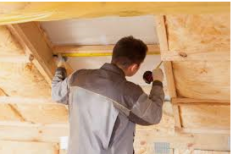
Energy Retro- Fit Programme
Preparing tenders with estimated value of €460k for
90 homes in Lindisfarne, Clondalkin
140 homes in Drumcairn, Tallaght
We are currently finishing Phase 1 of the programme which involves :
Cavity Wall fill insulation
Insulation of attic, tank etc and fitting lagging jackets
Replacement of cold water tank where necessary
Roof & wall ventilation and draught proofing
Mechanical fans fitted to kitchen and bathrooms
Cost €2000 per unit

