Slide 1
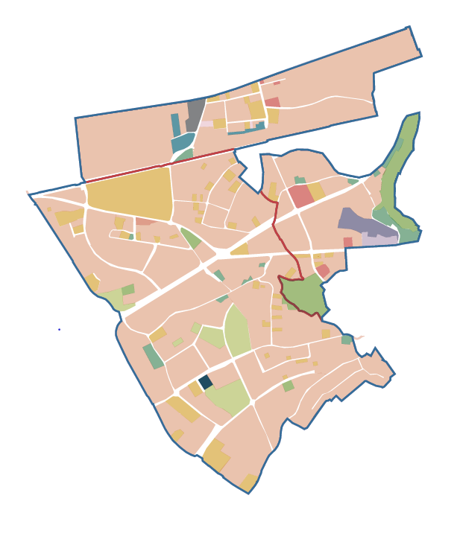
Naas Road - Ballymount -
Cherry Orchard – Park West URDF Masterplan
Land Use Planning and Transportation SPC Meeting
September 2020

Slide 2
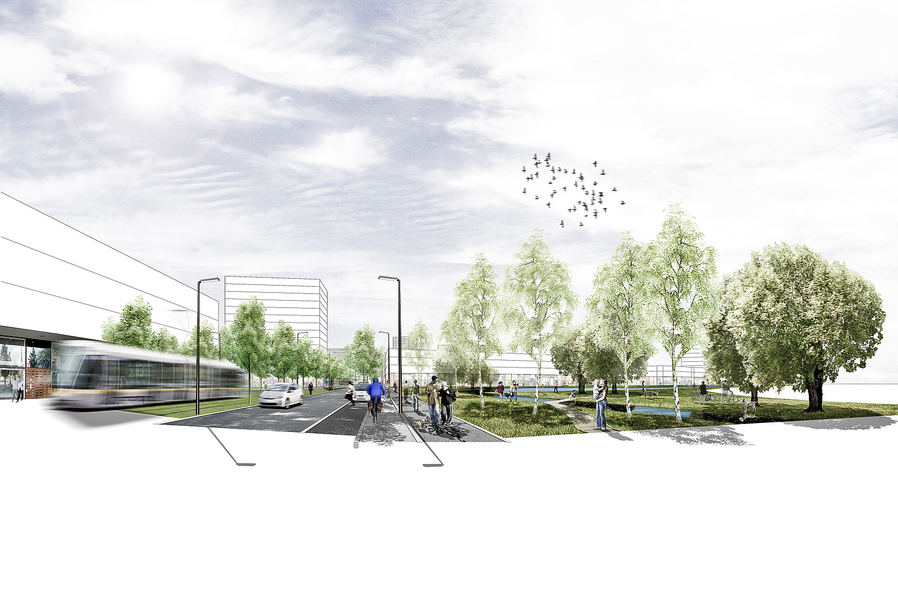
CONTENT
1. Study Area
2. Project Background
3. SDCC/DCC Zoning
4. Constraints /Challenges
5. Project Team
6. Timeline
7. Next Steps
Questions

Slide 3
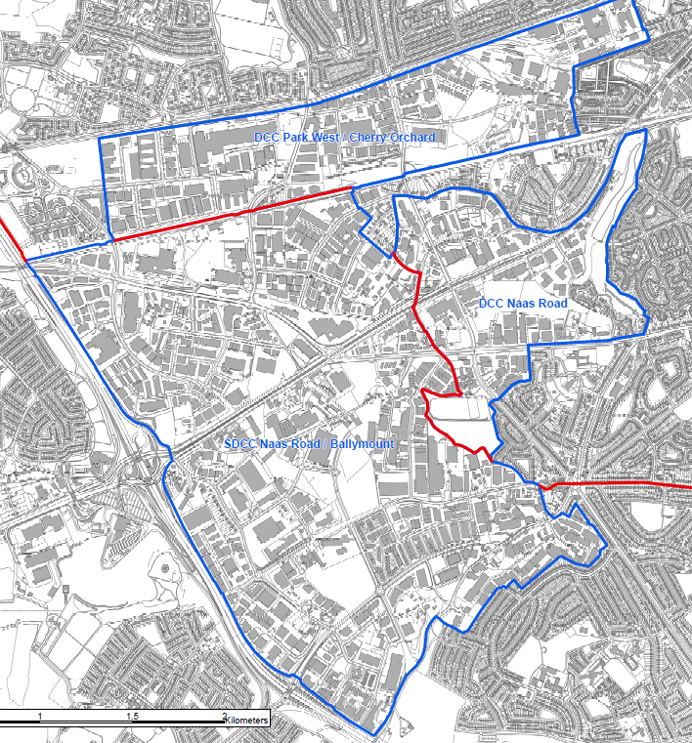
1. Study Area
Study Area
700 hectares in total (SDCC and DCC lands)
649 hectares net developable area
Net Developable Lands – DCC
The Naas Road Lands LAP c. 111 ha
DCC Park West/Cherry Orchard c. 151 ha of land zoned Z6 (Employment/Enterprise) and Z7 (Industry and Employment)
Net Developable Lands – SDCC
440 ha in SDCC URDF bid Study Area
387 ha represent the net developable area.
280 hectares zoned REGEN
107 hectares zoned EE
Public Transport
Kildare Rail Line
Red Line Luas
Greenhills Road to City Centre Bus Route

Slide 4
2. Project Background
Rebuilding Ireland (2016) and National Planning Framework’s National Strategic Objectives to promote Compact Growth.
Strategic Location, close to City and straddling boundary of DCC / SDCC.
SDCC’s CDP Objective - CS6 SLO 1: ‘To prepare a Ballymount Local Area Plan for lands zoned REGEN, EE, and LC, stretching southwest from Walkinstown Roundabout along the Greenhills Road to the M50….’
August 2018 2 Category 2 URDF bids:
SDCC submitted Naas Road / Ballymount.
DCC submitted Naas Road LAP land and Park West Cherry Orchard.
November 2018 DHPLG committed €1,075,000 of URDF funding a joint SDCC/DCC project with 25% match funding requirement.
Variation No. 3 of SDCC’s CDP in February 2019 – Rezoning of 178ha of EE lands to Regen.

Slide 5
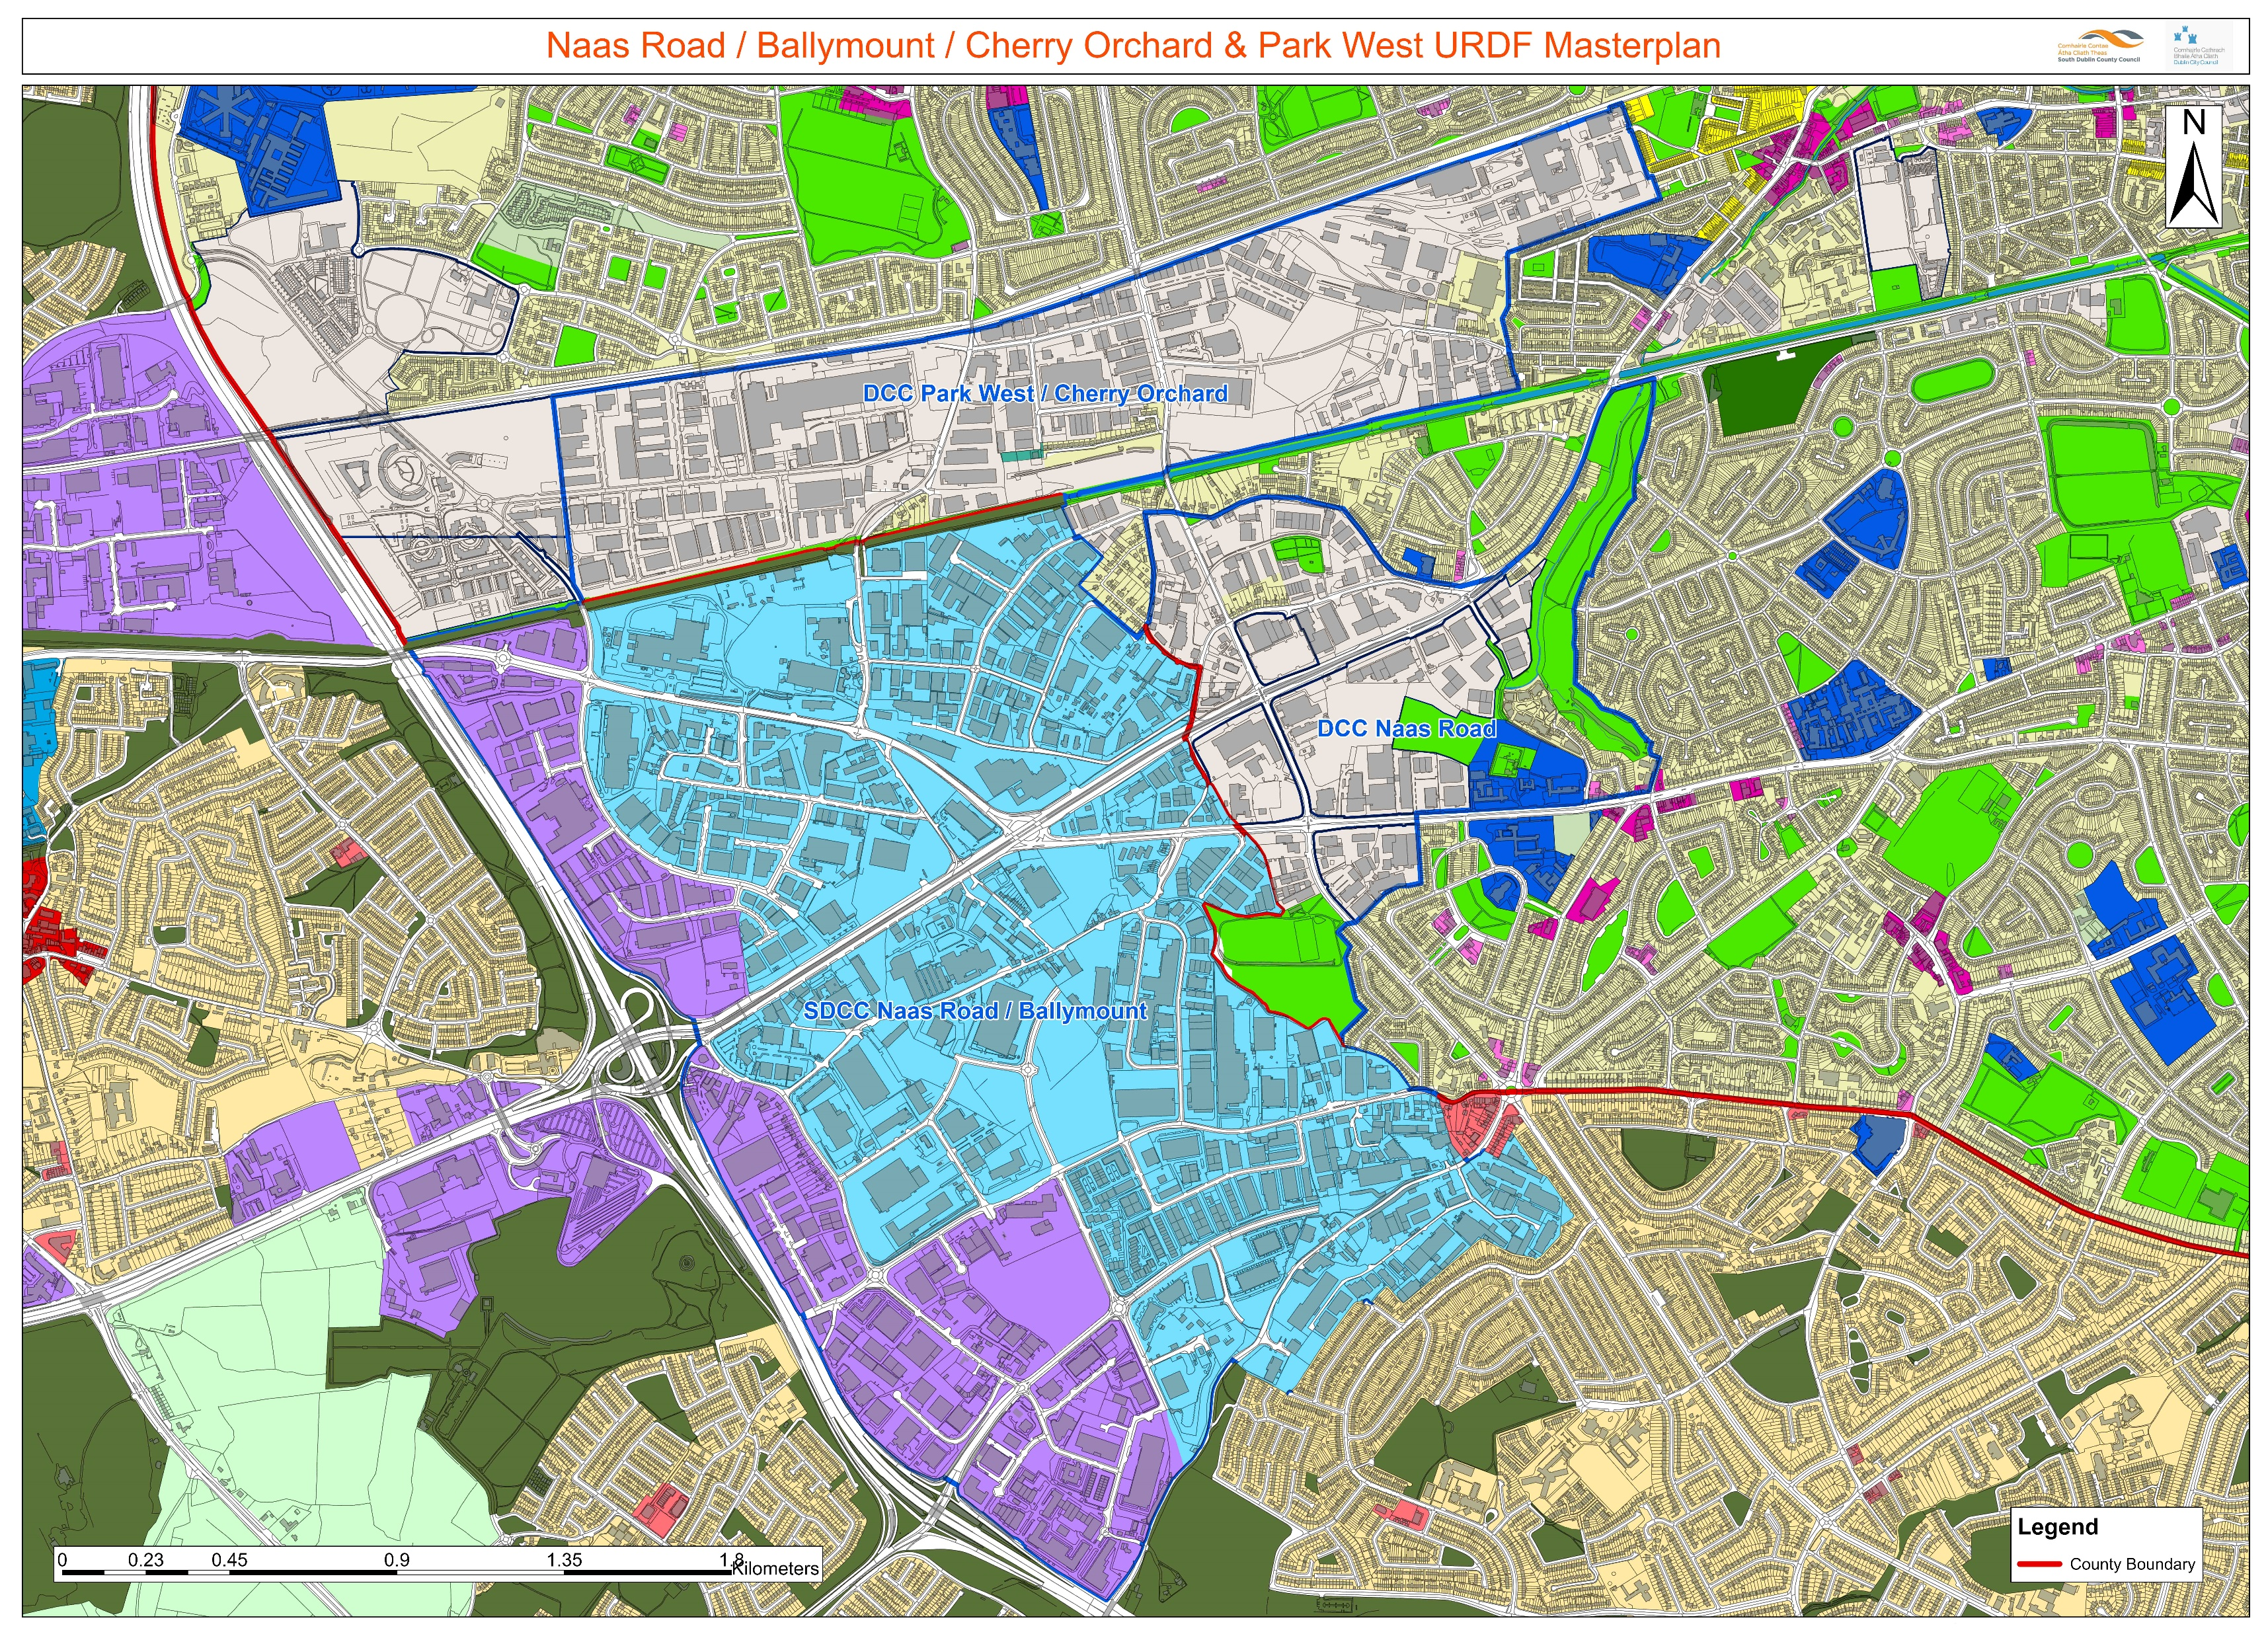
3. SDCC - DCC Zoning
DCC Lands
SDCC Lands

Slide 6
4. Constraints & Challenges
Environmental
Seveso sites
110kv power lines
Contaminated land
Noise pollution & air quality
Infrastructure & Utilities
Foul capacity
Water supply
Transportation
Public transport capacity
Heavily trafficked road network
Cycling & pedestrian environment
Landownership
Multiple Landowners
Economic
Displacement of existing industrial uses
Land values
Short-term development disincentives Vs longer-term development incentives
State investment
Place-making & Community
Lack of community facilities / open space
Lack of local facilities e.g. shops, cafes etc.
Small existing residential community
Planning
Absence of integrated planning framework
SHD process
Development Plan process & potential variations
Area designation & plan-making type

Slide 7
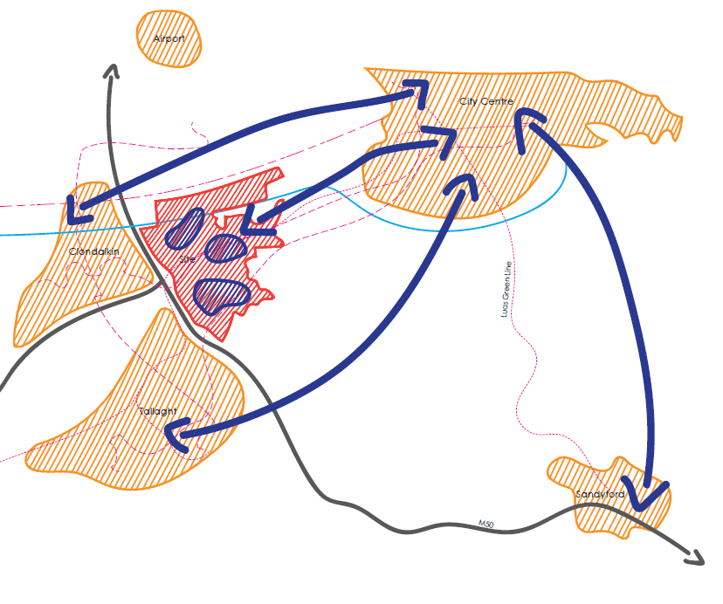
5. Project Team
Multi-disciplinary Team
Maccreanor Lavington – Project Lead.
Urban Agency – Urban Design.
Avison Young – Land Use Planning, Property & Economics.
Systra - Transport Planning & Transport Engineering.
Grant Associates – Landscape Architecture.
Jacobs – Environmental Engineering & Quantity Surveying.
IAC – Archaeology & Heritage.
Task - 3 brownfield regeneration areas are the Study Area:
SDCC Naas Road / Ballymount.
DCC Naas Road.
DCC Park West/Cherry Orchard.
Objective to investigate the potential of this strategic transboundary landbank.
Aim is to provide a new urban Quarter for Dublin City in accordance with the national and regional planning policy.
Brief pertains to the following 4 separate stages:
Stage I Study
Stage II Strategic Framework
Stage III Plan
Stage IV Projects
Project Team commissioned Stage I & Stage II
Stage III & Stage IV subject to separate commission.

Slide 8
6. Timeframe
2020
July-December
2021
January-December
2022 onwards
Future work
Stage 1: Study
Technical analysis Understanding what you have Research
Baseline study
Visioning
Scenarios Strategic brief
Stage 2: Strategic Framework
Vision & Objectives Strategies Infrastructure requirements
Guiding principles Key infrastructure investments Intervention locations
Development options
Following the conclusion of this Project:
Stage 3: Plan
Strategic framework
Engagement
Councillor workshop
– Oct./Nov. 2020
Councillor workshop
– Feb./Mar. 2021
Councillor workshop
– June/July 2021
Stage 4: Projects
Stakeholder Webinar
– Oct. 2020
Stakeholder Workshop
– May/June 2021
SDCC/DCC workshops
– Oct./Nov. 2020
SDCC/DCC workshops
– Feb./Mar. 2021
State agency workshops
– Oct./Nov. 2020
State agency workshops
– Feb./Mar. 2021

Slide 9
6. Next Steps
Masterplan Team
Working Group Meetings being held on a monthly basis to analyse 4 themes before Christmas:
Movement and Mobility
The Economy
Green and Blue Infrastructure
Sustainability
Elected Members
Workshop for Elected Members to be held in October / November
Opportunity provided to Elected Members to input into the plan-making process and present ideas to the Masterplan Team
Key Stakeholders
Key Stakeholder webinars to be held in October
Steering Group
Steering Group Meeting to be held end of October / early November and group to be briefed on progress of project, to date.
Stage 1 of project (Baseline Study) to be completed by December 2020
Stage 4: Projects

Slide 10
________________________
Thank you

