Slide 1
South Dublin County Council
Environment, Public Realm and
Climate Change SPC
September 2020
Transport

Slide 2
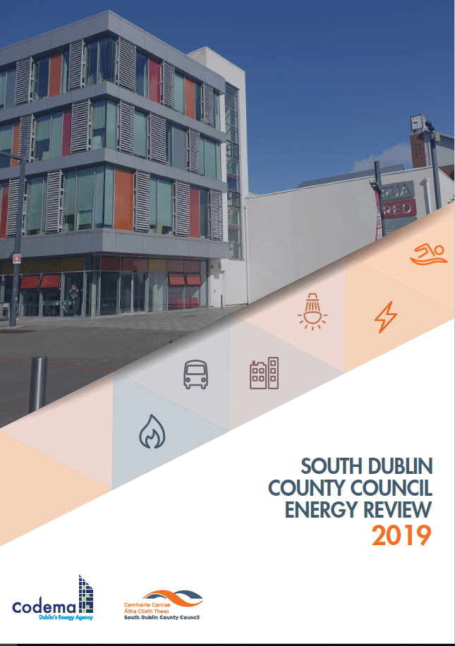
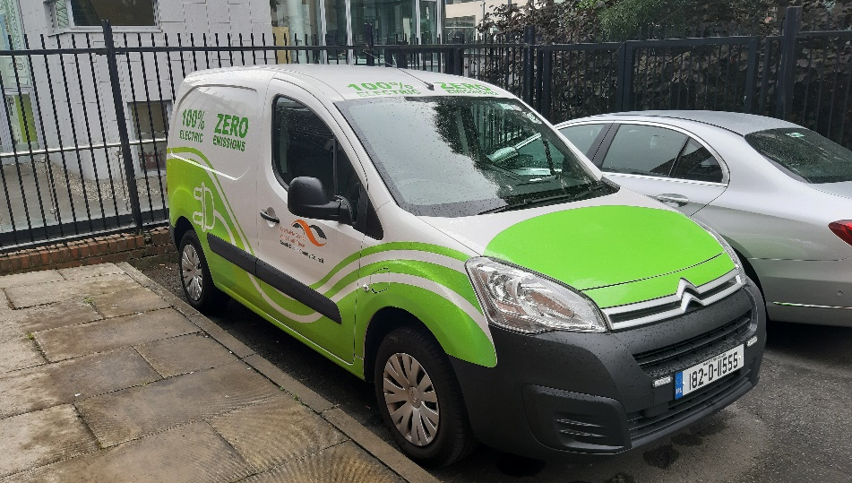
Energy/Fleet Management
Implement cohesive Energy Management system
Invest in Decarbonising the Corporate Fleet
Continue Eco-Driver training

Slide 3
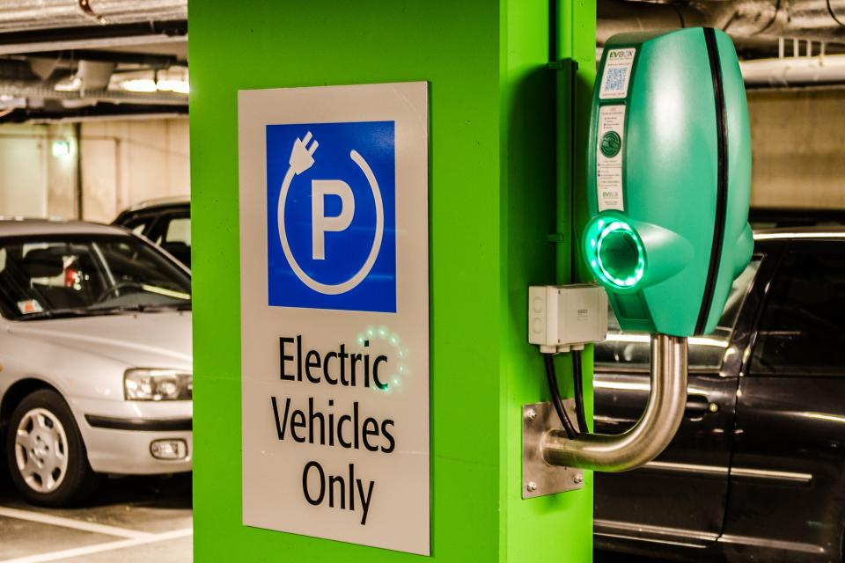
EV Strategy
Regional Approach to ensure compatibility
Keep ahead of Demand
Guide Development Policy

Slide 4
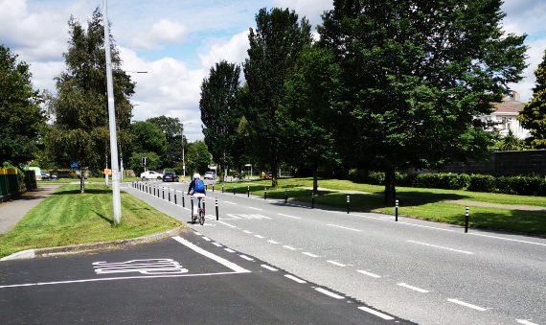
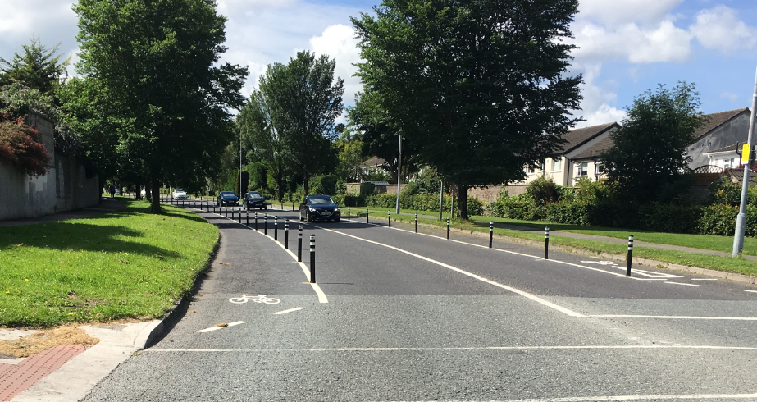
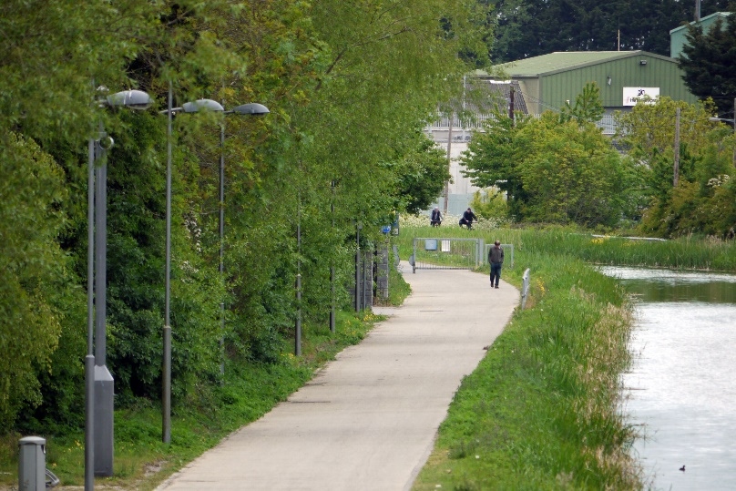
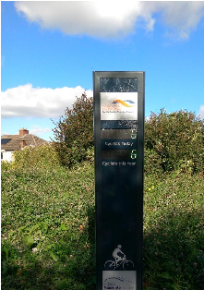
Cycleways/Greenways
Cycle South Dublin > 200km
Dodder Greenway 10km
N81 Jobstown 2km
Grange Road 1km
Wellington Lane 3km
Tallaght to Liffey Valley 12km
Belgard Square to Cookstown Link Road 0.3km
Celbridge Link Road 2.2km
SEAI Sustainable Energy Communities
Cycling up 72% since 2019

Slide 5
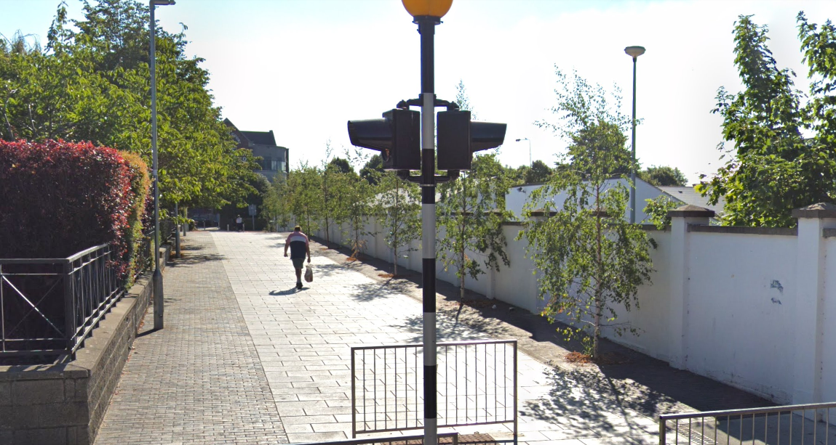
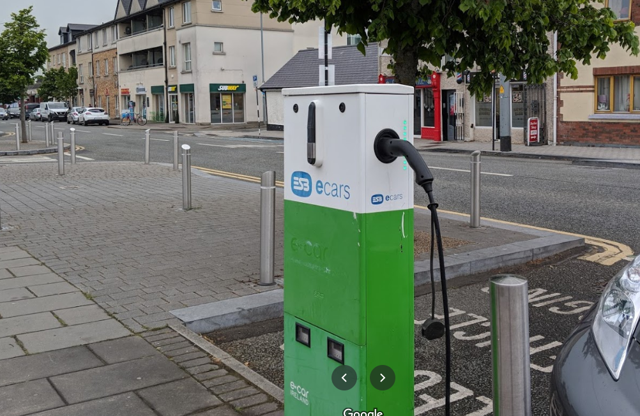
Village Renewal Scheme
Templeogue Village Initiative
District Centre Enhancement Programme
Providing Greener, more Sustainable Places, with strategic transport linkage
Urban planting with water attenuation systems
Consider suitable locations for EV Charging
Objective 5
Provide greener and more sustainable places
Potential for E-charging units

Slide 6
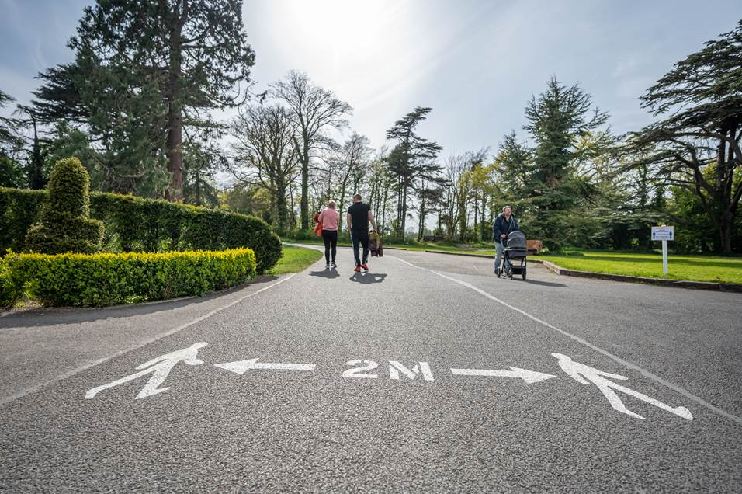
Sharing The Space
Temporarily reassign roadspace to accommodate social distancing with increased volumes of pedestrians and cyclists resulting from Covid-19

Slide 7
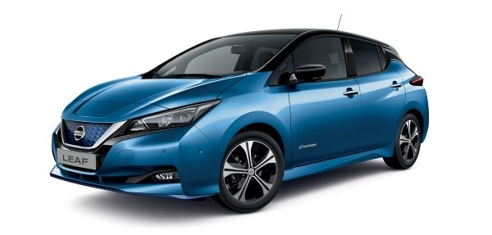
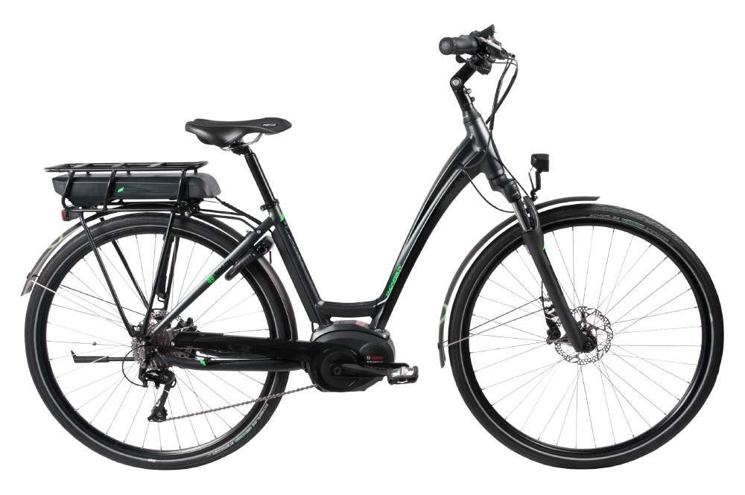
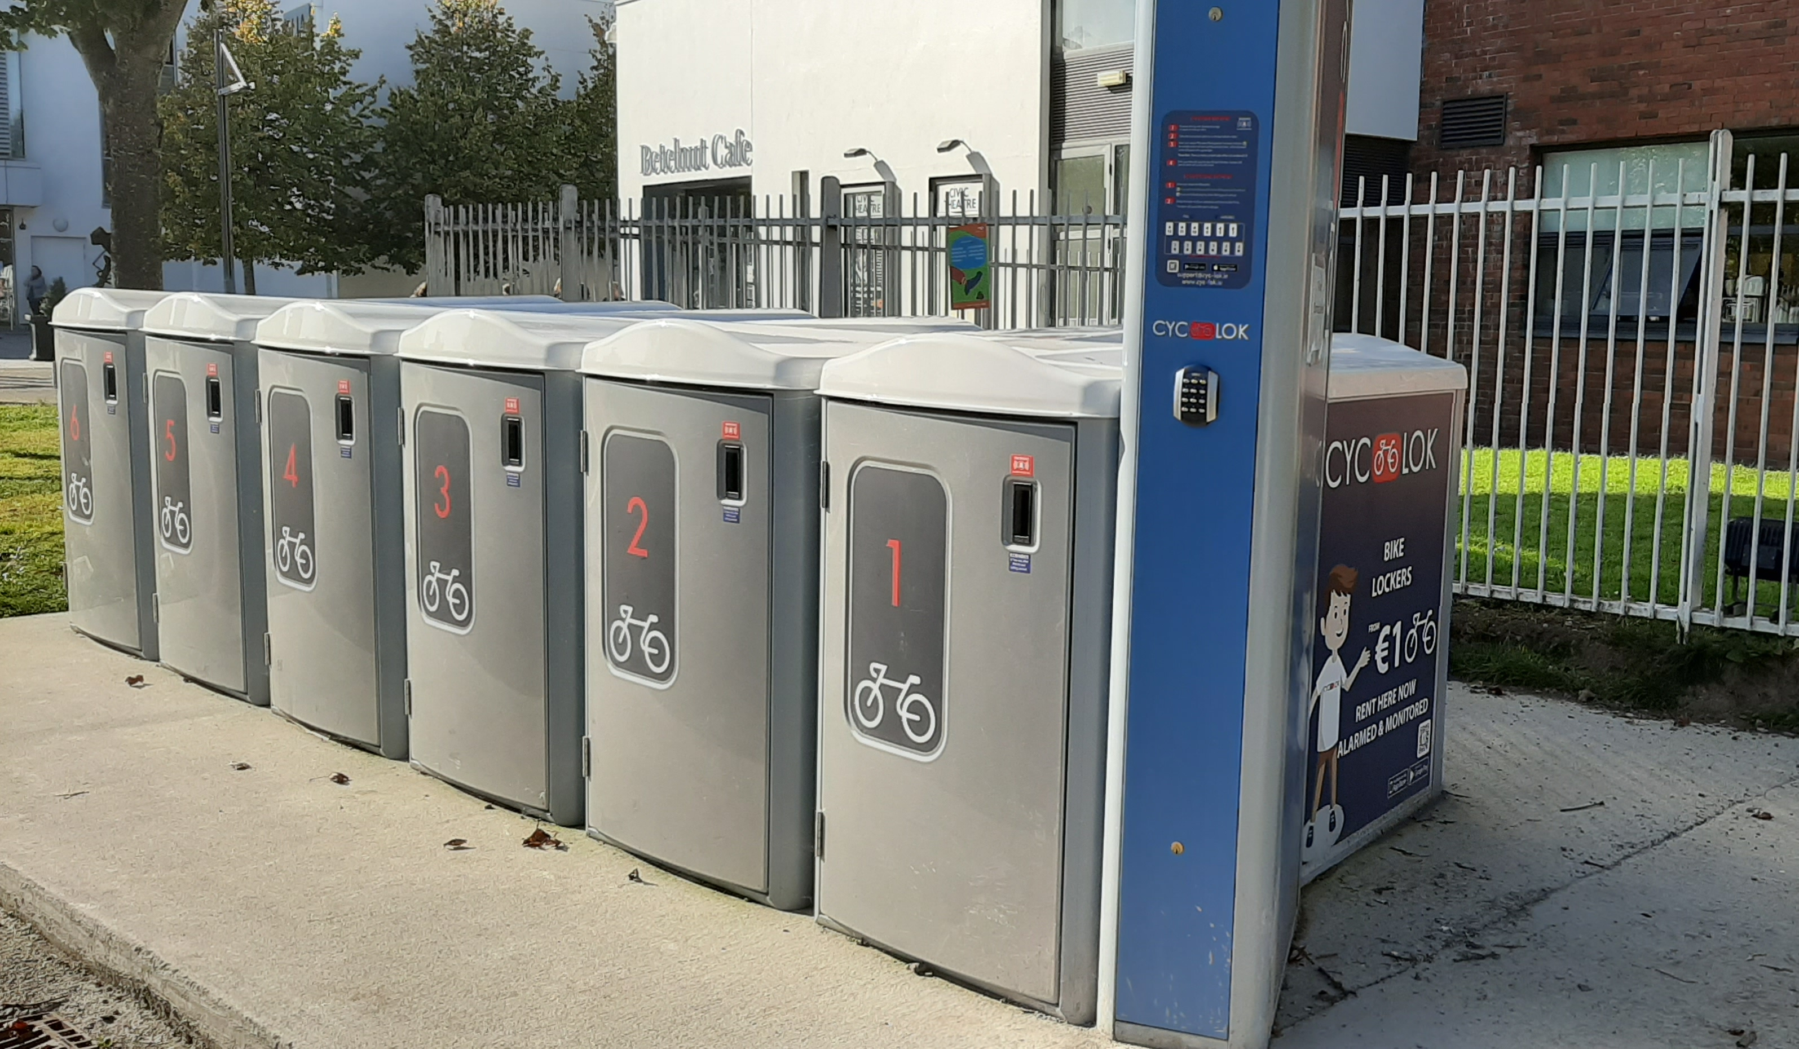
Mobility Hub
Encourage Modal Shift
Phase 1
1 Electric Car
3 electric Bicycles
Additional Bicycle Lockers
Covid-19 Safety Procedures for Vehicle Use

