Slide 1
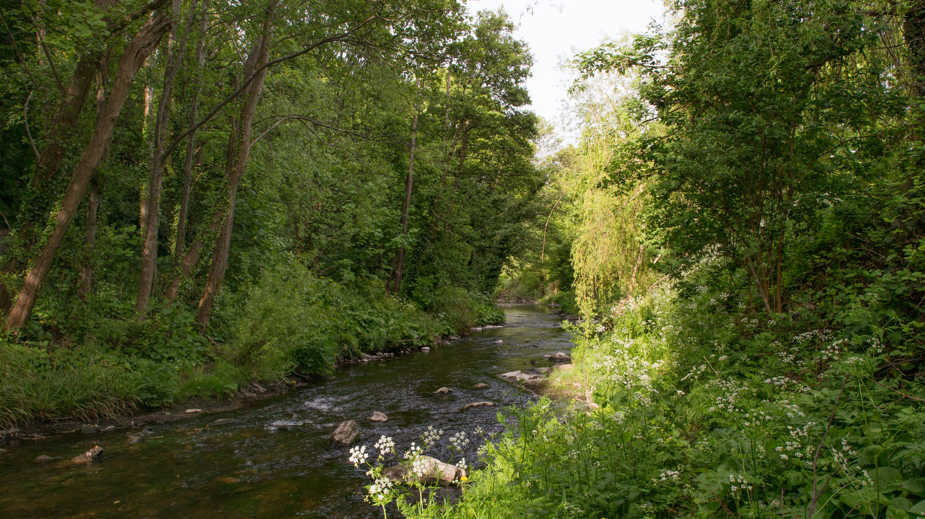
Green Infrastructure (GI) Strategy
LUPT SPC
24 09 2020

Slide 2
GREEN INFRASTRUCTURE “a strategically planned network of natural and semi-natural areas with other environmental features designed and managed to deliver a wide range of ecosystem services such as water purification, air quality, space for recreation and climate mitigation and adaptation.” The GI strategy will: “form the basis for the identification, protection, enhancement and management of the Green Infrastructure network within the County.”
Core areas: Glenasmole, the Liffey Valley and Wicklow Mountains National Park.
Hubs include parks and farmland,
Corridors are watercourses, hedgerows, ecological links, particularly the Liffey, Dodder and Grand Canal
Parks and areas of open space connected with ecological and recreational corridors to aid the movement of biodiversity and people and to strengthen the overall Green Infrastructure network
- Urban environment can further enhance the Green Infrastructure connectivity, such as residential gardens, the landscape settings of enterprise and employment areas, street verges, open spaces and parks, woodlands, hedgerows, cemeteries, and allotments.
Notes:
South Dublin covers suburbs, mountains, and everything in between. The Green Infrastructure Strategy will guide policies and actions.
It is essential that parks and areas of open space are connected with ecological and recreational corridors to aid the movement of biodiversity and people and to strengthen the overall Green Infrastructure network.

Slide 3
Strategic Basis:
COUNTY DEVELOPMENT PLAN 2016-2022
GREEN INFRASTRUCTURE (G) Policy 1 Overarching
It is the policy of the Council to protect, enhance and further develop a multifunctional Green Infrastructure network by building an interconnected network of parks, open spaces, hedgerows, grasslands, protected areas, and rivers and streams that provide a shared space for amenity and recreation, biodiversity protection, flood management and adaptation to climate change.
G1 Objective 2:
To prepare and implement a South Dublin County Green Infrastructure Strategy during the lifetime of this plan that will form the basis for the identification, protection, enhancement and management of the Green Infrastructure network within the County.
Action
South Dublin County Council will develop and implement a Green Infrastructure Strategy for the County in accordance with international best practice and emerging national guidance, and in consultation with key stakeholders and the public during the lifetime of the Development Plan. The Green Infrastructure strategy will form the basis for the identification, protection and promotion of Green Infrastructure and provide a structure for the long term management, enhancement and expansion of the Green Infrastructure network across urban and rural areas. The strategy will include a spatial framework on which priorities and actions can be based and a delivery framework.
SDCC CORPORATE PLAN:
Support a GI network across the county to provide a shared space for amenity, recreation, biodiversity protection, flood management and adaptation to climate change.
Deliver a Green Infrastructure Strategy for the county and commence its implementation
Develop a parks and open space strategy for the county, commence consultation and background data gathering.
SDCC CLIMATE CHANGE ACTION PLAN:
N7: Develop a Green Infrastructure Strategy that identifies areas and priorities for green infrastructure and investment
N8: Develop a Public Open Space and Parks Strategy that incorporates climate change mitigation and adaptation

Slide 4
Consultants
The assignment calls for a multi-disciplinary team with skills and experience in planning, ecology, landscape architecture, urban design, recreational planning and engineering (water, drainage and flooding).
Future Analytics Consulting Ltd. (FAC), a chartered planning, research and economic development consultancy with complementary expertise in tourism and recreation, GIS, data analytics and demographics, located at 23 Fitzwilliam Square (South), Dublin 2 appointed
in partnership with
Mary Tubridy Associates (Ecology)
Nicholas de Jong Architects (Landscape Architects, Urban Designers and Recreation Specialists)
Curtins Engineering (Engineering)

Slide 5
Methodology and programme: Consultation and adoption of GI strategy in tandem with CDP review to allow for incorporation of policies and actions in CDP. Currently: GI strategy to be incorporated as an appendix in CDP Parks and Open Space Strategy is being delivered in tandem but has a separate consultation process.
STAGE 1
Scoping of Project and Summary Report
August 2020
STAGE 2
Desktop Investigation, Surveys and Mapping
August-October 2020
STAGE 3
Interim Report(s), Analysis, Mapping
Sept 2020-May 2021 with submission of policy and mapping information in line with requirements of CDP key dates.
STAGE 4
Final Report – Draft reports, Consultation, Finalised Mapping, Findings, Recommendations & Action Plans
Feb 2021-March 2022

