Slide 1
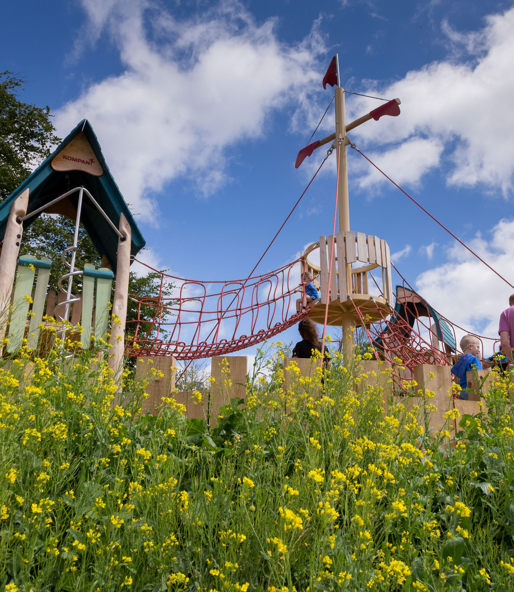
Parks and Open Space (POS) Strategy
EWCC SPC
23 09 2020

Slide 2
PARKS AND OPEN SPACES: Are fundamental in contributing to a high quality of life for those living, working and visiting the County. They provide habitats for ecological processes, a focal point for active and passive recreation, promote community interaction and help mitigate the impacts of climate change.
A parks and open space strategy guides the protection and creation of a network of high-quality open spaces that can:
reinforce local identity and civic pride
enhance the physical character of an area,
shaping existing and future development
improve physical and social inclusion including accessibility
provide connected routes between places for wildlife, recreation, walking and cycling, and safer routes to schools
protect and enhance biodiversity and ecological habitats
provide green infrastructure and ecosystem services
Provide for multi generational use, spaces for older people, people of middle age, for children and young people’s play and recreation
raise property values and aid urban regeneration
boost the economic potential of tourism, leisure and cultural activities
provide cultural, social, recreational, sporting and community facilities
protect and promote understanding of the historical, cultural and archaeological value of places
contribute to the creation of healthy places, including quiet areas
provide popular outdoor educational facilities
promote the opportunities for local food production
help mitigate and adapt to climate change
improve opportunities to enjoy contact with the natural world.

Slide 3
THE PARKS AND OPEN SPACE STRATEGY: “The basic aim is to understand supply and demand for open spaces, to identify deficiencies, to secure new provision, and to improve quality through better management. The spatial elements of the open space strategy will also feed into the local development plans and can be of consideration in the determination of planning applications.”
The strategy’s action plan will chime with the vision for the county promoting community involvement, greater use of public open space, and more effective cross-departmental and partnership working.
Is an essential management tool and the basis for producing promotional materials. Without a clear strategy, it is difficult to prioritise, spend and plan resources and to show how much open space is valued.
Open space is multi-functional so the strategy will reflect a widely shared vision. It is not just for the parks and planning departments. Many stakeholders will be consulted and involved.

Slide 4
Consultants
The assignment calls for a multi-disciplinary team with skills and experience in planning, ecology, landscape architecture, urban design, recreational planning and engineering (water, drainage and flooding).
Future Analytics Consulting Ltd. (FAC), a chartered planning, research and economic development consultancy with complementary expertise in tourism and recreation, GIS, data analytics and demographics, located at 23 Fitzwilliam Square (South), Dublin 2
in partnership with
Mary Tubridy Associates (Ecology)
Nicholas de Jong Architects (Landscape Architects, Urban Designers and Recreation Specialists)
Curtins Engineering (Engineering)

Slide 5
Methodology and programme: GI Strategy and POS Strategy being delivered in tandem 2 separate but complementary documents POS has a separate consultation process. Relevant POS policies and actions will be incorporated into the CDP.
STAGE 1
Scoping of Project and Summary Report
August 2020
STAGE 2
Desktop Investigation, Surveys and Mapping
August-October 2020
STAGE 3
Interim Report(s), Analysis, Mapping
Sept 2020-May 2021 with submission of policy and mapping information in line with requirements of CDP key dates.
STAGE 4
Final Report – Draft reports, Consultation, Finalised Mapping, Findings, Recommendations & Action Plans
Feb 2021-March 2022

