Slide 1
SHD Application:
Stoneyhill Road, Rathcoole.
SDCC Ref: SHD3ABP-307698-20
Applicant: Romeville Developments Ltd.
16/09/2020
Fiona Redmond
Senior Executive Planner

Slide 2
Strategic Housing Development
Planning and Development (Housing) and Residential Tenancies Act 2016
Planning and Development (Strategic Housing Development) Regulations 2017
Section 4 applications for strategic housing development (SHD) are to be made directly to An Bord Pleanála.
Steps
Pre-Application Consultation with Planning Authority
Pre- Application with An Bord Pleanala (ABP) and the Planning Authority
Planning Application lodged with ABP

Slide 3
Strategic Housing Development
At the next Area Committee meeting, or the municipal district meeting for each municipal district concerned, as appropriate, the Planning Authority shall inform the relevant elected members of the following:
- The details of the application;
- The consultations that have taken place in relation to the proposed development with both the Planning Authority and An Bord Pleanála;
Details of the Notice of Opinion issued by An Bord Pleanála.
A summary of the views of the relevant elected members on the proposed development as expressed at the meeting shall be attached to the report of the Chief Executive and shall be submitted within 8 weeks of the lodgement of the application to ABP.

Slide 4
Timelines
SHD Lodged with ABP on 27/7/2020.
5 Weeks Observations
8 Weeks SDCC report due to ABP 21/9/2020.
Decision due from ABP 16 weeks after
application lodged with ABP.
Consultations
S.247 Pre-Planning meeting held with SDCC on 21st May 2019.
A Pre-Planning meeting was held on 27th November 2019 with An Bord Pleanala, the applicant and SDCC.

Slide 5
Site Zoning in South Dublin County Development Plan 2016-2022

Slide 6
Proposed Development
7.985 hectare site comprising 2 sites:
7.783 hectares located to the east of Stoney Hill Road, Rathcoole, Co. Dublin;
and
0.202 hectares comprising an existing undeveloped portion of the Peyton Residential Estate located to the west of the existing roundabout north of Stoney Hill Road.
- 2 no. storey creche building of 639.2 sq.m. plus an outdoor play area of 624.31 sq.m. located on an existing undeveloped portion of the Peyton site located to the west of Stoney Hill Road. 10 no. car parking spaces and 20 no. bicycle parking spaces.

Slide 7
Proposed Development (continued)

Slide 8
Key Development Statistics
Site Area: 7.783 ha
No. of units: 204 (151 dwellings, 53 apartments including 28 duplex).
Density units p. ha. : 40
Car Parking: 355
Public Open Space 7,608 sq.m.
Communal open space 331 sq.m.
Linear Park 21,420 sq.m.

Slide 9
ABP Opinion – Summary of Items requiring clarification/ amendment
Item 1- Development Strategy
Further consideration/justification of the documents as they relate to:
The requirement for development on RES-N zoned lands to be ‘in accordance with approved area plans’ and in the context of the draft Masterplan prepared by SDCC for the lands to the east. In particular having regard to the relationship of the subject site and adjoining lands with regard to:
Alignment, layout and function of spine road.
Vehicular, pedestrian and cycle connections.
Retention of existing trees and hedgerows.
Coherent and functional hierarchy of open spaces, including linear park along the southern boundary
Provision of site services.
Phasing of development with regard to traffic impacts and site services.

Slide 10
ABP Opinion – Summary of Items requiring clarification/ amendment
Item 2 – Design and Layout of Residential Development
Further consideration/justification of the documents as they relate to the design and layout of residential development:
The proposed development to provide optimal urban design and architectural solution for the site and are of sufficient quality to make a positive contribution to the area. In particular:
Cross sections and details of proposed levels.
Further consideration of design and layout of apartment block and associated communal parking area, open space and pedestrian connections, consideration of sunlight and daylight levels, provision of high quality elevational treatments.
Reconsider the overall public open space provision to provide a hierarchy of open spaces. Include detailed cross sections of the open space and adjacent residential units.
Provision of safe and accessible pedestrian and cycle connections.
The consideration of these issues may require an amendment to the documents and/or design proposals.

Slide 11
Summary of Specific Information to be submitted with the application:
1- Housing Quality Assessment
2 - Details of existing and proposed levels across the site.
3 - Shadow Analysis.
4 – Rationale for proposed childcare provision.
5 – Details of Phasing including timeframe for delivery of creche.
6 – Photomontages and visual impact analysis and landscaping proposals.
7 – Traffic and Transport Impact Assessment

Slide 12
Summary of Specific Information to be submitted with the application (cont’d):
8 - Landscaping design rationale and comprehensive landscaping proposals.
9 - A site layout indicating areas to be taken in charge.
10 – Ecological Impact Assessment
11 - Appropriate Assessment Screening
12 - Archaeological Assessment
13 – Site Specific Flood Risk Assessment

Slide 13
SITE FEATURES

Slide 14
SITE CONSTRAINTS

Slide 15
Conceptual Layout including Open Space and Street Network

Slide 16
Applicant’s Proposed Area Plan Indicative Strategy

Slide 17
Proposed Scheme

Slide 18
Proposed Apartment Block 39 units

Slide 19
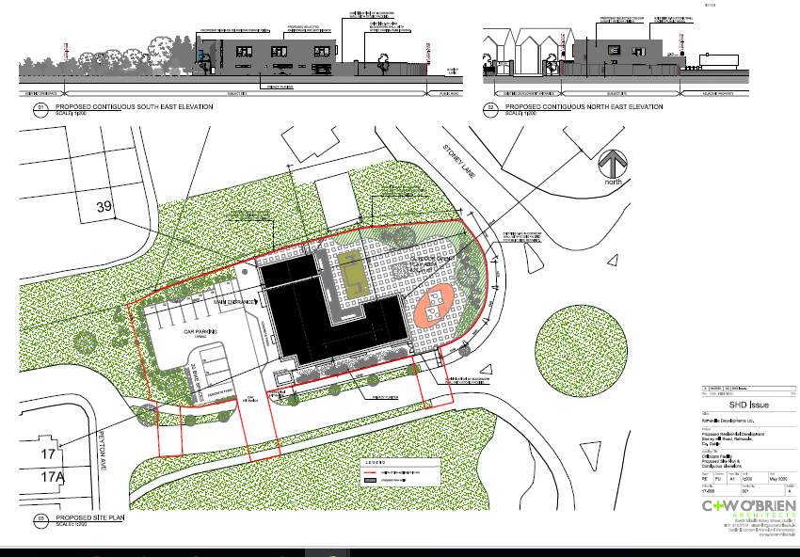
Proposed Childcare Facility

Slide 20
CGI Image
Cre

Slide 21
Photomontages
Cre

Slide 22
Cre

Slide 23
Cre

Slide 24
Cre
CGI Image

Slide 25
Cre
CGI Image

Slide 26
Cre
Submissions
161 no. submissions were lodged with An Bord Pleanala in relation to this SHD application.
Key Issues raised in submissions

Slide 27
Aerial View from the south
Cre

Slide 28
Thank You
Comments

Slide 29
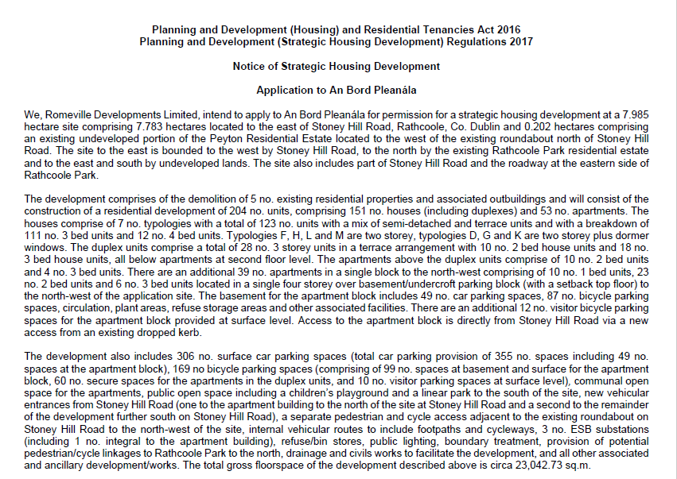
Site Notice
Cre

Slide 30
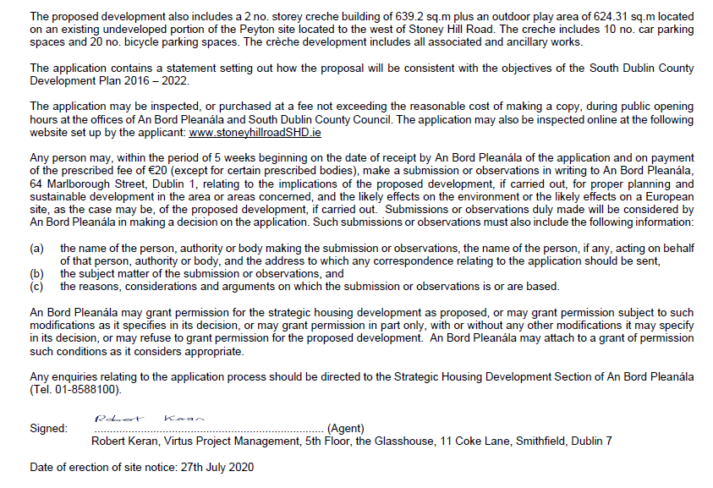
Site Notice
Cre

