Slide 1
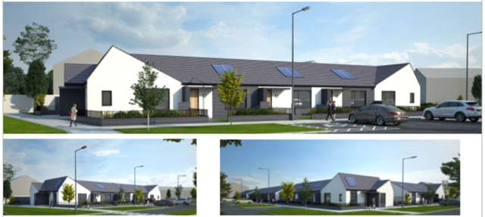
Age Friendly Housing
Council Meeting, 14th September 2020

Slide 2
Introduction

Slide 3
Overview
Age Friendly County Strategy & projected ageing population growth
Rightsizing Research / Under-occupancy study (1,200 tenancies)
Housing List analysis (700 applicants aged 55+)
Key principles: Location/design/services/community
Identify potential sites for infill development of age friendly homes
Rightsizing policy (through Housing SPC)
More efficient use of existing public & private housing: release existing, under-occupied homes for larger households
Support & guide prospective tenants from concept to move-in
Notes:
(34% growth in 65+ in South Dublin at 2016 census)

Slide 4
Principles
Need to develop exemplar “housing with care” model
Proximity to supports, services & existing community
Retain the concept of independent and secure living
Assist older people to lead heathier, more active lives
Core design features (AF Housing Technical Specialist)
Universal design approach, fully self-contained, own front door;
Communal space and facilities / Integration of supports;
Location – healthcare, transport, retail, community supports;

Slide 5
Existing & Planned Older Persons’ Housing
Local Electoral Area | Current No | Planned | No. | Status
Lucan | 55
Tallaght Central | 81 | Springfield Whitestown Brady’s Field | 40 81 12 | On site Site start pending Detailed design
Tallaght South | 30
Clondalkin | 73
Rathfarnham/Templeogue | 30 | Ballyboden Templeogue | 12 11 | AHB/CALF on site Tender to issue
Palmerstown/Fonthill | 77 | Lucan Rd St. Mark’s Ave | 4 9 | At Part 8 Detailed design
Firhouse/ Bohernabreena | 19
Total | 365 |  | 169

Slide 6
Next Steps
Potential Sites: (see following slides)
Feasibility/Design/Consult local Elected Members
Part 8/Detailed Design/Tender/Construction
Additional sites:
LEAs / Underoccupancy
Planned/potential AHB & private developments
Rightsizing policy through SPC
Estate management support role

Slide 7
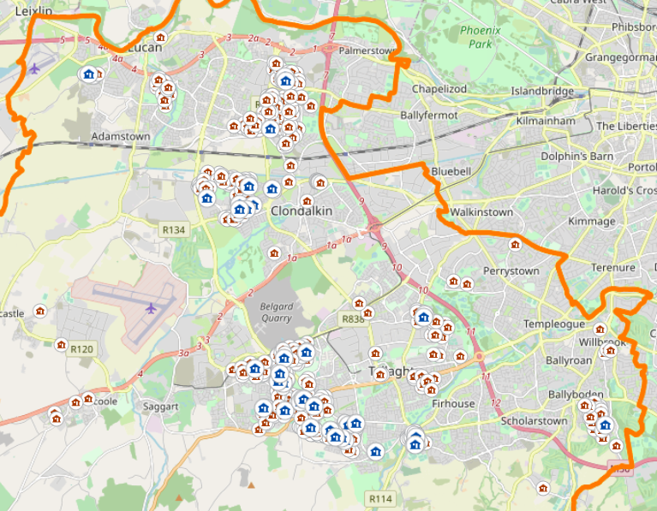
Potential Sites / Underoccupancy in Council Tenancies
Under-occupancy study of 3- & 4-bedroom homes in social housing stock
Over 55’s
Profile of 700 single occupiers & 500 couples
Mapping of data
Informs potential locations for targeted infill development of age friendly homes within existing communities
Overlay supports/services

Slide 8
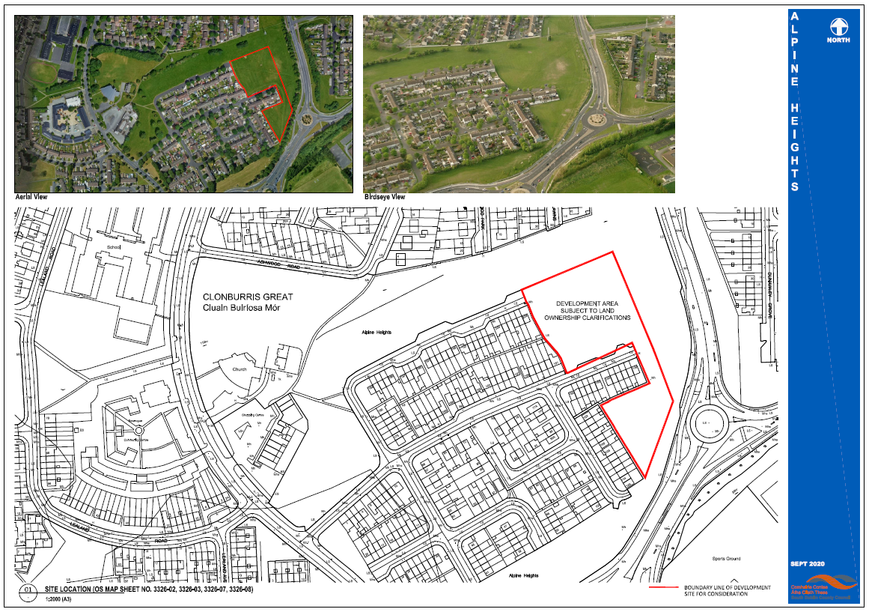
Potential Site – Alpine Heights

Slide 9
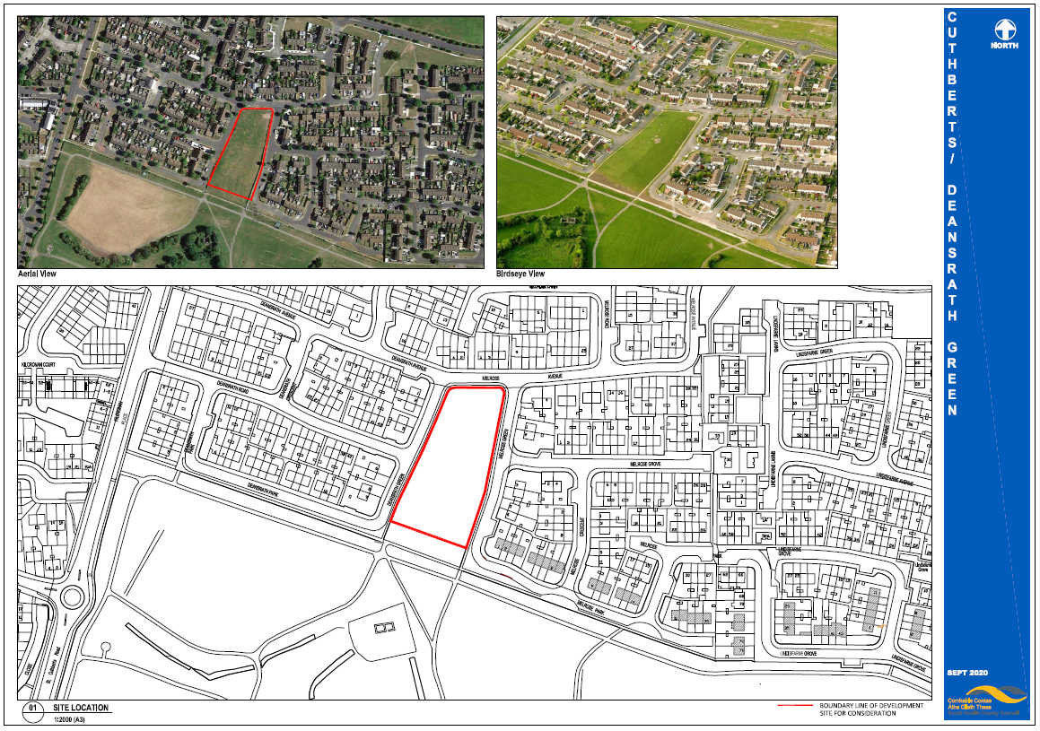
Potential Site – Deansrath/Melrose

Slide 10
Potential Site – Pearse Brothers Park

Slide 11
Potential Site – St. Aongus’ Green

Slide 12
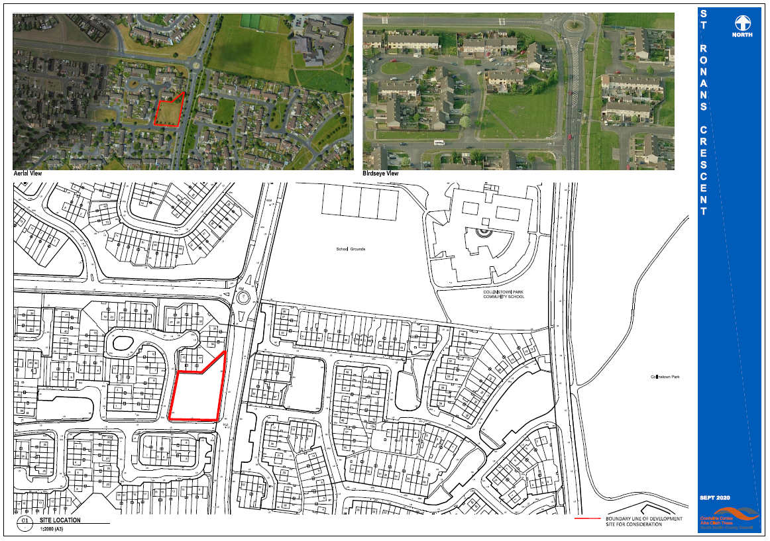
Potential Site – St. Ronan’s Crescent

Slide 13
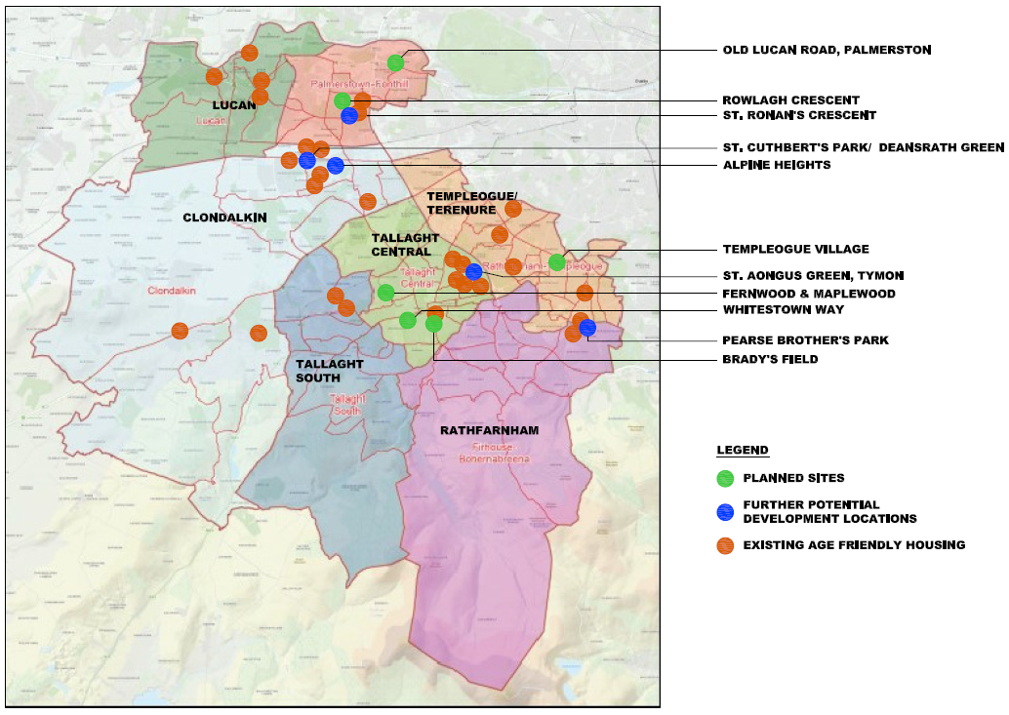
Age Friendly Housing Locations

