Slide 1
H.16 Part 8 Report on Public Consultation for Proposed Development of Older Persons’ Housing at Old Lucan Road, Palmerstown
Meeting of South Dublin County Council
14th September 2020

Slide 2
Project History
Site identified in Old Lucan Road, Palmerstown as suitable for Older Persons Housing & presented to Housing SPC & Area Committee as location for proposed housing scheme
In 2018 expressions of interest sought from Approved Housing Bodies and Túath Housing Asscoiation were appointed in accordance with the AHB Protocol
Design proposal developed for 4 no. 1-bedroom apartments in a two-storey structure
Proceded to Part 8 public consultation 11th June 2020 to 23rd July 2020 (inclusive)

Slide 3
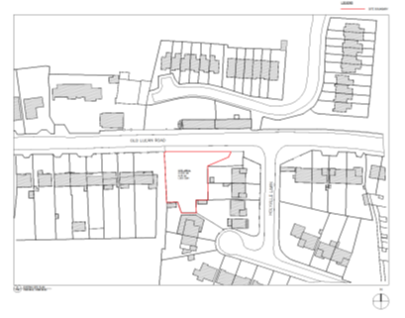
Site Location Map

Slide 4
Proposed Design

Slide 5
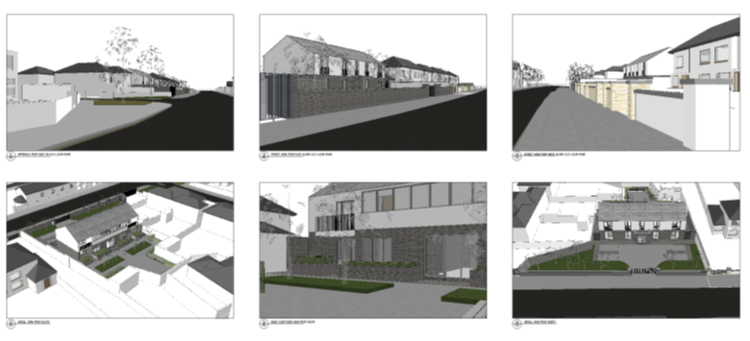
Proposed 3-D Design Views

Slide 6
Public Consultation
Six-week public consultation from 11th June 2020 to 23rd July 2020 (inclusive)
8 Submissions received
Issues raised during consultation:
Concern regarding condition of boundary walls
Ownership of adjacent site
Environmental concerns from previous site use
Design of units & landscaping within development
All issues satisfactorily addressed in the report
Recommendation to proceed with the proposed development

Slide 7
Next Step
If Part 8 Approved-
Section 183 will be prepared for disposal of site to Túath Housing
Túath Housing to develop detailed design and progress to tender
Projected construction start 2021
Allocation in accordance with Allocations Scheme including amended Rightsizing Policy (to be developed with SPC)

