Slide 1
South Dublin County Council
Council Meeting
Contract
Tallaght Innovation Centre
Candidate
McCullough Mulvin Architects
14th September 2020

Slide 2
Council Meeting
Tallaght Innovation Centre, Dublin McCullough Mulvin Architects
Agenda
Introduction
Planning Context
Proposal
3D VIEW OF TALLAGHT INNOVATION CENTRE BY DIGITAL DIMENSIONS
TALLAGHT INNOVATION CENTRE, COUNCIL MEEETING

Slide 3
Introduction
Tallaght Innovation Centre, Dublin McCullough Mulvin Architects
KEY ISSUES
Oxford Innovation
An Innovation building of 3000m2
A 4 storey landmark building
Contemporary gesture on a key site in Tallaght
An innovative civic presence
Forms the focus of the new park project – ground floor opens out to the park
A start up space for new and existing innovators
Complies with Tallaght Town Centre LAP
Connects to the Tallaght District heating scheme
TALLAGHT INNOVATION CENTRE, COUNCIL MEEETING

Slide 4
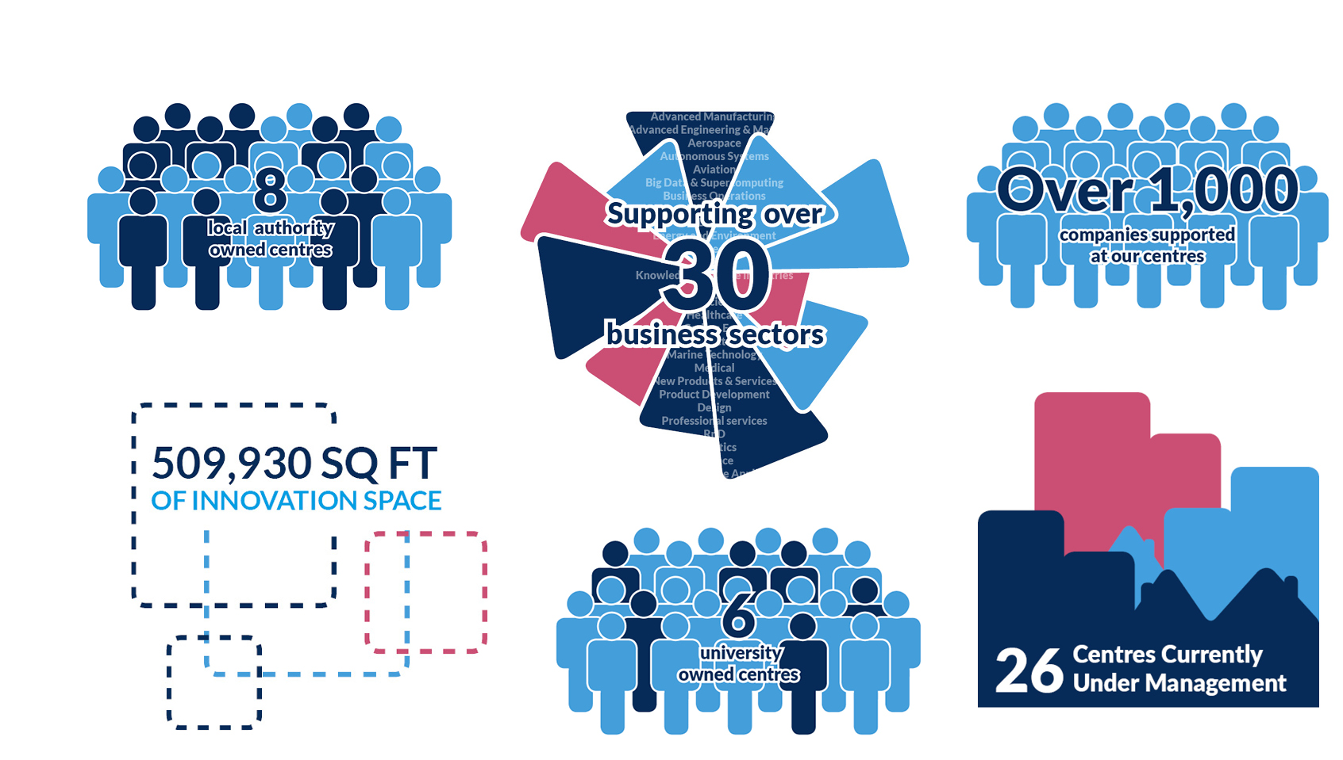
Introduction to Oxford Innovation
Founded by The Oxford Trust to provide support to science, technology and knowledge-led early stage companies
We have 30 years of experience of running spaces and places to support SMEs and entrepreneurs
We are the largest operator of innovation centres in the UK*
Our clients are universities, research & major science site owners, public sector, private investors and charities
We deliver a range of objectives for clients; support to high-growth SMEs & spin outs, on-going revenue and financial sustainability, economic development, jobs growth, profile and business engagement
* See NESTA survey of UK innovation and incubation space

Slide 5
Tallaght Innovation Centre – a home in South Dublin for ambitious, young and growing technology companies
Achieving local, regional and national impact and recognition
A core component of the regional innovation ecosystem
Best in class innovation and business support
Strong branding, marketing, positioning and recognition
Experienced and professional management of finances and other systems and processes
Best in class innovation centre management

Slide 6
3.0 Planning Context
Tallaght Innovation Centre, Dublin McCullough Mulvin Architects
ZONING
The site is zoned ‘REGEN’, the objective of which is to facilitate enterprise and/or residential-led regeneration’ in the SDCC Development plan2016-2022 (Figure 1).
The site is earmarked for the construction of an Innovation centre in the Tallaght Town Centre Local Area Plan (Figure 2).
OPPORTUNITIES
The site is located in close proximity to Tallaght Town Centre and has excellent public transport accessibility.
The sites main facade faces out onto the proposed urban square, which is south facing, and therefore the proposed development will not effect the daylight/sunlight of surrounding properties.
Road and public realm upgrades are necessary to improve access to the Innovation Centre.
The proposal will contribute to the consolidation of this area as the primary Civic space in Tallaght.

Slide 7
4.0 Proposal
Tallaght Innovation Centre, Dublin McCullough Mulvin Architects
DESIGN STRATEGY FOR TALLAGHT INNOVATION CENTRE
Singular landmark 4 storey building
Views in 4 directions and southwards to the Dublin Mountains over the public park
Public area on ground floor with town hall space and café – open building designed to see through from side to side
Outdoor south facing café terrace space engaging with park
Central atrium space gives visual connection to upper levels
Lettable offices in various sizes on upper floors informed by Oxford Innovation - the successful operator
Break out space and tea stations on each level – space for conversations and chance encounters to happen
Provides a new location for work opportunity and employment
2 stair cores and one lift - ewwfficient and flexible plan
Integrated staff facilities
Car parking spaces to north & east
Sustainable agenda, NZEB compliant
Day and night presence

Slide 8
4.0 Proposal
Tallaght Innovation Centre, Dublin McCullough Mulvin Architects
FACADE REFERENCE IMAGES
Metal Cladding
Solid base in concrete and masonry
Aluminium glazing systems
Quality materials facing public realm
Solidity, durability and robustness
REFERENCE IMAGES

Slide 9
Tallaght Innovation Centre, Dublin McCullough Mulvin Architects
3D VIEW BY DIGITAL DIMENSIONS

Slide 10
Tallaght Innovation Centre, Dublin McCullough Mulvin Architects
VIEW FROM PLANNED PUBLIC PARK
SOUTH ELEVATION

Slide 11
Tallaght Innovation Centre, Dublin McCullough Mulvin Architects
WEST ELEVATION TO PUBLIC PARK

Slide 12
Tallaght Innovation Centre, Dublin McCullough Mulvin Architects
ESB SUBSTATION
4x3.5m
PLANT ROOM
37 sq. m
7.
SWITCHROOM
3x3.5m
STORAGE
5 sq. m
COMMS ROOM/SWITCH
^{23 sq. m} TOWNHALL _{STORAGE}
37 sq. m _{9 sq. m}
RISER
POST
CHANGING ^{8 sq. m}
30 sq. m
MEETING ROOM _{(EXTERNAL)}m
32 sq. m _{BINSsq}
.
15
STAFF OFFICE/MANAGEMENT
29 sq. m
CAFE
103 sq. m
FLEXIBLE MEETING ROOMS RECEPTION ^{KITCHEN}
54 sq. m 73 sq. m ^{30 sq. m}
CAFE TERRACE
BINS
CURRENT LAYOUT - GROUND FLOOR PLAN

Slide 13
Tallaght Innovation Centre, Dublin McCullough Mulvin Architects
7946mm
5083mm
2570mm
9.
56.8 sq. m
8.
51.5 sq. m
7585mm
3.
19.5 sq. m
6941mm
6.
38.6 sq. m
5347mm
RISER
RISER
RISER
2444mm
2.
2.
13.1 sq. m
21.3.1 sq. m
TEA STATION
RISER
4863mm
6.
39.1 sq. m
BREAKOUT SPACE
5.
32.7 sq. m
5481mm
8046mm
5708mm
3867mm
5.
31.1 sq. m
MEETING ROOM
20 sq. m
7007mm
3249mm
2.
13.1 sq. m
2.
2444mm
2.
1⁵3³.⁴1^{7m}s^{m}q. m
7247mm
7069mm
2777mm
3369mm
3545mm
5493mm
8.
50.1 sq. m
3.
21.1 sq. m
4.
25.6 sq. m
7585mm
4.
26.9 sq.m
6.
41.7 sq. m
6941mm
8.
51.5 sq. m
FIRST FLOOR AREA - 730 SQ. M
CURRENT LAYOUT - FIRST FLOOR PLAN

Slide 14
4.0 Proposal
Tallaght Innovation Centre, Dublin McCullough Mulvin Architects
SCHEME STATISTICS
Parking - 8 parking spaces, 2 disabled spaces to the north and 11 spaces to the east of the site
Bicycle spaces as per brief
3700mm
4700mm
SECTION OF TALLAGHT INNOVATION CENTRE

