Slide 1
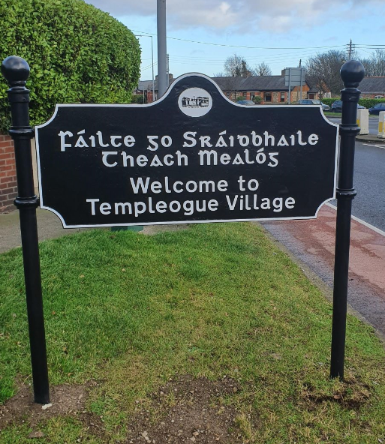
Templeogue Village Initiative
Land Use Planning and Transportation

Slide 2
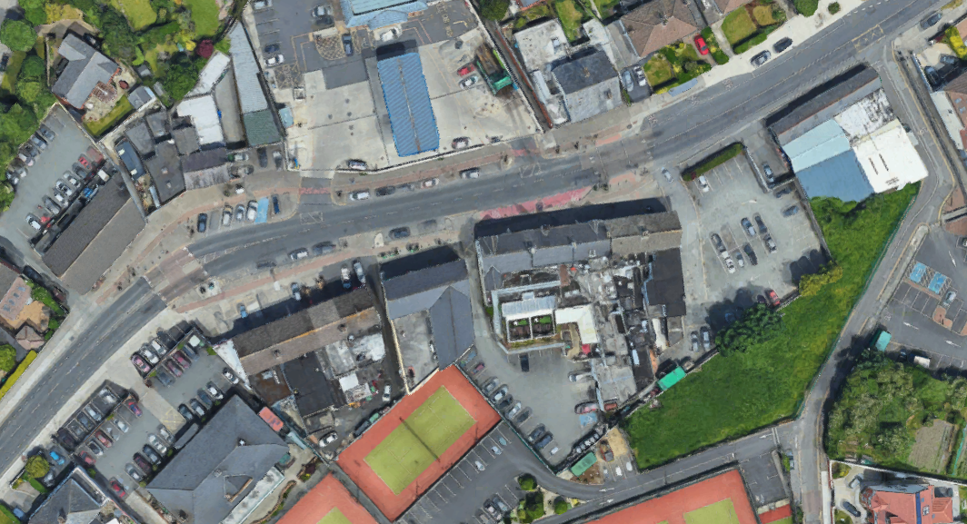
History
Buddhist
Centre
Atlas
Hollingsworth
MAXOL
Diep
The Morgue
O’Briens
Massey’s
Tennis Club
Public Consultation period held, 29th March till 17th of May 2018
Deadline for Submissions 1st June 2018
Part 8 was passed at the July Council Meeting 2018 with commitments by SDCC
Please see Part 8 Report attached
Consultation including NTA bus connects, TII and Local Stakeholders
The Car Park Part 8 was passed in 2007 (Known as The Piggery)

Slide 3
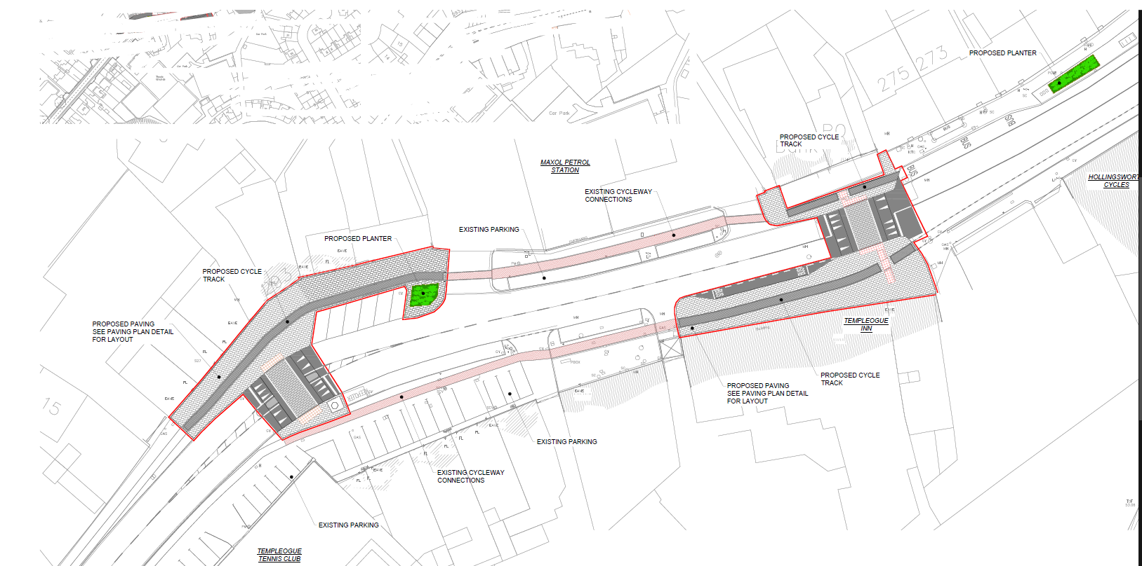
Part 8 Drawing 2018 as displayed for Public Consultation
The proposal focused on the east and west gateways to the Village
Primarily upgrading paving and crossings at these locations
Realigning the cycle track at the Morgue
Reducing the width of the Bus Stop to resolve conflict with cyclists
Reduce footway at morgue
East gateway
West gateway

Slide 4
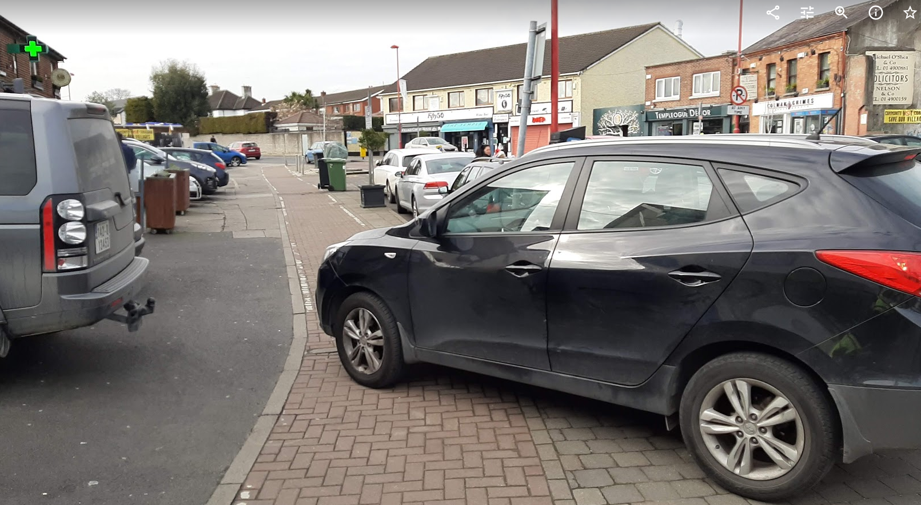
Part 8 Submissions
Following the Public Consultation a number of submissions were received raising concern about;
Alignment of cycleways and various conflicts
Vehicles traversing the footways and cycleways
Scope of scheme, include between the gateways
Planters, seating and other street furniture
Public Lighting upgrade to be included
Sightlines at the ‘Love All’ sculpture
Inclusion of tree planting
Uncontrolled pedestrian crossing at West Gateway
These submissions led to a number of commitments by SDCC for the Part 8 Approval by Councillors. SDCC have taken these commitments into account in the detailed design.

Slide 5
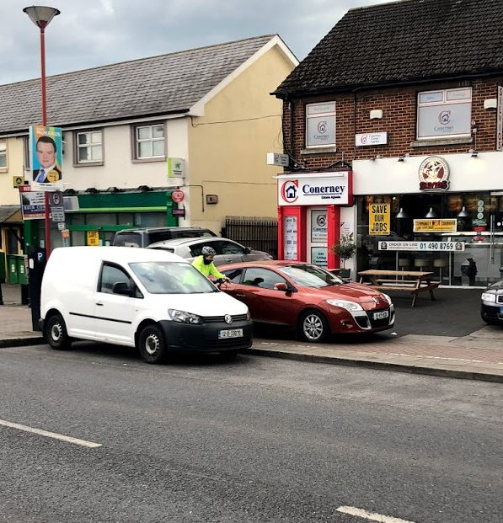
RSA – Road Safety Audit
A Stage 4 RSA (existing condition) was conducted by an independent body prior to the detailed design
Several issues were identified including;
Pedestrian facilities – crossings, surfaces, hazards, etc.
Cycle lane markings and signage
Cycle lane alignment, conflicts and hazards
Parking – vehicles overhanging, buffer zones, private spaces inadequate, etc.
Vehicles traversing footways and cycleways
Reduced visibility to the crossing at the ‘Love All’ sculpture due to existing planter
These issues all fed into the detailed design

Slide 6
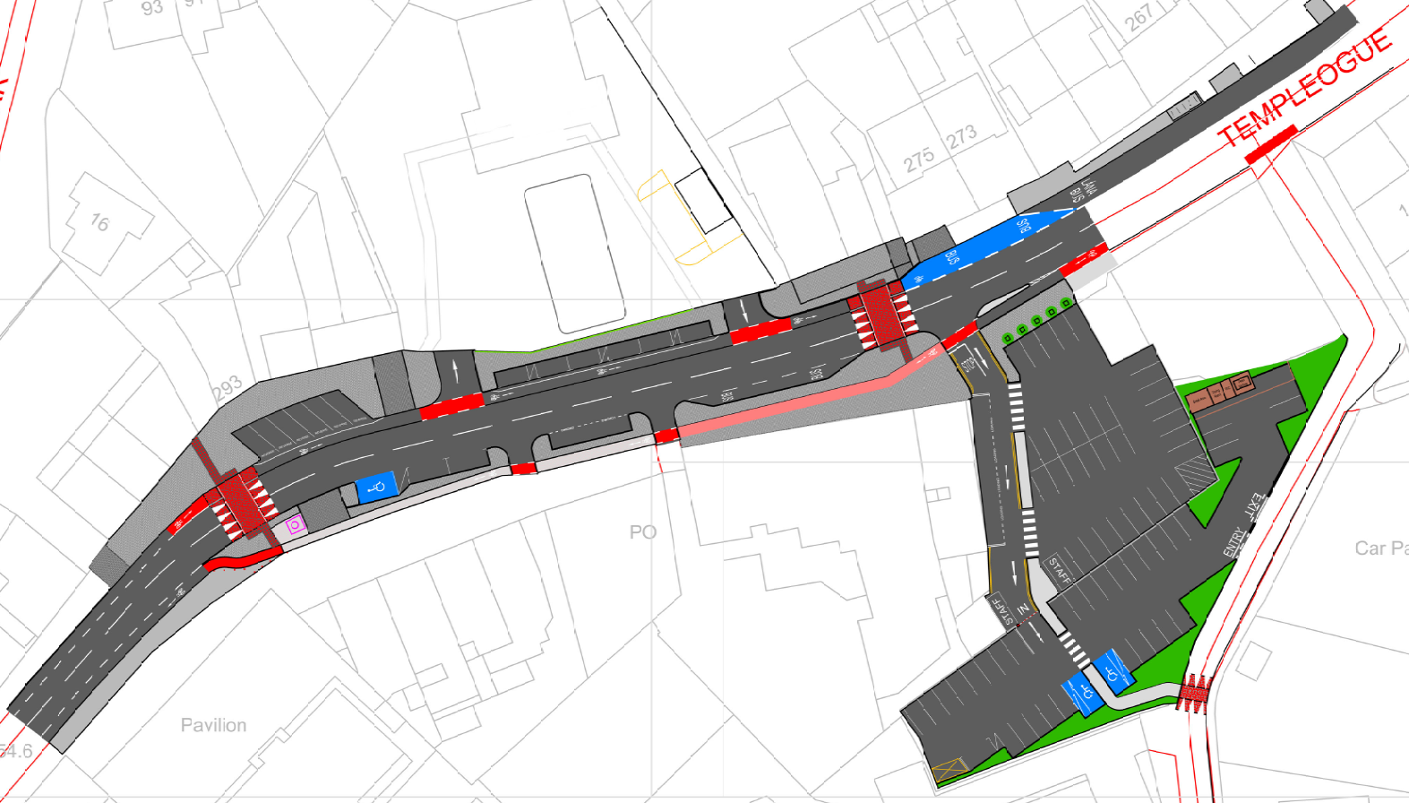
Final Design
Detailed Design
The scope for tender purposes has been increased on foot of Part 8 Commitments
New Car park (2007 Part 8) included in tender scope for construction
Provision of a segregated eastbound cycle track and improved westbound alignment
Carriageway has been slightly realigned to improve sightlines
Signalised crossing provided at both gateways
East gateway
Buddhist
Centre
Provision of a Surface Water carrier to separate SW from Sewer
Existing parking on Mainstreet retained
Hollingsworth
Bus connects will tie-in at either side
MAXOL
West gateway
Diep
The Morgue’s Car Park
The Morgue
O’Briens
Massey’s
Tennis Club
Proposed Car Park

Slide 7
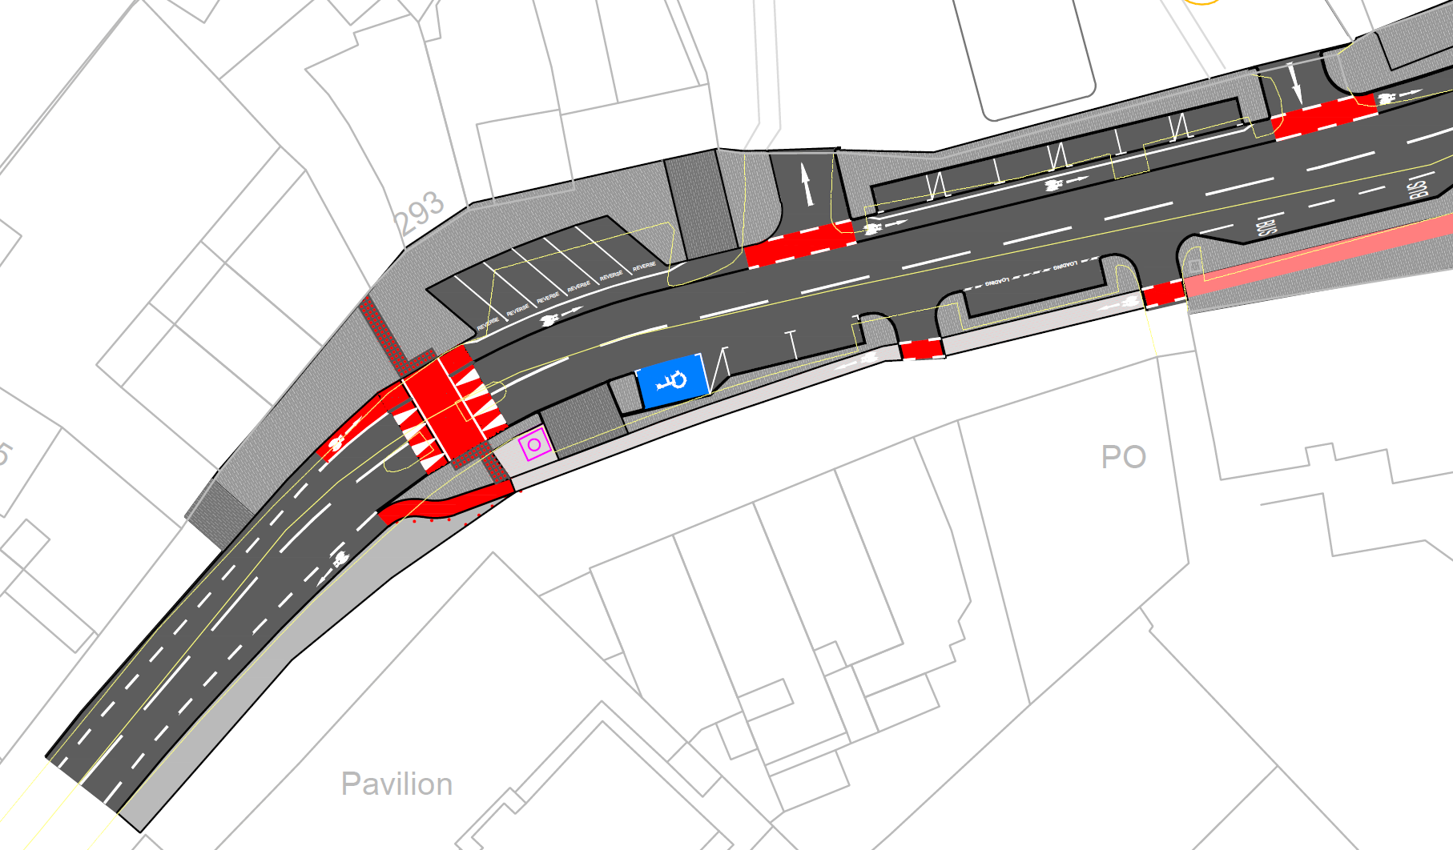
Western Gateway
All on-street parking is retained
Angled bays are reverse in for safety
Alignment moved away from sculpture
Entrances realigned for pedestrian safety
Westbound cycle lane realigned
Basic maintenance repairs only. The RSA identified issues here which could not be resolved as part of our design due to ownership. This precluded us from undertaking any works to this section.

Slide 8
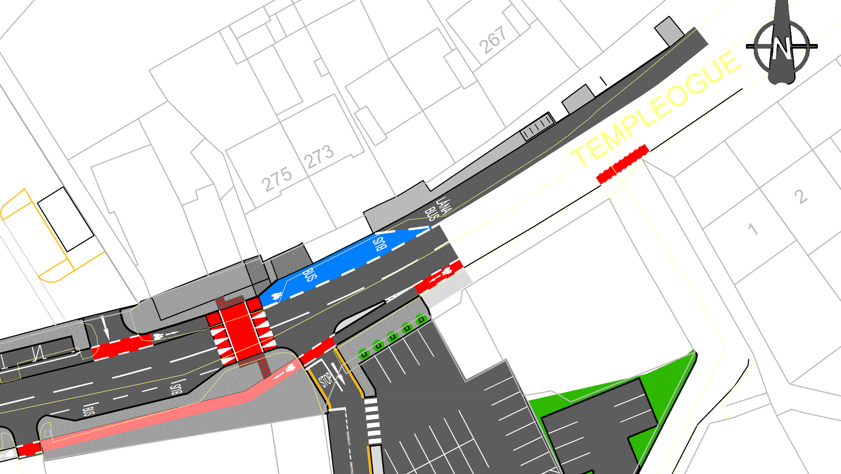
Eastern Gateway
Micro Plaza with Trees, up-lighting and seats
Blue Surface to cycle/bus conflict zone
Bus Lane extended to meet the Bus Stop
Pencil islands to shelter the cycle lanes
Improve cycle lane alignments

Slide 9
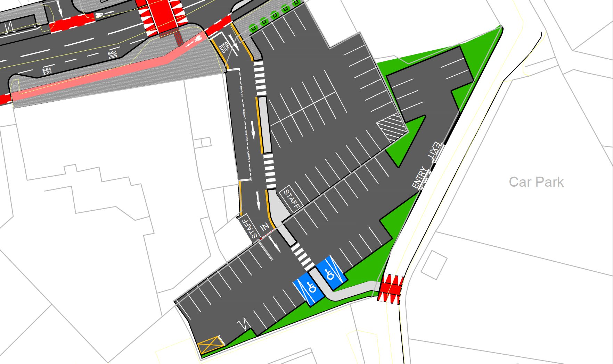
Proposed Car Park
The Morgue’s Car Park
New 38 Space Car Park
Entry Only Route via The Morgue premises
Entry and Exit to Riverside Cottages
2 disabled bays
E-Charge infrastructure (civils only)
Pedestrian link to Dodder Valley Greenway
Boundary wall replaced with low railings between the two carparks for openness

Slide 10
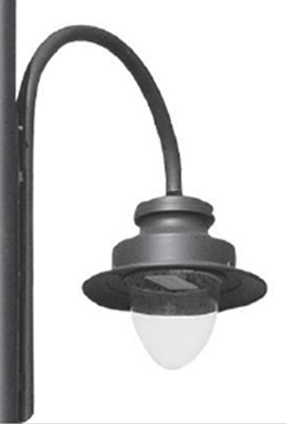
Public Lighting Upgrade
The public lighting on the Main Street will be upgraded to Warm White LED lanterns in a Heritage design with a stepped lantern feature providing for both vehicular traffic and amenity use.
LED In-ground accent lighting will installed in the Micro Plaza, complete with colour changing capabilities to highlight festive days in line with the Council’s annual programme of events.
The new Car Park will also have high quality LED lighting, serving the dual purpose of providing safe and secure lighting to the car park users and increasing the lighting provision for Riverside Lane and access to the Dodder Valley cycle Way.

Slide 11
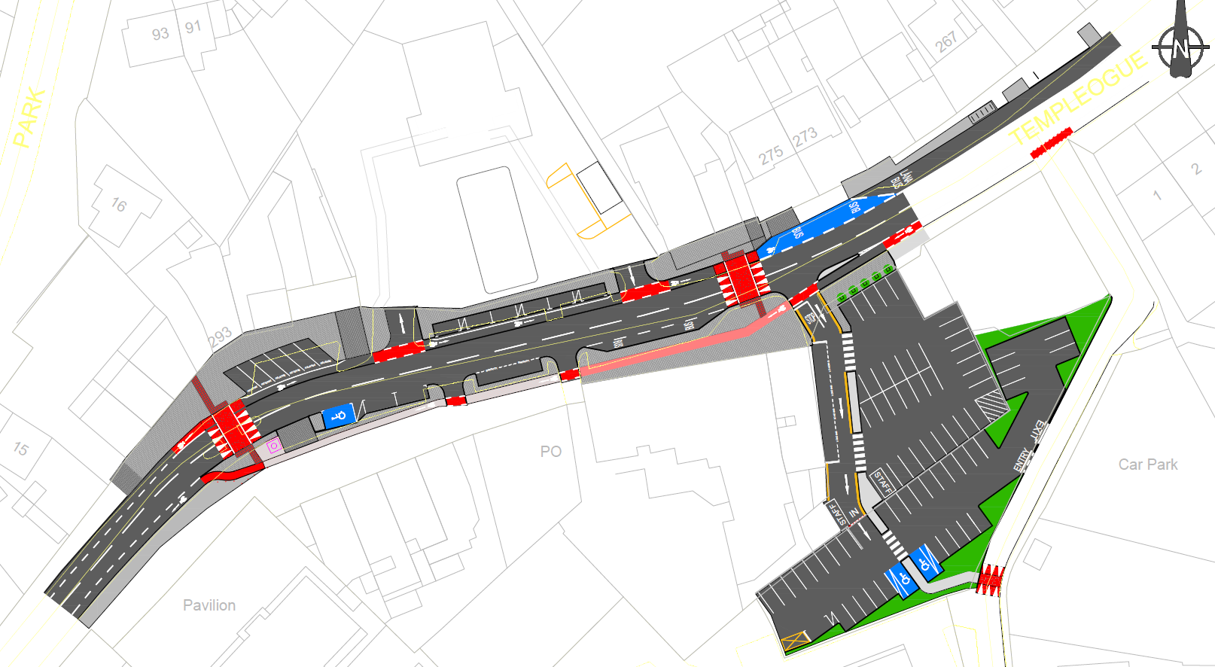
Questions?
Buddhist
Centre
Hollingsworth
MAXOL
Diep
The Morgue
The Morgue’s
Car Park
O’Briens
Massey’s
Tennis Club

