Slide 1
Part-8: Corkagh Park Pavilion
Presentation for Approval by Council
13, July 2020

Slide 2
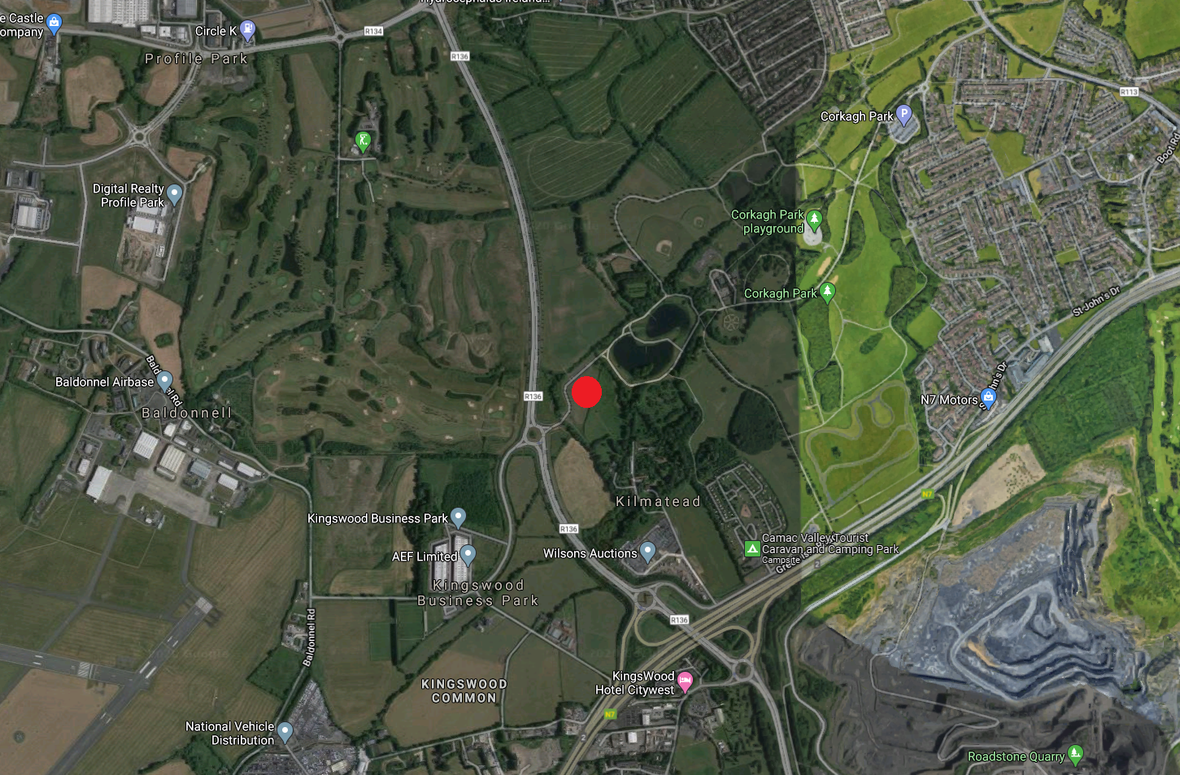
SURROUNDING AREA MAP

Slide 3
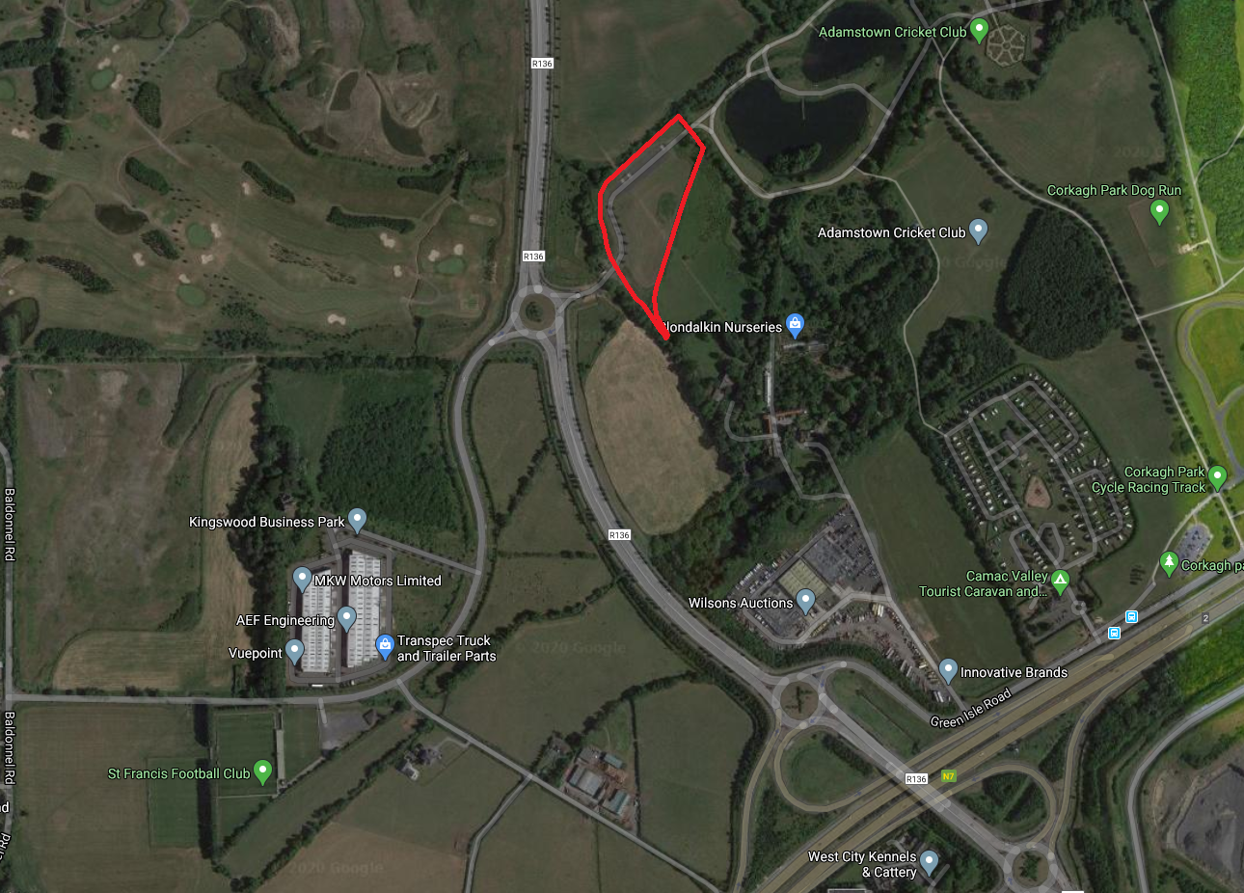
SITE LOCATION MAP

Slide 4
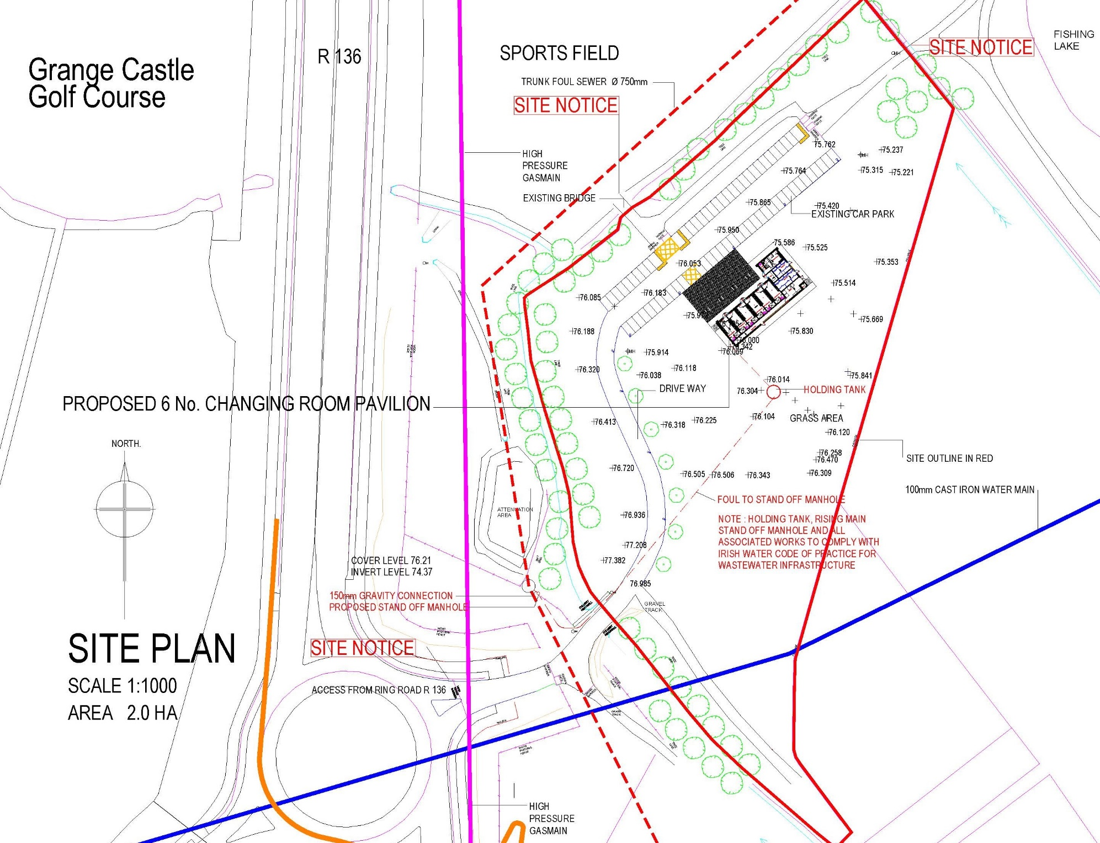
SITE PLAN

Slide 5
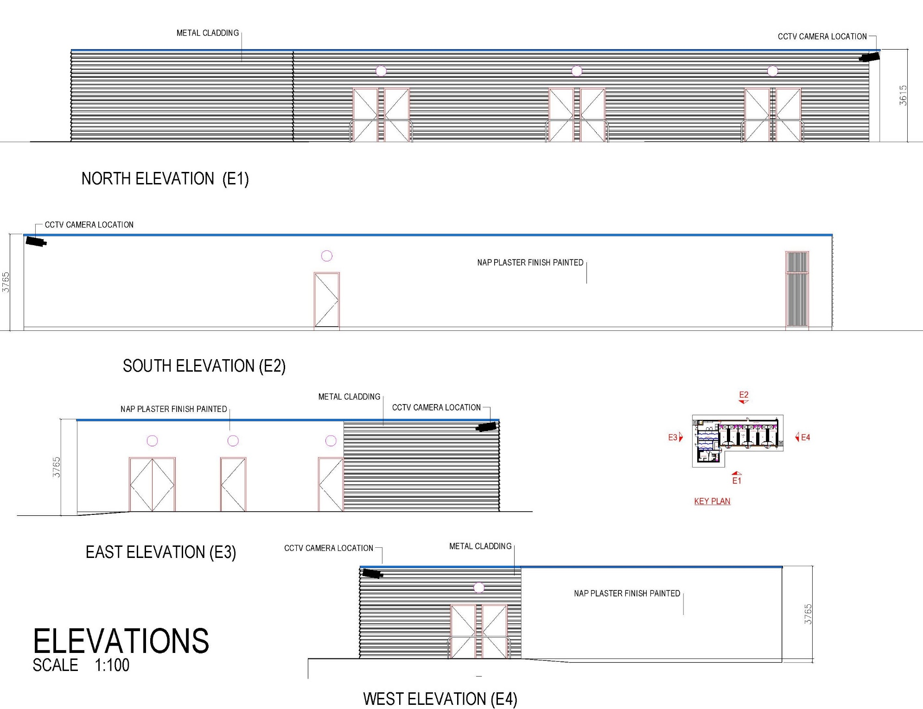
PAVILLION ELEVATION

