Slide 1


8,714 Homes Over 10 years
€235m Funding Application
38% Social & Affordable Homes
€2.3bn Regeneration Project

Slide 2

Clonburris URDF Proposal
URDF Proposal
€235m Funding Application
25% Match Funding (requirement provided by all 4 main landowners)
Key Timelines
URDF Application Submitted: June 2020
URDF Expected Decision: Q3/Q4 2020
8,700 new homes (minimum)
c.2100 SDCC Social & Affordable Homes
c.1200 Part V & Affordable Homes provided by private developers
c.5300+ Private Homes
Delivery Target Timelines
Commence Delivery in 2021
Phase 1 (south of rail-line): 4,780 Units By c.2027
Phase 2 (north of rail-line): 3,934 Units By c.2030
Strategic / Abnormal Infrastructure
Strategic Roads & Utility Corridors
Bridges over rail lines
Community Centres
Regional & Local Parks
Community Centres & Park Hubs
Water, Foul & Surface Water Services
Phase 1 Delivery Target Timelines
Overall Delivery: 2020 - 2027
South Link Road: 2020 – 2022
Grand Canal Park: 2022 - 2024
Kishoge Community Facility: 2021 – 2023
Griffeen Valley Park: 2024 – 2026

Slide 3
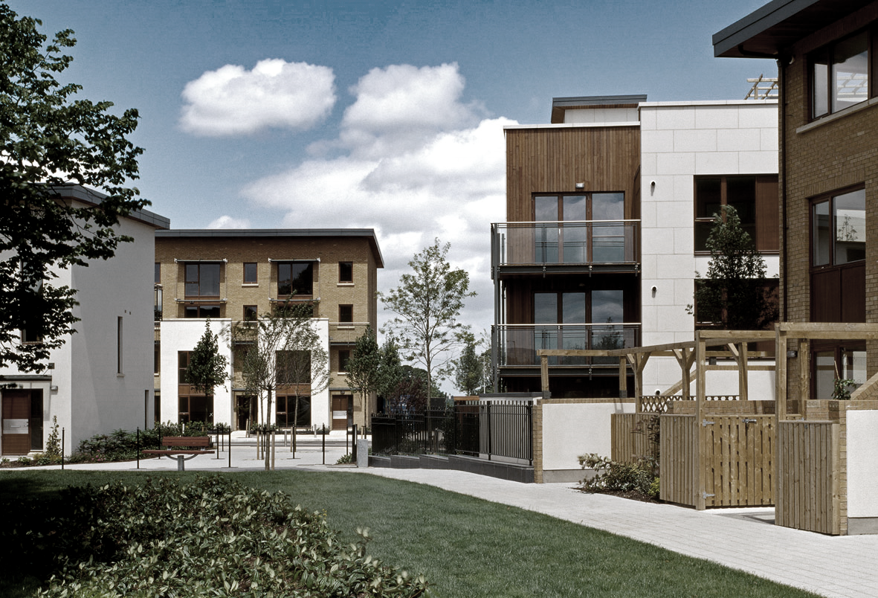

Adamstown URDF Proposal
585 Homes
By 2024
€12m Funding Application
20% Social & Affordable Homes
URDF Proposal
€12m Funding Application
25% Match Funding (requirement provided by 3 private landowners)
Housing & Infrastructure
585 Homes: 2021 - 2024
Central Boulevard Park: Q3 2020 – Q2 2023
Civic/Library Building: Q3 2020 – Q4 2022
Town Centre Plaza: Q3 2020 – Q4 2022

