Slide 1
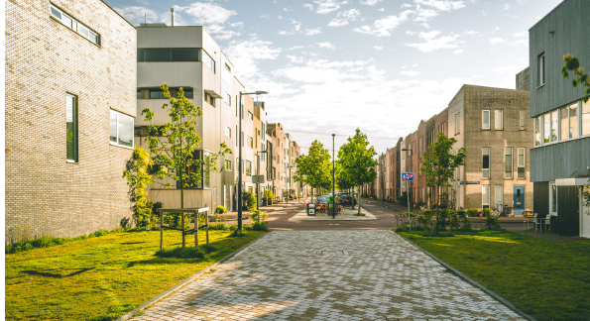
Fortunestown Local Area Plan – Progress Update
June 2020 Council Meeting

Slide 2
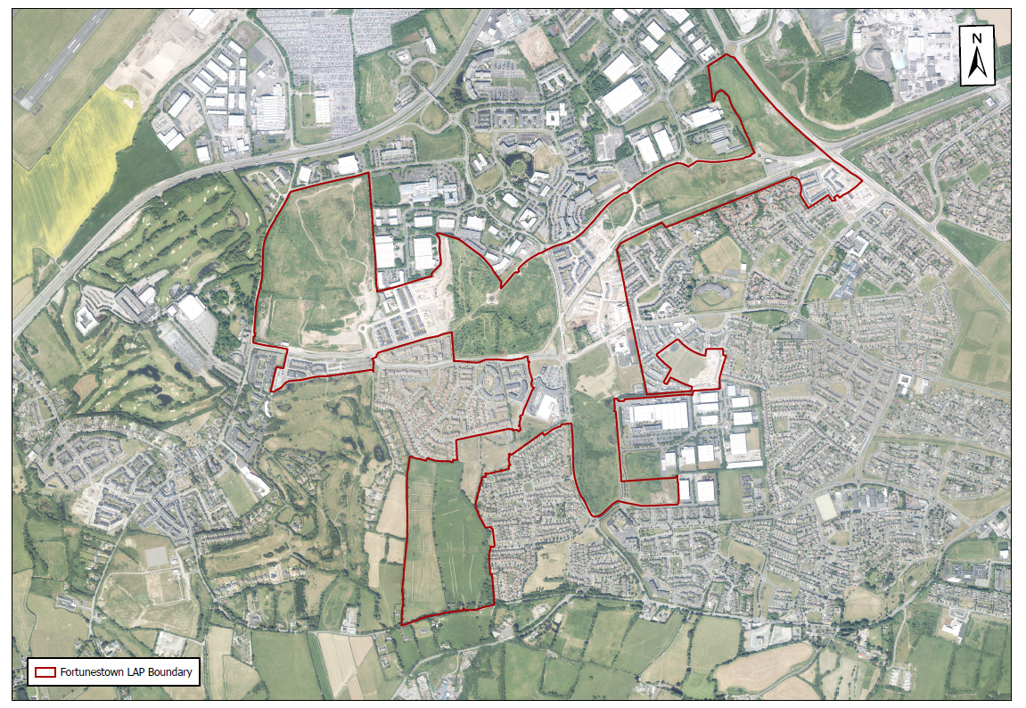
LAP Boundary Map
Citywest Campus
Brookfield
Citywest SC
Citywest Hotel
Cheeverstown Luas
Saggart Luas
Luas Line
Saggart
Naas Road

Slide 3
LAP Framework
Citywest SC

Slide 4
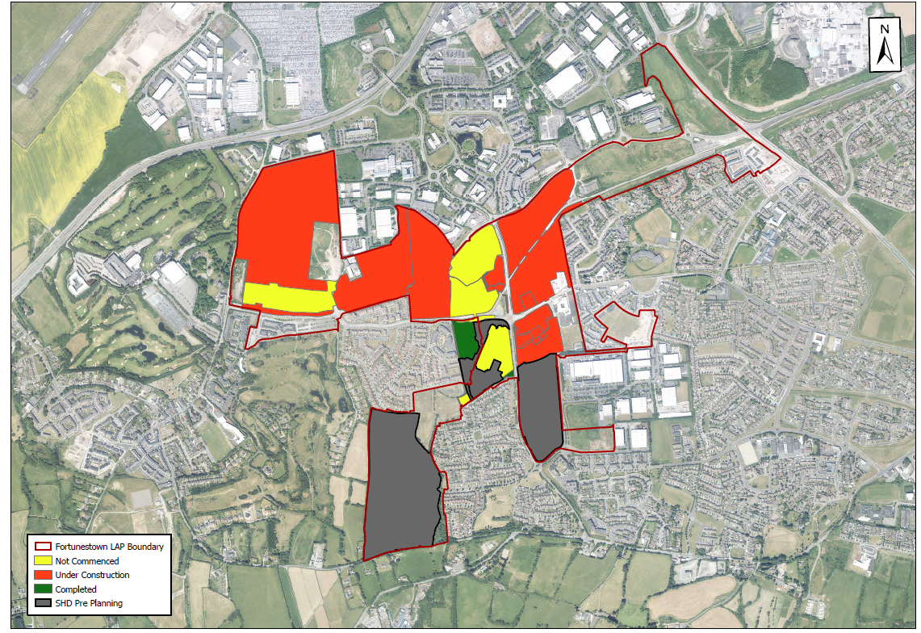
Housing Development
524 Permitted, 88 under construction
226 Permitted, 24 under construction, 212 complete
459 permitted, 336 under construction, 105 complete
111 permitted
128 permitted
12 permitted, 6 complete
384 permitted, 55 under construction, 195 complete
78 permitted, 78 under construction
52 permitted, 52 under construction
263 Permitted, 263 complete
488 Permitted
290 Permitted
463 Permitted
SHD Pre Planning Stage 690 Units
1
7
3
4
2
11
5
6
8
10
9
12
13
14
3,488 Units Permitted
City West SC
781 Units Delivered
690 Units @ Pre-planning

Slide 5
Planned v. Delivered
 | Required by LAP | Permitted to Date (Q1 2020) | Total Under Construction | Total Delivered
Housing (Phase 1-4) | 3,300 | 3,488 (Incl 463 Units Permitted 27/5/2020) | 633 | 781
Schools | 3 Primary Schools 2 Secondary Schools | 3 Primary Schools Note: A primary & post – primary school on further information request | 0 | 3 Primary Schools
Community | 780 sq.m required before phase 3 990 sq.m over plan | 646 sq.m Note: 7 independent spaces provided | 181 sq.m | n/a
Community Facilities
Ad hoc approach to community space provision has been ineffective.
€3m Community Infrastructure funding allocated in SDCC’s Capital Programme 2020-2022.
SDCC are currently in discussions with a Landowner in the Fortunestown area regarding the provision of a c.450 sq. metres community centre adjacent to the Saggart Luas Stop.

Slide 6
Planned v. Delivered
 | Required by LAP | Permitted to Date (Q1 2020) | Total Under Construction | Total Delivered
Parks | 2 District Parks Neighbourhood Parks in all Neighbourhoods | 2 Districts Parks | Saggart-Cooldown Commons Park 5.01 Ha 1.227 Ha of Neighbourhood Parks | Carrickmore Park 4.28 Ha Neighbourhood Parks .134 Ha
Creche | 990 sq.m over plan | 2,699 sq.m Note: 7 creches provided | 1,213 sq.m | n/a
Transport | Citywest Avenue Extension Upgrade of Fortunestown Way/City west Road Junction Upgrade Upgrade Junctions to signalised junctions |  | Junction upgrades being delivered in tandem with Planning application construction | Citywest Avenue Extension Complete Junction Upgrade Citywest complete
Parks
Funding for Carrickmore Park upgrade to be sought in Development Contribution Scheme
Retail
14,000 sq. m completed through delivery of Citywest Shopping Centre

Slide 7
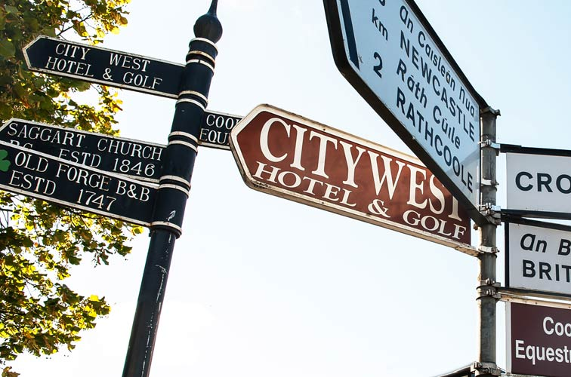
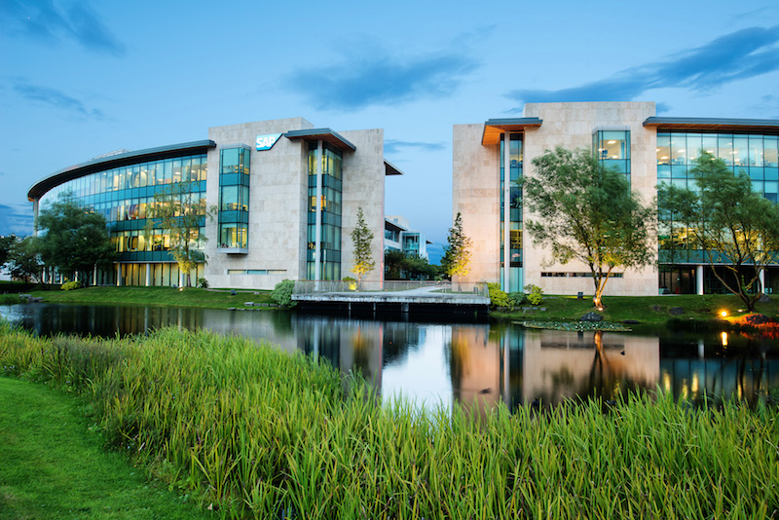
Summary
3,300 units planned in LAP with 3,488 permitted (2020, Q1 figures + Latest SHD Granted)
Majority of main housing sites are under construction with further SHD’s in pipeline
LAP density likely to increase through SHD’s – possible to deliver c. 4,000 if all permitted/constructed
7 creches and 7 community facilities permitted in the LAP (majority on sites under construction)
3 permitted primary schools, 3 completed primary schools.
Parks being delivered in tandem housing developments
Retail space of over 14,000 sq. m completed in Fortunestown centre through delivery of Citywest Shopping Centre
Road and junction upgrades are integrated into residential planning applications including the upgrade of the Citywest Road junction, which has been completed.
Notes:
68% of housing requirement permitted – Q4 house count figures

