Slide 1

Building Height Review and
Proposed Non-Material Alteration
Lucan ACM Members’ Briefing, 23/06/20

Slide 2
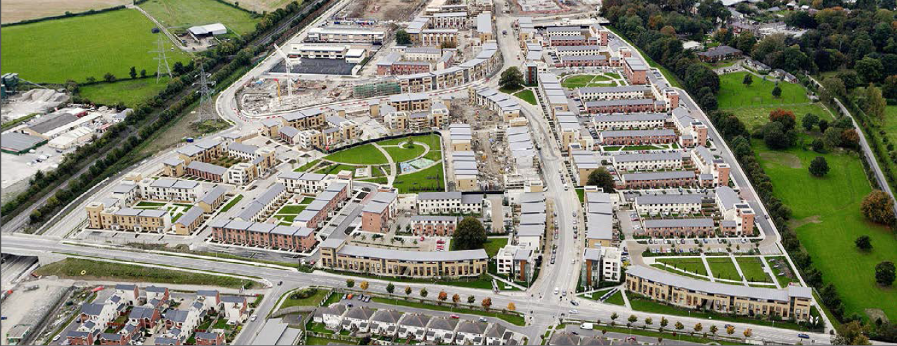
Overview of Development to Date
3,795 dwellings units granted permission to date (2,346 since 2017).
2,613 homes provided (up to Q4, 2019).
Significant supporting infrastructure and services delivered, including
  The railway station
  A crèche, 2 primary schools and a post primary school
  A neighbourhood park
  Local retail services
  A community centre and sports hall
  Internal strategic roads and upgrades to the adjoining road network
  Water and sewerage infrastructure.
A further 600 residential units (figure for Q4 2019), Tandy’s Lane Park and Tobermaclugg Village centre currently under construction.
Development entering Phase 4 of the Planning Scheme.

Slide 3
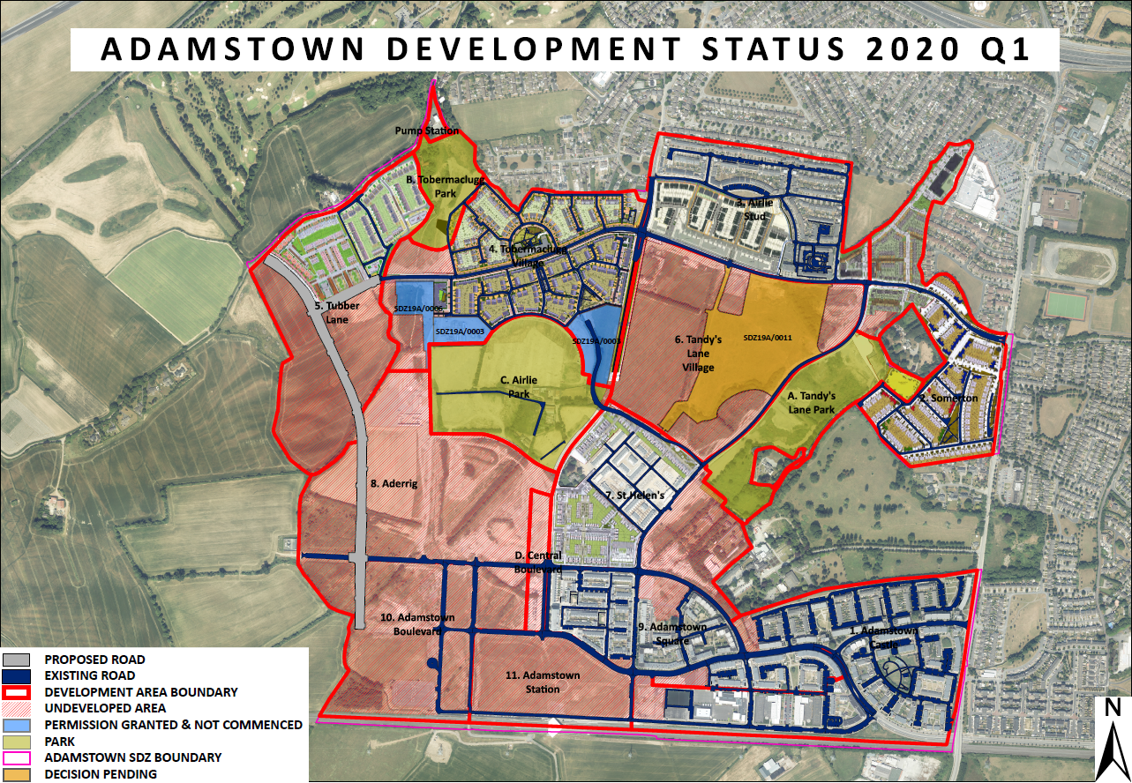

Slide 4
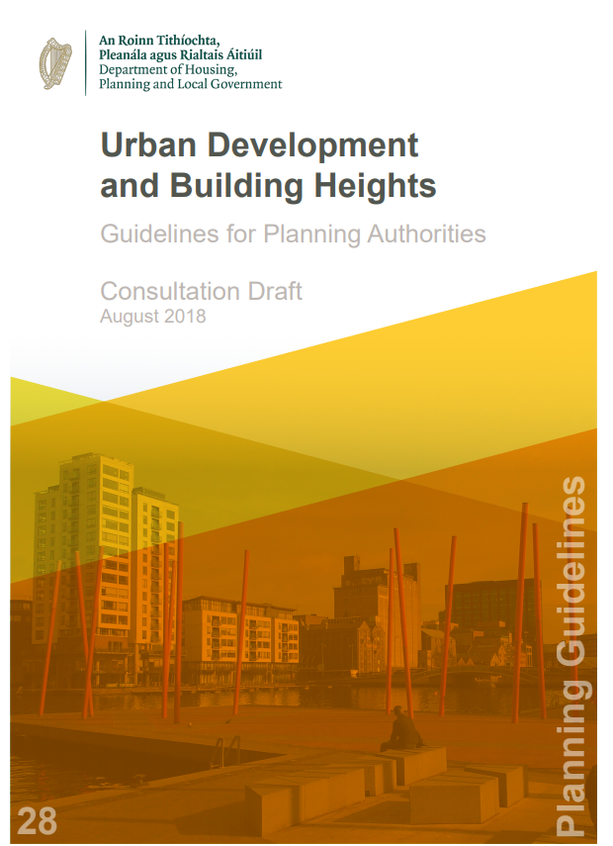
Policy and Guidance
Adamstown SDZ Planning Scheme reviewed in light of Recent policy and guidance including:
  National Planning Framework (NPF), 2018, DoHPLG
  Regional Spatial and Economic Strategy (RSES), 2019, EMRA
  Sustainable Urban Housing: Design Standards for New Apartments: Guidelines for Planning Authorities (‘The Apartment Guidelines’), 2018, DoHPLG
  Urban Development and Building Heights: Guidelines for Planning Authorities (‘The Building Heights Guidelines’), 2018, DoHPLG
    SPPR 3(B) requires adopted planning schemes to be reviewed to ensure that the Guidelines are fully reflected.
Together, these documents seek compact growth focussed on urban cores and public transport links.

Slide 5
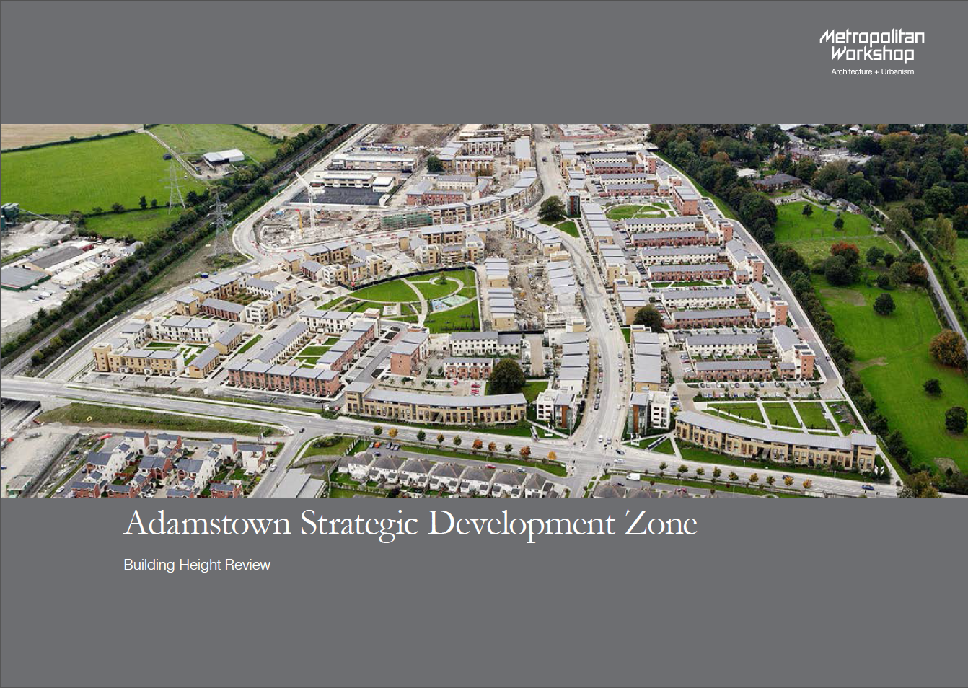
Building Height and Density Study
Metropolitan Workshop urban design consultants engaged by SDCC to carry out independent study of building heights within undeveloped parts of Adamstown. Interrelated issue of density also examined.
Overall finding – Adamstown SDZ Planning Scheme 2014 is compliant with the Building Heights Guidelines.
Recommended a one storey height increase within part of Aderrig.
  - Justified in terms of improving legibility and creating a stronger urban edge addressing Central Boulevard Park.
Recommended density increases within Adamstown Station, Aderrig and Adamstown Boulevard.
  - Justified in terms of facilitating higher density urban form close to public transport links in line with recent national planning policy and guidelines.
Adamstown Boulevard not being pursued currently as closer analysis of possible alternatives is required.

Slide 6
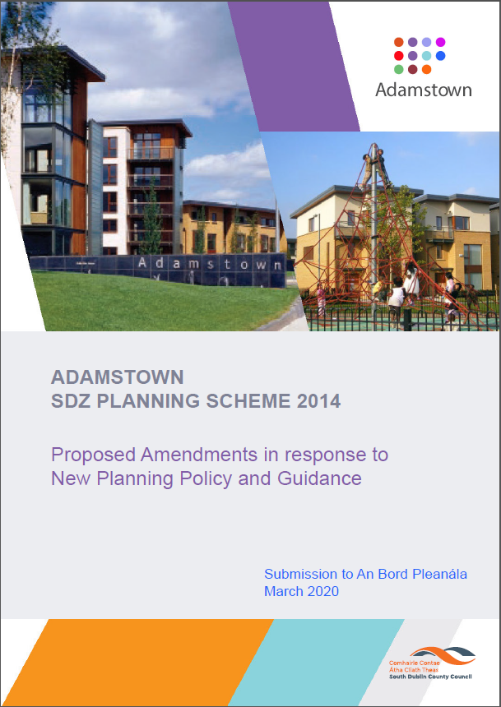
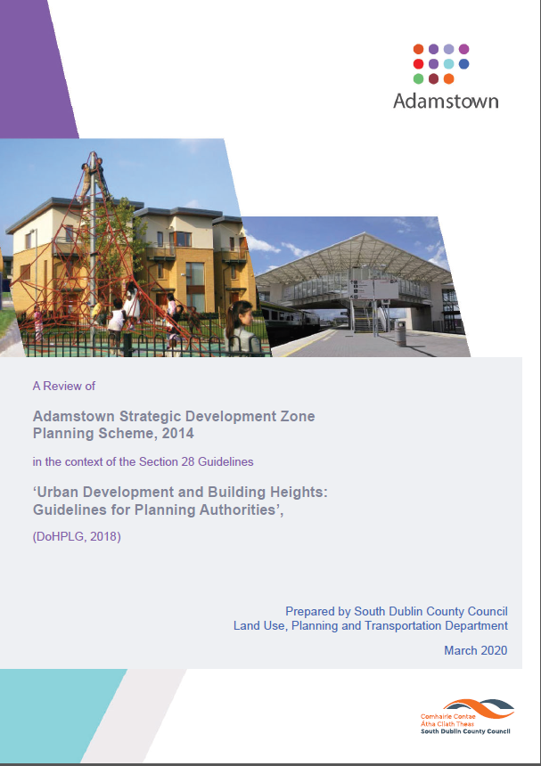
Proposed Amendments to Adamstown SDZ Planning Scheme 2014
Two documents prepared as a result of review.
  Proposed Amendments in response to New Planning Policy and Guidance (‘The Proposed Amendment’).
  A Review of Adamstown SDZ Planning Scheme in the context of the Section 28 Guidelines ‘Urban Development and Building Height Guidelines for Planning Authorities’ (‘The Building Height Review’).
Both documents informed by Metropolitan Workshop Study.
Main amendments proposed:
  An increase in unit numbers, density and residential floor area within the Adamstown Station development area.
  An increase in unit numbers, density and residential floor area and a location-specific increase in building height within the Aderrig development area.
  Relocation of a proposed enterprise centre from the Tobermaclugg Village/Tandy’s Lane Village local centre to the Adamstown Station district centre.
  Other minor amendments including updated references, summaries of new policy and guidance, and other clarifications.

Slide 7
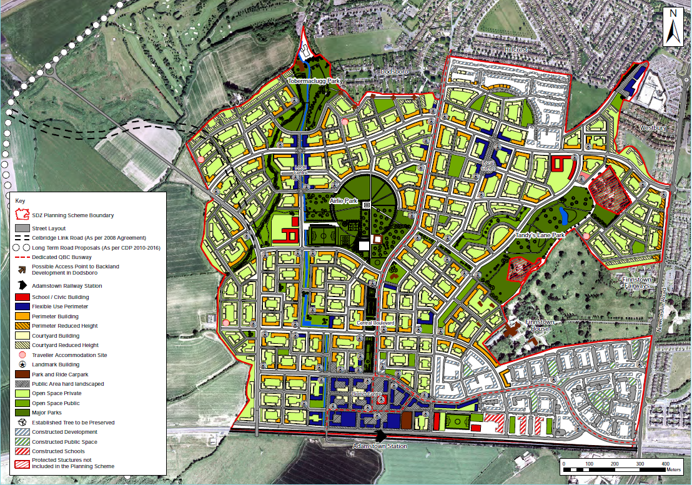
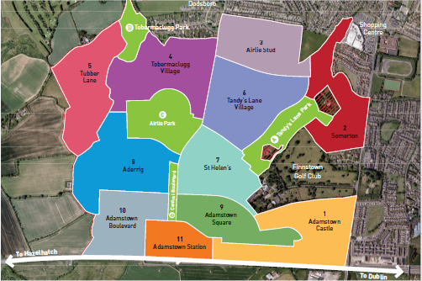
Adamstown SDZ Planning Scheme 2014 –
Layout and Development Areas

Slide 8
Table 1: ADAMSTOWN STATION Residential Floor Area, Density and Unit Numbers as Provided for in SDZ Planning Scheme and as Now Proposed
 | SDZ Planning Scheme | Proposed
Min-max total residential development (sqm) | 49,000 – 58,500 | 49,000 – 97,500
Min-max dwellings per hectare (density) | 75 - 90 | 75 - 150
Min-max total dwelling units | 490 – 585 | 490 - 975

Slide 9
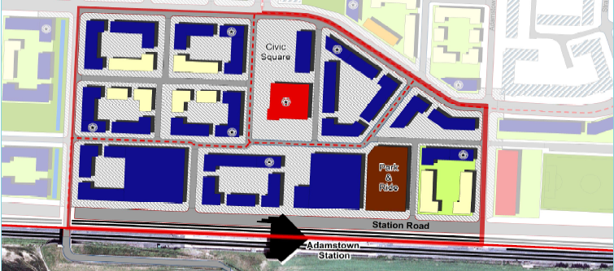
Adamstown Station Indicative Layout

Slide 10
Table 2: ADERRIG Residential Floor Area, Density and Unit Numbers as Provided for in SDZ Planning Scheme and as Now Proposed
ADERRIG | SDZ Planning Scheme | Proposed
Min-max total residential development (sqm) | 97,125 – 121,275 | 97,125 - 130,830
Min-max dwellings per hectare (density) | 52 - 65 | 52 - 70
Min-max total dwelling units | 925 – 1155 | 925 - 1,246

Slide 11
Table 3: ADERRIG Building Heights as Per SDZ Planning Scheme and as Now Proposed
Building Type | Heights in SDZ Planning Scheme 2014 | Proposed Heights (adjoining Central Boulevard Park only)
Courtyard Building | 2-3 storeys with up to 4 storeys at corner/feature building | 3 to 5 storeys (i.e. 1 storey increase)
Perimeter Building | 3-5 storeys | 3 + 1 setback – 5 + 1 setback (i.e. 1 storey increase)
Landmark Building | Up to 7 storeys | Up to 7 storeys (No change)
Table 3: ADERRIG Building Heights as Per SDZ Planning Scheme and as Now Proposed

Slide 12
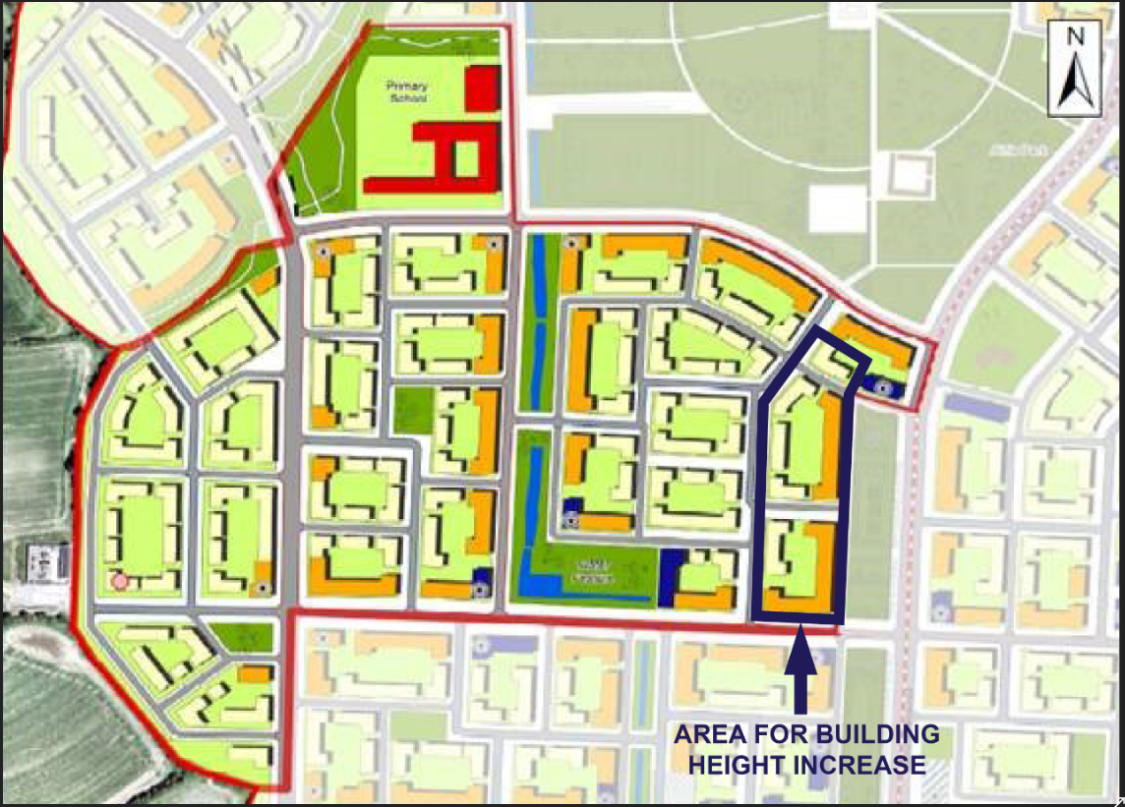
Aderrig Development Area –
Location for Proposed Building Height Increase

Slide 13
Compliance with Requirements of Legislation
Proposed amendments submitted by SDCC for consideration of An Bord Pleanála, which will determine whether or not they are material. Decision due end of July.
Case made by SDCC that proposed amendments are not material and satisfy criteria outlined in legislation against which proposed amendments to SDZ Planning Schemes must be assessed, including that they:
  ‘would not constitute a change in the overall objectives of the Planning Scheme concerned’.
  ‘would not relate to already developed land in the planning scheme’.
  ‘would not significantly increase or decrease the overall floor area or density of proposed development’.
  ‘would not adversely affect or diminish the amenity of the area that is the subject of the proposed amendment’.
(Reference: Section 170A (3)(b) of the Planning and Development Act, 2000 (as amended)
AA and SEA Screening carried out – finding that unlikely to be any significant effect on any European Sites and no significant environmental effects identified; full SEA not required.

Slide 14
Justification for Proposed Amendments
Adamstown Station development area is a district centre within a 5-minute walk of railway station. Aderrig is within a 10-minute walk.
Current 75-90 dph density range set out in SDZ Planning Scheme for Adamstown Station is under-scaled for a district centre served by a railway station.
Proposed increased density within Adamstown Station Area and Aderrig and proposed increased height in part of Aderrig would align the Planning Scheme more closely with recent national and regional policy and guidance which together, seek compact growth focussed on urban cores and public transport links.
Would make more efficient use of land within development areas in close proximity to railway station.
Would contribute to urgent need to meet current housing requirements.

Slide 15
Justification for Proposed Amendments
Increase in density to 75-150 dph would align Adamstown Station with analogous densities in nearby Clonburris SDZ.
Overall density achieved to date within Adamstown area (47dph) is at the lowest end of the current 47-56 dph density range for the entire SDZ Planning scheme area.
Capacity analysis undertaken by SDCC demonstrates that when the additional units proposed for Adamstown Station and Aderrig are added to existing, proposed and potential units, dwelling unit numbers for overall SDZ Planning Scheme are projected to exceed the current maximum of the dwelling unit range (8,905) by just 45 units.
Infrastructure, commercial development and community facility requirements including amenities such as parks will be more than adequate to cater for the modest increase in unit numbers.

Slide 16
Justification for Proposed Amendments
Proposed one-storey height increase in Aderrig is in a confined location and would provide a stronger urban edge addressing Central Boulevard Park.
Blocks where additional height is proposed are located beside or close to a major street and quality bus corridor (QBC) and are within a 5-7-minute walk of train station and district centre.
Relocation of enterprise centre would optimise the use, would complement other district centre activities and would benefit from proximity to the railway station.
Neutral impact in terms of overall Planning Scheme as it involves transferring a use from one location to another.

Slide 17
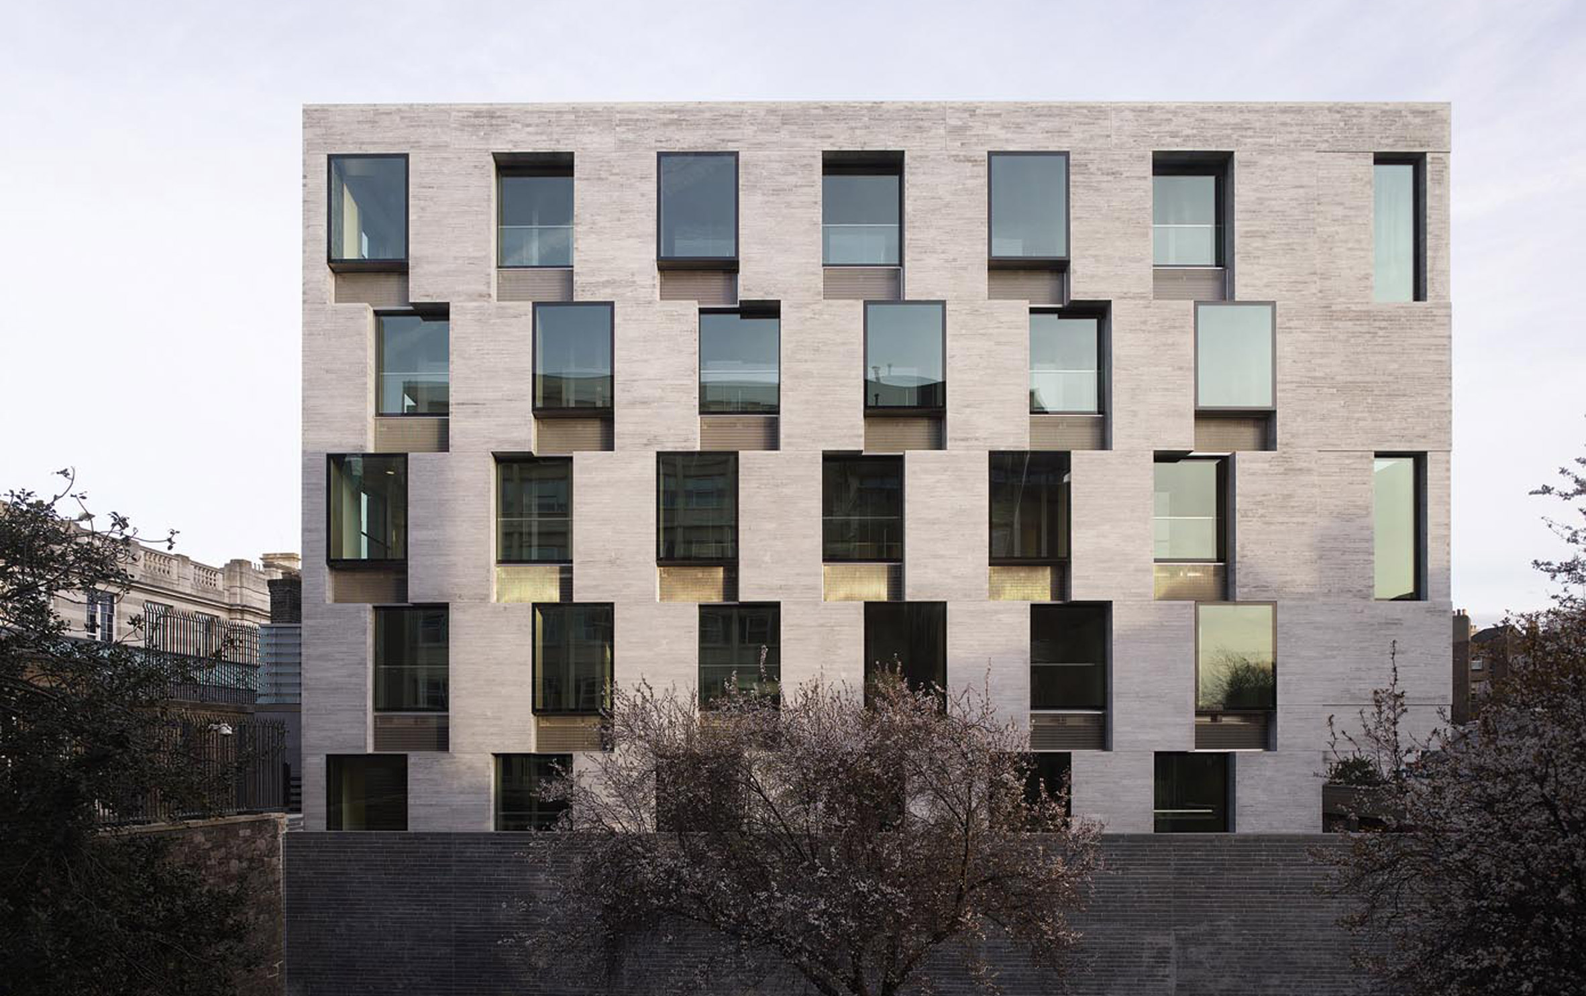
Adamstown Planning Scheme and proposed Aderrig height increase – Compliance with Building Height Guidelines
Served by high quality public transport – railway station.
Increased densities and greater heights facilitated compared to the surrounding context.
No blanket height restrictions – flexible building height ranges appropriate to different character areas.
Taller buildings and lower buildings in appropriate locations.
Variety of building heights improves legibility; results in diversity of built form; enhances the urban design context for the public realm.
Broad mix of uses including residential, employment, retail, recreation, education and community.
Wide range of residential building types including apartments, duplexes and own-door houses.
Proposed one storey height increase within Aderrig (part) would be consistent with Guidelines – location close to train station; improved legibility; and stronger urban edge addressing a key urban public open space.

