Slide 1
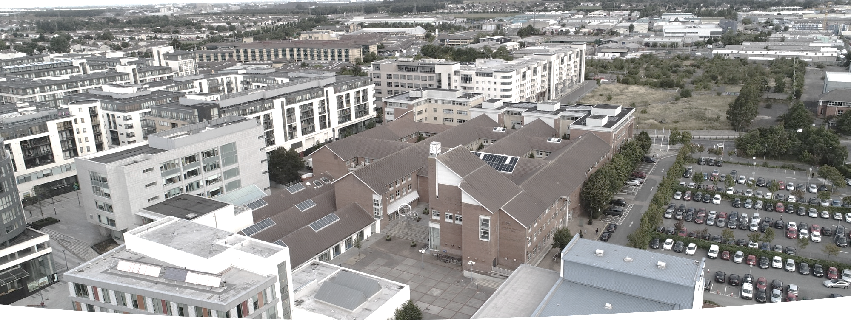


TALLAGHT AREA
COMMITTEE MEETING
22nd June 2020
Proposed Part 8
Civic Square, Innovation Square and associated links
Context for the Projects
National plans, including National Development Plan, Project 2040 Building Irelands Future, National Planning Framework, SDCC Development Plan, Tallaght Local Area Plan.
November 2018, Government launched Urban Regeneration and Development Fund a flagship element of Project 2040
Delivery of these projects will raise the profile of Tallaght and create a sense of pride and place for Tallaght Town Centre.
SDCC’s application successful in receiving funding for projects in Tallaght’s Core Urban Centre to include:
  New Innovation Square,
  Upgrade and regeneration of Civic Square and associated pedestrian links
  Innovation Centre,
  Tallaght Stadium 4th Stand,
  Tallaght Mobility Hub,
  Belgard Link Roads
  Astro pitch for Sean Walsh Park.
Prepared on behalf of South Dublin County Council

Slide 2
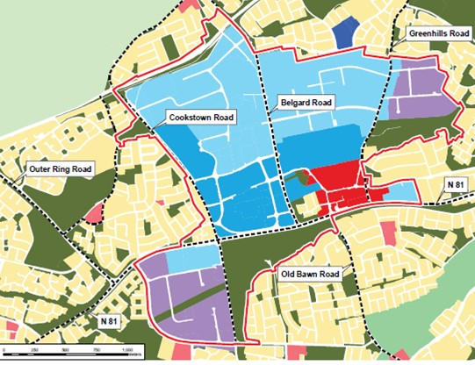
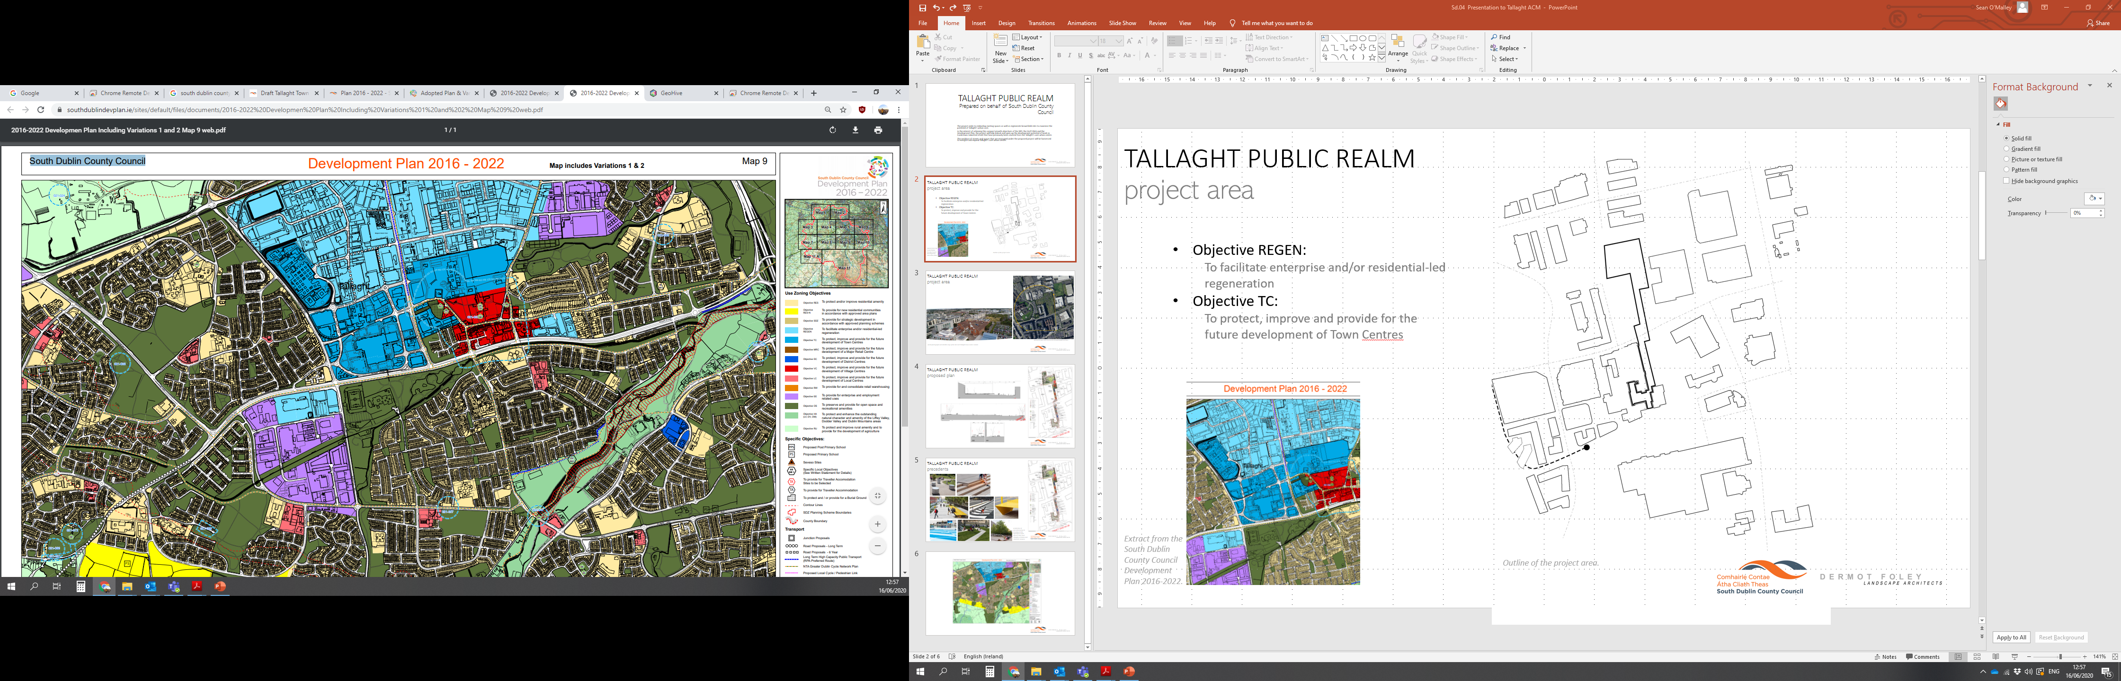
TALLAGHT PUBLIC REALM project area
Extract from the South Dublin County Council Development Plan 2016-2022.
Extract from the County Development Plan with Tallaght LAP boundary shown .
Objective REGEN:
  To facilitate enterprise and/or residential-led regeneration
Objective TC:
  To protect, improve and provide for the future development of Town Centres
Objectives of Tallaght LAP 2020
To promote a mix of uses in a manner that creates a sustainable and active area (Objective UF2);
To ensure that development is carried out in a design led manner that prioritises place making and accords with the core principles of urban design and the creation of integrated streets (Objective UF3);
To promote a mix of uses in a manner that creates a sustainable and active area (Objective UF2);
To ensure that development is carried out in a design led manner that prioritises place making and accords with the core principles of urban design and the creation of integrated streets (Objective UF3);

Slide 3
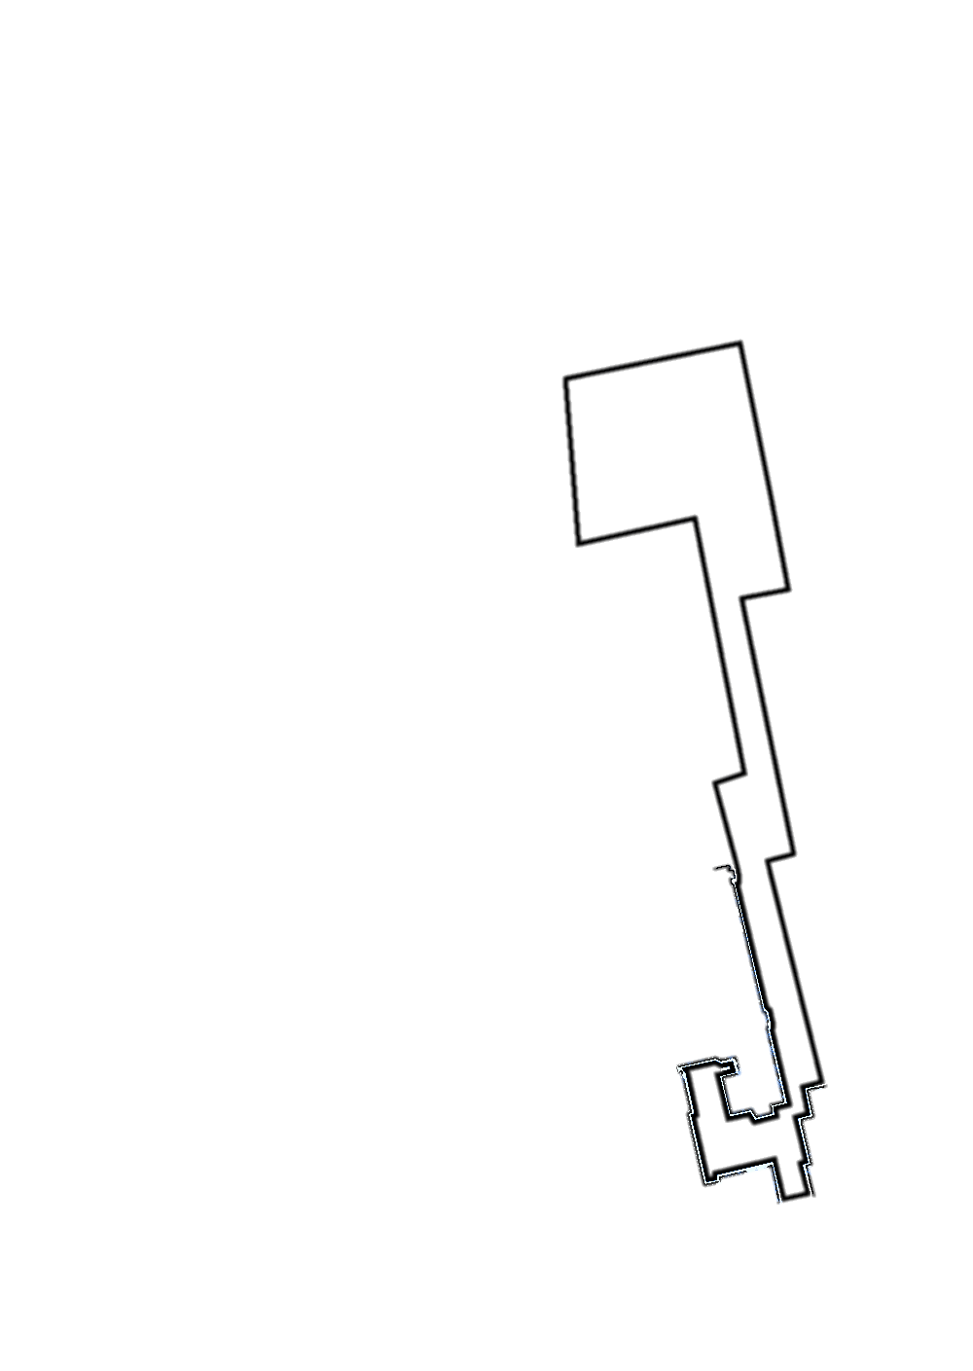
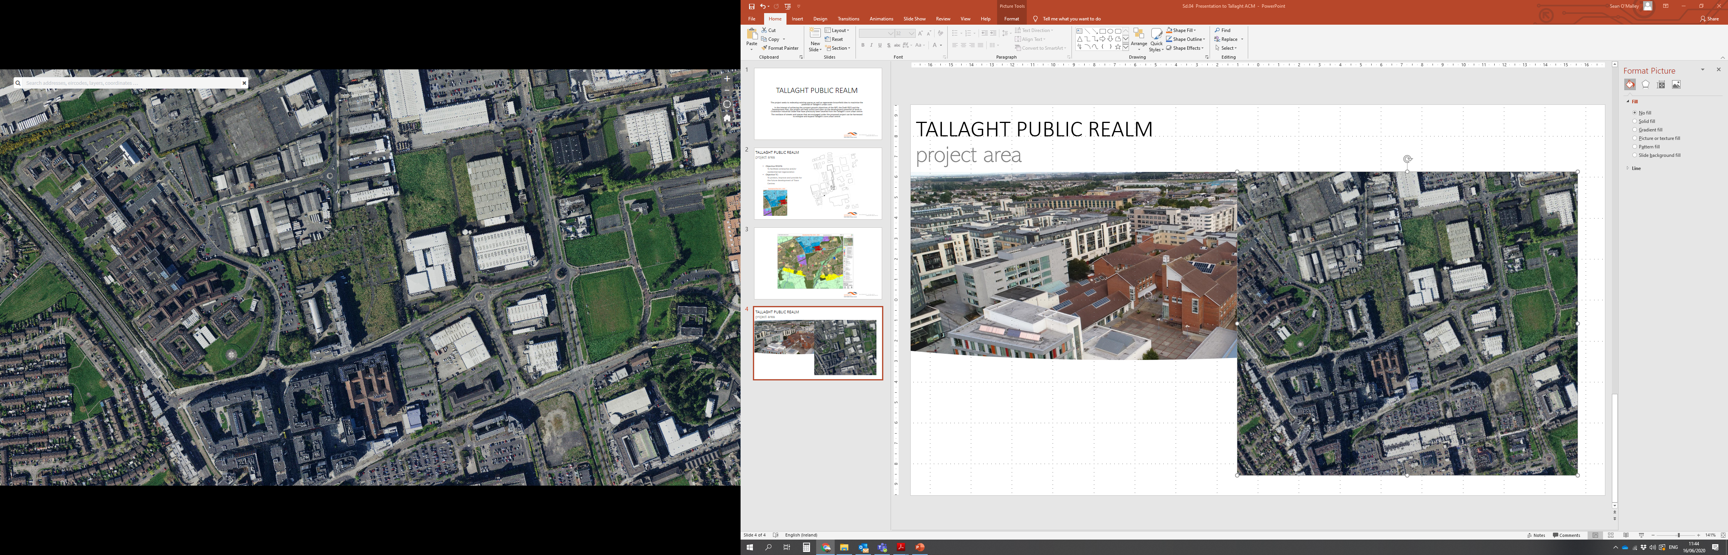
TALLAGHT PUBLIC REALM
project area
Outline of the project area.
Objectives of Tallaght Local Area Plan for the Urban Centre
The Centre: Continued transformation towards a high quality mixed use urban centre of city scale and character, promotion of new and enhanced retail, civic and town centre uses, new employment space and a vibrant mix of residential, that will support the whole of the County all set within an attractive network of streets, spaces and buildings.
Design intent for Plaza and Squares in Tallaght LAP 2020
Squares and spaces connect the mixed--use area
Urban squares and spaces shall be designed to the highest quality taking into account:-
quality of materials,
variety of sub spaces
links into and across the squares and spaces and
maintenance and management of the spaces over time.

Slide 4
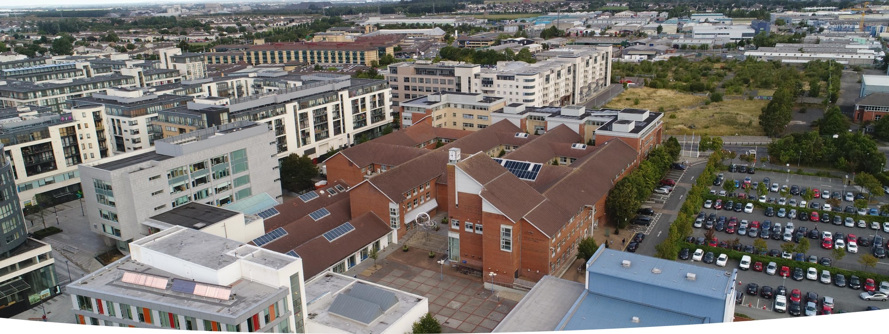
TALLAGHT PUBLIC REALM
project area
Aerial photograph and satellite map of the site and Tallaght town centre context.
Tallaght Core Centre
Tallaght Central population of 76,119
Tallaght Core population of 6,126 (Source Census 2016)
Diverse and integrated community
Objectives for Project
Unlocking a new urban quarter for Tallaght Core Centre to integrate with existing spaces and redefine and recreate links to existing Public realm
Encourage public spaces to be seen as assets that encourage sociability, gatherings, events, accessibility and daily activities.
Integrate and improve urban setting and place making for proposed developments including adjacent and interconnected sites.
Annotations depict which direction the aerial photograph was taken.

Slide 5
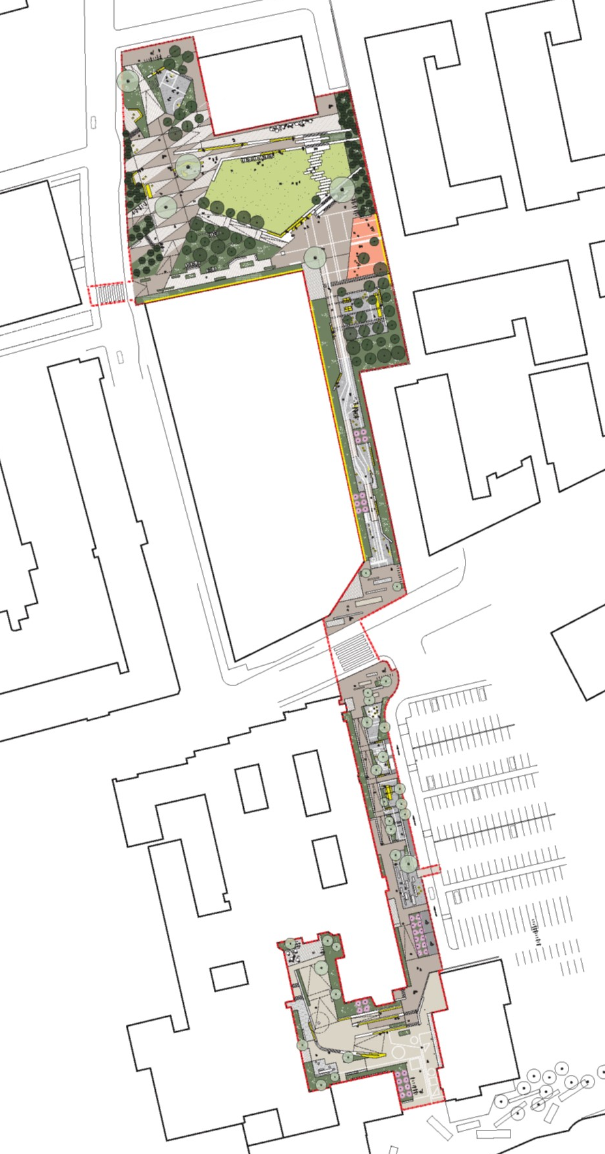
TALLAGHT PUBLIC REALM
proposed plan
Innovation Hub
Innovation Square
Proposed School
School Pedestrian Link
County Hall Pedestrian Link
Civic Square
Landscape Masterplan

Slide 6
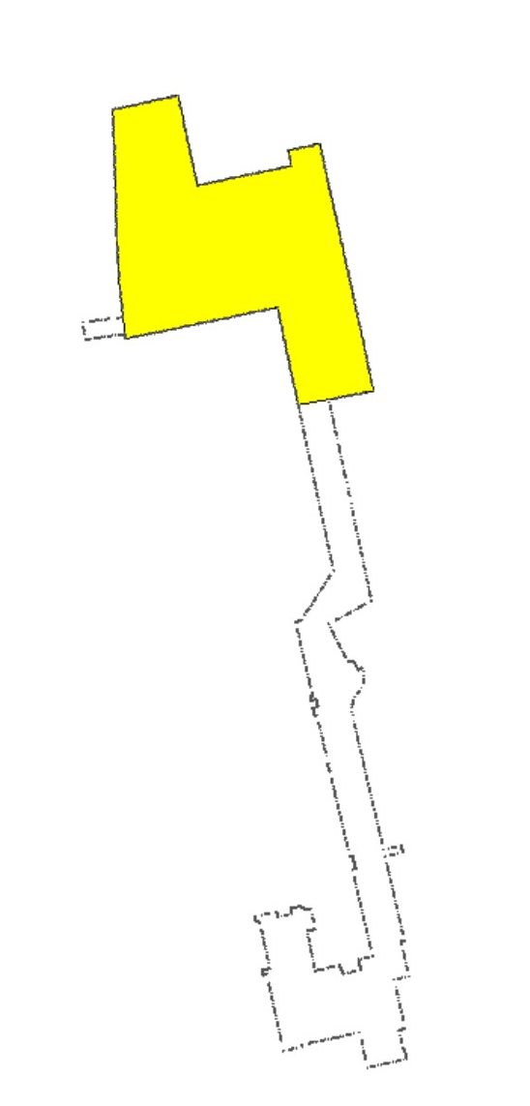
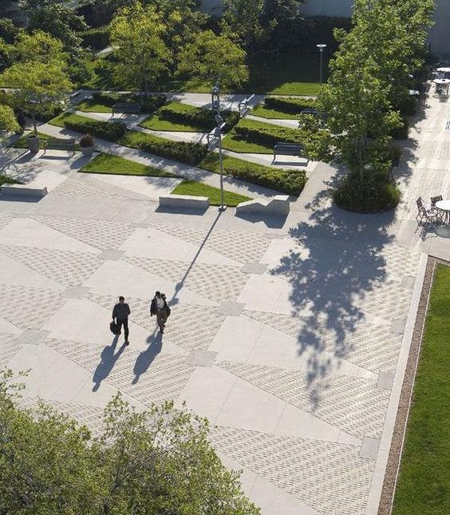
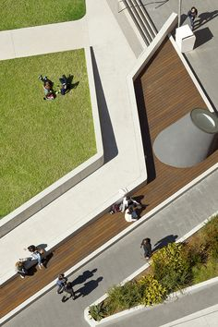
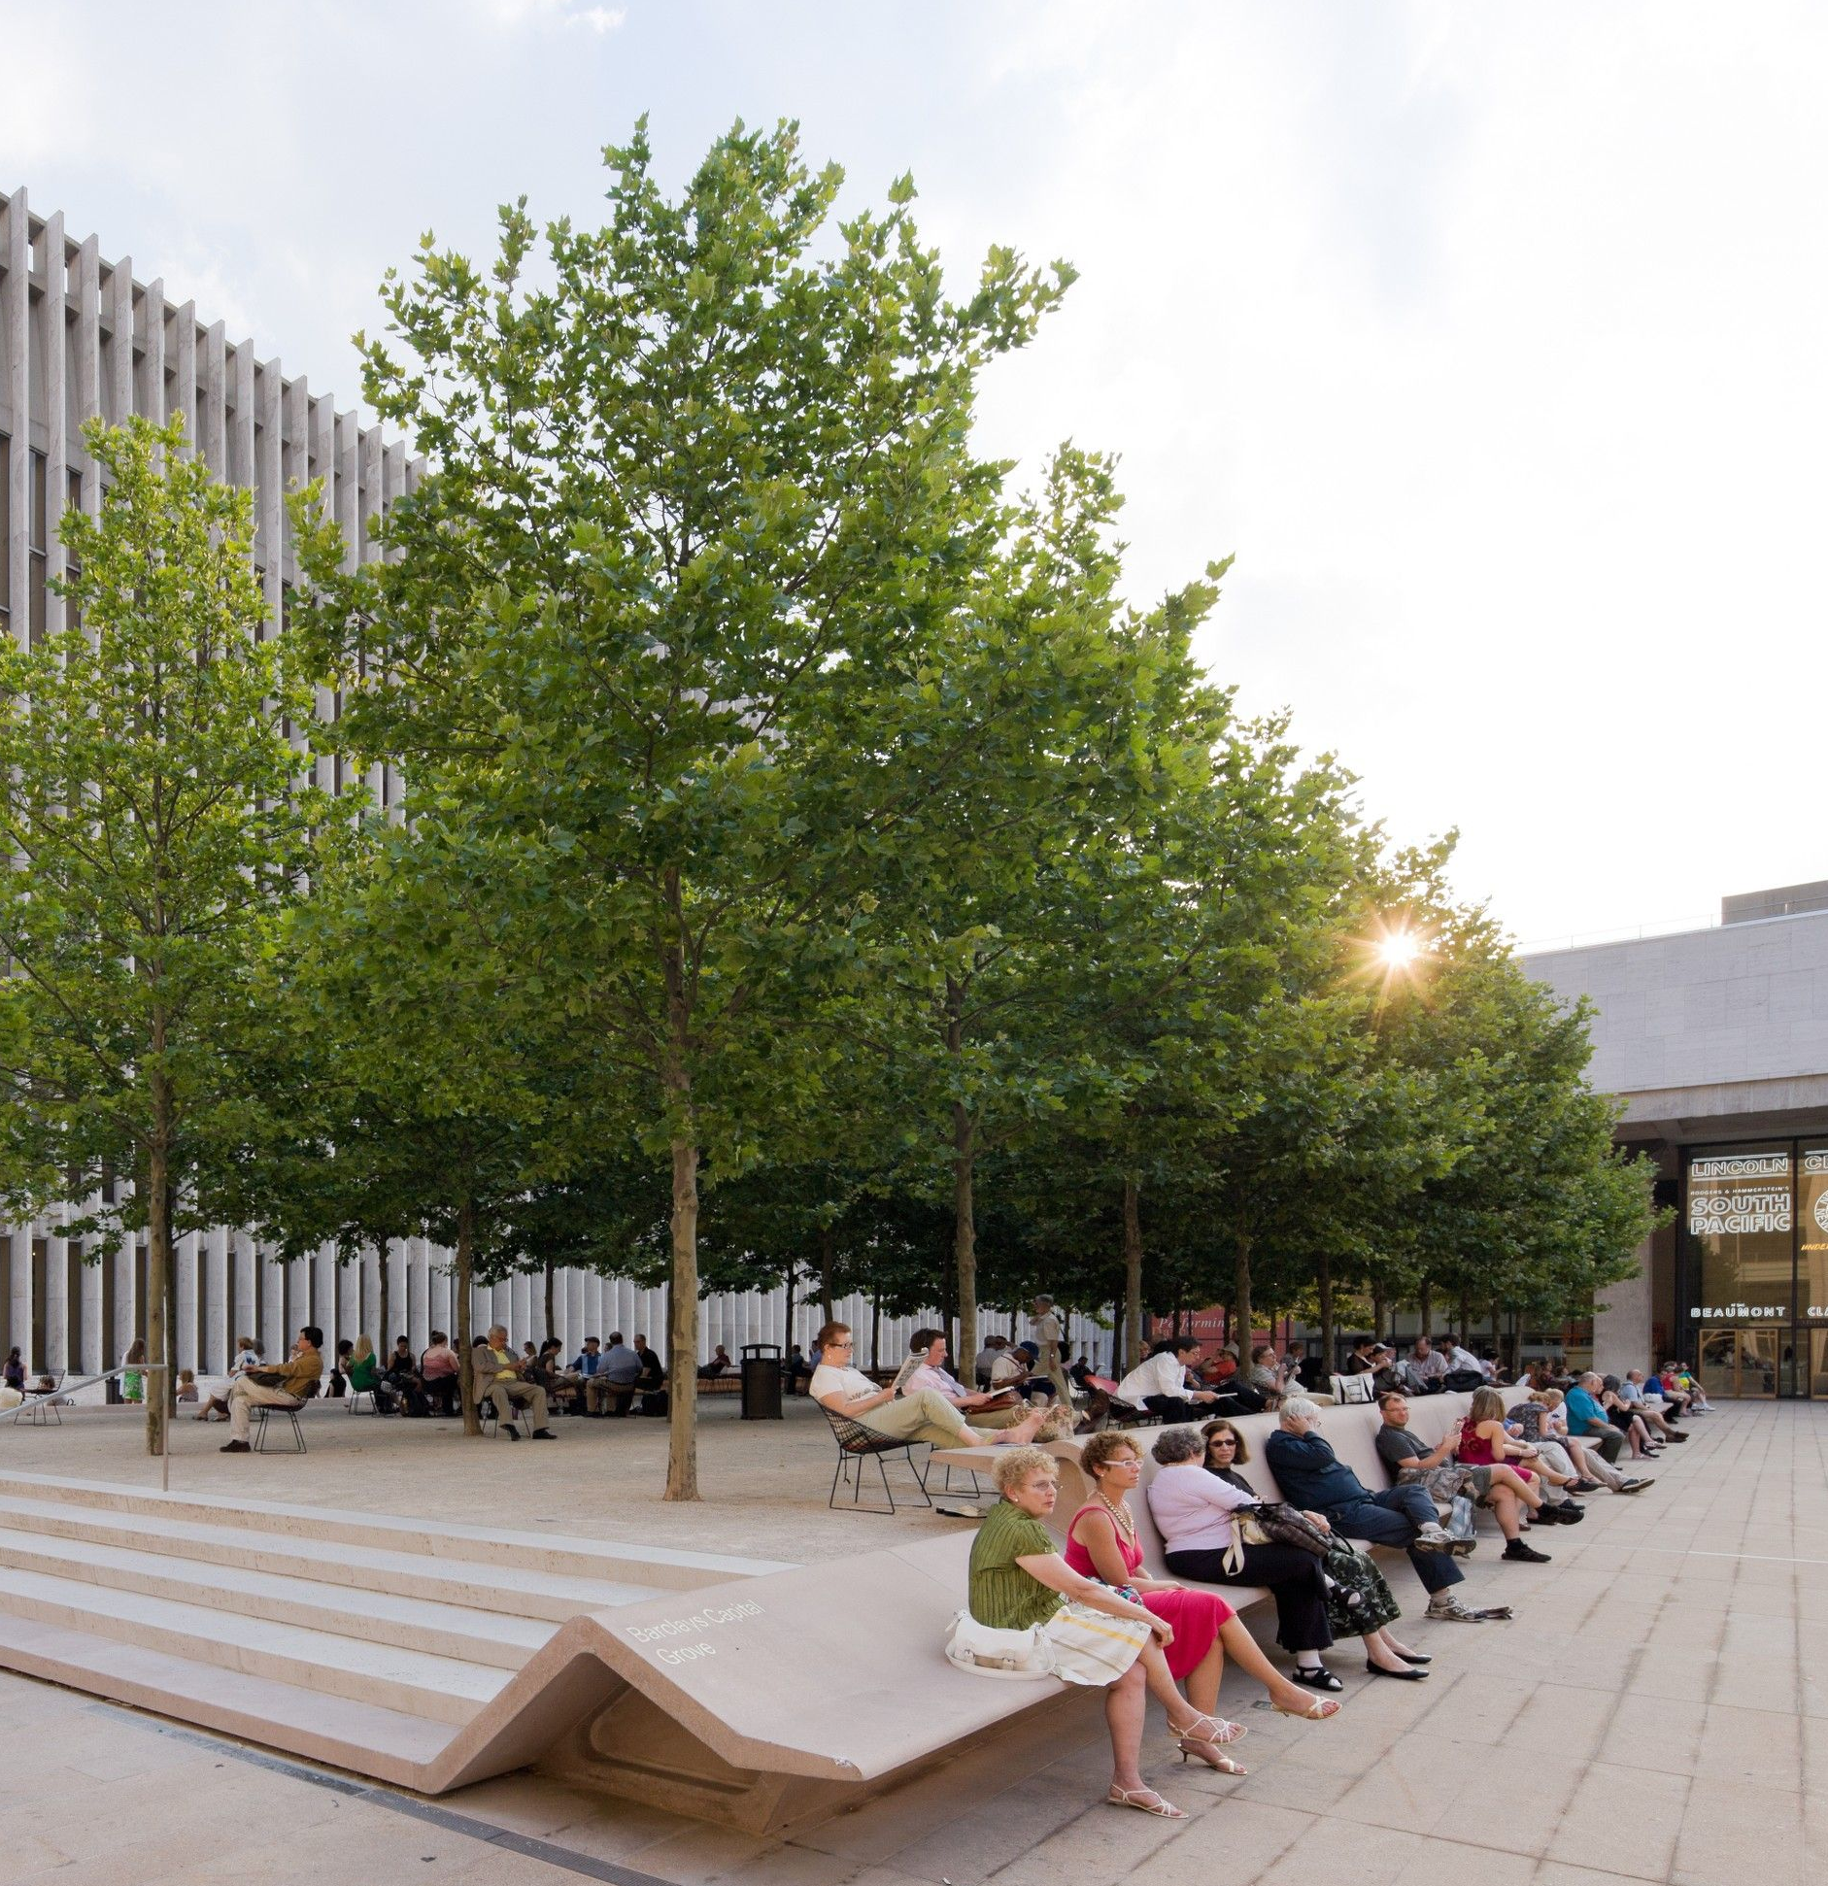
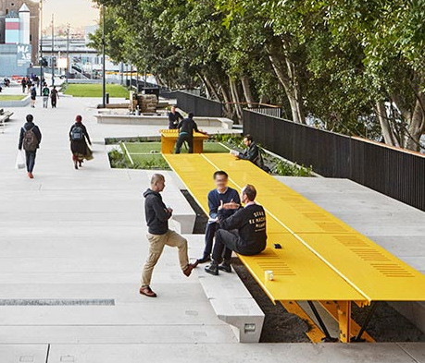
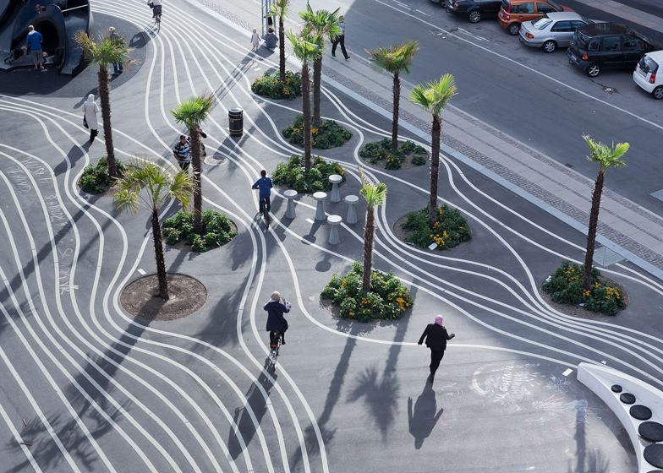
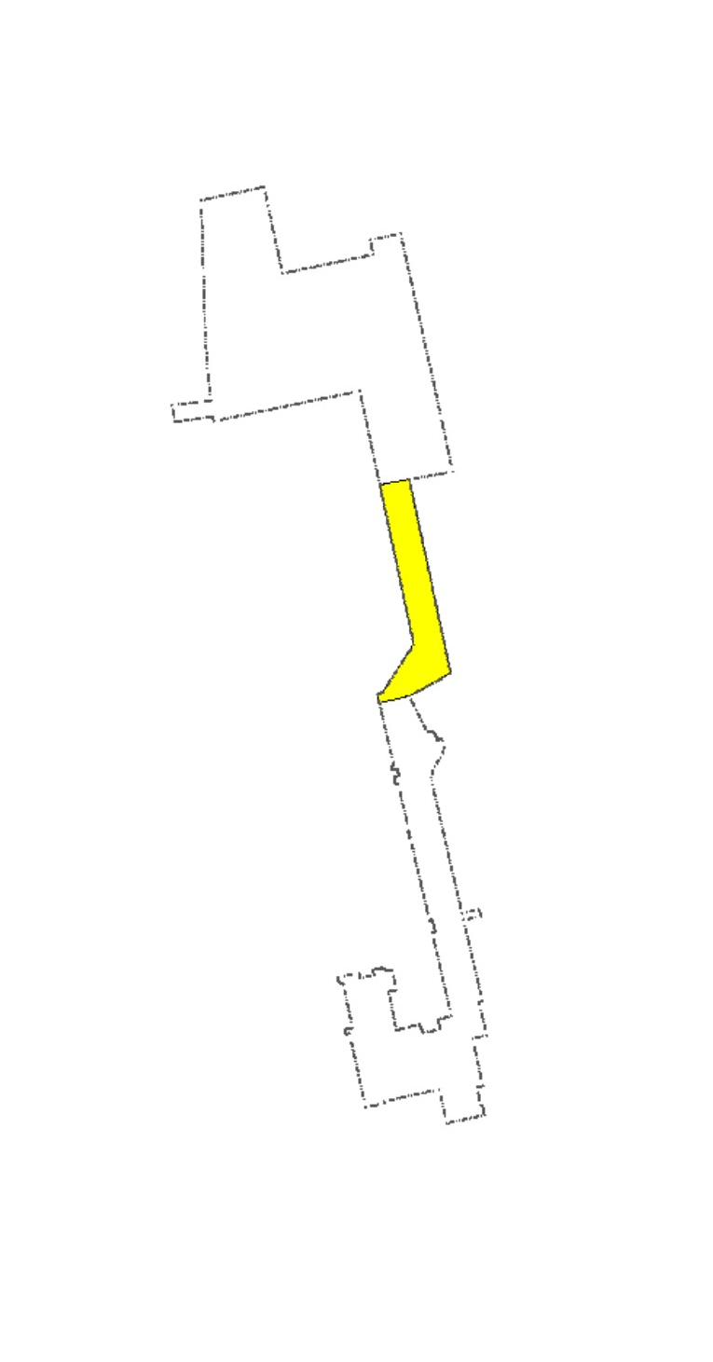
TALLAGHT PUBLIC REALM
precedents
Innovation Square
New multifunctional square to include formal terraced lawn area, trees and planting, plaza, seating, play and teen spaces
Square also incorporates extension of pedestrian ‘zip’ link east-west
School Pedestrian Link
Shared pedestrian/cycle north south linking Belgard Square North to Innovation Square
Playful graphics proposed on surface
Seating and informal balance / play opportunities
A selection of precedent projects focusing on the typology of open spaces, uses, level changes, activities and character of space.

Slide 7
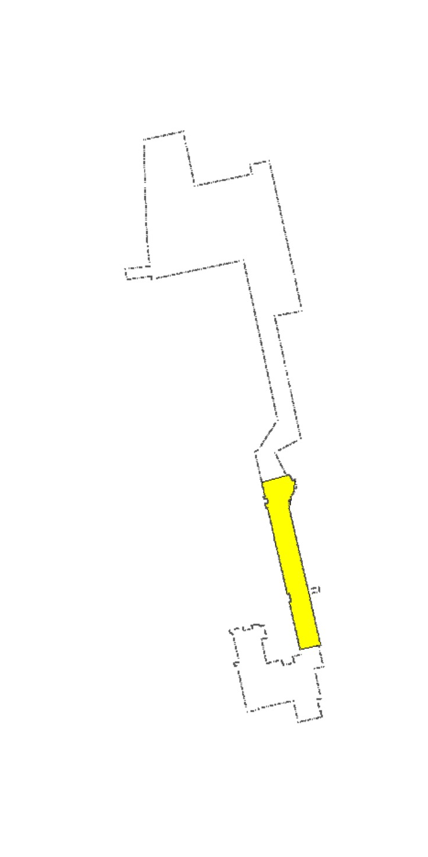
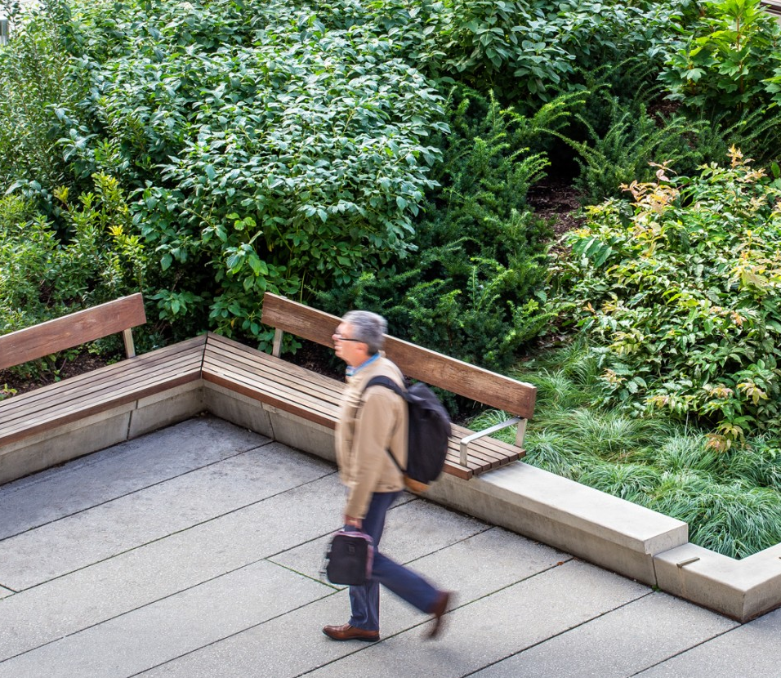
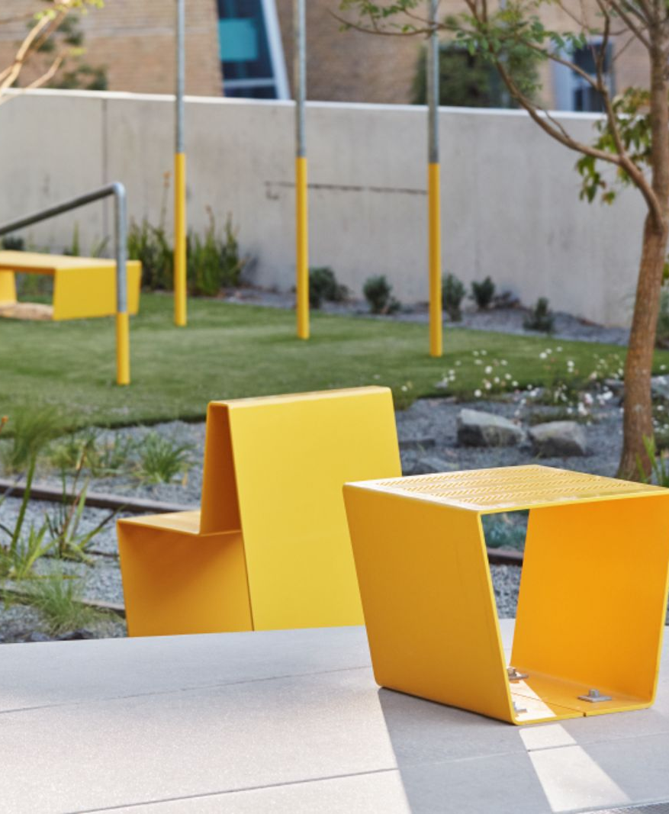
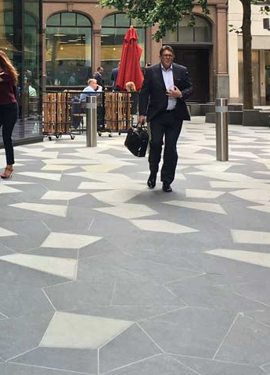
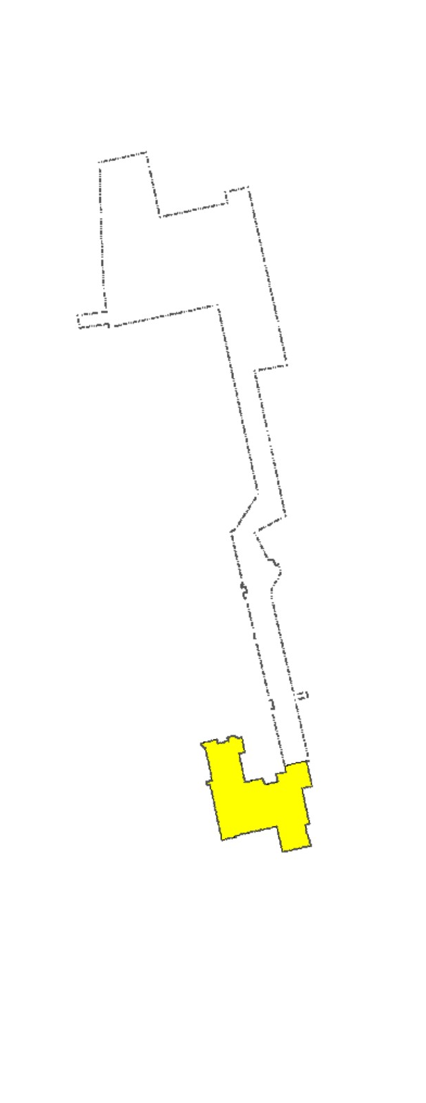
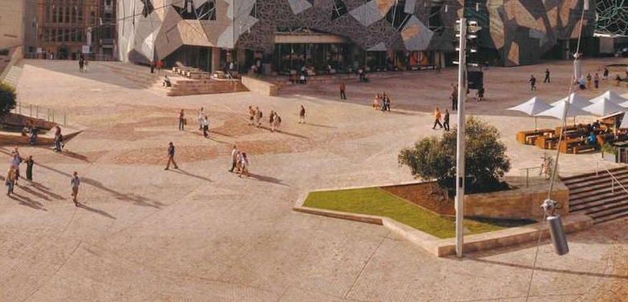
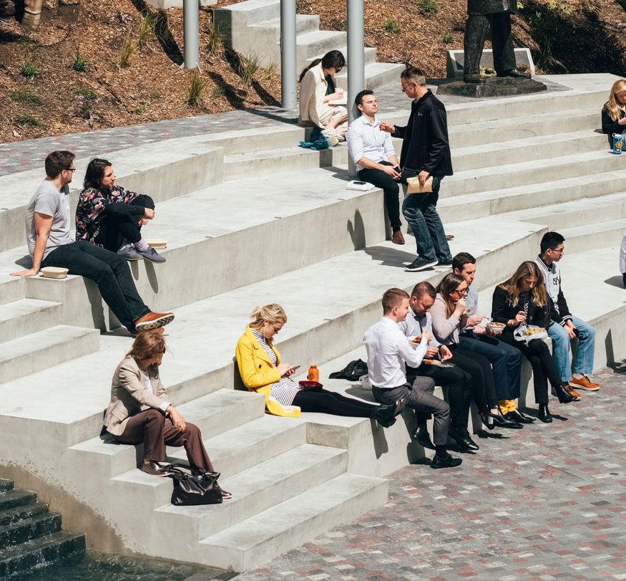
County Hall Pedestrian Link
New redeveloped gently sloped route north-south linking County Hall to Belgard Square North
Secondary informal route incorporated with seating and planting
New feature paving area proposed at entrance to County Hall
Drop off and parking areas incorporated along eastern boundary with car park
Civic Square
Terraced amphitheatre style seating
Incorporation of leisure/public events
Redesign of levels to provide gently sloped continuous surface to County Hall entrance
Planting and trees

Slide 8
“Spaces as well as places are designed and built: walking, witnessing, being in public, are as much part of the design and purpose as is being inside to eat, sleep or drink…. The word citizen has to do with the city and the ideal city is organised around citizenship - participation in public life” (Rebecca Solnit)
Next Steps:
Proposed to present scheme to members at July County Council before going out on public display.
Questions?

