Slide 1
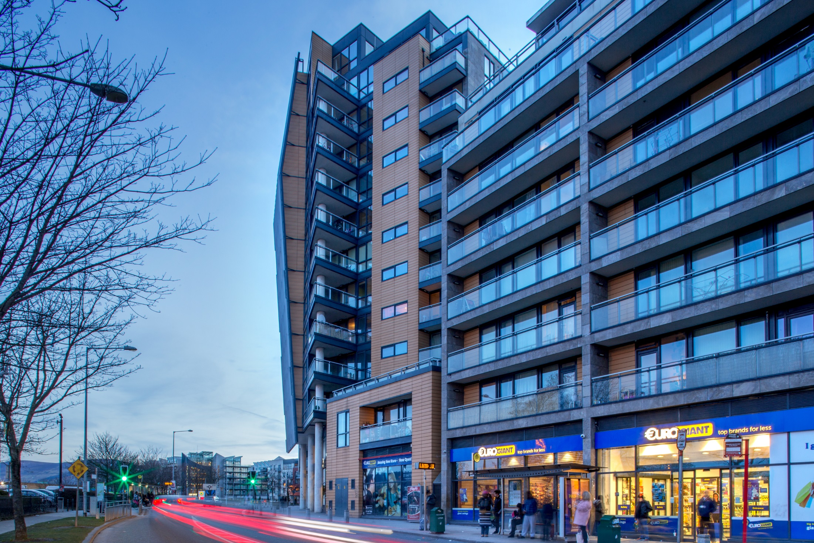
Land Use Planning & Transportation
Proposed Draft Tallaght Town Centre Local Area Plan Material Alterations
Briefing
June 2020

Slide 2
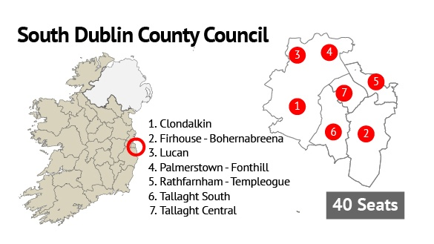
Timeframe & Elected Members Role
Stage | Timeframe
Draft Consultation (6 Weeks) COMPLETED | 12th September - 24th October
CE Report to Council (6 Weeks) COMPLETED | 9th December
Decision by Council (6 weeks) COMPLETED | 23rd January + 4 weeks: Adopted 20th February
Resolution to adopt the Draft LAP with Amendments, some of which were deemed to be Material
+3 weeks (Assessments) | 13th February
Material Alterations Public Display (4 Weeks) COMPLETED | 13th February – 12th March
CE Report to Council (4 Weeks – affected by Covid-19) COMPLETED | 9th May
Decision by Council on Material Alterations (6 Weeks) | 8th June + 6 weeks: LAP has effect 20th July

Slide 3
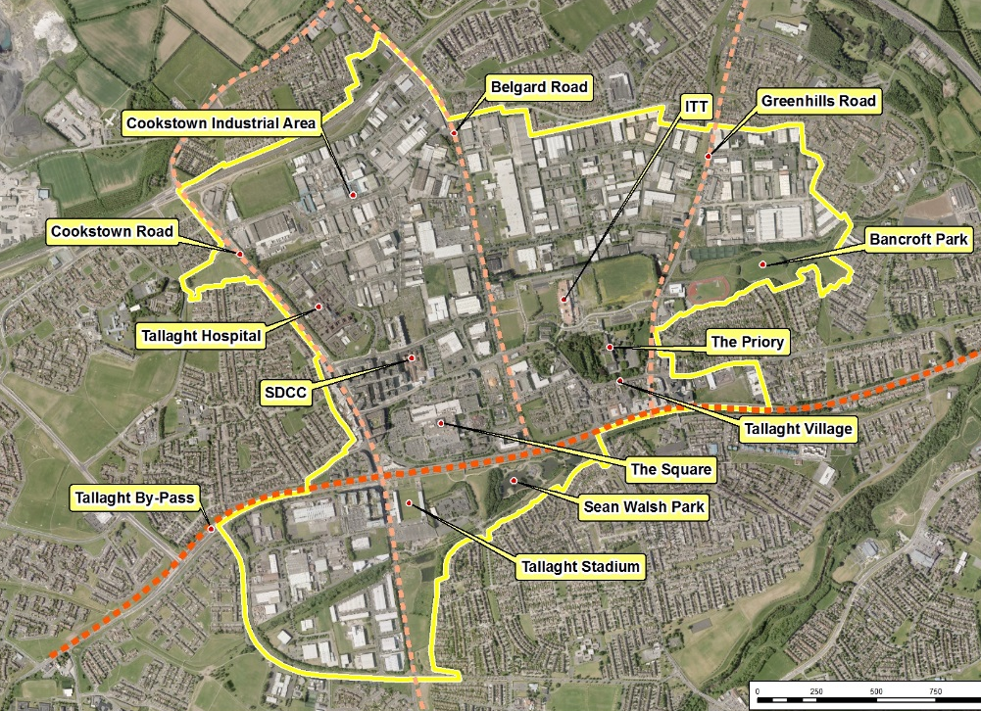
LAP Boundary
370 Hectares

Slide 4
Summary of Submissions
13th February -
23 submissions were received
All submissions were reviewed and broken down into 60 issues:
Material Alteration No. 4: Plot Ratio & Height (10 times / 16.7%)
General / Acknowledgement (9 Times / 15%)
A number of submissions welcomed the proposed material alterations and looked forward to finalisation of the LAP
Material Alteration No. 3: Plot Ratio (8 Times / 13.3%)
Material Alteration No. 6: Landmark Buildings (8 Times / 13.3%)
Outside Scope (8 times / 13.3%)
Strategic Environmental Assessment (5 Times / 8.3%
Material Alteration No. 7: Tenure Mix (4 Times / 6.7%)
Material Alteration No. 1: Broomhill Neighbourhood (4 Times / 6.7%)
Material Alteration No. 2: Employment Clause (2 Times / 3.3%)
Material Alteration No. 5: Building Height in Centre (2 Times / 3.3%)
Source of Submissions:
12th March
Landowners/Developers – 11
Statutory Bodies – 7
Individuals & Community Groups – 5

Slide 5
Material Alteration No. 1

Slide 6
Material Alteration No. 2
N.B. Submission received from Office of Planning Regulator recommended deleting this material alteration

Slide 7
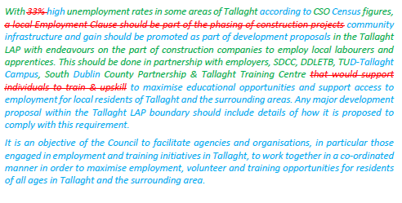
Material Alteration No. 2
Proposed Amended Material Alteration No. 2, as recommended in CE Report

Slide 8
Material Alteration No. 3

Slide 9
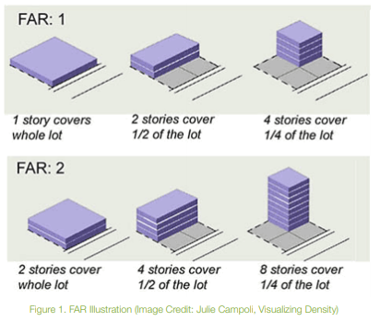
What is Plot Ratio?
FAR (floor area ratio) =
plot ratio
FAR: 1 =
Plot Ratio 1:1
FAR: 2 =
Plot Ratio 2:1

Slide 10
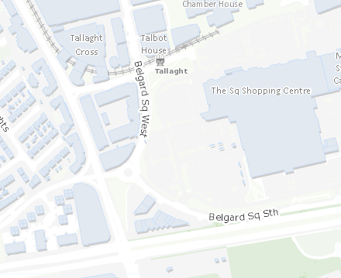
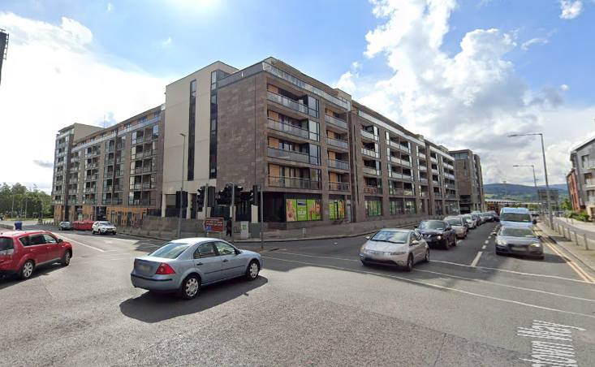
Belgard Square West, Cookstown Way
Plot ratio of 3.8 : 1
Heights:
6 to 9 storeys
Minimum height 5 storeys + 1 storey One Block up to 12 and 13 storeys

Slide 11
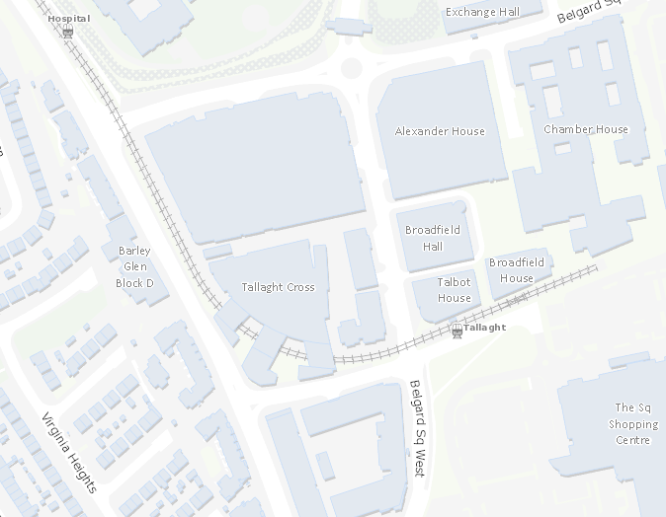
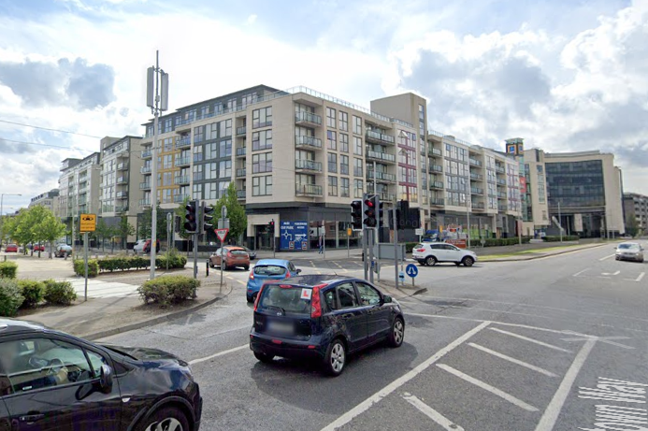
Tallaght Cross,
Plot ratio: 3.1 : 1
Heights:
Minimum height 6 storeys
Mix of block heights predominantly 6-10 storeys

Slide 12
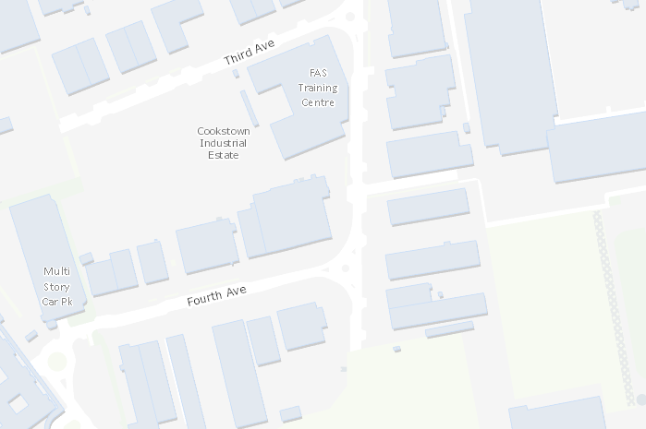
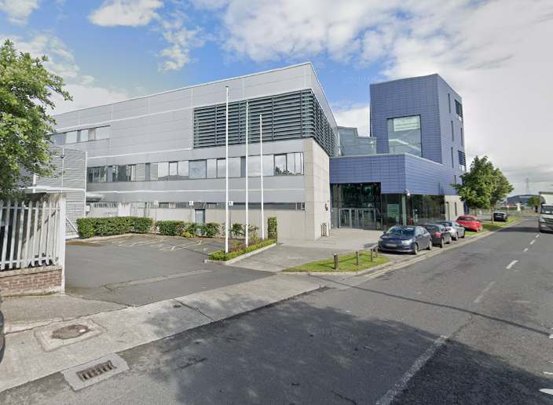
DDLETB Training Centre, Cookstown Industrial Estate
Plot ratio: 1.6 : 1
Heights: 2 to 5 storeys

Slide 13
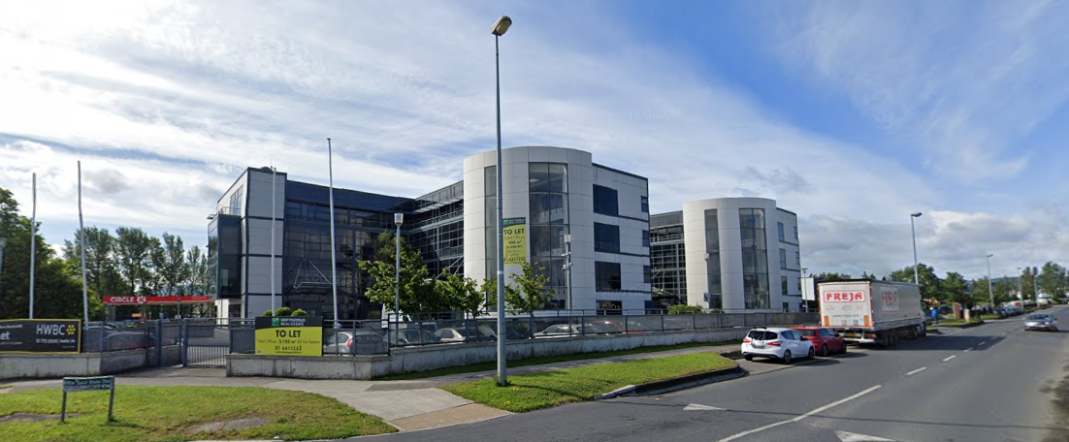
Office building, Cookstown Industrial Estate
Plot ratio: 1.3 : 1
Heights: 4-storeys

Slide 14
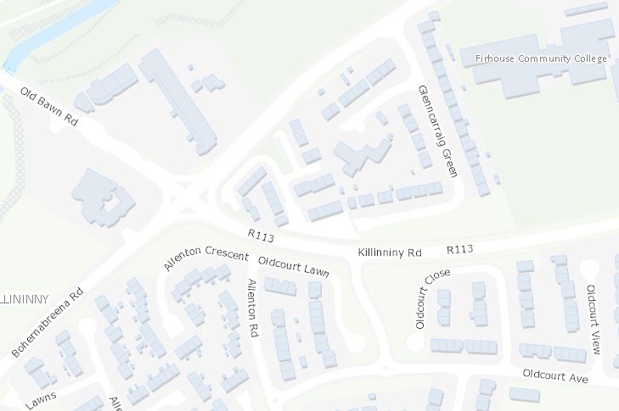
SDCC Part VIII housing Killinniny Road
Plot ratio: 0.28 : 1
Heights: 2-storey houses

Slide 15
Material Alteration No. 4

Slide 16
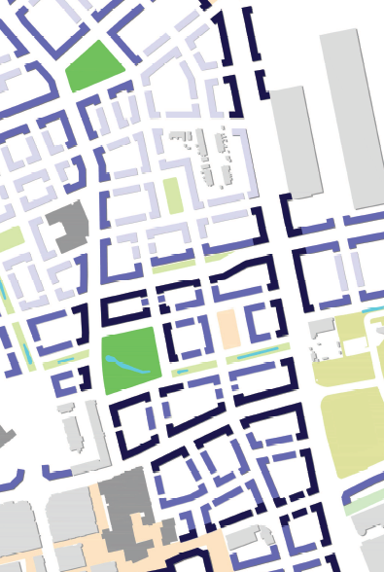
What are ‘Typical Heights’ of the LAP?
3–4 storeys residential and non-residential
Predominant building height indicated across the LAP lands
Light blue on map
4–6 storeys residential, 3–5 storeys non-residential
Predominantly along secondary routes/frontages and central urban areas
Blue colour on map
6–7 storeys residential (+1 recessed), 5–6 storeys non-residential (+1 recessed)
Predominantly along primary routes/frontages, at key locations and in central urban areas
Dark blue colour on map

Slide 17
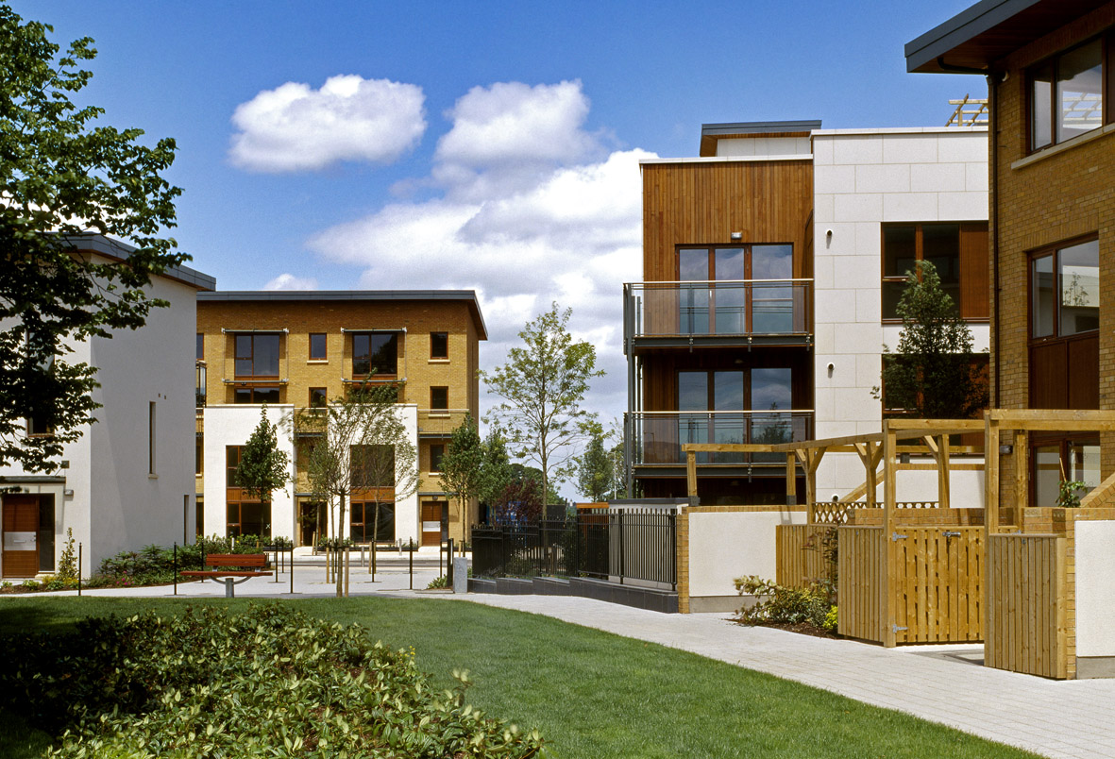
Housing Typologies
Adamstown Example

Slide 18
Material Alteration No. 5

Slide 19
Material Alteration No. 6

Slide 20
Material Alteration No. 7

Slide 21
Material Alteration No. 7

Slide 22
Next Steps
Step 3
Complete
Council Decision (Material Alterations)
23rd January 2020
Council Meeting
Step 4
Complete
Public Consultation on Material Alterations
13th February 2020
12th March
Step 5
Complete
CE Report to Council
8th May 2020
4 Weeks (affected by Covid-19)
Step 6
Decision of Council on Material Alterations
8th June 2020
Council Meeting
Step 7
Adopted Local Area Plan Takes Effect
6 Weeks
July 2020

