Slide 1
SHD Application Ref:SHD3ABP-307222-20
Applicant: Augustinian site Taylors Lane
Presentation to Rathfarnham ACM 9th June 2020
Jim Johnston
Senior Executive Planner

Slide 2
Timelines
SHD Lodged with ABP on 25/05/20
5 Weeks - Observations by 5.30pm on 29/06/20
8 Weeks - SDCC report due to ABP by 20/07/20
16 Weeks - Decision Issued by ABP by 14/09/20
Consultations
S.247 pre-planning meeting was held with SDCC on 08/08/19
A pre-planning meeting was held on 15/01/20 with An Bord Pleanala, the applicant and SDCC.

Slide 3
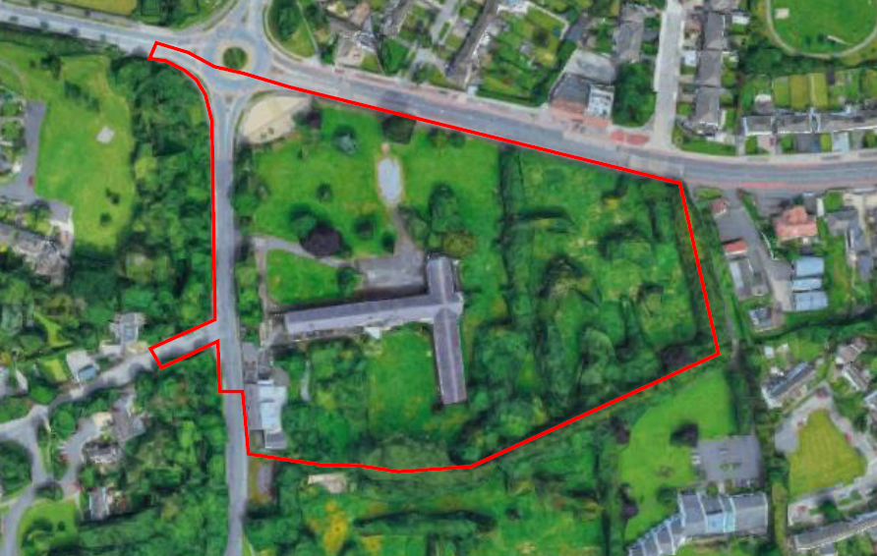

Slide 5
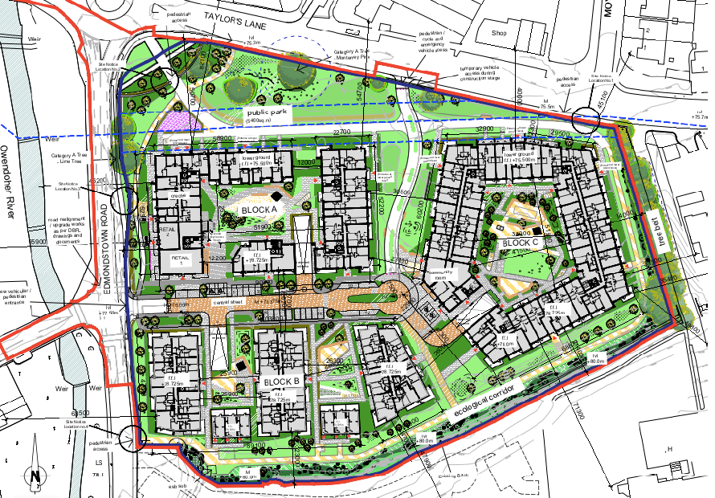

Slide 6
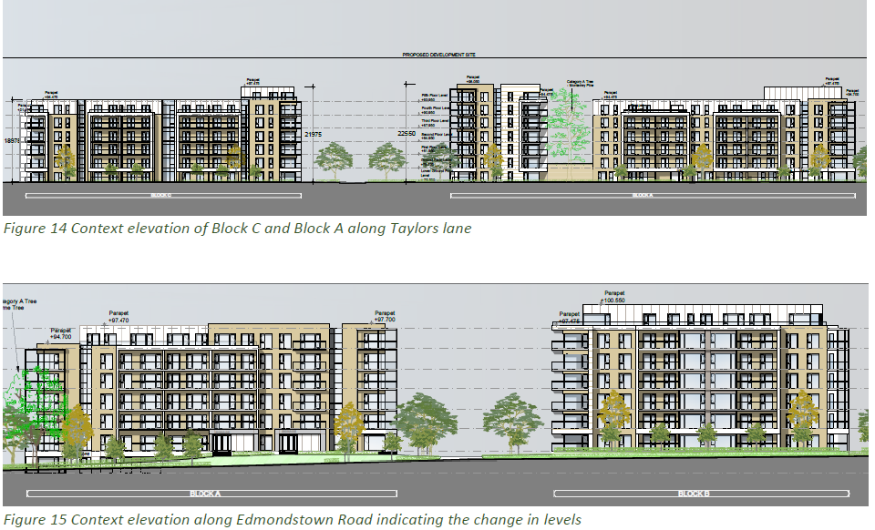

Slide 8
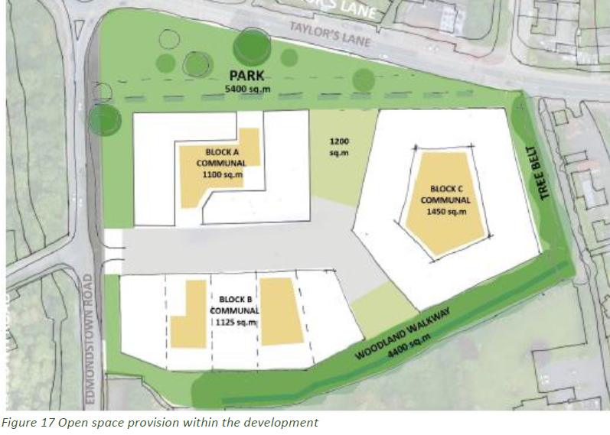

Slide 9
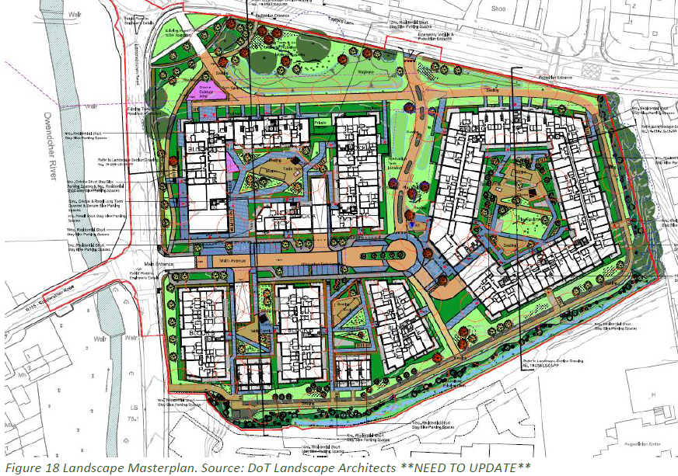

Slide 10
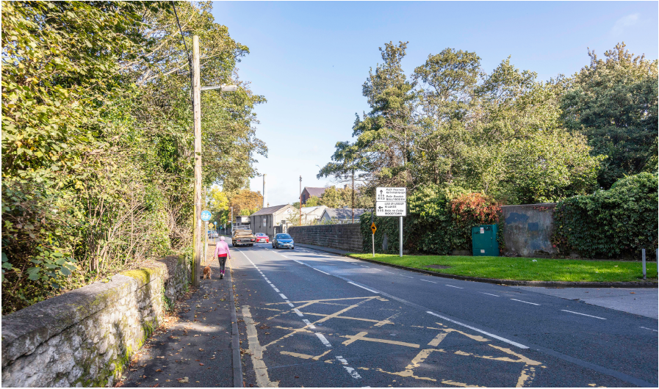

Slide 11
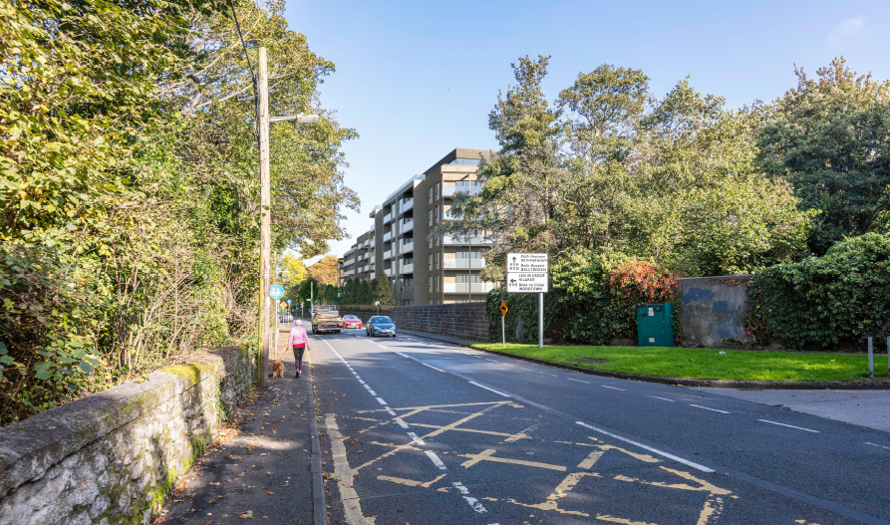

Slide 12
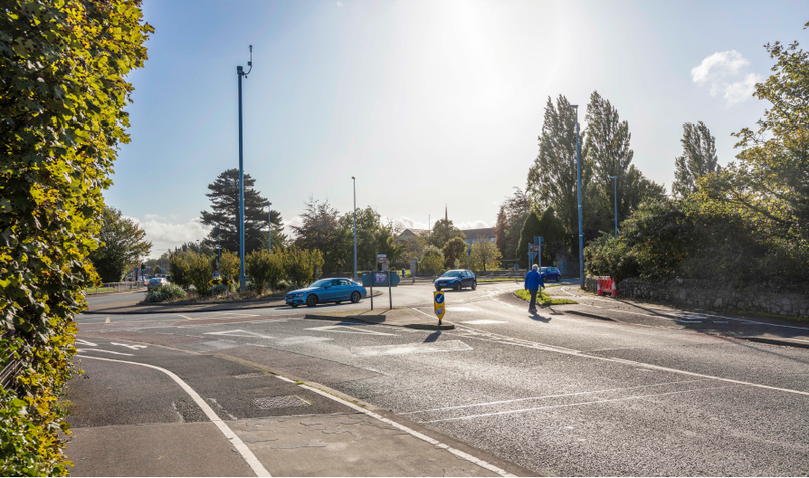

Slide 13
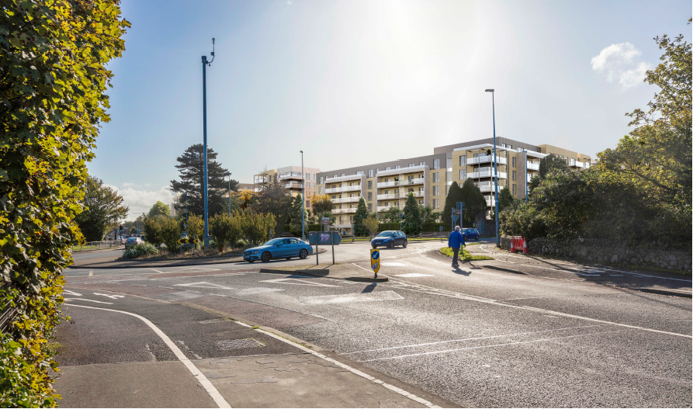

Slide 14
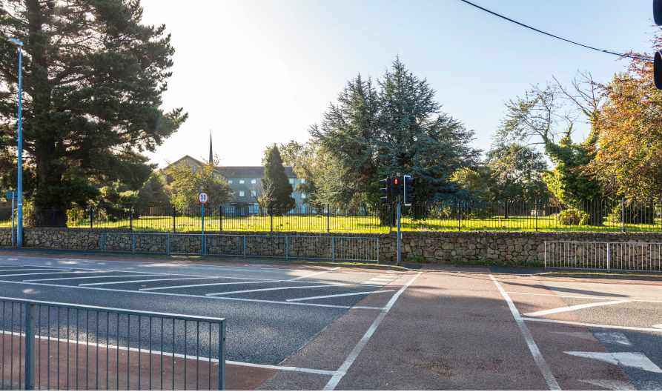

Slide 15
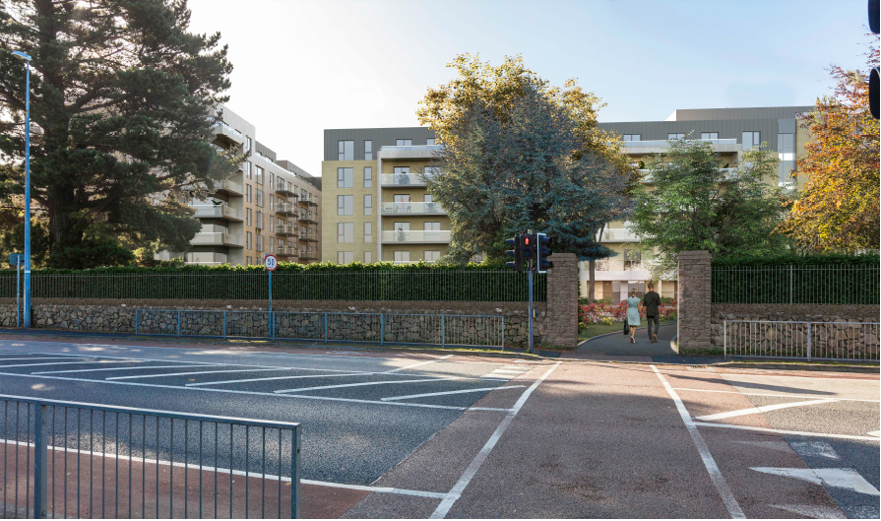

Slide 16
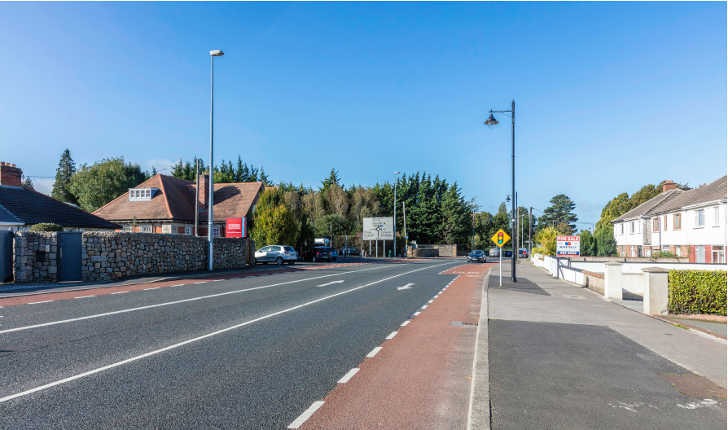

Slide 17
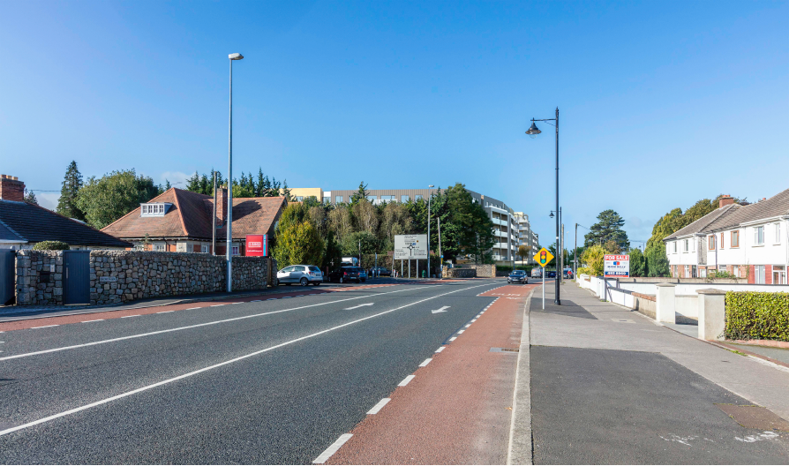

Slide 18
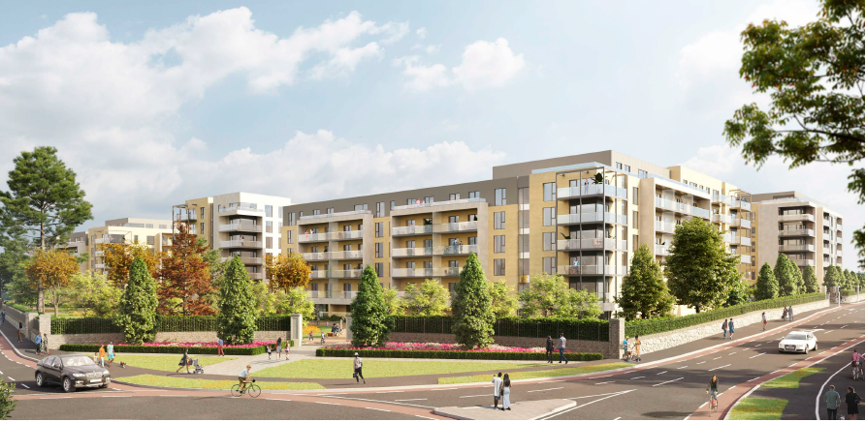

Slide 19
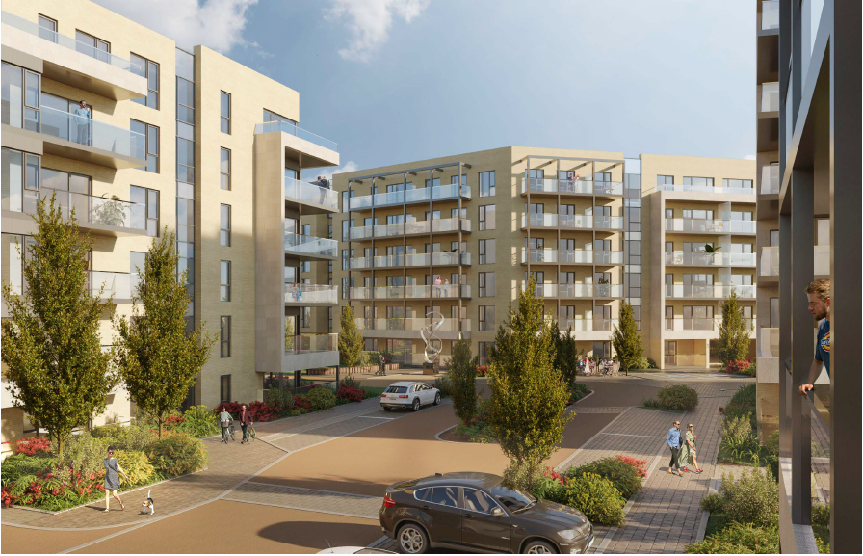

Slide 20
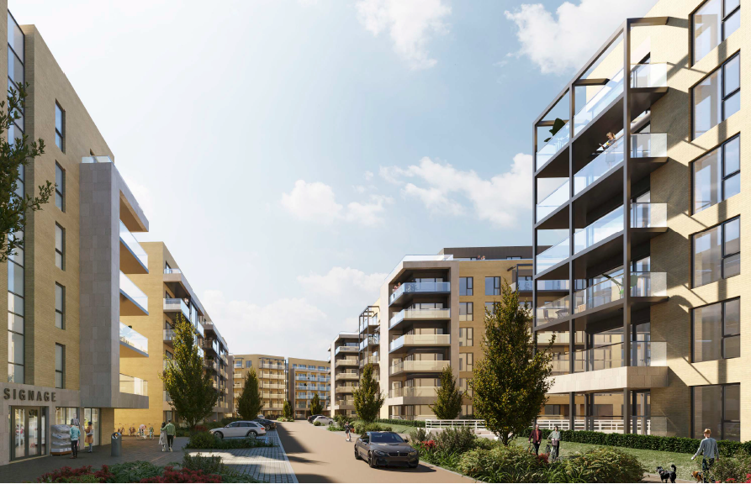

Slide 21
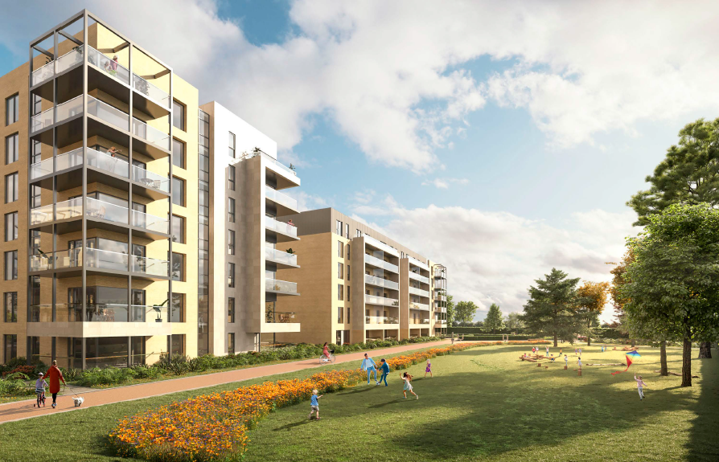

Slide 22
ABP Comments

Slide 24
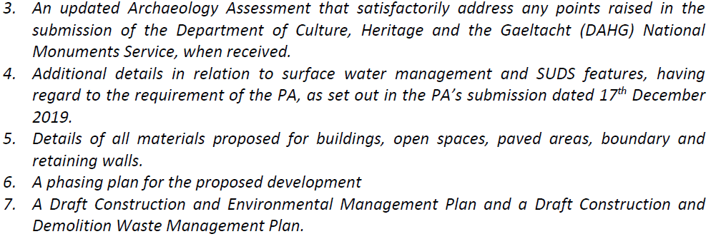

Slide 25
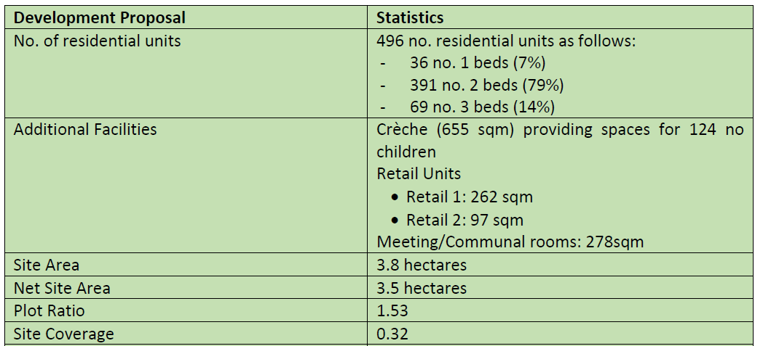
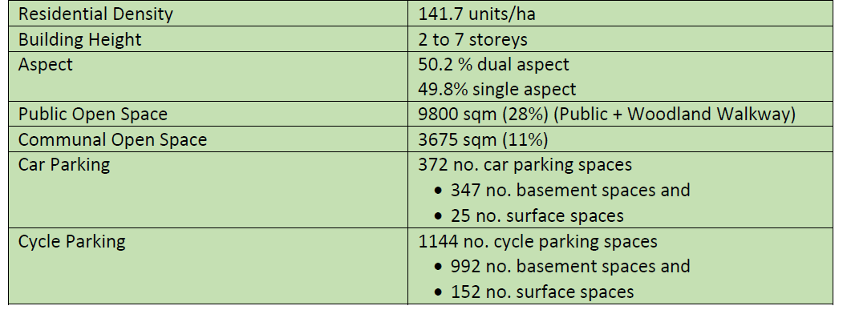

Slide 26
Statistics for Proposed Development:

Slide 27
Thank You
Questions

