Slide 1
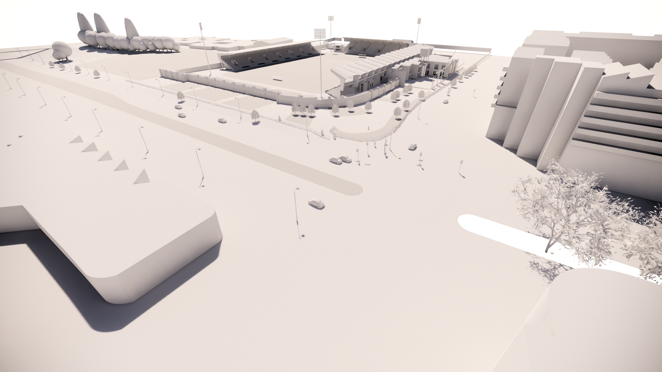





Tallaght Stadium
Date issued – 05.06.2020
CooneyArchitects

Slide 2
Overview_Existing
CooneyArchitects

Slide 3
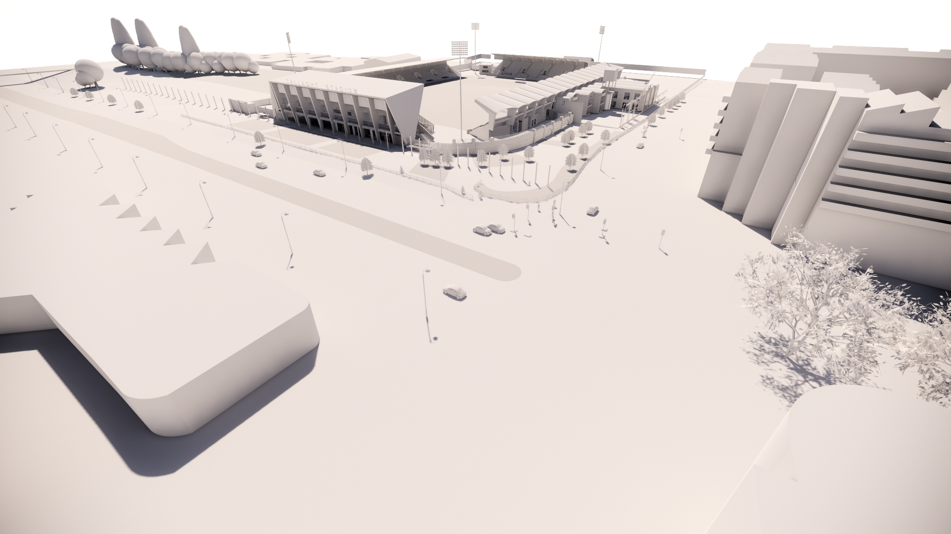
Overview_Proposed
CooneyArchitects

Slide 4
NORTH STAND
CooneyArchitects

Slide 5
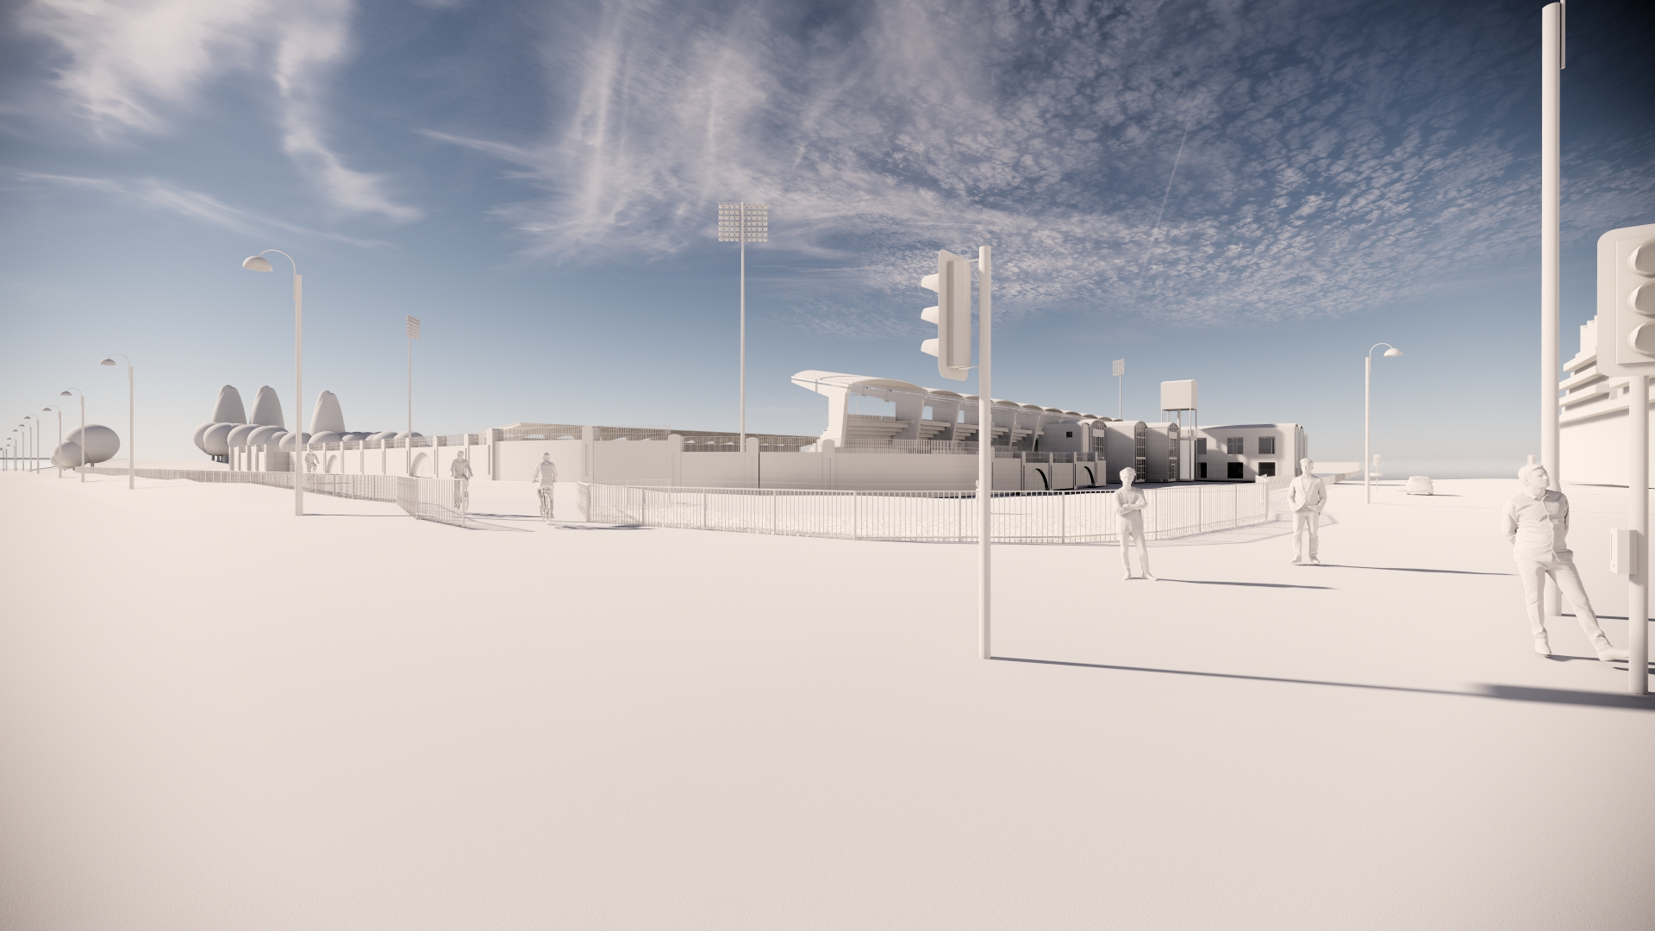
Existing
NORTH STAND
CooneyArchitects

Slide 6
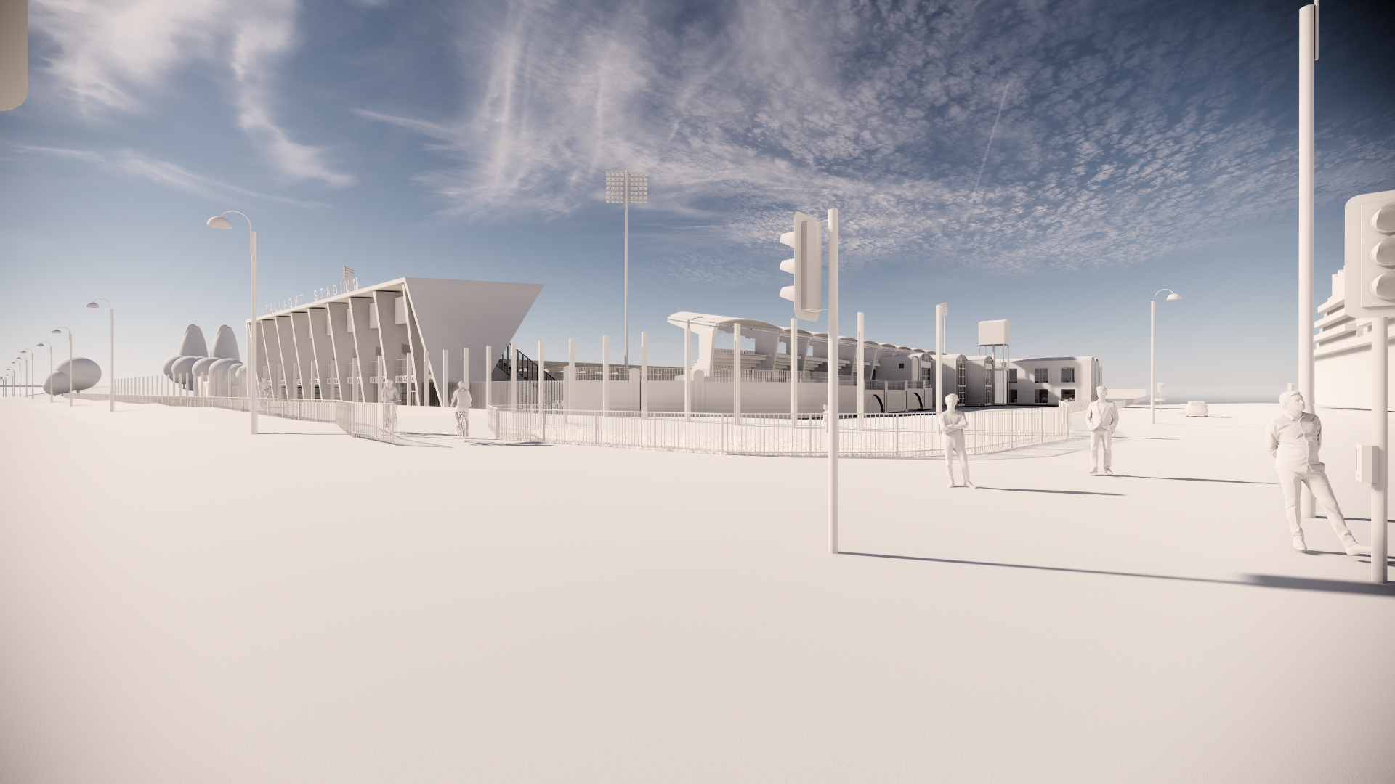
Proposed
NORTH STAND
CooneyArchitects

Slide 7
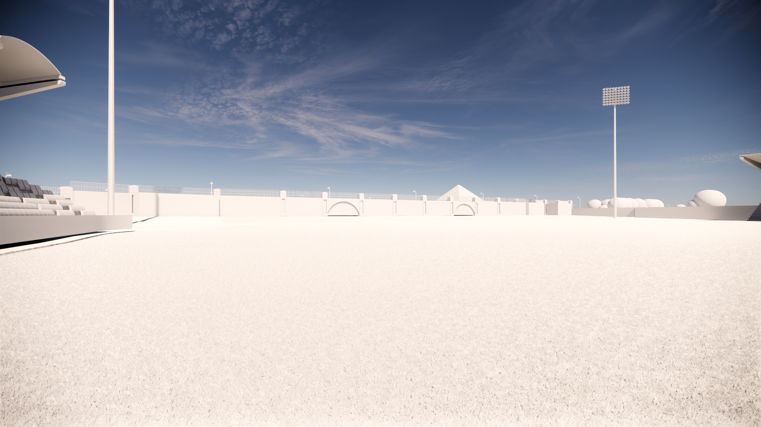
Existing
NORTH STAND
CooneyArchitects

Slide 8
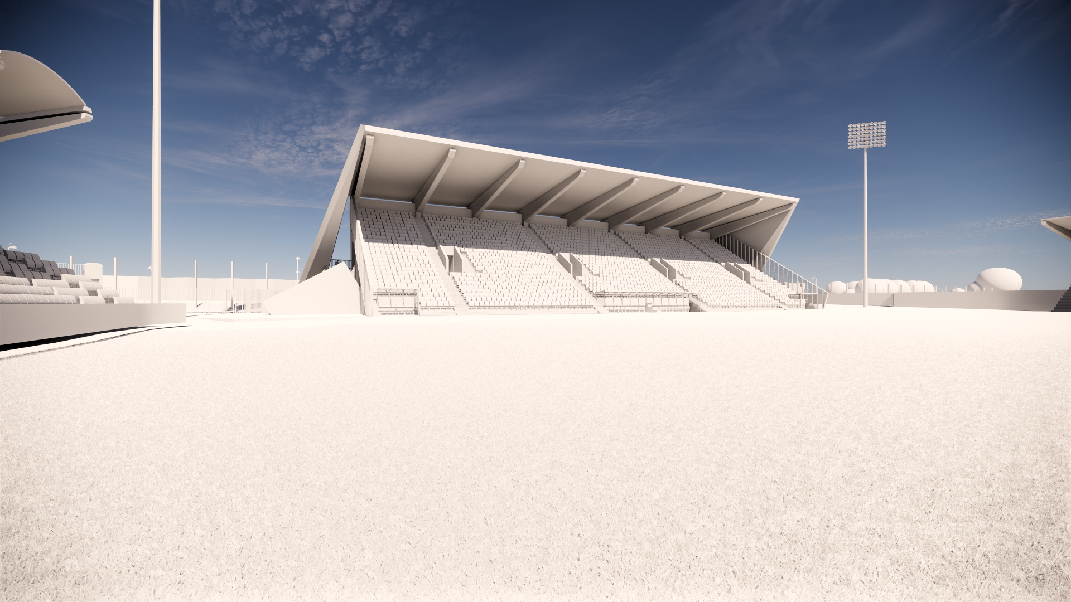
Proposed
NORTH STAND
CooneyArchitects

Slide 9
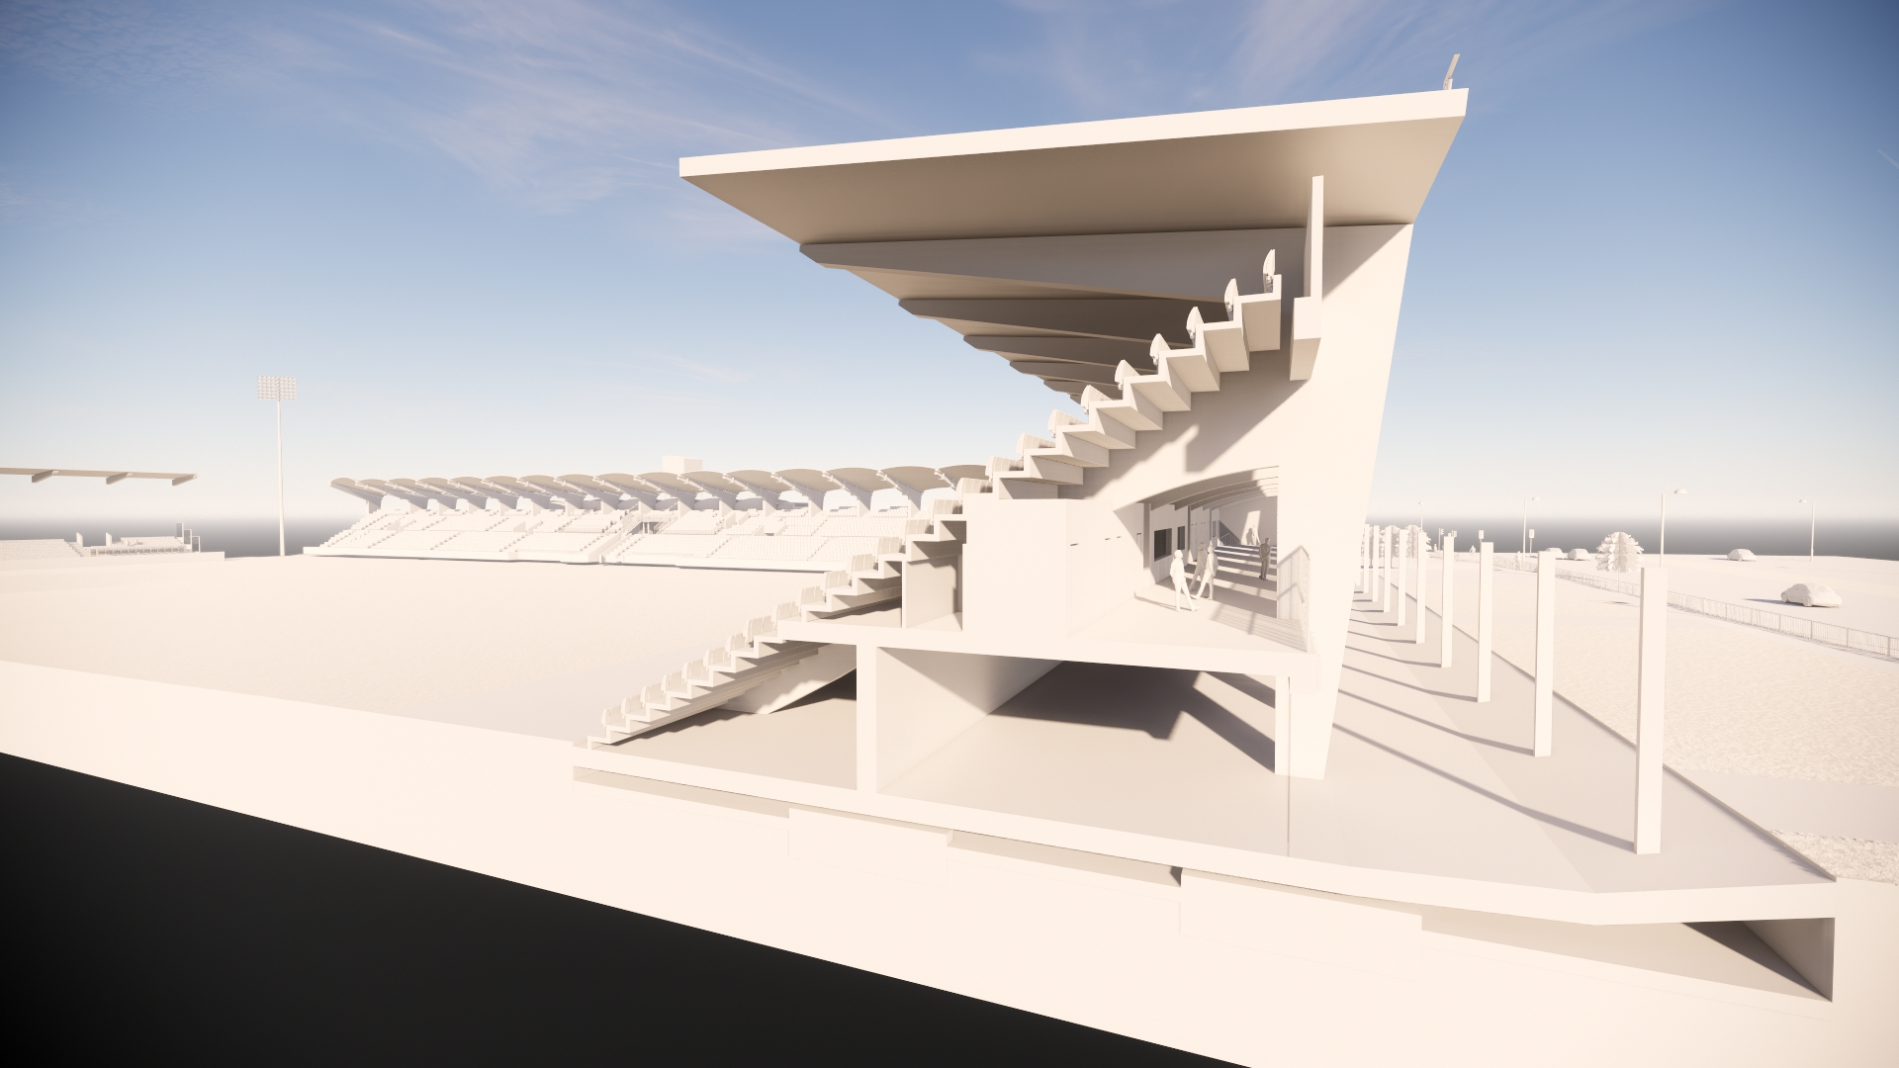
Proposed
NORTH STAND
CooneyArchitects

Slide 10
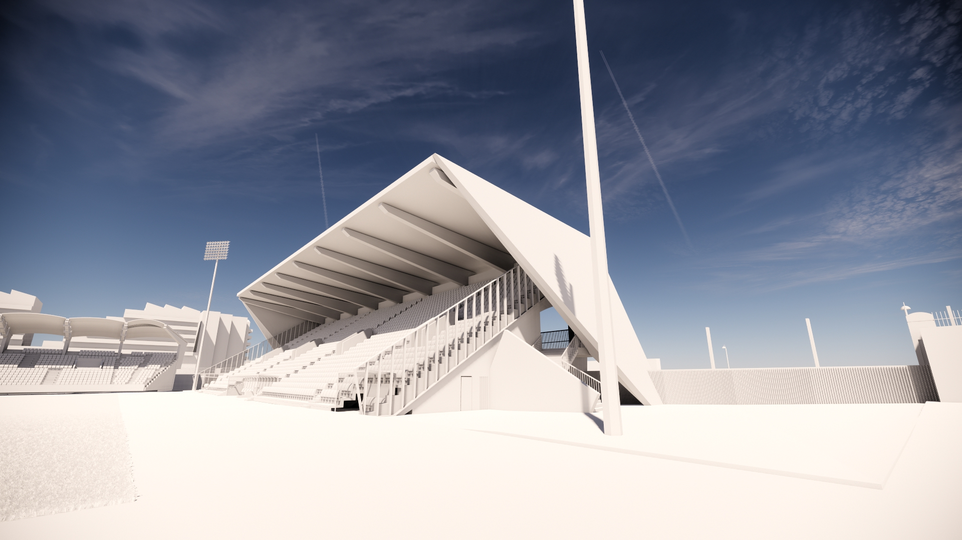
Proposed
NORTH STAND
CooneyArchitects

Slide 11
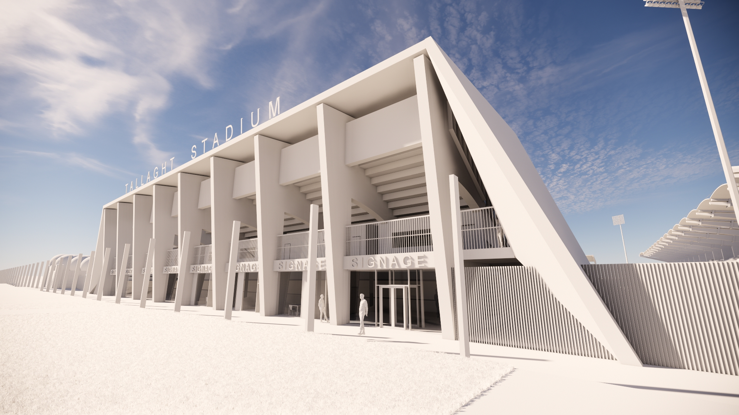
Proposed
NORTH STAND
CooneyArchitects

Slide 12
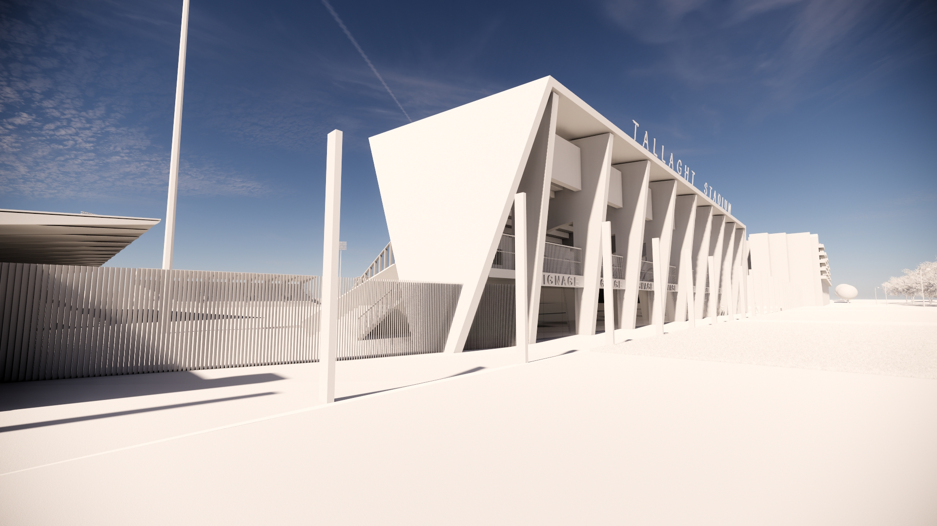
Proposed
NORTH STAND
CooneyArchitects

Slide 13
WEST STAND
CooneyArchitects

Slide 14
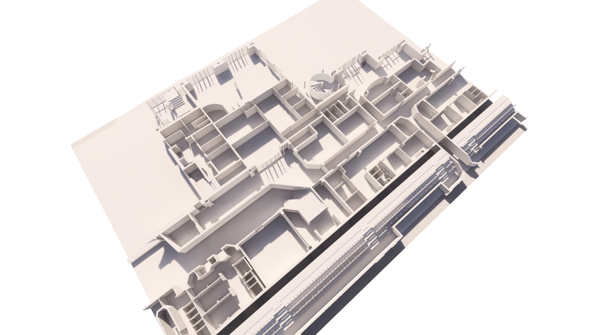
Ground Floor_Existing
Existing
WEST STAND
CooneyArchitects

Slide 15
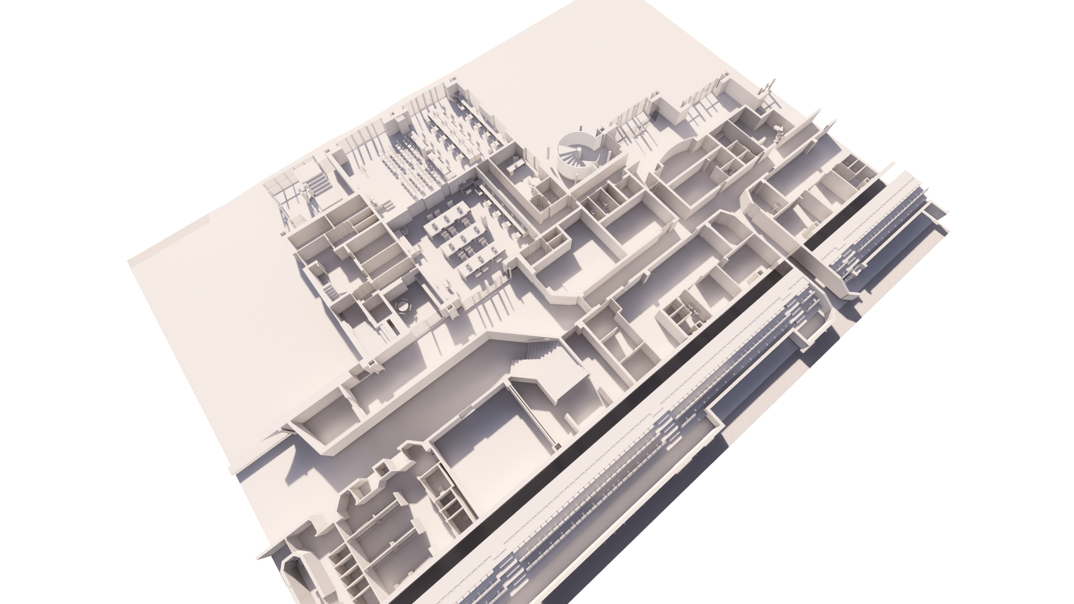
Ground Floor_Proposed
Proposed
WEST STAND
CooneyArchitects

Slide 16
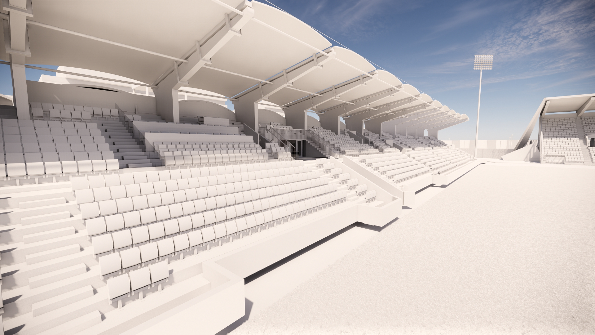
Corporate Seating_Proposed
Proposed
WEST STAND
CooneyArchitects

Slide 17
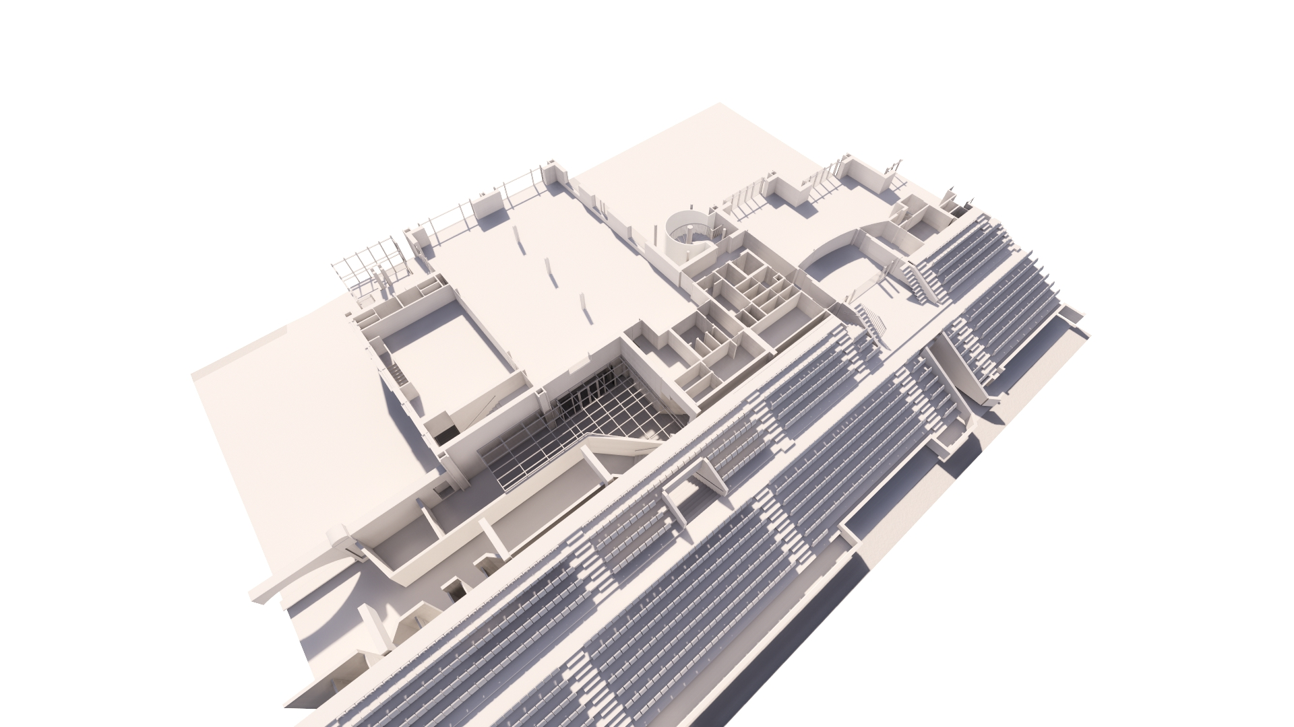
First Floor_Existing
Existing
WEST STAND
CooneyArchitects

Slide 18
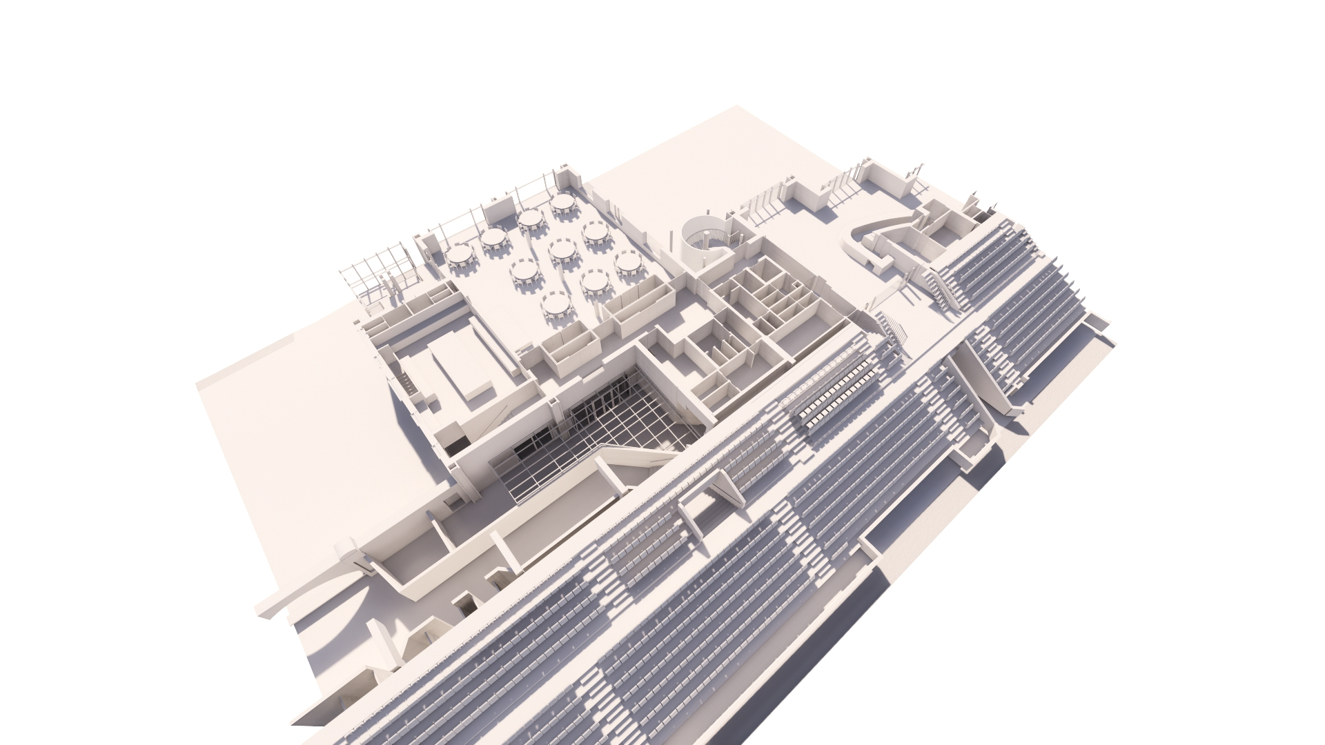
First Floor_Proposed
Proposed
WEST STAND
CooneyArchitects

Slide 19
SOUTH STAND
CooneyArchitects

Slide 20
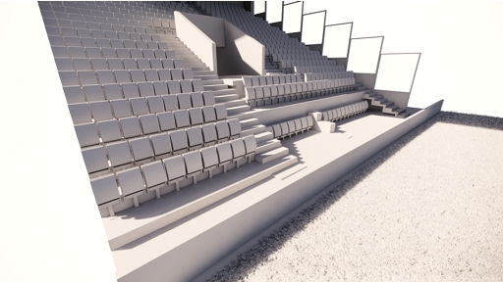
Accessible Seating_Existing
Existing
SOUTH STAND
CooneyArchitects

Slide 21
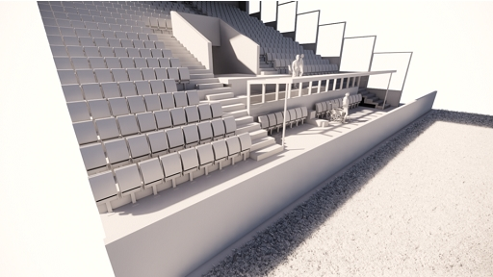
Accessible Seating_Proposed
Proposed
SOUTH STAND
CooneyArchitects

Slide 22
COSTINGS
CooneyArchitects

