Slide 1
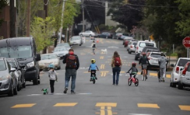
Social Distancing For better mobility
Plan for Social Distancing in the Public Realm (Covid-19 Temporary Measures)
Presentation to South Dublin County Council Meeting June 2020

Slide 2
Why is this required?
During Covid-19 restrictions - Vehicular traffic has decreased, public transport capacity has decreased and pedestrians & cyclists increased
In some locations, particularly congested locations in our villages and centre social distancing on streets is a challenge
All of these raise new road safety issues not experienced before to this extent.
Type of Public Transport | C19 Total Capacity *
Dublin Bus | 17%
Luas | 5%
Dart | 5%

Slide 3
Background to ‘Share the SDCC Space’ the Plan
SDCC acknowledged the changing needs of its communities & Engineers carried out a needs assessment at sites across the whole SDCC county
Aim 1: to address social distancing challenges in congested areas of the public realm to better enable people adhere to the 2m rule.
Aim 2: In recognition of the sizeable decrease in public transport capacity to provide alternative walking and cycling measures
Solution: to temporarily repurpose roads, streets and public realm spaces to facilitate social distancing

Slide 4
Legislative Framework
The two main legislative provisions to enable the implementation of the above physical measures are:
Section 95 of the Road Traffic Act 1961 (as amended by Section 37 of the Road Traffic Act 1994); and
Section 38 of the Road Traffic Act 1994.
(b) restrict or control the speed or movement of, or which prevent, restrict or control access to a public road or roads by, mechanically propelled vehicles (whether generally or of a particular class) and measures which facilitate the safe use of public roads by different classes of traffic (including pedestrians and cyclists),
and includes for the purposes of the above the provision of traffic signs, road markings, bollards, posts, poles, chicanes, rumble areas, raised, lowered or modified road surfaces, ramps, speed cushions, speed tables or other similar works or devices, islands or central reservations, roundabouts, modified junctions, works to reduce or modify the width of the roadway and landscaping, planting or other similar works.”

Slide 5
Possible interventions ….
Localised removal of parking and loading bays to increase footpath widths especially outside busy essential shops to reduce congestion
Increase footpath widths using infrastructure placed in the roadway
Implementation of temporary cycle lanes
Introduction of pedestrianised locations whilst maintaining motor vehicle access for residents, deliveries and emergency responders
Introduction of one-way systems, including the introduction of a temporary extra lane for walking and cycling where suitable

Slide 6
Localised interventions at:
Lucan
Rosemount
Clondalkin
Saggart

Slide 7
Intervention Locations

Slide 8
Lucan village
Remove 8 parallel parking spaces in front of Centra

Slide 9
Clondalkin Village
AIB bank, temporary closure of 4 parallel parking spaces for queueing

Slide 10
Rosemount Shopping Centre
Temporary closure of 6 parallel parking spaces.

Slide 11
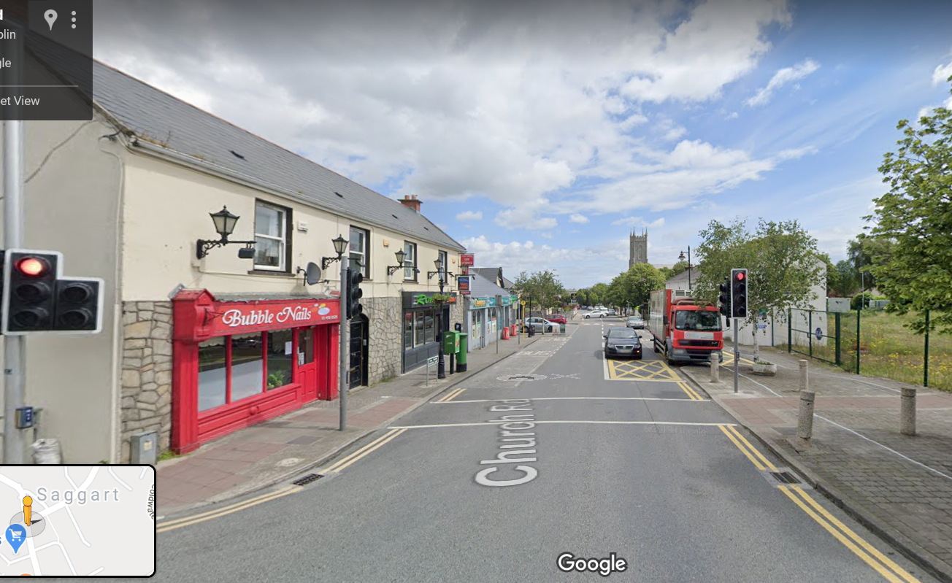
Saggart Village
Relocation of bus stop in front of Centra in Saggart

Slide 12
Other locations under review…
Main St, Rathfarnham
Social Welfare Office, Clondalkin
Post Office, Clondalkin
Clondalkin Village
Muckross Ave, Mace
Barton Drive Local Centre
St Peters Road, Cherrytree Spar
The Pantry, Lucan Village
Coffee Work, Lucan Village
Lidl, Old Belgard Road
Euro Giant Belgard Sq. West

Slide 13
Cycle intervention at:
Wellington Lane

Slide 14
